Slide 1
PATIENT MANAGEMENT SYSTEM
Team Members
Dhanalakshmi V
Kavitha M
Kowsalya S
Nandhini P
INDUSTRY GUIDE FACULTY GUIDE
Mr. Sivaraj Mr. Ashok
Department of CSE, KGiSL Institute of Technology, Coimbatore

Slide 2
Abstract
Patient management system is a web based application.
It is mainly used to reduce manual registration work
To avoid waiting line at Reception.
It can be used for only second time visitors(patients)
Patients can access their medical records .
Department of CSE, KGiSL Institute of Technology, Coimbatore

Slide 3
Existing system
Patients do registration at admission counter with help of receptionist.
Appointment through phone call
Doctor availability verify by call
Patients medical details can access only by Doctor
Department of CSE, KGiSL Institute of Technology, Coimbatore

Slide 4
Proposed System
Advantages
It is a user friendly and easily accessible.
Reduce paperwork .
Patients medical records in digital format.
Doctor knows no of patient going to consult
Department of CSE, KGiSL Institute of Technology, Coimbatore
Notes:
When the patient enter their ph.no in screen automatically it send availability of patients to the doctor.

Slide 5
Literature Review
Drawbacks
Patients cannot able to view their medical records
References
www.practo.com
www.qkdoc.com
www.icliniq.com
Department of CSE, KGiSL Institute of Technology, Coimbatore

Slide 6
ER Diagram

Slide 7
Module Split-up
Request appointment with doctor
Self check-in
Visit history
Investigation history

Slide 8
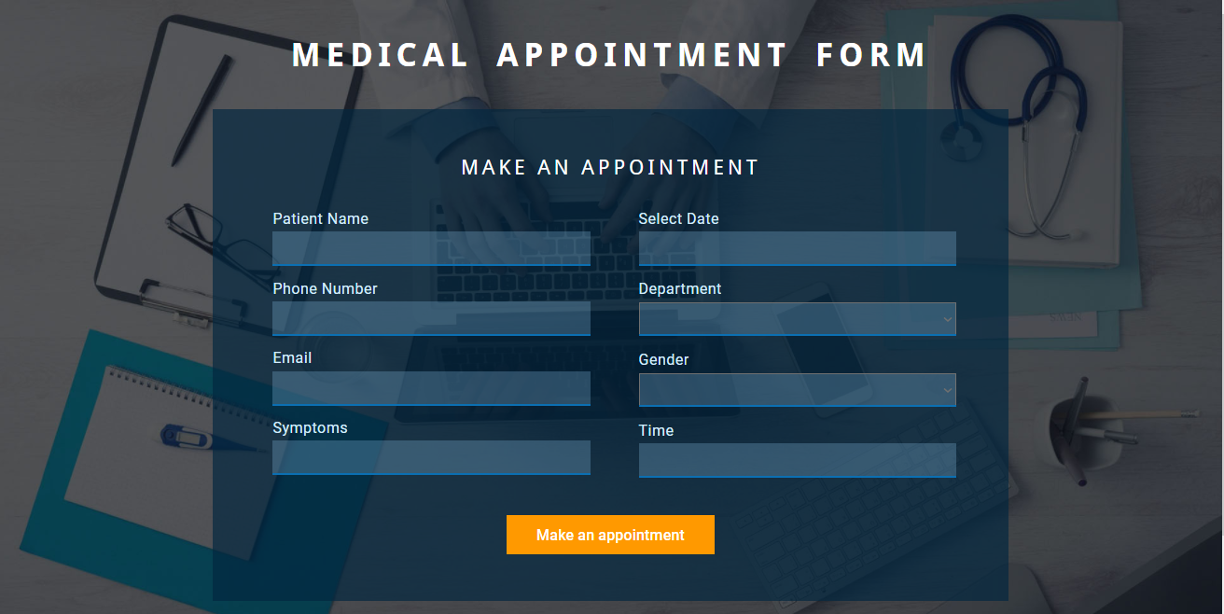
Screenshots

Slide 9
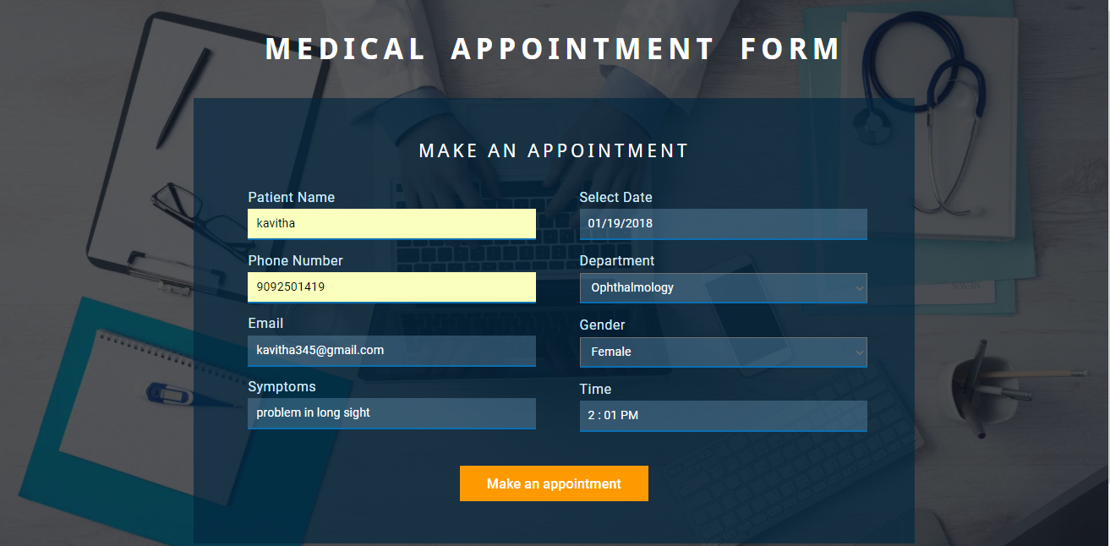

Slide 10


Slide 11
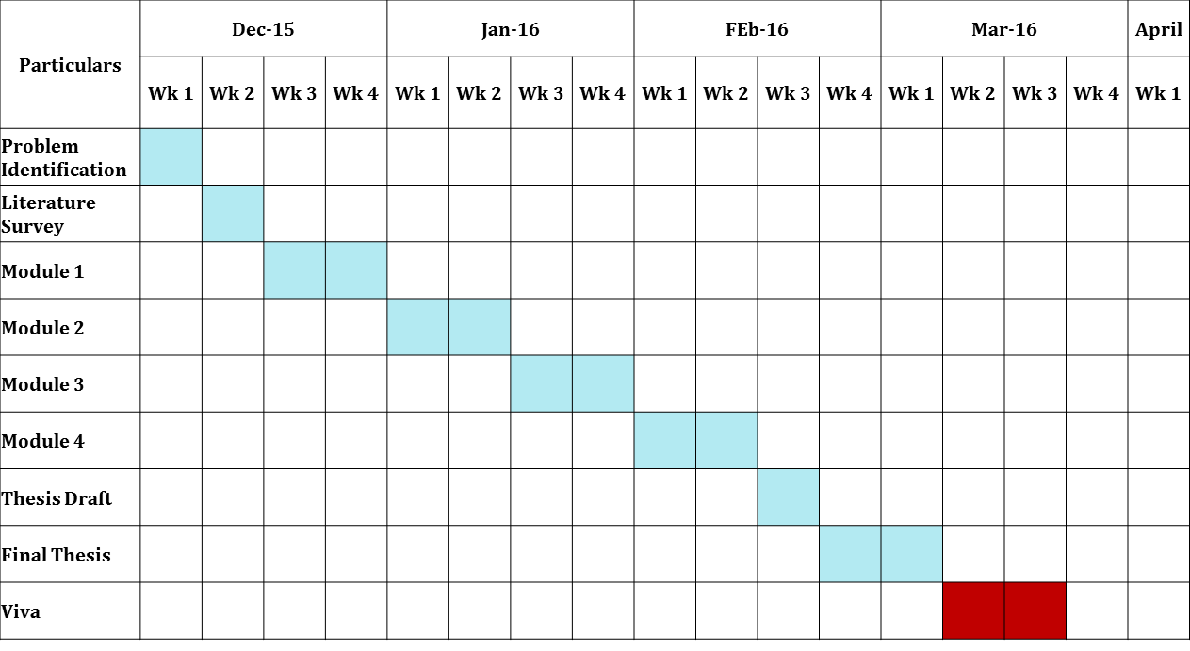
Project Planner / Timeline (Gantt chart)
Department of CSE, KGiSL Institute of Technology, Coimbatore

Slide 12
THANK YOU

