Slide 1
Online Shopping Management System Java Console Application
This Project simulates the working of an online shopping portal where customers can buy products.
Our Online Shopping Management System project is a
purely console-based application
implemented using the programming language JAVA

Slide 2
Java Concepts used in the project are :
String manipulations
Collections framework in form of ArrayList
JDBC
Exception Handling
Inheritance
Classes and Objects
BufferedReader for taking entry

Slide 3
Class File:
Shop.java ( This is the main/superclass or the starting point of the project )
SUBCLASSES of Shop.java = admin.java and customer.java
Admin.java
Customer.java
ShoppingCustomConnection.java
Database connection.java
Products.java
Cart.java
Payment.java
Bills.java
FILE:
ShoppingDatabase.properties

Slide 4
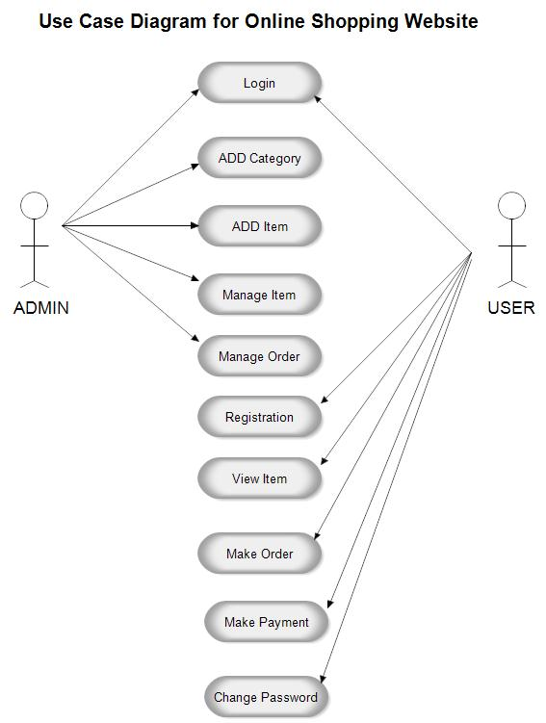

Slide 5
DATABASE SCHEMA USED IN THE PROJECT
Here, the concept of JDBC comes into the picture and is implemented using MySQL and JAVA.
The database is used in the project for storing information about admins, customers, products, bills, and login details.
Database details are as follows :
Name of the database = Onlineshop
The tables used in the project are :
Login Info Table
Admin Info Table
Cust Info Table
Products Table
Bills Table

Slide 6
System Requirements of Online Shopping System
The user should have the appropriate version of windows.
The system should have up to 2 GB ram minimum requirement for the application.
Some important points regarding the project :
Create a new Maven Project ,In that pom.xml file add the maven dependencies of mysql version 8.0.28 ,so we can connect the database of mysql from eclipse.
For connecting to the database used in the project, enter the root password of MySql
Download the Complete Java Console Application Project on Online Shopping Management System

Slide 7
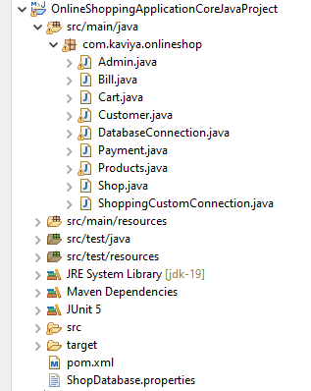
Snapshot of this Project:

Slide 8
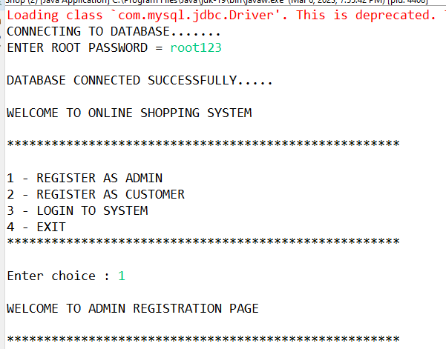
OUTPUT:

Slide 9
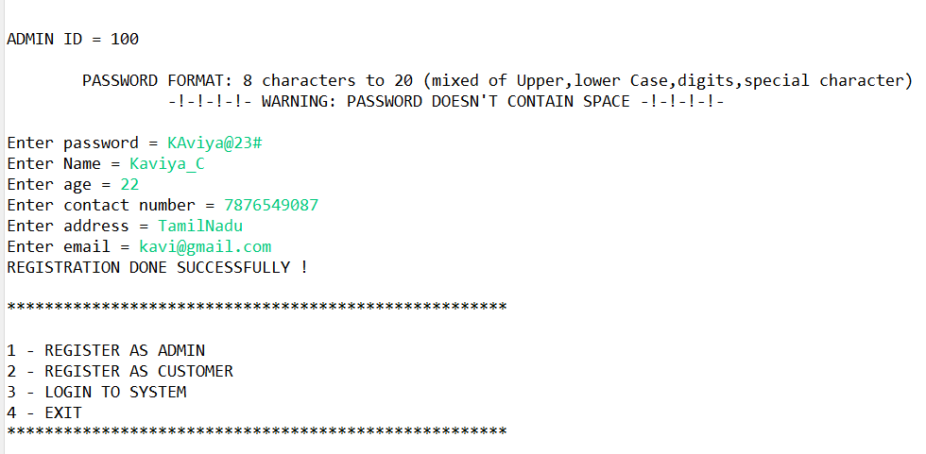

Slide 10
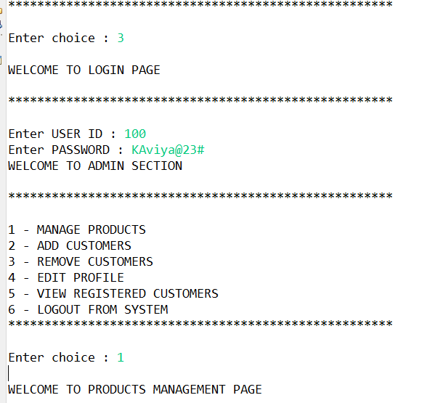

Slide 11
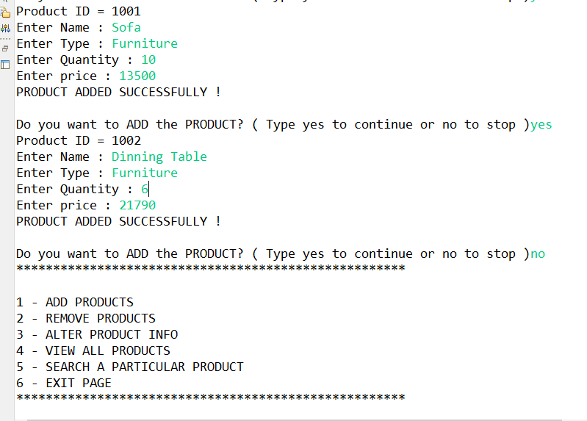

Slide 12
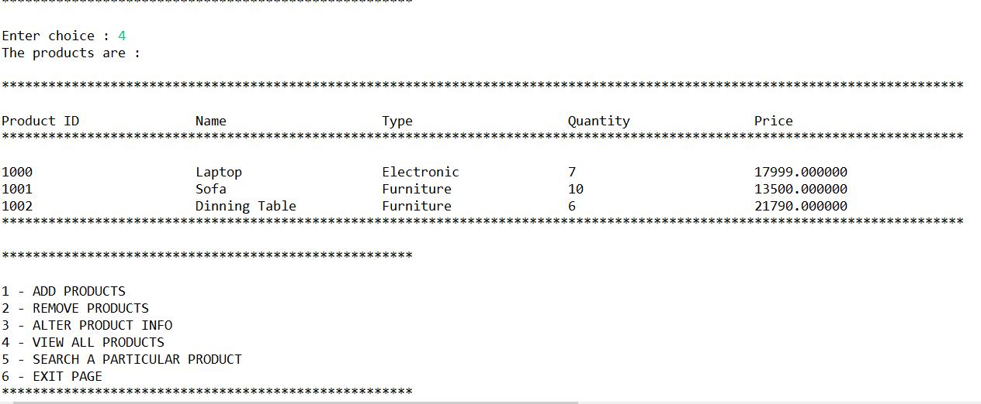

Slide 13
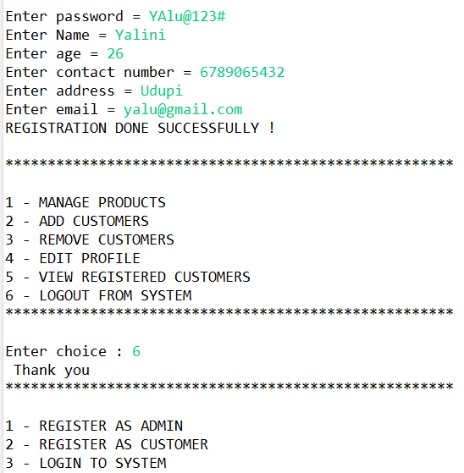

Slide 14
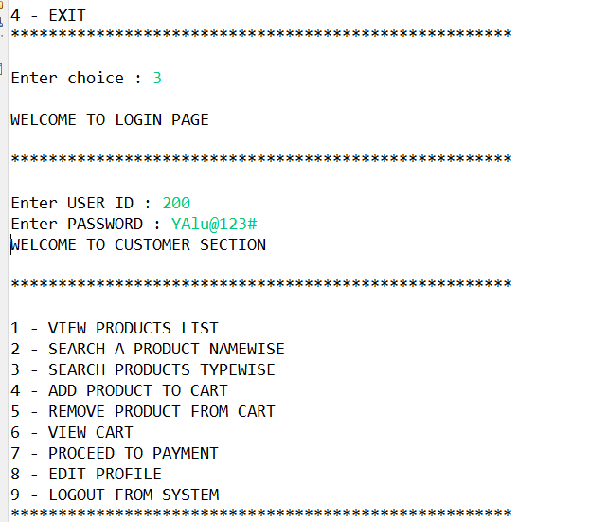

Slide 15
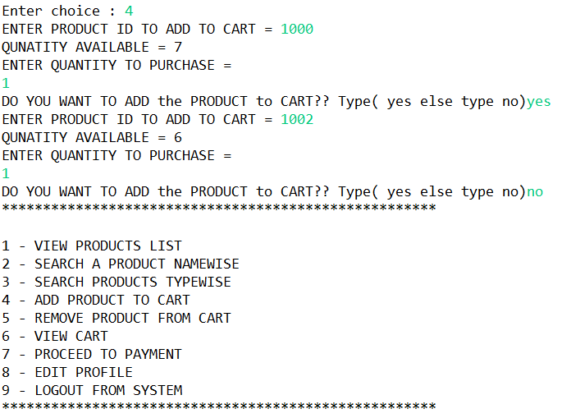

Slide 16
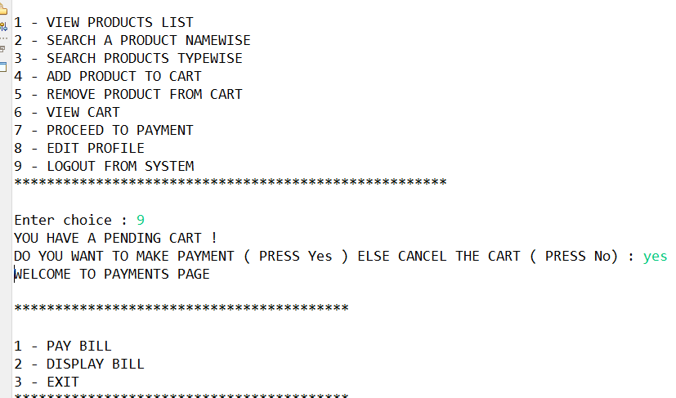

Slide 17
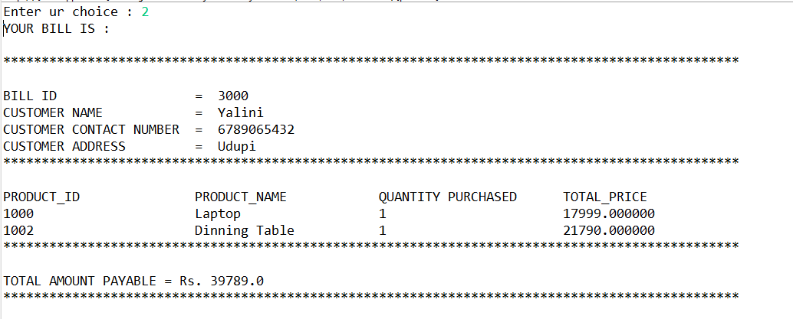

Slide 18
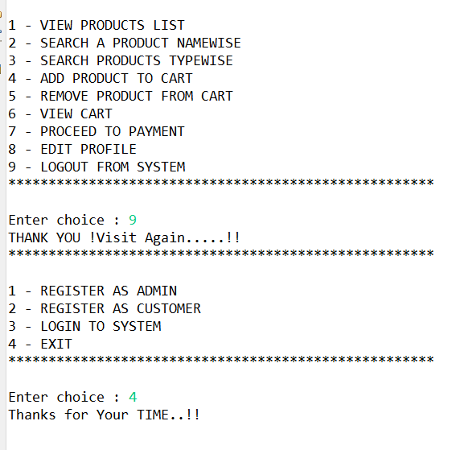

Slide 19
REFERENCES:
https://1000projects.org/projects/php-projects
https://meeraacademy.com/use-case-diagram-for-online-shopping/

Slide 20
CONCLUSION:
Technology has made significant progress over the years to provide consumers a better online shopping experience and will continue to do so for years to come.
With the rapid growth of products and brands, people have speculated that online shopping will overtake in-store shopping.
However, the availability of online shopping has produced a more educated consumer that can shop around with relative ease without having to spend a large amount of time.
In exchange, online shopping has opened up doors to many small retailers that would never be in business if they had to incur the high cost of owning a brick and mortar store. At the end, it has been a win-win situation for both consumer and sellers.

