Slide 1
HIRING PROCESS ANALYTICS

Slide 2
Project Description
To analyze data and answer below questions that can help the company improve its hiring process
Data Analytics Tasks:
Hiring Analysis: Gender Distribution of hires
Salary Analysis : Average salary offered
Salary Distribution
Departmental Analysis: Proportion of people working in different departments
Position Tier Analysis: Distribution of Position across different tiers

Slide 3
Approach
Initially, I imported data and checked for empty values in all the columns.
Then, changed column names as per relevant understanding.
Found some duplicates and handled them by removing which seemed to have incorrect data
Used Pivot tables and charts to infer the results of analysis
Formatted charts to make it look great.
Created a dynamic dashboard with important key metrics and charts.

Slide 4
Tech-Stack Used
Tools & software : Microsoft Excel 2021
Version: 2403 Build 16.0.17425.20176) 64-bit
It is easy to use and open source tool.

Slide 5
Insights
Since a person could apply multiple times or get hired and promoted ignored such employee id’s which was duplicating, but there were around four duplicate set which had different gender but same application id. Hence based on the offered salary and oldest date, removed duplicates.
After cleaning the data out of 7164 applicants, 4693 were hired and 2471 got rejected. We also see there are about 4081 male applicants and 2675 female applicants.
HIRING ANALYSIS- –In hiring we see about 54% were male and 40% were female who got hired and 6% didn’t reveal the gender.
SALARY ANALYSIS-An average of 49,990 is being offered by the company.
SALARY DISTRIBUTION- We see only 3 people have salary range greater than 1lakh.
DEPARTMENT ANALYSIS – Operation Department holds the highest hiring followed by service department and then by sales department

Slide 6
Result
It was good to explore different formulas and charts
I used column charts, histogram, pie charts and more to find the results.
There was a good exposure to explore all formatting options and worked on some ongoing practical application.

Slide 7
1. Handling Missing Data: Check if there are any missing values in the dataset. If there are, decide on the best strategy to handle them.
Step 1: Changed column Event Name to Gender
Step 2: Using sort and filter option checked for empty/missing values, spell check for all the columns.
Step 3: In post column replaced c-10 to c10 using Find and replace option..
Step 4: Offered Salary had one row with Blank value, replaced it with average of all offered salary with average function
Step 5: Using pivot table found the highest mode of post with count of post and replaced this value to the cell that was empty under post column. Didn’t remove the row because it said the applicant was hired so replaced it with highest mode post category.
Step 6: Gender Column had incorrect data as “-” replaced it with “Don't want to say”.
Step 7: There were many duplicates of application_id column, assuming an applicant can apply to many post and there were also few data which got hired to two different post within a month gap seemed to look like promotion. Ignoring above scenarios there were 4 sets which had same application id but different gender. Hence removed 4 rows which seemed to have oldest date or comparatively less offered salary.

Slide 8
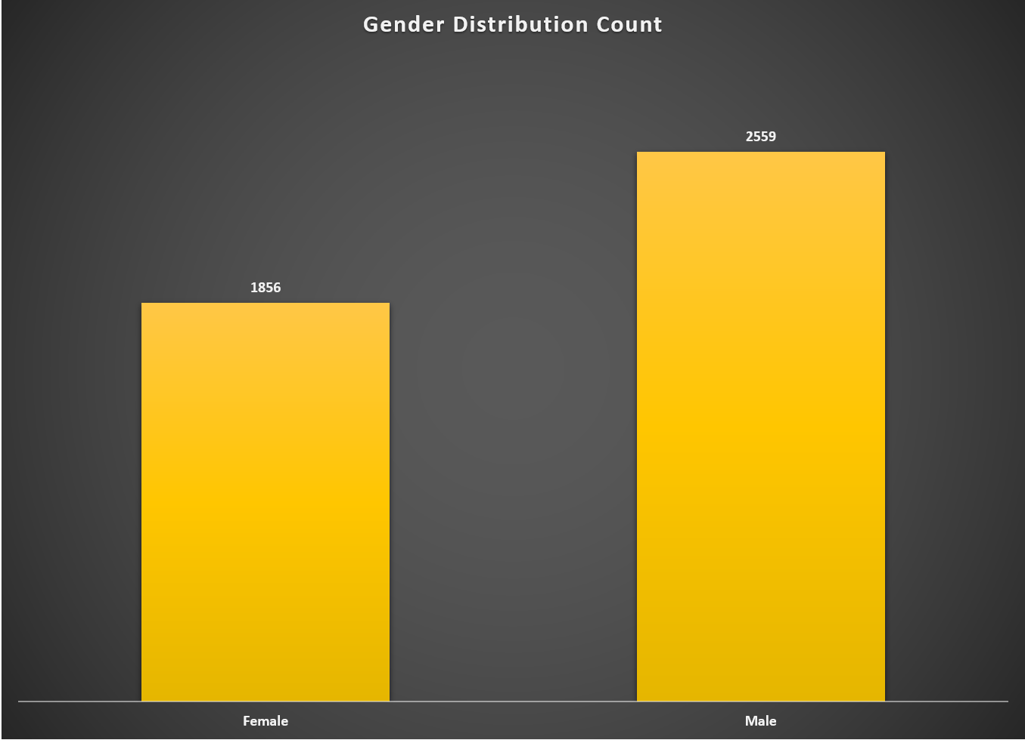
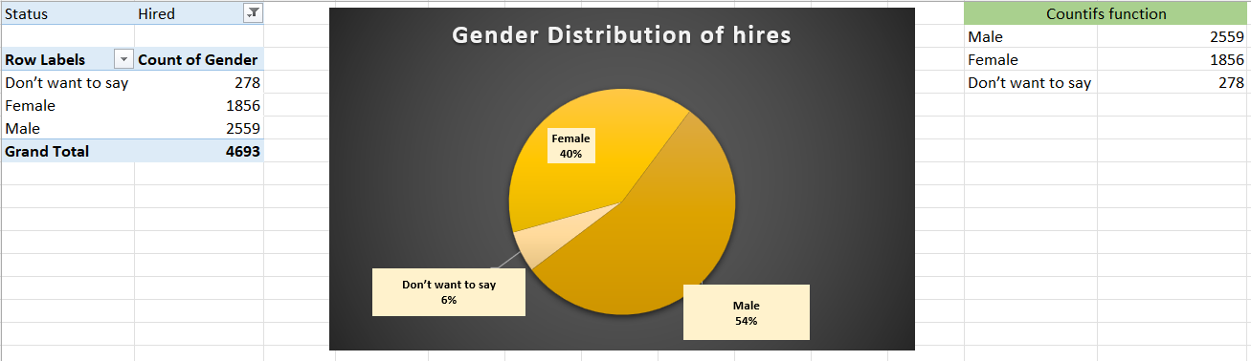
A. Hiring Analysis: The hiring process involves bringing new individuals into the organization for various roles. Your Task: Determine the gender distribution of hires. How many males and females have been hired by the company?
In the hired employees, we see about 2559 are male and 1856 are female

Slide 9
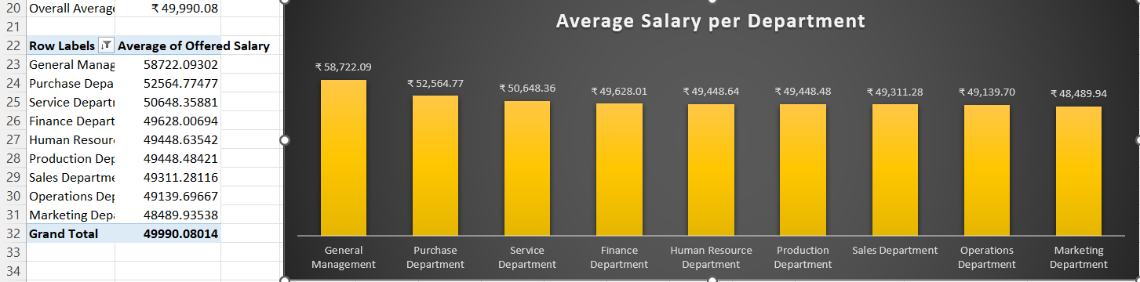
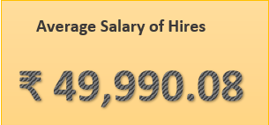
B. SALARY Analysis: The average salary is calculated by adding up the salaries of a group of employees and then dividing the total by the number of employees. Your Task: What is the average salary offered by this company? Use Excel functions to calculate this.
Used average function to get overall average salary that is about 49,990 and used pivot table to see department wise average salary.

Slide 10
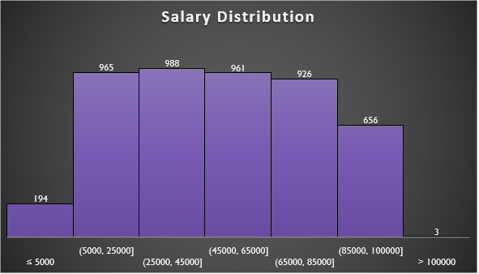
C. SALARY DISTRIBUTION: Class intervals represent ranges of values, in this case, salary ranges. The class interval is the difference between the upper and lower limits of a class Your Task: Create class intervals for the salaries in the company. This will help you understand the salary distribution.
We see only 3 employees has got salary offered greater than 1lakh and around 194 people got offer less than 5000.

Slide 11
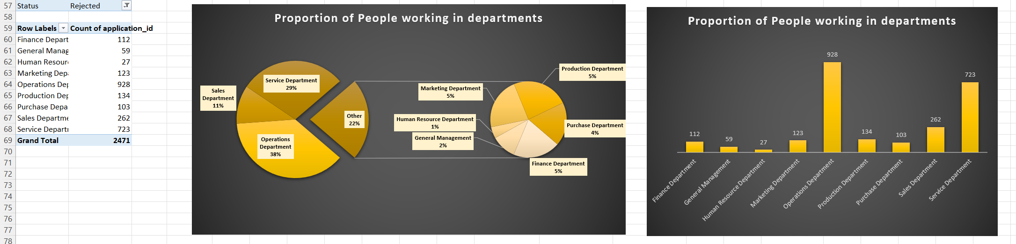
D. DEPARTMENT ANALYSIS: Visualizing data through charts and plots is a crucial part of data analysis. Your Task: Use a pie chart, bar graph, or any other suitable visualization to show the proportion of people working in different departments.

Slide 12
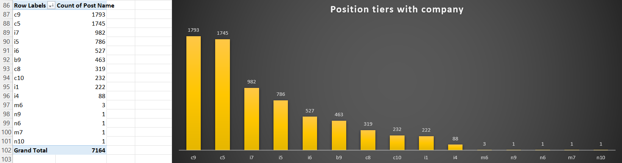
E.POSITION TIER ANALYSIS: Different positions within a company often have different tiers or levels. Your Task: Use a chart or graph to represent the different position tiers within the company. This will help you understand the distribution of positions across different tiers.

Slide 13
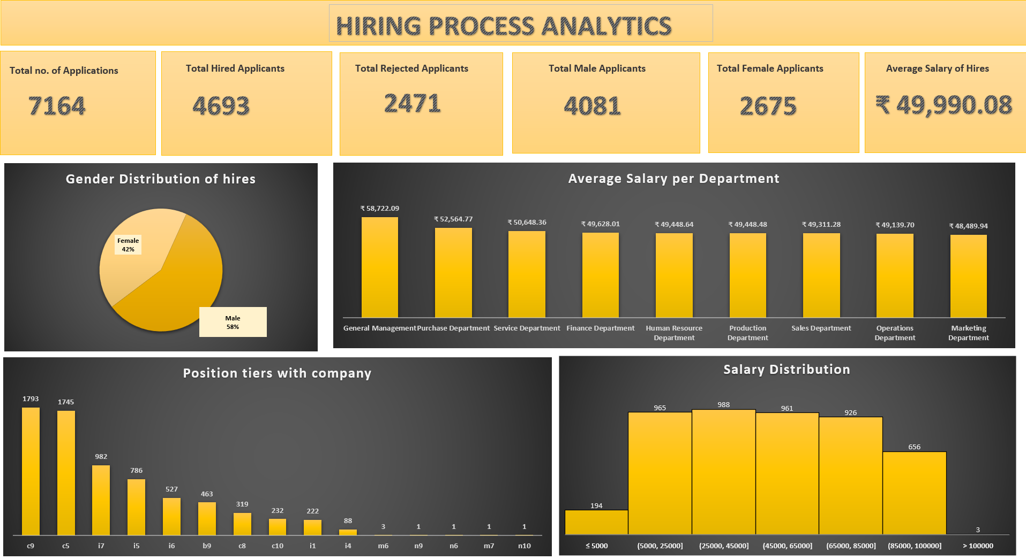
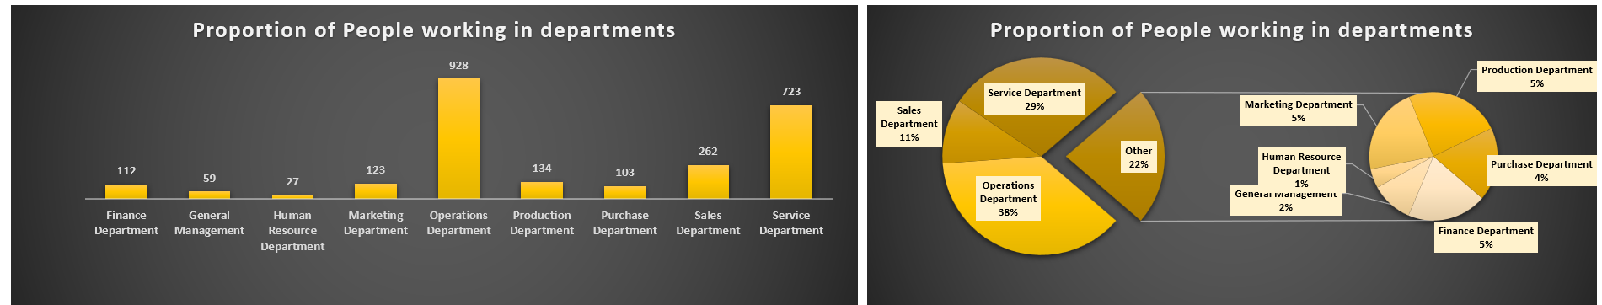

Slide 14
Drive Link:
https://docs.google.com/spreadsheets/d/1r_-bC_4xQQz-iRtdAxJ2_8zTmdW1vBRA/edit?usp=drive_link&ouid=109302203887767869225&rtpof=true&sd=true
The above link has lost some pivot tables that didn’t support in goggle sheet
THANK YOU

