Slide 1
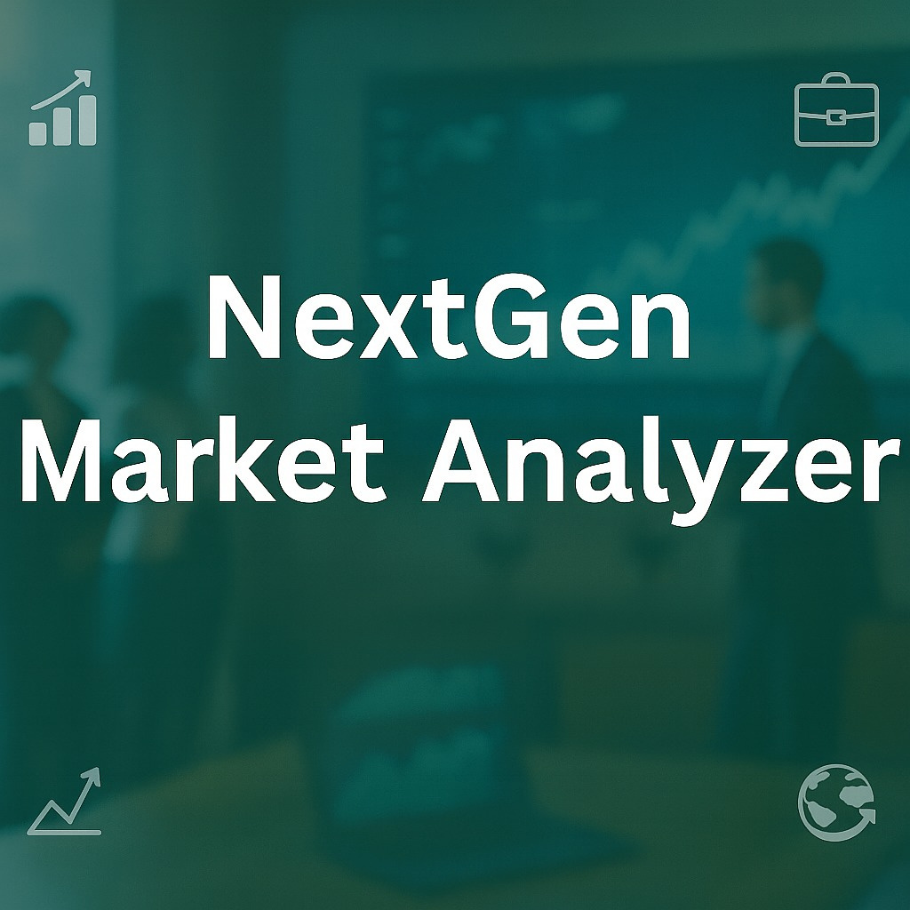


Slide 2
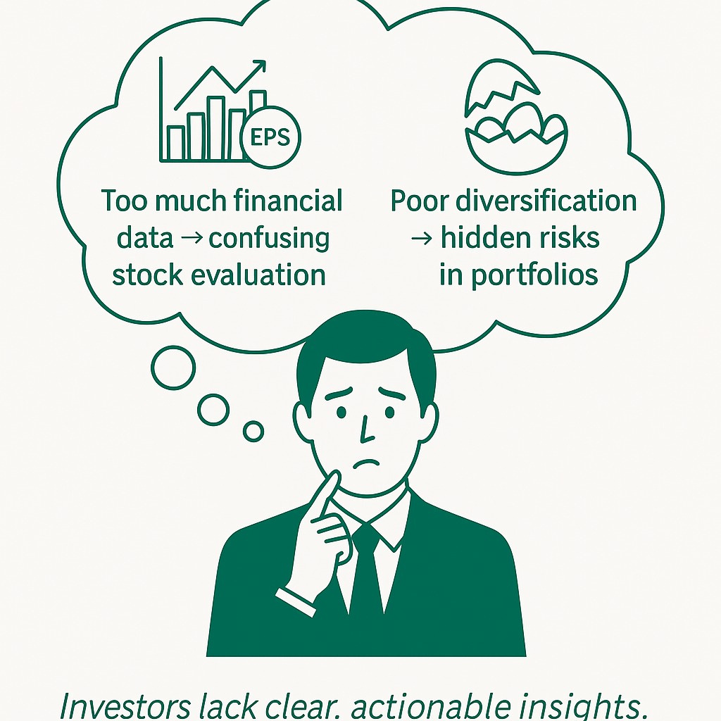
PROBLEM STATEMENT
Investors often face difficulty in evaluating individual stocks.
They struggle with managing portfolio concentration effectively.
The absence of comprehensive analysis platforms makes decisions harder.
As a result, these challenges lead to suboptimal decisions and higher risk.

Slide 3
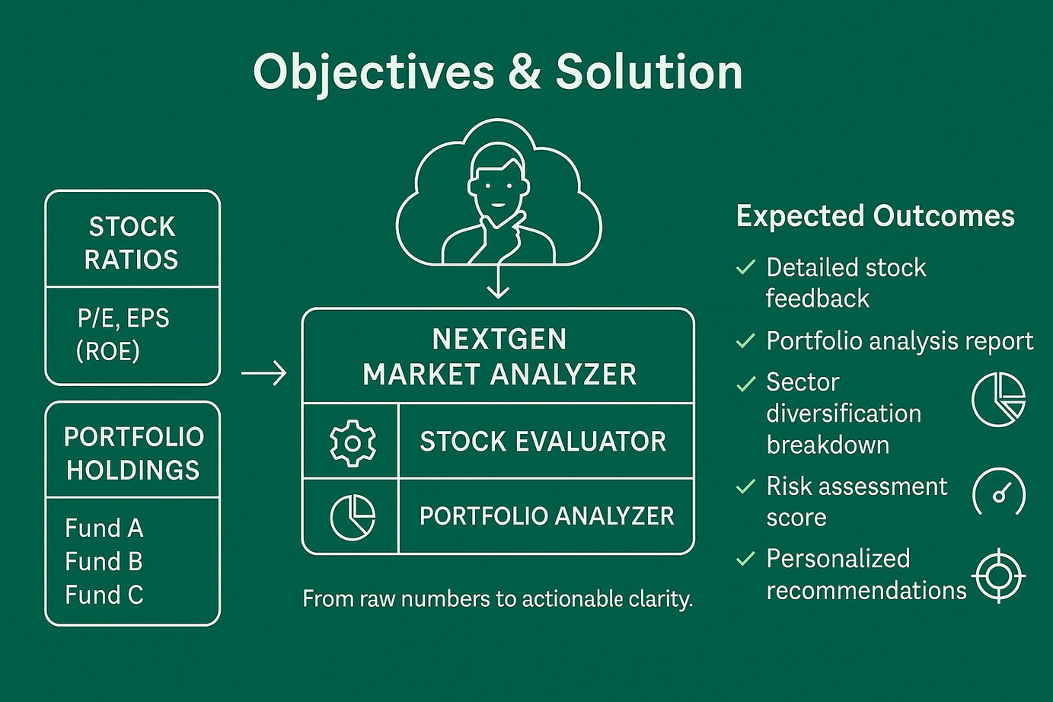
SOLUTION
Accurate stock evaluation using financial ratios
Delivering portfolio health analysis (diversification, risk, returns)
Offering personalized recommendations aligned with risk profile
Enhanced investor decision-making

Slide 4
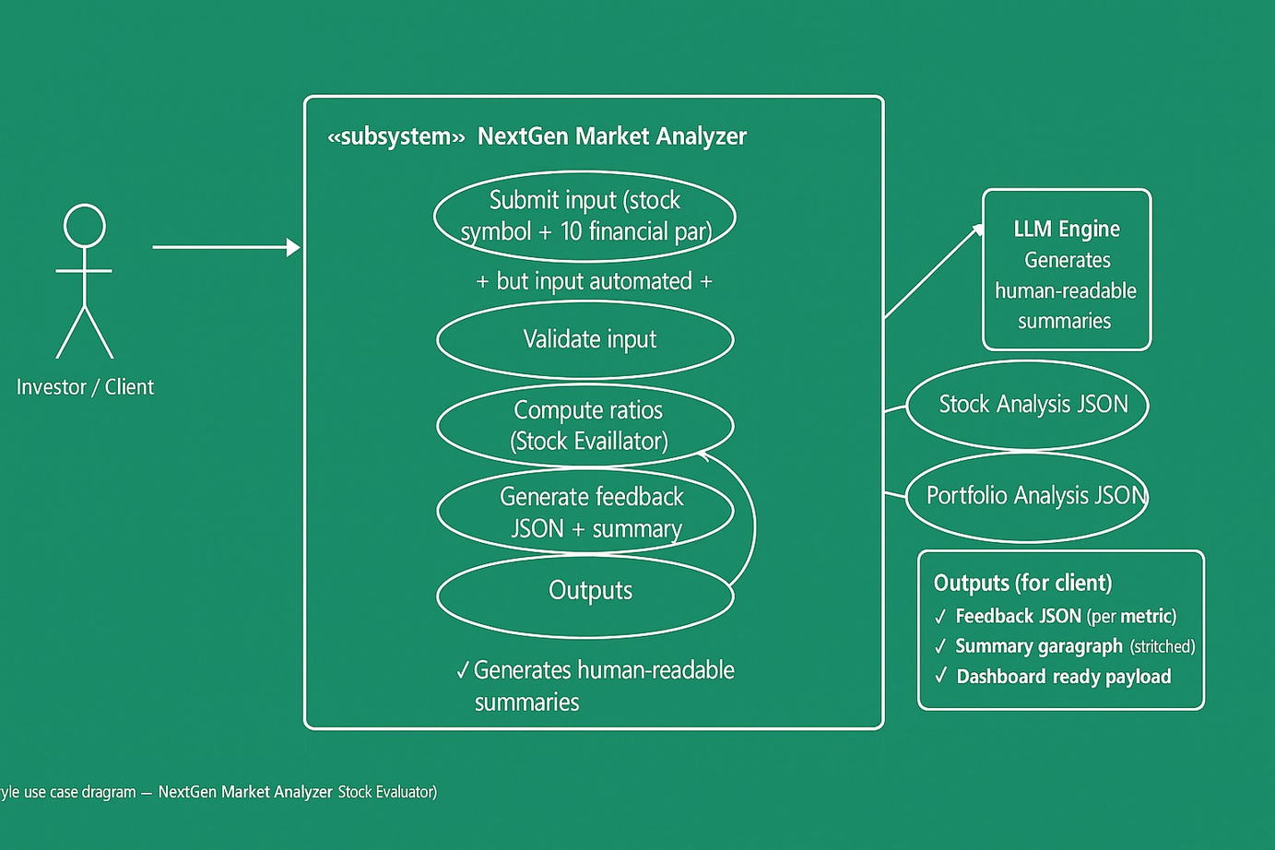
STOCK EVALUATOR
“From JSON input to actionable feedback and dashboard-ready outputs.”
Actor: Investor’s portfolio data (stock symbol + key financial parameters) is supplied to the system.
Process: Backend services automatically validate and process the data without manual effort.
Stock Evaluator: Computes ratios (P/E, EPS, ROE, etc.) and applies financial rules to classify performance.
LLM Integration: Converts technical outputs into structured, human-readable feedback and stitched summaries.
Output: Stock and portfolio analysis reports are displayed directly on the investor dashboard.

Slide 5
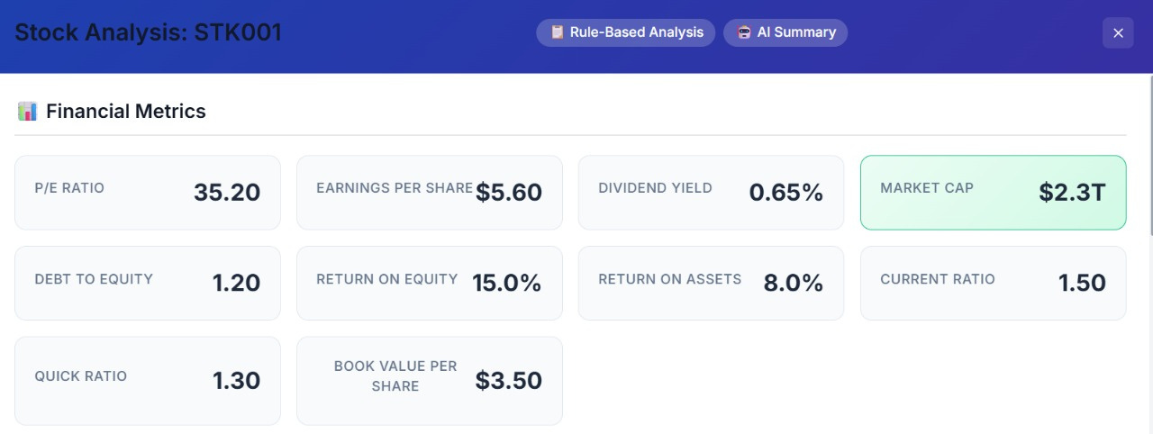
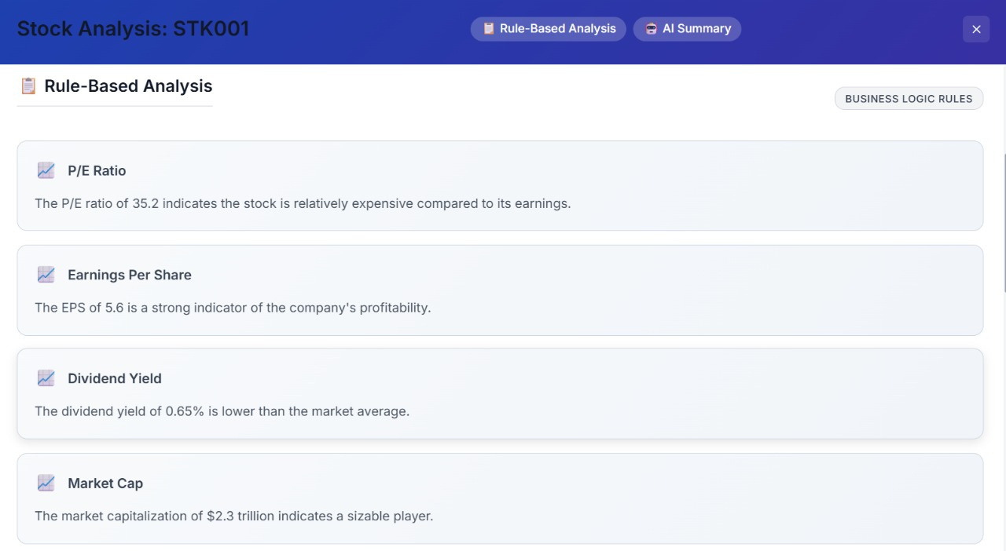
Financial Metrics Dashboard
Shows key ratios like P/E, EPS, ROE, and liquidity metrics for a given stock.
Rule-Based Analysis
Converts raw financial ratios into simple, rule-based interpretations for investors.

Slide 6
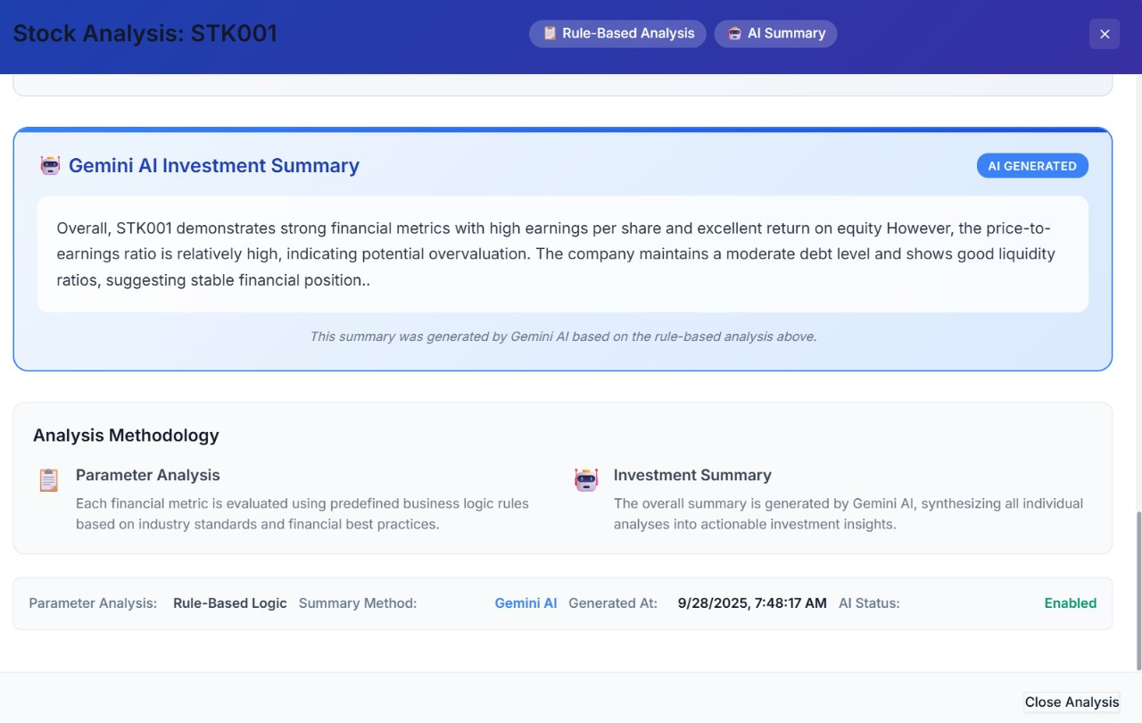
AI Investment Summary
LLM-generated summary stitches all metrics into a clear, human-readable insight.

Slide 7
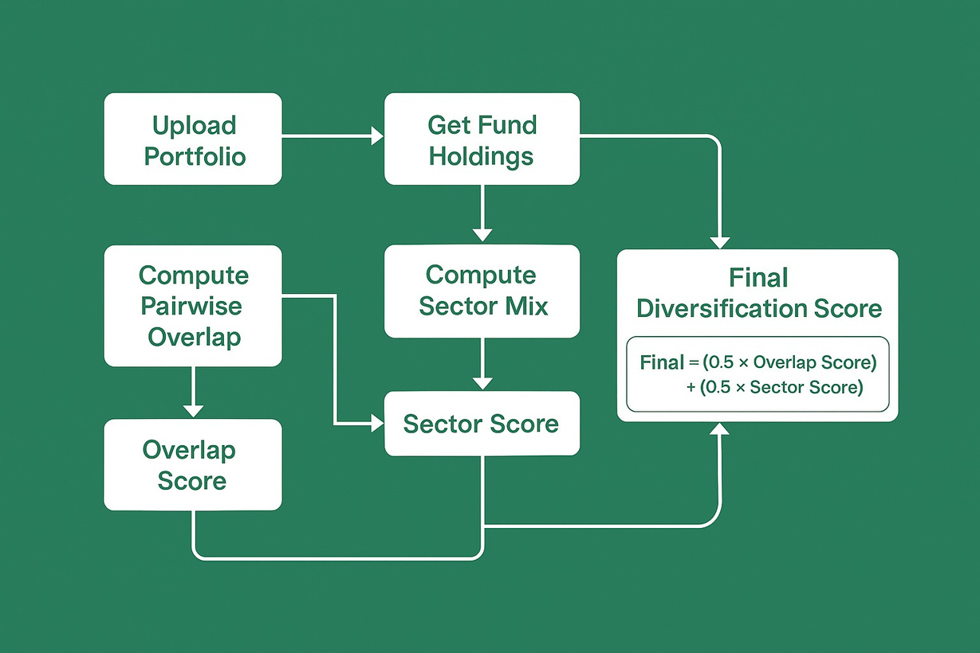
PORTFOLIO ANALYZER
Upload a portfolio → fetch fund holdings and sectors.
Calculate pairwise fund overlap (common stocks).
Compute sector mix (IT, Banking, FMCG, Energy, etc.).
Derive two scores:
✅ Overlap Score = (1 − average overlap) * 100
✅ Sector Score = (1 − HHI) * 100
Combine into Final Diversification Score
Final Score = (0.5 × Overlap Score) + (0.5 × Sector Score)

Slide 8
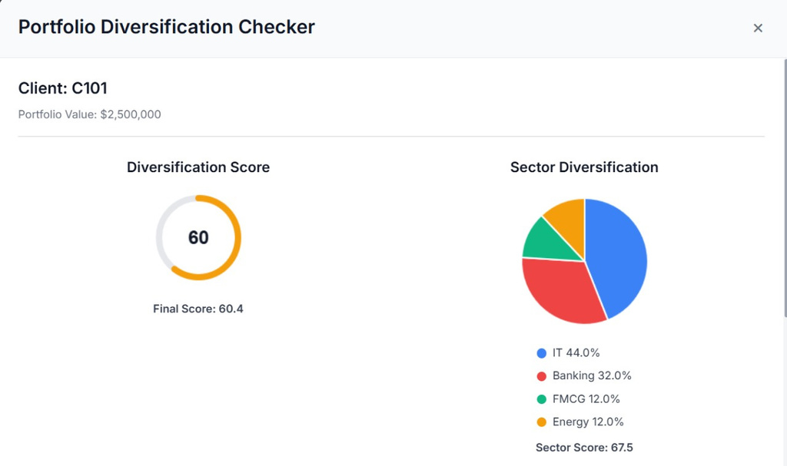
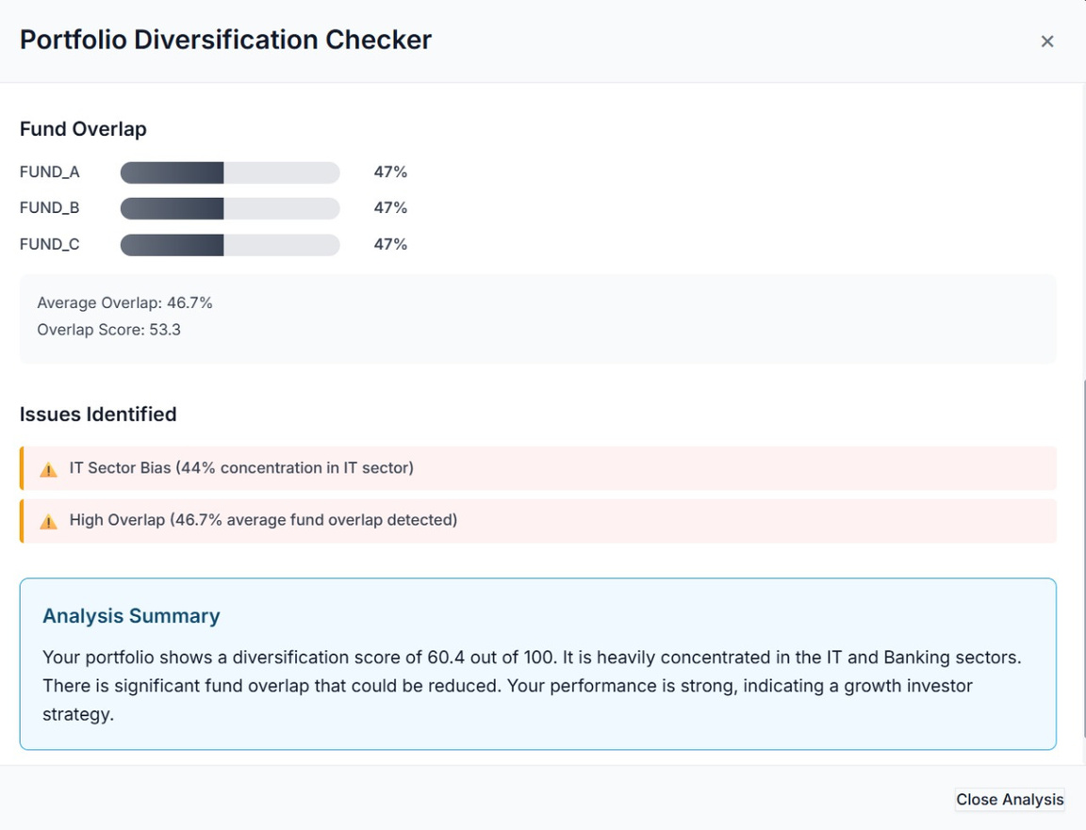
Diversification Score & Sector Mix
Provides sector-level diversification, sector score, and final portfolio health score.
Fund Overlap & Issues Identified
Highlights fund overlap %, sector bias, and flags risks with a concise portfolio summary.

Slide 9
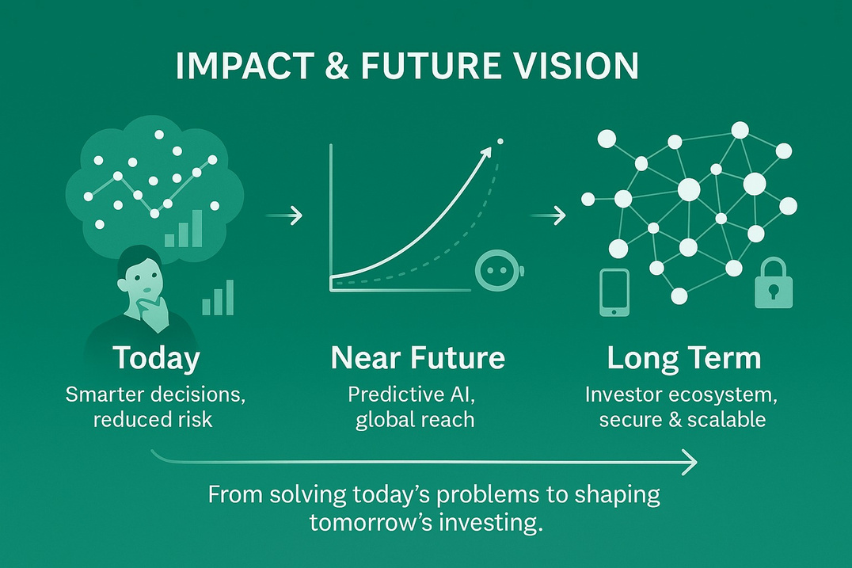
IMPACT & FUTURE VISION
Impact Today
📊 Smarter investment decisions with clarity-driven insights
🛡 Reduced risk via diversification awareness
⏱ Faster evaluation → from raw ratios to actionable advice in seconds
Future Enhancements
🌍 Global expansion: Multi-currency & international markets
🤖 Predictive AI: Early risk detection & trend forecasting
📱 Mobile-first dashboard for investors on the go
🔒 Enterprise-ready with security, scalability, and compliance

Slide 10
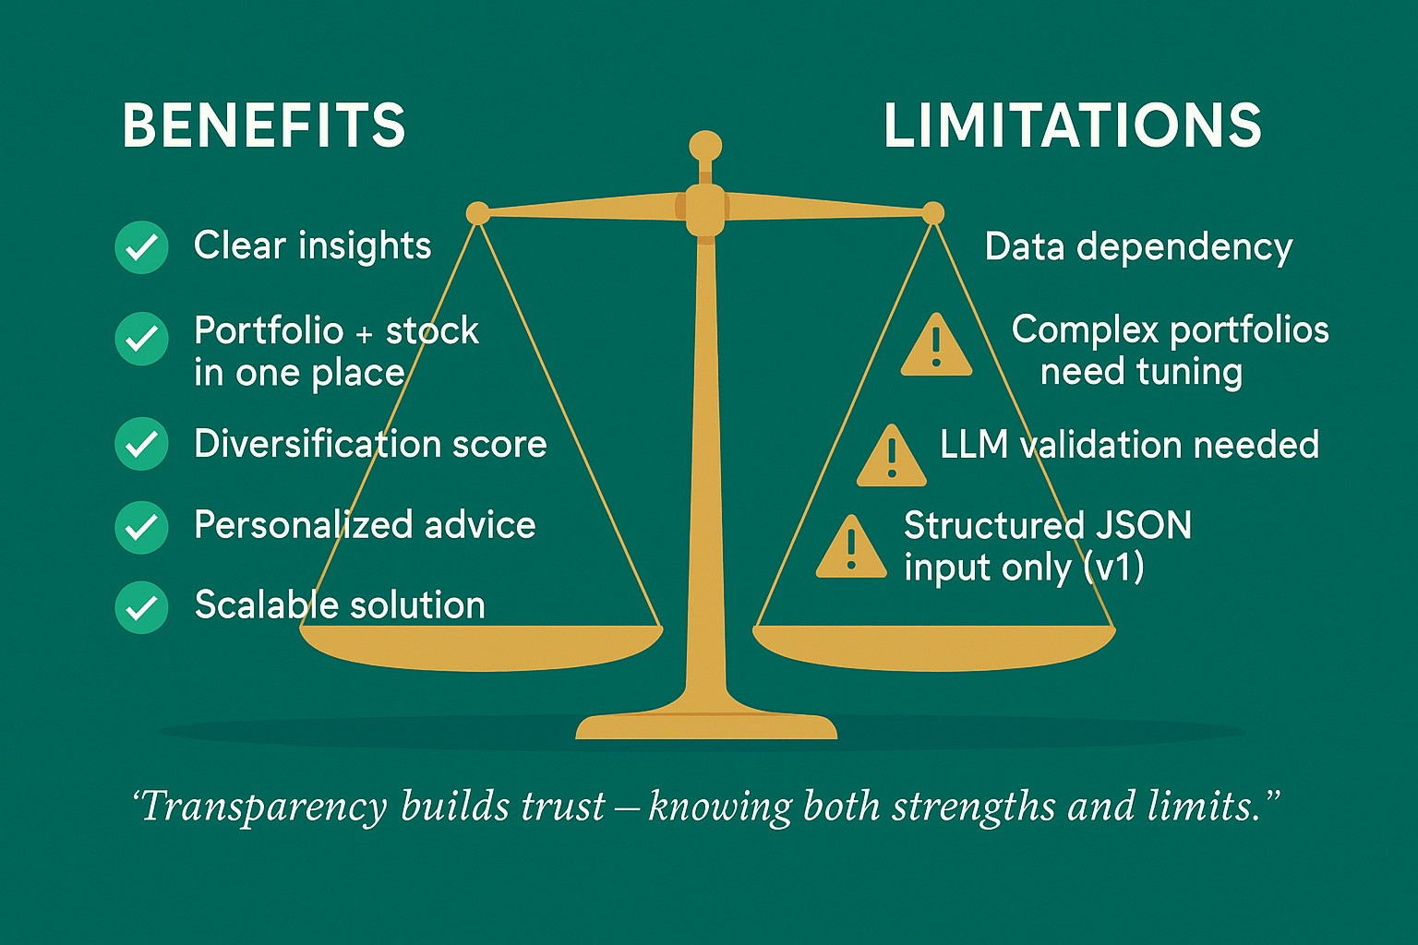

Slide 11


