Slide 1
Employee Data Analysis using Excel
STUDENT NAME: KAVIYA.S
REGISTER NO: 12223993
DEPARTMENT: Bcom (Corporate secretaryship)
COLLEGE: SHRI KRISHNASWAMY COLLEGE FOR WOMEN

Slide 2
PROJECT TITLE
Employee Gender Analysis using Excel

Slide 3


AGENDA
Problem Statement
Project Overview
End Users
Our Solution and Proposition
Dataset Description
Modelling Approach
Results and Discussion
Conclusion
3/21/2024 Annual Review

Slide 4

PROBLEM STATEMENT
The organization seeks to understand the gender distribution across various departments to assess diversity and inclusivity. There is a need to analyze trends in gender representation, identify any gender imbalances, and explore potential factors contributing to disparities. This analysis will help guide initiatives aimed at improving gender equity and fostering a more inclusive workplace.

Slide 5

PROJECT OVERVIEW
This project aims to analyze the gender distribution within the organization using Excel. Key metrics such as gender ratio, department-wise gender representation, and trends over time will be examined. Excel tools like pivot tables, charts, and data filters will be utilized to visualize and summarize the findings. The analysis will provide insights into gender imbalances and help inform diversity and inclusion initiatives.

Slide 6

WHO ARE THE END USERS?
HR Department – To assess gender diversity and design strategies for gender balance.
Management & Leadership – To make informed decisions on diversity and inclusion policies.
Diversity & Inclusion Teams – To track progress and implement gender equity initiatives.
Department Heads – To monitor gender distribution in their respective teams. Employee’s – To gain awareness of the organization's gender diversity efforts.

Slide 7

OUR SOLUTION AND ITS VALUE PROPOSITION
Our Solution: A comprehensive gender analysis using Excel, offering data visualization and insights on gender distribution across the organization.
Value Proposition:
Informed Decisions: on diversity strategies
- Data-Driven Insights: into gender trends
- Cost-Effective : using familiar tools
- Customizable Reports : for specific needs
- Support for Inclusive Culture: initiatives

Slide 8
Dataset Description
The dataset includes employee information such as gender, department, job role, hire date, and tenure. It also covers additional fields like salary, age, and performance ratings, enabling a comprehensive analysis of gender distribution, representation across departments, and trends over time.

Slide 9

THE "WOW" IN OUR SOLUTION
Our gender analysis solution offers real-time insights with interactive Excel dashboards, making complex data easy to understand. It's a cost-effective, user-friendly approach that empowers decision-makers to quickly spot gender imbalances and take action. The ability to customize reports and visualize trends ensures immediate impact and supports proactive diversity initiatives without the need for expensive software or advanced technical skills.
3/21/2024 Annual Review
9

Slide 10
MODELLING
Data Cleaning: Ensure accurate and complete data.
Segmentation: Analyze by department, role, and tenure.
Gender Ratios: Calculate male-to-female ratios across categories.
Trend Analysis: Track gender distribution changes over time.
Visualization: Use charts and pivot tables for clear insights.
Advanced Metrics: Apply diversity indexes for deeper analysis.
10

Slide 11
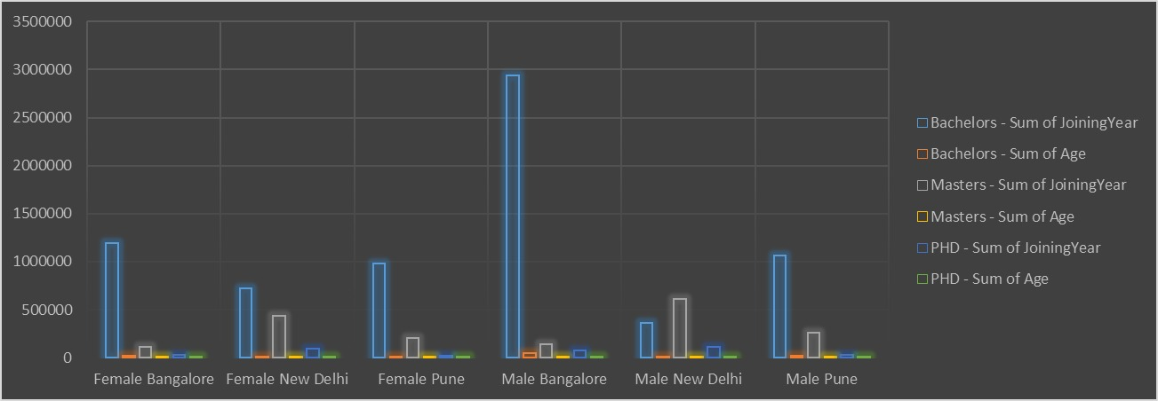
RESULTS
11

Slide 12
conclusion
The employees' gender analysis using Excel provides valuable insights into gender distribution, helping the organization identify imbalances and trends. By leveraging Excel’s powerful data tools, decision-makers can implement targeted strategies to promote gender equity and foster a more inclusive workplace. This cost-effective and accessible solution supports ongoing diversity initiatives and drives informed decision-making.

