Slide 1
Superstore Sales Dataset Analysis-Advanced Excel Project
NAME : B.KAVIYA
COURSE : DADS
BATCH : JULY-2025
DATE : 02-09-2025

Slide 2
Project Overview Objectives:
Objectives:
"To analyze sales data to identify trends, understand sales performance, and provide actionable business insights."
GOALS:
Analyze sales trends over time.
Identify high performance products and sales channel.
Determine the impact of returns and discounts.
Create a dynamic dashboard with key matrics.

Slide 3
Data Description :
9900+ rows, columns such as Order ID, Sale ID, Product Type, etc.
Data Cleaning Process :
Date formatting(dd-mm-yyyy)
Discount as percentage(%)
Profit as currency($)
Removed duplicate records
Numerical as correction of 2 decimal values
Remove blanks

Slide 4
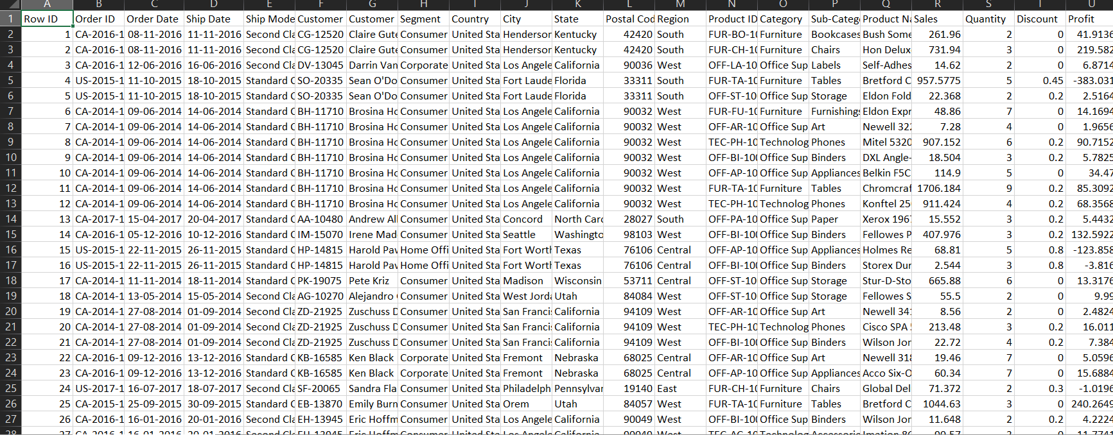
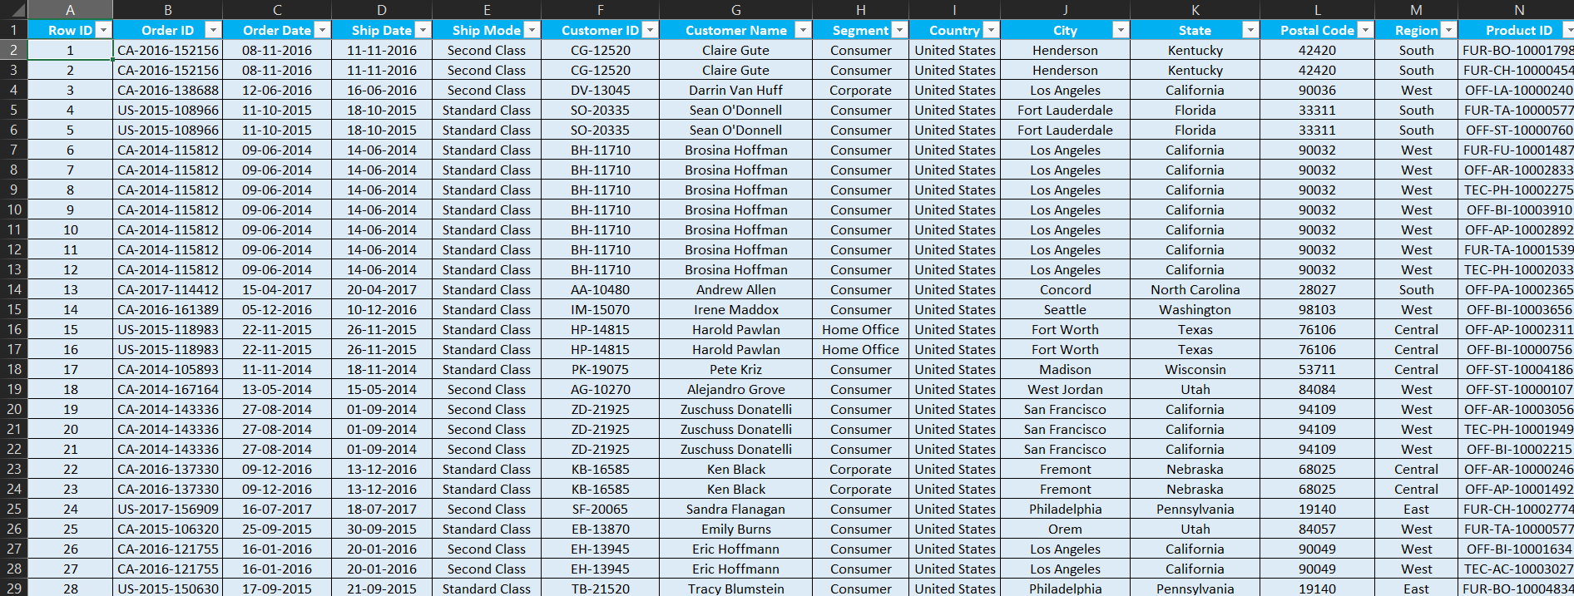
RAW DATA Cleaned data

Slide 5
Key Metrics Calculation:
Adjusted Sales = Sales × (1 - Discount)
Total Revenue = Sum of Adjusted Sales
Average Order Value (AOV) = Total Revenue / Number of Transactions
Discount Amount = Sales × Discount
Total Discounts = Sum of all Discount Amounts per transaction

Slide 6
Use Formulas to Extract Insights :
COUNTIF — Single Condition
=COUNTIF(range, criteria)
Count all "Consumer" orders
SUMIF— Multiple Conditions
=SUMIF(range, criteria, [sum_range])
Count how many orders were for Furniture and made by Consumer
AVERAGEIF — Single Condition
=AVERAGEIF(range, criteria, average_range)
Average Discount for the Consumer

Slide 7
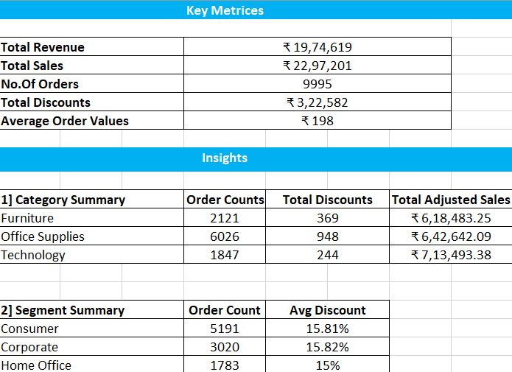

KEY METRICS & INSIGHTS CALCULATION AND DATA ANALYSIS

Slide 8
PIVOT TABLE AND CHARTS
Aggregation by Product Type
  Fields Used: Segment & Category
  Purpose: Analyze sales and profit performance by product type.
  Pivot Setup:
  Rows: Segment & Category
  Values:
    Adjusted Sales (Sum)
    Profit (Sum)
  Chart: Bar or Column Chart

Slide 9
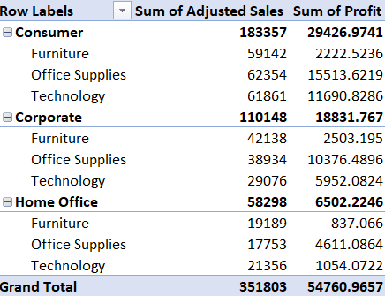
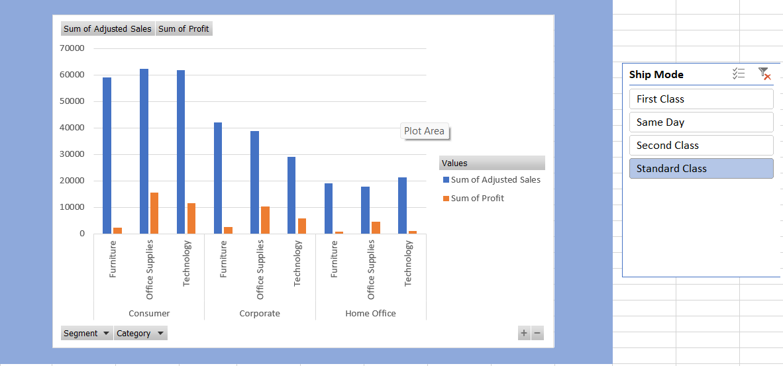
TABLE CHART

Slide 10
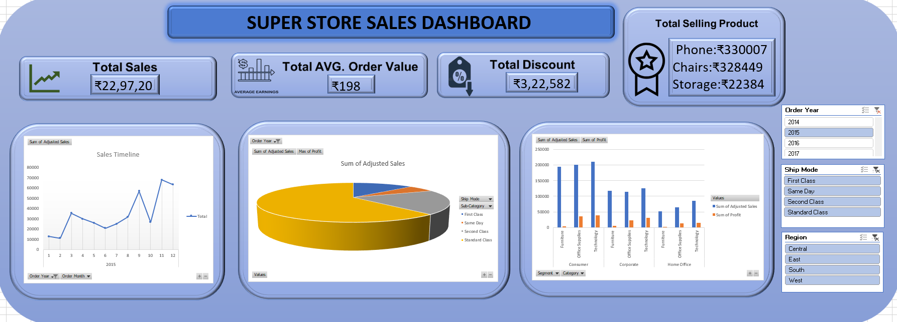
DASHBOARD

Slide 11
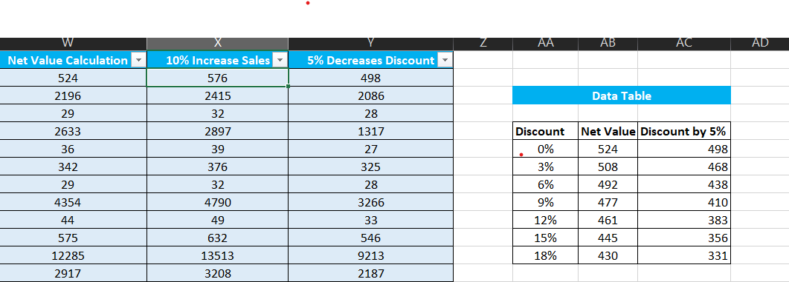
WHAT-IF ANALYSIS:
The process of changing the values in cells to see how those changes will affect the outcome of formulas on your worksheet. It is a powerful forecasting and planning tool that allows you to explore multiple scenarios and make data-driven decisions without changing your original data.
Net Value Calculation:
=Sales*(1-Discount)*Quantity
5% Decreased Discount:
=Netvalue*((1-Discount)-0.05)

Slide 12
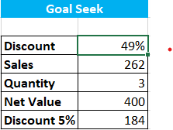
GOAL SEEKING:
In simple words, Goal Seek is Excel's "back-solving" tool. You tell it what final result you want to get from a formula, and it automatically figures out what single input number you need to make that happen.
Instead of you manually guessing and checking different numbers to reach a goal, Goal Seek does it instantly.
Net Value Calculation:
=Sales*(1-Discount)*Quantity
5% Decreased Discount:
=Netvalue*((1-Discount)-0.05)

Slide 13
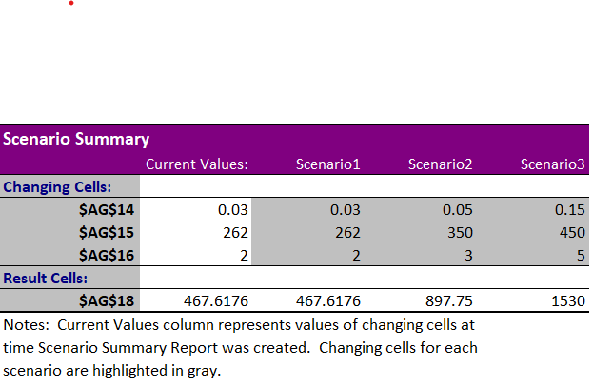
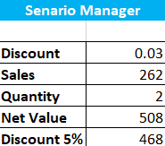
SCENARIO MANAGER & SUMMARY:
Scenario Manager: A tool in Excel that lets you create and compare different sets of input values (scenarios) to see their impact on results.
Scenario Summary: A report that displays the results of multiple scenarios side by side for easy comparison.

Slide 14
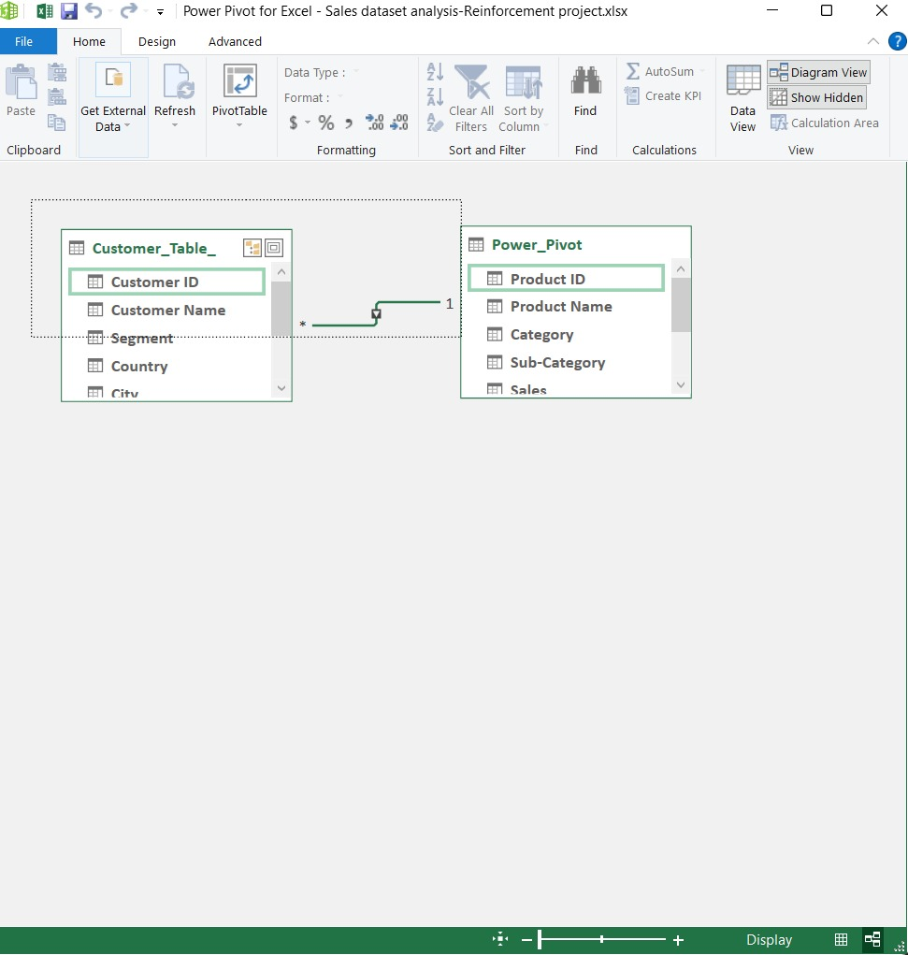
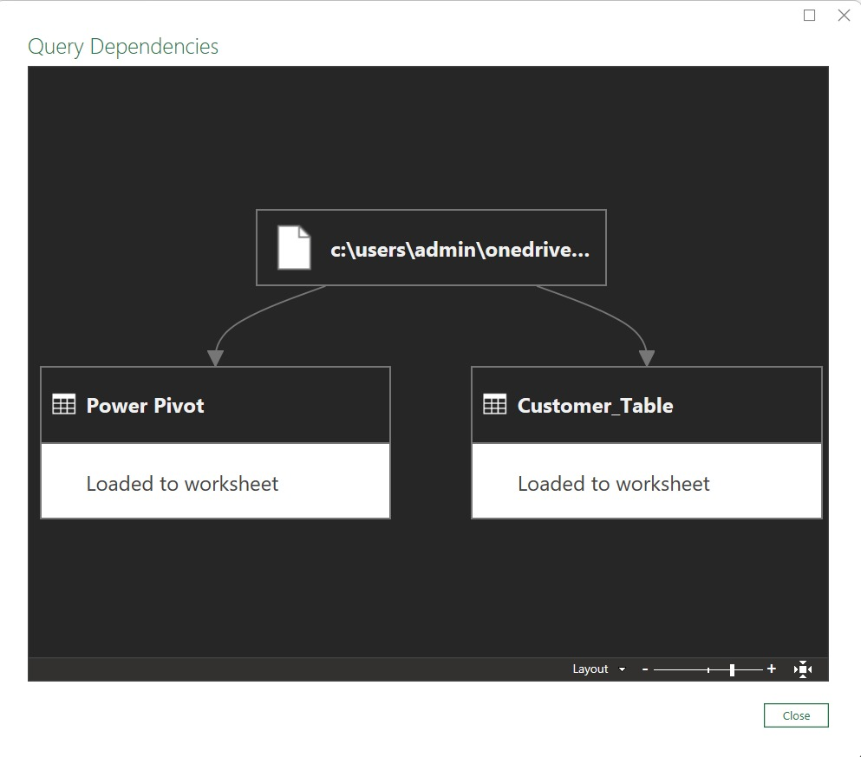
POWER PIVOT AND POWER QUERY

Slide 15
Thank you

