Slide 1
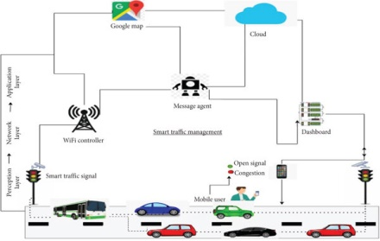
IOT IN TRAFFIC MANAGEMENT

Slide 2
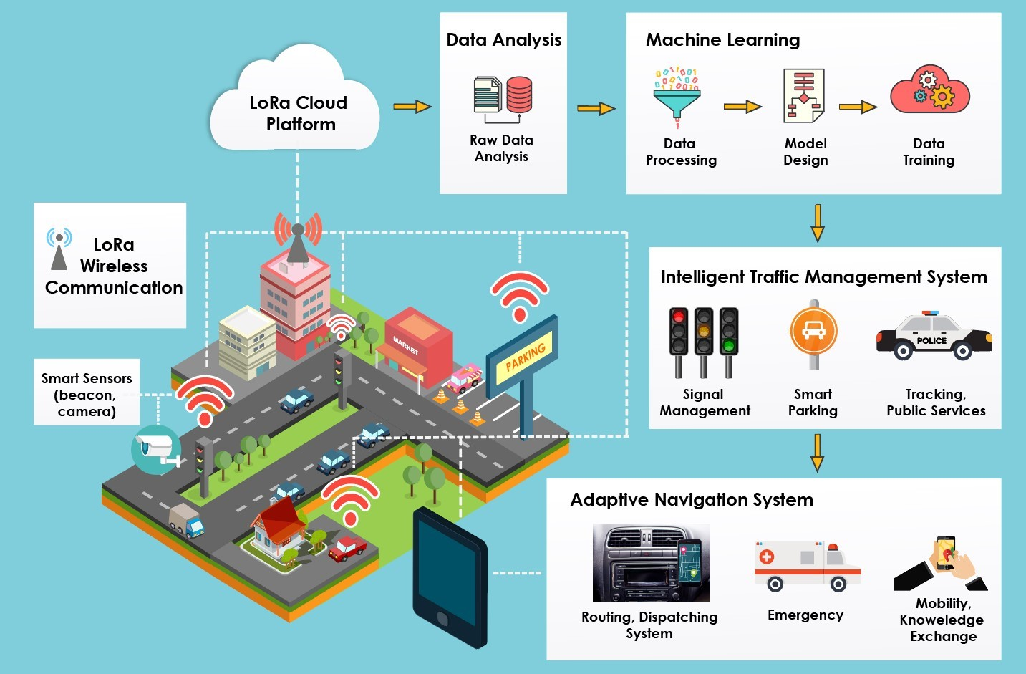

Slide 3

INTRODUCTION
In the contemporary world, urban mobility is one of the unprecedented challenges to be tackled in the administration of a big city. Further, an advanced traffic management system is proposed, implemented using Internet of Things (IoT). The system is supported by a circuit embedded in the vehicle, which operates using RFID with clustered systems. The functionalities of the system include efficient traffic light control, parking space identification and anti-theft security mechanism. Moreover, supervised learning methodologies are proposed that would help in determining the standard of roads, estimating overall traffic flow, calculating average speed of distinct vehicle types on a road and analyzing the travel path of a vehicle. In this day & age, the conventional systems to manage urban mobility are proving incompetent. And there’s a growing need for an efficient traffic management system. Cities big and small are in dire need of technology-led digital solutions to manage & monitor traffic. They can help regulate heavy traffic, road blockages at signals & congested networks.
An Internet of Things (IoT)-enabled intelligent traffic management system can solve pertinent issues by leveraging technologies like wireless connectivity & intelligent sensors. Considered a cornerstone of a smart city, they help improve the comfort and safety of drivers, passengers & pedestrians.

Slide 4

Role of IoT in Traffic Management
Expand the capacity of city streets without having to build new roads.
Optimize the traffic flow and keep the drivers safe. It would include cameras, sensors, and cellular technologies that automatically adjust traffic lights, expressway lanes, speed limits, and highway exit counters.
Transmit accurate information about available parking spaces to citizens in real-time
Collect data on congestion and improve traffic signaling to reduce blockages and optimize commute
Locate incidents and report them to emergency rooms immediately with road sensors and video surveillance
Employ real-time data feeds to ensure the streetlights turn dim or brighten up per the changing weather conditions and the onset of day and night

Slide 5

Advantages of a Smart Traffic Management System
Cleaner, greener, safer, and more accessible roads are a few benefits of implementing IoT and intelligent technology.
It helps with the following:
Reducing traffic jams and accidents on the streets
Ensuring immediate clearance for emergency vehicles
Facilitating safer and shorter commute times
Reducing congestion & energy consumption at intersections
Offering significant productivity benefits with real-time monitoring of crucial infrastructures
Reducing operating costs with efficient traffic management processes
Ensuring compliance with the regulations for reducing the carbon footprint
Saving billions of gallons of fuel wasted every year
Accurate tracking & quick recovery of lost and stolen vehicles

Slide 6
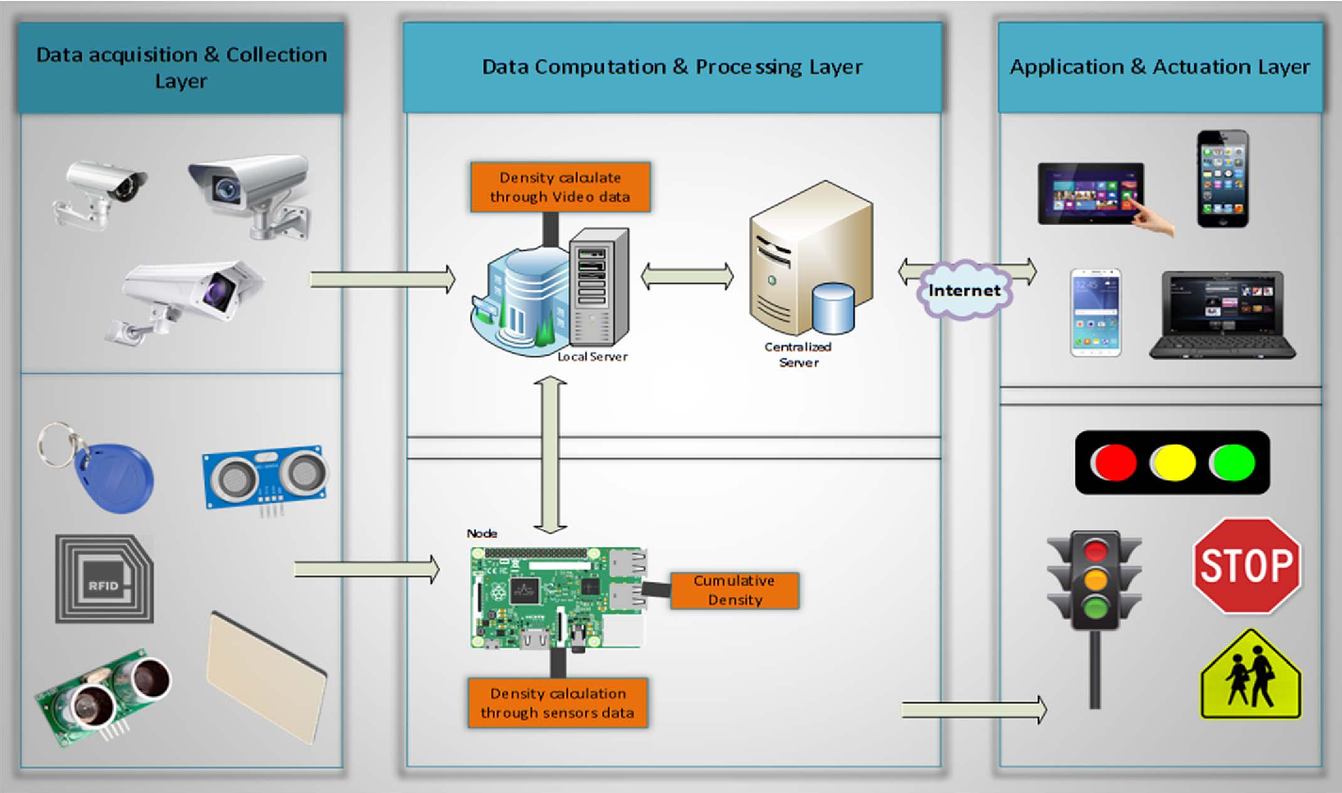

Slide 7
Functioning of Traffic Monitoring System Using IoT Capabilities
This intelligent system comprises several components, including wireless sensors, RFID tags, and BLE beacons installed at the traffic signals to monitor the movement of vehicles. A real-time data analytics tool connects the Geographic Information System (GIS-enabled) digital roadmap with control rooms for real-time traffic monitoring.
The smart traffic management system captures the images of vehicles at the signals using the digital image processing technique. This data is then transferred to the control room via wireless sensors. The system also leverages BLE beacons or RFID tags to track the movement of vehicles and keep traffic congestion in control, track down stolen vehicles and even clear the road for emergency vehicles that are installed with RFID readers.

Slide 8
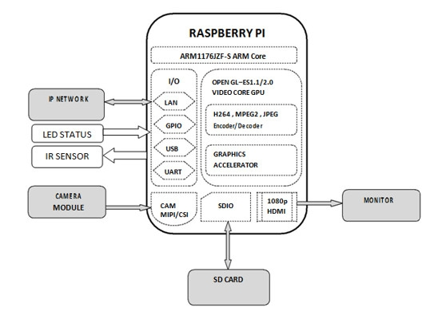

Slide 9
Application of IoT in Traffic Management
City governments can improve their operations & infrastructure by placing IoT sensors and tracking devices on roads and highways for recording, analyzing, and sharing data in real-time.
Traffic Lights and IoT Control Systems: Smart traffic signals may look like a typical stoplight, yet they utilize an array of sensors to monitor real-time traffic. Usually, the goal is to help cars reduce the amount of time spent idle. And IoT technology enables the various signals to communicate with each other. This is while adapting to changing traffic conditions in real time. The outcome is less time spent in traffic jams and even reduced carbon emissions.

Slide 10
Parking Enabled through IoT: Smart meters and mobile apps make on-street parking spaces easily accessible with instant notifications. Drivers receive alerts whenever a parking spot is available to reserve it instantly. The app gives easy directions to the parking spot with a convenient online payment option.
Emergency Assistance through IoT: A traffic monitoring system using IoT technology enables emergency responders to speed up the care mechanism in case of accidents late at night or in isolated locations. The sensors on the road detect any accident, and the problem is immediately reported to the traffic management system. This request is passed on to relevant authorities to take corrective action. Emergency response personnel would include medical technicians, police officers, and fire departments for enhanced responsiveness and timely intervention.
Commute Assistance: With every vehicle acting as an IoT sensor, a dedicated app can make suggestions, determine optimal routes & provide advance notice of accidents or traffic jams. Further, it can even suggest the best time to leave. It is all because of a robust algorithm that helps reduce driving time with intelligent traffic lights.

Slide 11
Key Features of a Smart Traffic Management System
Traffic Jam Detection: With cloud connectivity, sensors, and CCTV cameras tracking intersections 24×7, technicians can remotely monitor all the streets in real-time from the city’s traffic control room.
Connected Vehicles: A smart traffic system using IoT technology can connect with roadside tracking devices to enable direct communication between intelligent vehicles & intersections.
Modular Control: Real-time detection of congestion triggers dynamic adjustments in the systems meant for controlling traffic lights, express lanes, and entry alarms.

Slide 12
Emergency Navigation: A system with edge data processing & programmatic alerting capabilities can alert response units (police, ambulance & tow trucks) in case of a car crash or collision. It reduces the crucial time an injured driver or passenger remains unattended.
Road Safety Analytics: Systems with pattern detection capabilities can immediately flag high cruising speeds and reckless driver or inappropriate pedestrian behavior.
Digital Payments: Commercial traffic management systems enable quick and convenient electronic transactions in real time while ensuring financial data safety.

Slide 13

CONCLUSION
The shortcomings of the traditional traffic management system are presented along with the smart traffic control mechanisms employed in a few cities. An efficient system is proposed with the implementation by big data analytics and RFID, supported by IoT. The architecture and functionalities of the proposed system are described along with supervised learning used to determine the attributes of traffic management. This advanced system, once implemented would drastically reduce traffic congestion in big cities
and improve the security of vehicles.Traffic management plays a vital role in determining a city’s livability. By using the tracking devices and data effectively – a city government can seamlessly regulate traffic & manage it without expanding the infrastructure. IoT in traffic management can save smart cities a significant chunk of their time, money & resources while making public transport safer and more convenient. Yet IoT will continue to gain momentum in the development & integration of infrastructure and services for future cities.

Slide 14
THANKYOU

