Slide 1
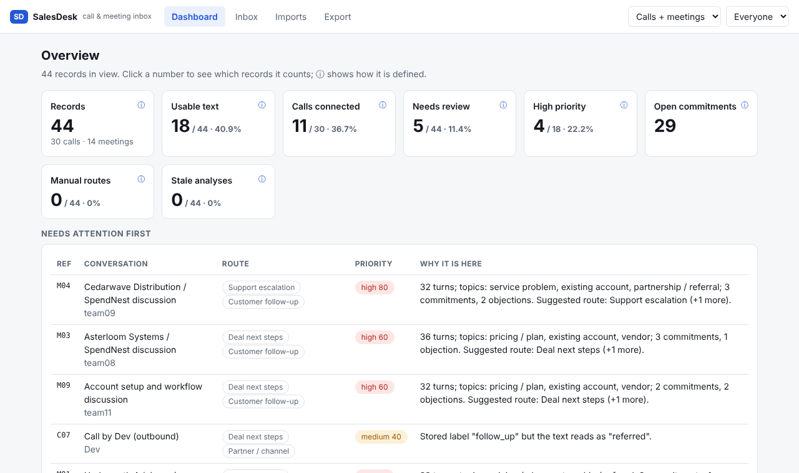
What needs attention, and what cannot be judged
44
records: 30 calls, 14 meetings
18 / 44
usable text (40.9%)
11 / 30
calls connected (source flag)
4 / 18
high priority (22.2%)
Every number shows its denominator and a definition, and clicking it lists the exact records behind it. People are split into call reps and meeting organisers because an organiser is not automatically the salesperson. Records with no text are listed in intake, not hidden.
SalesDesk · 1/5

Slide 2
Three findings, each traceable to the source
1 Most of the day cannot be judged
2 M04 Cedarwave needs a manager today
3 C09 is not a referral
18/44 usable. 20 calls have no text; 3 meetings silent, 3 never captured. 2 of the 11 "connected" calls (B11, B14) have no text.
Existing customer leaving its prepaid card programme. Both sides left with open follow-ups and no date. Priority 80.
Stored label says “referred”. The contact declined and refused use of their name, so it goes to Outreach log, not the pipeline.
M05: “The meeting was recorded but nobody spoke.”
M04 turn 11: “moving from prepaid to credit is the main issue for us”
C09: “No, please don't use my name.”
So what: Fix capture before judging reps.
So what: Name an owner and a date.
So what: Treat stored labels as inputs to check.
SalesDesk · 2/5

Slide 3
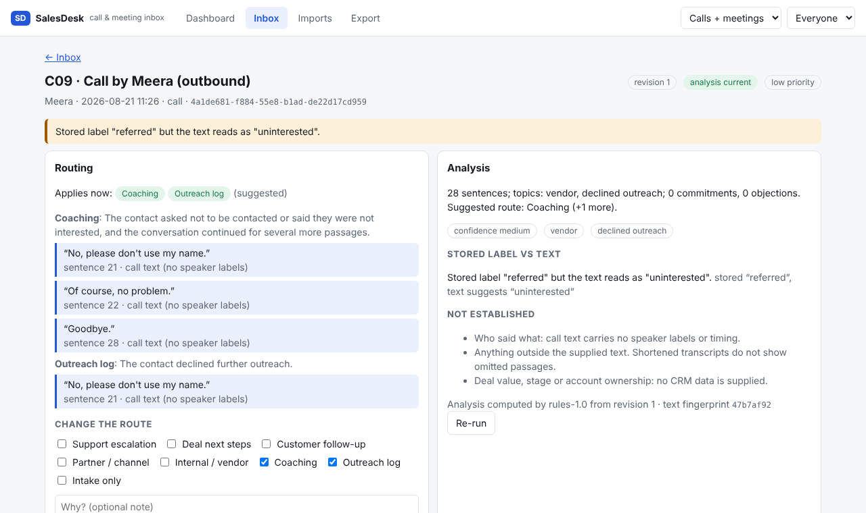
Routing: how a record gets its route, and one hard call (C09)
How it works
Rules read the supplied text for pricing, next steps, problems, partners, refusals.
Each of 8 routes carries a reason and exact quotes; meetings cite turn numbers, calls cite quotes.
A record can sit in several routes; the manager can change them.
The hard call
C09 says “referred”, but the contact said they build their own software and “No, please don't use my name.” Cost of my choice: a real lead could be under-counted. It is flagged for review, so a person decides.
Routes: Support escalation · Deal next steps · Customer follow-up · Partner / channel · Internal / vendor · Coaching · Outreach log · Intake only
SalesDesk · 3/5

Slide 4
Repeats and updates cannot inflate counts or erase a correction
Step | Added | Updated | Ignored | Unique | Usable
1 Import batch 1 | 44 | 0 | 0 | 44 | 17
2 Same batch, reordered | 0 | 0 | 44 | 44 | 17
3 Manual route on M07 | – | – | – | 44 | 17
4 Update (revision 2) | 0 | 1 | 0 | 44 | 18
5 Batch 1 again (older) | 0 | 0 | 44 | 44 | 18
6 Refresh the page | – | – | – | 44 | 18
What M07 shows
Revision 1 had no transcript. I routed it to Customer follow-up by hand.
Revision 2 brought 27 turns and replaced the whole record.
The suggestion changed; my manual route stayed, with a banner offering to keep it or take the new one.
The other 43 records were unchanged.
Identity is (source type, source id), never the ref, title or position. Export manifest lists applied revision, routes, manual flag and analysis freshness; a changed route moves its file and the old one is listed as superseded.
SalesDesk · 4/5

Slide 5
The decision I rejected, and what this does not do
Rejected: one route field that every import overwrites
Limits, stated plainly
Analysis is keyword rules, not a model. The label check flagged 5 of 10 calls; only C09 was a true mismatch, so 4 were false alarms.
Call text has no speakers, so call commitments have no owner.
Priority is a heuristic that orders the queue, not a forecast.
JSON file store, no login: right for one manager or a demo.
AI use: I used Claude to build the code and rules; every finding quote is checked by a test.
It is the simplest design: no override model, no banner, no superseded files.
But M07 breaks it. The manager's choice made while the transcript was missing would vanish when the update ran, and a re-import of old data could undo any correction.
Chosen instead: the manual route lives beside the source and the suggestion. Cost: a second field, a banner and extra manifest bookkeeping.
SalesDesk · 5/5

