Slide 1


Data Flow Analysis and Optimization: A Deep Dive into Compiler Techniques
This presentation delves into the fascinating world of compiler optimization, exploring powerful techniques like data flow analysis. We will uncover how compilers analyze and transform code to improve its efficiency and performance.
By Kaviya.S (192224148)
Gokul.S (192224131)

Slide 2

Introduction to Data Flow Analysis
1
Understanding Code Behavior
2
Optimization Foundation
Data flow analysis meticulously examines the flow of data within a program, tracing its movement through different instructions and variables.
By analyzing data dependencies and usage patterns, compilers can identify opportunities for optimization, improving code efficiency.
3
Types of Analysis
4
Compiler's Insight
There are various data flow analysis techniques, each targeting specific aspects of code behavior, like reaching definitions, live variables, and constant propagation.
Data flow analysis empowers compilers to gain a deep understanding of the program's structure and how data interacts within it.

Slide 3

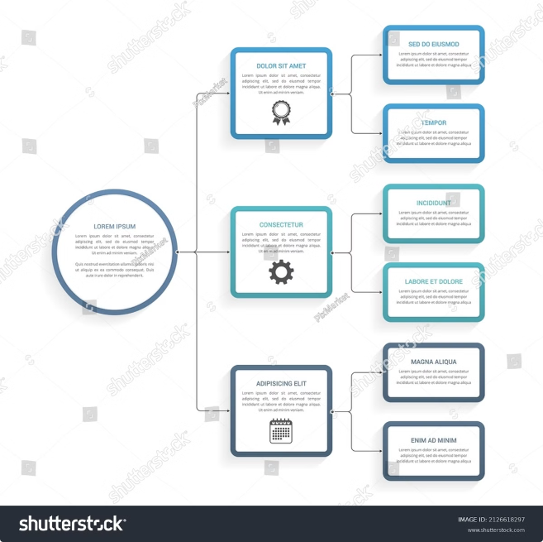
Control Flow Graphs and Program Representation
1
Program Structure
Control flow graphs represent the execution flow of a program, depicting the sequence of instructions and decision points.
2
Nodes and Edges
Nodes represent instructions or basic blocks, while edges indicate the flow of control between them, illustrating possible execution paths.
3
Visual Representation
This graphical representation provides a clear visualization of the program's logic, aiding in understanding its structure and potential optimization opportunities.

Slide 4

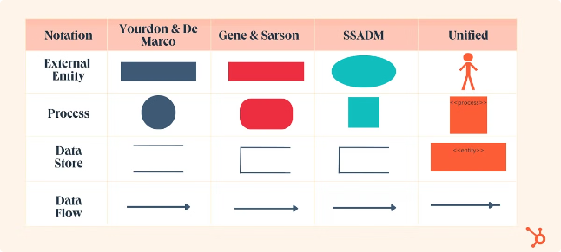
Data Flow Equations and Iterative Algorithms
Data Flow Equations
Iterative Algorithms
Data flow equations mathematically describe the flow of data through the program, capturing the relationships between variables and instructions.
Iterative algorithms solve these equations, repeatedly updating data flow information until a stable state is reached, providing accurate analysis results.
Reaching a Fixed Point
The process continues until no further changes occur, indicating that the analysis has converged, providing a comprehensive understanding of data flow.

Slide 5
Reaching Definitions and Live Variables Analysis
Reaching Definitions
Live Variables
This analysis identifies the set of definitions that might reach a specific point in the program, determining which definitions could potentially influence the value of a variable.
Live variables analysis pinpoints variables that might be used later in the program's execution path, highlighting variables that should not be overwritten prematurely.

Slide 6




Constant Propagation and Constant Folding
Constant Propagation
This technique replaces variable references with their constant values, simplifying the code and reducing redundant calculations.
Constant Folding
Constant folding evaluates expressions involving constants during compilation, eliminating runtime overhead associated with redundant computations.

Slide 7

Dead Code Elimination and Sparse Conditional Constant Propagation
Optimization Technique
Description
Dead Code Elimination
Removes unreachable or unused code sections, streamlining the program and improving its efficiency.
Sparse Conditional Constant Propagation
Propagates constant values through conditional branches, simplifying control flow and potentially eliminating unnecessary branches.

Slide 8





Practical Applications and Optimization Techniques
Performance Enhancements
These techniques significantly improve program performance, reducing execution time, memory usage, and overall resource consumption.
Code Size Reduction
Data flow analysis techniques streamline code by eliminating redundancies and unused components, resulting in smaller and more efficient programs.
Enhanced Security
Optimized code can be more resilient to attacks and exploits, as data flow analysis can uncover potential vulnerabilities and ensure proper data handling.

Slide 9


Conclusion and Future Directions
Data flow analysis plays a pivotal role in compiler optimization, enabling the generation of efficient, robust, and secure code. As technology advances, further research and development in data flow analysis will continue to shape the future of compiler design and software optimization.

