Slide 1
Employee Data Analysis using Excel
STUDENT NAME: P. KAVIYA
REGISTER NO: 312220818
DEPARTMENT: COMMERCE
COLLEGE: GOVERNMENT ARTS AND SCIENCE COLLEGE,SRIPERUMBUDUR, KUNDRATHUR, CHENNAI 600 069.

Slide 2
PROJECT TITLE
Employee Salary Analysis using Excel

Slide 3


AGENDA
Problem Statement
Project Overview
End Users
Our Solution and Proposition
Dataset Description
Modelling Approach
Results and Discussion
Conclusion
3/21/2024 Annual Review

Slide 4

PROBLEM STATEMENT
Analyze the organisation’s salary distribution to identify discrepancies across departments, job levels, and demographics. Benchmarks salaries against industry standards to ensures competitiveness. Align compensation with employee performance while optimizing overall salary costs.

Slide 5

PROJECT OVERVIEW
The employee analysis assesses workforce performance, productivity, and engagement, identifying trends and areas for improvement. It offers insights into employee satisfaction and skill gaps, guiding data-driven HR decisions. The goal is to enhance talent management and overall organizational effectiveness.

Slide 6

WHO ARE THE END USERS?
HR DEPARTMENT – Who ensure equitable compensation
MANAGEMENT & EXECUTIVES – Who make strategic salary decisions
FINANCE DEPARTMENT – Which aligns salary costs with budget goals
DEPARTMENT HEAD – Who analysis to manage team compensation

Slide 7

OUR SOLUTION AND ITS VALUE PROPOSITION
FORMULA FOR ANALYSIS SALARY LEVEL
=IFS(F2>=F9,"VERYHIGH",F2>=F13,"HIGH",F2>=F22,"MED",TRUE,"LOW").

Slide 8
Dataset Description
SIGN UP/LOG IN TO KAGGLE: Access datasets by creating or logging into my Kaggle account.
SEARCH FOR EMPLOYEE DATASETS: Use keywords like “employee dataset” or “HR analytical” to find relevant data.
SELECT AND DOWNLOAD: Choose a dataset that fits my needs and download it to my local machine.
LOAD AND CLEAN DATA: Import the dataset into a tool like Excel , then clean and prepare it for analysis.
ANALYZE: Explore the dataset to generate insights for my salary analysis.

Slide 9
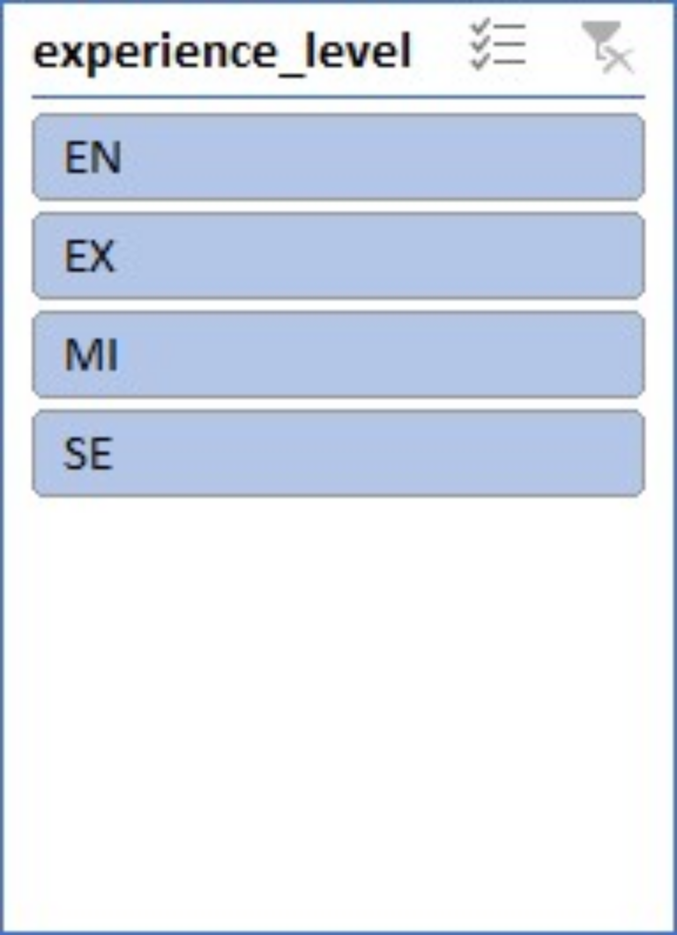

THE "WOW" IN OUR SOLUTION
PREPARE INSERT SLICER FOR EXPERIENCE WISE ANALYSE SALARY
3/21/2024 Annual Review
9

Slide 10
MODELLING
First I log in the Kaggle website form google, then I search employee dataset
Next, I select the employee dataset by my preference and download it.
Next, I go to “this PC” -> downloads -> datasets. Then it is open through excel.
Next, I analyze salary from the dataset.
By using formula for find out the highest and lowest salary in the dataset,
Formula: =IFS(F2>=F9,"VERYHIGH",F2>=F13,"HIGH",F2>=F22,"MED",TRUE,"LOW").
Next, I create a chart for showing the dataset for easily understand.
Then, I go to the pivot table analysis tab->click inserts slicer for extract experiment level salary analysis.
10

Slide 11
RESULTS
MY DATA VISUALIZATION OUTPUT
11

Slide 12
conclusion
The employee salary analysis identified key disparities and areas for improvement in compensation practices. Addressing these issues will ensure fair, competitive salaries aligned with performance, boosting employee satisfaction and retention. Implementing these changes will enhance overall organizational effectiveness.

