Slide 1
Employee Salary Analysis
STUDENT NAME: KAVIYA G
REGISTER NO : 312204581, 4CAE35065F18D4D8F0D4375196896A9F
DEPARTMENT : COMMERCE
COLLEGE : K.C.S KAI NADAR COLLEGE OF ARTS & SCIENCE

Slide 2
PROJECT TITLE
Employee Salary Analysis

Slide 3
AGENDA
Problem Statement
Project Overview
End Users
Our Solution and Proposition
Dataset Description
Modelling Approach
Results and Discussion
Conclusion

Slide 4
PROBLEM STATEMENT
Recommendations will be made to address discrepancies and enhance compensation fairness.
The ultimate aim is to support equitable pay practices and informed decision-making.
Average salary age of employee according to their department gender and role.

Slide 5
PROJECT OVERVIEW
The Employee Salary Analysis project aims to evaluate compensation trends within the organization by examining salary distributions, identifying disparities, and assessing alignment with industry standards.
Tables
Slicer
Pivot chart(line chart, pie chart, Bar chart)
By inserting formula to make interaction dashboard

Slide 6

WHO ARE THE END USERS?
Human Resource department
Finance department
Compensation and Benefits
Operational manager
IT and data Management Team

Slide 7
OUR SOLUTION AND ITS VALUE PROPOSITION
Comprehensive Data Management
Data organization
Data integration
Advanced Analytical Tools
Formulas and Functions
pivotal Tables
Visual Representation
Charts and Graphs
Scenario Analysis
Used to analyze different situation
User-Friendly Interface
Accessibility
Ease of Use

Slide 8
Dataset Description
Data Overview The data for the Employee Salary Analysis includes employee salary records, job titles,
departments, years of experience, performance ratings, and demographic information.
2. Data fields
• Id
• Name
• username
• Age
• Tenure
• Gender
• Region
• Department
• Manager
• Hours
• Salary band
• FTE Salary
• Salary
• Performance

Slide 9
MODELLING
Data cleaning.
table.
Creating pivot chart.
Inserting pivot chart in dashboard.
Inserting formulas in dash board to make interaction.
Creating interactive dashboard by putting all together elements.
9

Slide 10
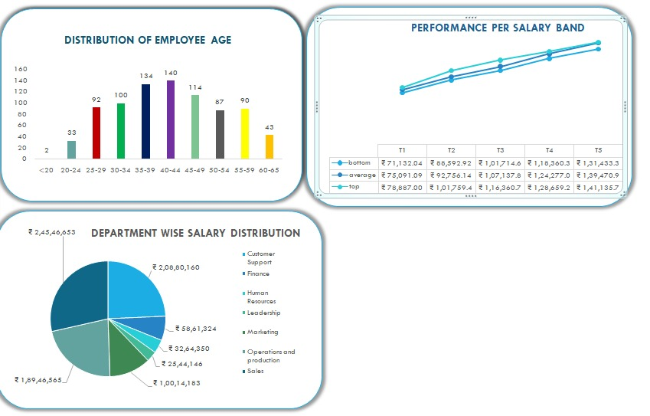
RESULTS
10

Slide 11
conclusion
The salary analysis reveals that compensation levels are competitive with industry standards but show some disparities across departments. To enhance fairness, it is recommended to address these disparities and review salary structures regularly. Further investigation into specific role-based variations will help ensure equitable pay practices.

