Slide 1

Customer retention Prediction
Customer satisfaction has emerged as one of the most important factors that guarantee the success of online store; it has been posited as a key stimulant of purchase, repurchase intentions and customer loyalty. A comprehensive review of the literature, theories and models have been carried out to propose the models for customer activation and customer retention. Five major factors that contributed to the success of an e-commerce store have been identified as: service quality, system quality, information quality, trust and net benefit. The research furthermore investigated the factors that influence the online customers repeat purchase intention
The combination of both utilitarian value and hedonistic values are needed to affect the repeat purchase intention (loyalty) positively. The data is collected from the Indian online shoppers. Results indicate the e-retail success factors, which are very much critical for customer satisfaction

Slide 2
Exploratory data analysis
Exploratory data analysis is statistical approach to analysing dataset to summarize their main characteristics often with visual methods
EDA we can get to know whether the selected features helpful to predict model
After analysis, EDA can be presented by graphs, plots, correlation matrix and distribution

Slide 3
EDA with customer retention data SET
Description of data
Shape: 269 rows and 71 columns
There is no numeric columns do no need of describe()

Slide 4
Handling Missing data
Retention.isnull().sum()!=0
There is no missing data in any columns. We can proceed with next Exploratory Data Analysis step.

Slide 5
Handling Outliers
The outlier removal is crucial part of the EDA.
The dataset is completely has categorical features. There is no need to handle outliers removal and no need to use any imputation techniques.
Ignoring the unwanted columns
Removing spaces and tabs from column names
retention_features.columns.str.rstrip()retention_features.columns = retention_features.columns.str.replace('\t', '')

Slide 6
Segregating the Features
The features type is important to process the each dataset. We need to segregate each type of features for further analysis.
Nominal
Ordinal
Descrete
Continous
numerical_feature=[feature for feature in Retention.columns if Retention[feature].dtypes!='O']
descrete_feature=[feature for feature in numerical_feature if len(Retention[feature].unique())<25]
cont_feature=[feature for feature in numerical_feature if feature not in descrete_feature]
category_feature=[feature for feature in Retention.columns if feature not in numerical_feature]

Slide 7
Target variable
As the analysis for retention of customers, I have understood that how long a single customer is been purchased with one of the online purchasing websites. here I am considering below columns for retention data
From the following, tick any (or all) of the online retailers you have shopped from

Slide 8
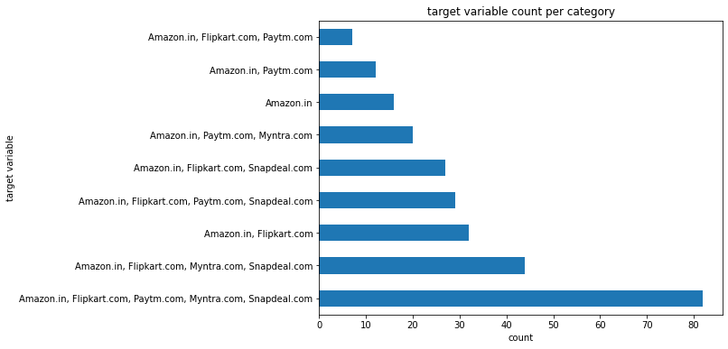
Target variable Category count

