Slide 1
UNIT 4 – SOFTWARE TESTING AND MAINTENANCE
Introduction to Testing, Test Driven Development, Coding Software Testing Fundamentals - Internal and External Views of Testing - Testing Strategies: Unit Testing - Integration Testing –Regression Testing Validation and System Testing, The Art of Debugging. Reengineering process model-Reverse and Forward Engineering

Slide 2
Software testing is a critical element of software quality assurance and represents the ultimate review of specification, design and coding.
The purpose of software testing is to ensure whether the software functions appear to be working according to specifications and performance requirements.
Testing is a process of executing a program with the intend of finding an error.
A good test case is one that has high probability of finding an undiscovered error.
A successful test is one that uncovers an as-yet undiscovered error.

Slide 3
Testing Principles
All tests should be traceable to customer requirements.
Tests should be planned long before testing begins.
The Pareto principle can be applied to software testing 80 % of all errors uncovered during testing will likely be traceable to 20 % of all program modules.
Testing should begin "in the small" and progress toward testing in the large".
Exhaustive testing is not possible.
To be most effective, testing should be conducted by an independent third party.

Slide 4
Internal and External Views of Testing
Two types of testing :
The internal view is also known as white box testing and the external view is also known as black box testing.
Black box testing
The black box testing is used to demonstrate that the software functions are operational. As the name suggests in black box testing it is tested whether the input is accepted properly and output is correctly produced.
The major focus of black box testing is on functions, operations, external interfaces, external data and information.

Slide 5
White box testing
In white box testing the procedural details are closely explained. In this testing the internals of software are tested to make sure that they operate according to specifications and designs. Thus major focus of white box testing is on internal structures, logic paths, control flows, data flows, internal data structures, conditions, loops, etc.
The white box testing is also called as structural testing.
In white box testing derivation of test cases is according to program structure. Hence knowledge of the program is used to identify additional test cases.
Objective of white box testing is to exercise all program statements.

Slide 6
Condition Testing
To test the logical conditions in the program module the condition testing is used. This condition can be a Boolean condition or a relational expression.
Boolean operator is incorrect, missing or extra.
Boolean variable is incorrect.
Boolean parenthesis may be missing, incorrect or extra.
Error in relational operator.
Error in arithmetic expression.
The condition testing focuses on each testing condition in the program.
The branch testing is a condition testing strategy in which for compound condition each and every true or false branches are tested.
The domain testing is a testing strategy in which relational expression can be tested using three or four tests.

Slide 7
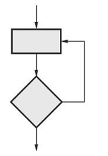
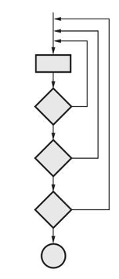
Loop Testing
Loop testing is a white box testing technique which is used to test the loop constructs. Basically there are four types of loops.
Simple loops :
Nested loops

Slide 8
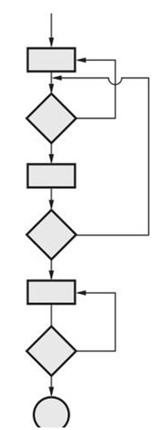
Concatenated loops
Test similar to simple loops.
Unstructured loops
The testing cannot be effectively conducted for unstructured loops. Hence these types of loops needs to be redesigned.

Slide 9
Basis Path Testing
Path testing is a structural testing strategy.
Step 1 : Design the flow graph for the program or a component.
Step 2 : Calculate the cyclomatic complexity.
Step 3 : Select a basis set of path.
Step 4 : Generate test cases for these paths.
Design the flow graph for the program or a component.
Flow graph is a graphical representation of logical control flow of the program.
Graph consists of circle called a flow graph node
Arrow called as edges or links
Graph the areas bounded by nodes and edges are called regions.

Slide 10
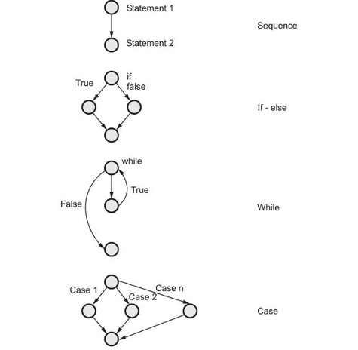

Slide 11
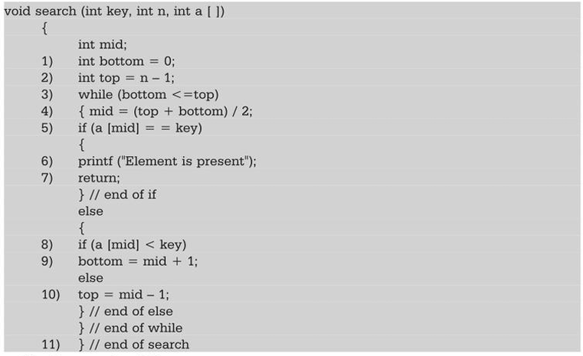
Calculate the cyclomatic complexity.
Cyclomatic complexity = Total number of regions in the flow graph = 4
Cyclomatic complexity= E - N + 2 = 13 edges - 11 nodes + 2
=2+2=4
Cyclomatic complexity = P + 1 = 3 + 1 = 4. There are 3 predicate (decision making)
nodes : Nodes 3, 5 and 8.

Slide 12
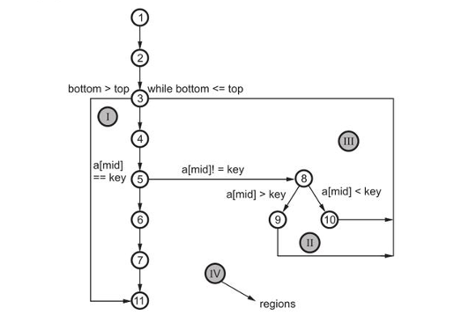
Select a basis set of path
Path 1 : 1, 2, 3, 4, 5, 6, 7, 11….
Path 2 : 1, 2, 3, 11…
Path 3 : 1, 2, 3, 4, 5, 8, 9, 3 ...
Path 4 : 1, 2, 3, 4, 5, 8, 10, 3 ...

Slide 13
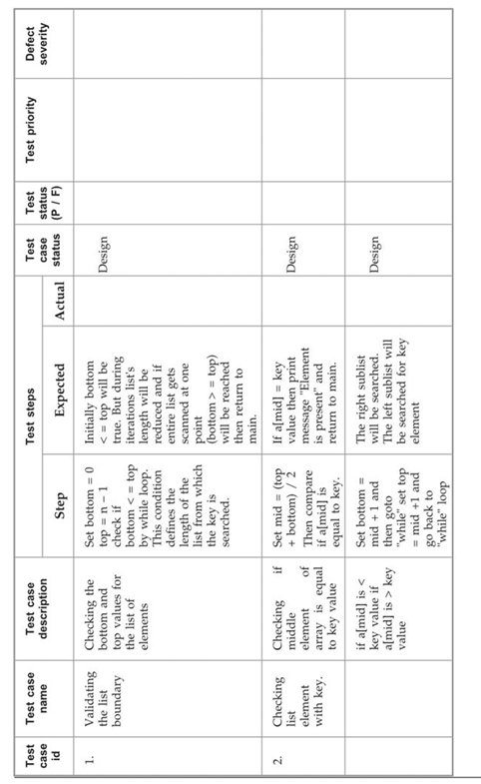
Generate test cases for these paths.
After computing cyclomatic complexity and finding independent basis paths, the test cases has to be executed for these paths.

Slide 14
Problem for White Box Testing
Write a program for sorting of n numbers. Draw the flowchart, flowgraph, find out the cyclomatic complexity.
Given a set of numbers 'n', the function (Prime numbers).

Slide 15
Black Box Testing
The black box testing is also called as behavioural testing.
Black box testing methods focus on the functional requirements of the software. Test sets are derived that fully exercise all functional requirements.
The black box testing is not an alternative to white box testing and it uncovers different class of errors than white box testing.
Incorrect or missing functions
Interface errors
Errors in data structures
Performance errors
Initialization or termination errors

Slide 16
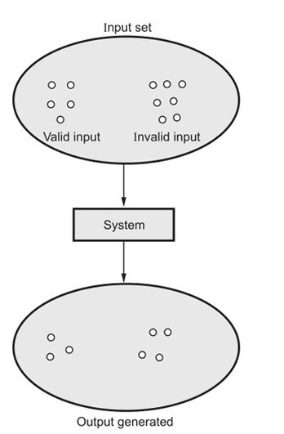
Equivalence Partitioning
It is a black box technique that divides the input domain into classes of data. From this data test cases can be derived.
An ideal test case uncovers a class of errors that might require many arbitrary test cases to be executed before a general error is observed.
In equivalence partitioning the equivalence classes are evaluated for given input condition. Equivalence class represents a set of valid or invalid states for input conditions.

Slide 17
Advantages :
The black box testing focuses on fundamental aspect of system without being concerned for internal logical structure of the software.
Disadvantages :
All the independent paths within a module cannot be tested.
Logical decisions along with their true and false sides cannot be tested.
All the loops and the boundaries of these loops cannot be exercised with black box testing.
Internal data structure cannot be validated.

Slide 18
Boundary Value Analysis (BVA)
Boundary value analysis is done to check boundary conditions.
A boundary value analysis is a testing technique in which the elements at the edge of the domain are selected and tested.
Using boundary value analysis, instead of focusing on input conditions only, the test cases from output domain are also derived.
If the input condition and output conditions specified the range bounded by values x and y, then test cases should be designed with values x and y.
If input condition and output conditions specifies the number of values then the test cases should be designed with minimum and maximum values as well as with the values that are just above and below the maximum and minimum should be tested.
If the internal program data structures specify such boundaries then the test cases must be designed such that the values at the boundaries of data structure can be tested.

Slide 19
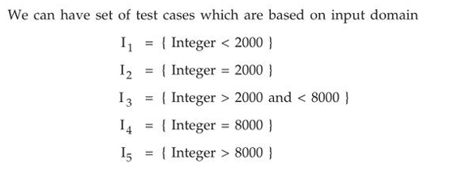
A program specifies state the following for an input field : The program shall accept an input value of 4-digit integer equal or greater than 2000 and less than or equal 8000. Determine the test cases using.
i).Equivalence class partitioning. ii) Boundary value analysis.
Equivalence class partitioning

Slide 20
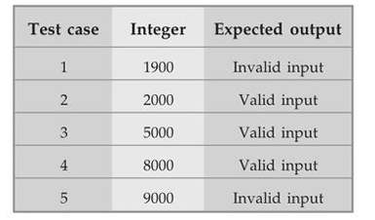
Boundary Value Analysis
The boundary values can be
less than 2000
greater than and / or equal to 2000
less than and / or equal to 8000
Greater than 8000

Slide 21
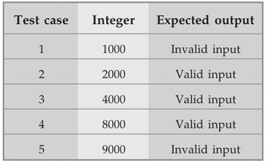
Consider a program for determining the previous date. Its input is n triple of day, month and year with the values in the range 1 month 12, 1 day 31, 1990 year 2014. The possible outputs would be previous date or invalid input date. Design the boundary value test cases.

Slide 22
Testing Strategy
We begin by 'testing-in-the-small' and move toward 'testing-in-the-large'.
Unit testing
Integration testing
Validation testing
System testing
Unit testing - In this type of testing techniques are applied to detect the errors from each software component individually.
Integration testing - It focuses on issues associated with verification and program construction as components begin interacting with one another.
Validation testing - It provides assurance that the software validation criteria (established during requirements analysis) meets all functional, behavioural, and performance requirements.
System testing - In system testing all system elements forming the system is tested as a whole.

Slide 23
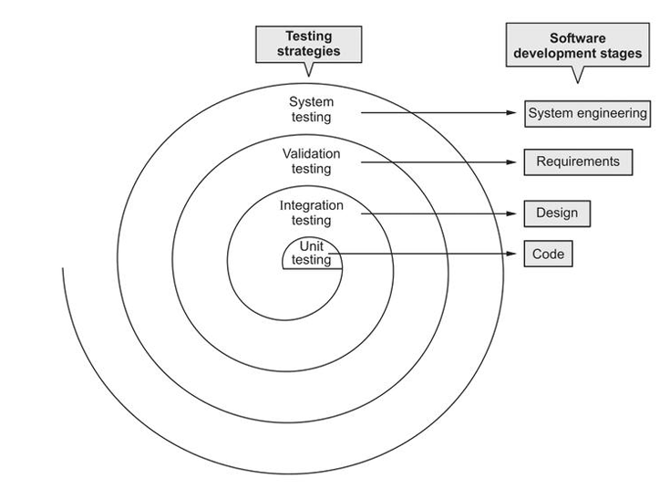

Slide 24
Unit Testing
In unit testing the individual components are tested independently to ensure their quality.
The focus is to uncover the errors in design and implementation.
Tests during the UNIT TESTING
1.Module interface to test flow in & out of prgm.
2.Local data are examined to check intergrity.
3.Boundary conditions are tested to fix limits.
4. Basic path test to ensure modules have executed once.
5.All error handling path should be tested.
6. Drivers and stub software need to be developed to test incomplete software. The "driver" is a program that accepts the test data and prints the relevant results. And the "stub" is a subprogram that uses the module interfaces and performs the minimal data manipulation if required.
7. The unit testing is simplified when a component with high cohesion .

Slide 25
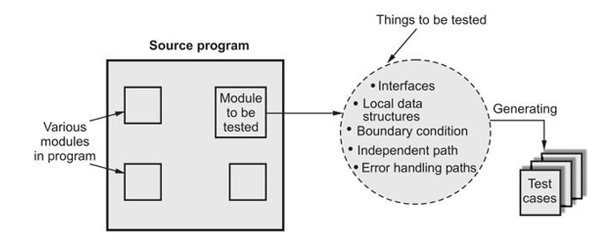
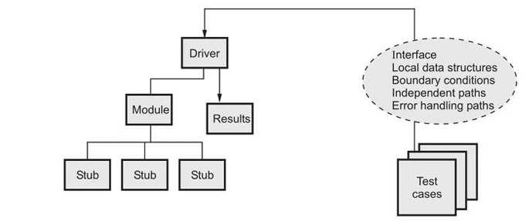

Slide 26
Integration Testing
A group of dependent components are tested together to ensure their quality of their integration unit.
The focus of integration testing is to uncover errors in :
Design and construction of software architecture.
Integrated functions or operations at subsystem level.
Interfaces and interactions between them.
Resource integration and/or environment integration.
The integration testing can be carried out using two approaches.
1.The non-incremental integration
2. Incremental integration

Slide 27
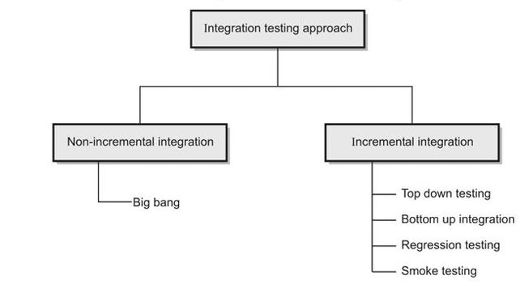
The non-incremental integration is given by the "big bang" approach.
The entire program and set of errors are tested I advance.
Correction is difficult because isolation of causes is complicated by the size of the entire program. Once these errors are corrected new ones appear. This process continues infinitely.

Slide 28
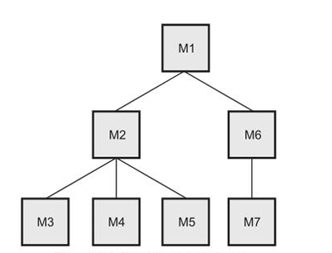
The main control module is used as a test driver and the stubs are substituted for all modules directly subordinate to the main control module.
Subordinate stubs are replaced one at a time with actual modules using either depth first or breadth first method.
Tests are conducted as each module is integrated.
On completion of each set of tests, another stub is replaced with the real module.
Regression testing is conducted to prevent the introduction of new errors.

Slide 29
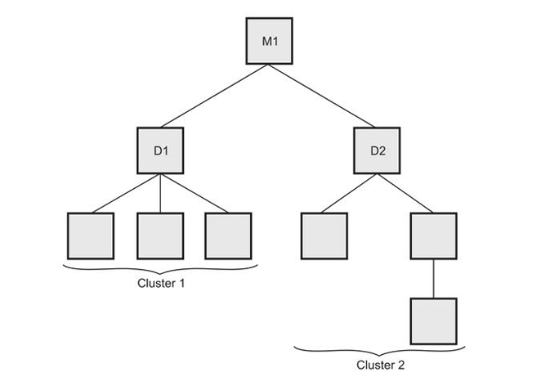
Bottom Up Integration Testing
Low-level inodules are combined into clusters that perform a specific software subfunction.
A driver program is written to co-ordinate test case input and output.
The whole cluster is tested.
Drivers are removed and clusters are combined moving upward in the program structure.

Slide 30
Regression Testing
Regression testing is used to check for defects propagated to other modules by changes made to existing program. Thus regression testing is used to reduce the side effects of the changes.
Representative sample of existing test cases is used to exercise all software functions.
Additional test cases focusing software functions likely to be affected by the change.
Tests cases that focus on the changed software components.
After product had been deployed, regression testing would be necessary because after a change has been made to the product an error that can be discovered and it should be corrected. Similarly for deployed product addition of new feature may be requested and implemented. For that reason regression testing is essential.

Slide 31
The smoke testing is a kind of integration testing technique used for time critical projects wherein the project needs to be assessed on frequent basis.
Software components already translated into code are integrated into a "build". The "build" can be data files, libraries, reusable ,modules or program components.
A series of tests are designed to expose errors from build so that the "build" performs its functioning correctly.
The "build" is integrated with the other builds and the entire product is smoke tested daily.
Smoke testing benefits
Integration risk is minimized.
The quality of the end product is improved.
Error diagnosis and correction are simplified.
Assessment of progress is easy.

Slide 32
Validation Testing
In validation testing the main focus is to uncover errors in
System input/output
System functions and information data
System interfaces with external parts
User interfaces
System behaviour- and performance
Software validation can be performed through a series of black box tests.
Acceptance Testing
The acceptance testing is a kind of testing conducted to ensure that the software
works correctly in the user work environment.
The acceptance testing can be conducted over a period of weeks or months.

Slide 33
Alpha test - The alpha testing is a testing in which the version of complete
software is tested by the customer under the supervision of developer. This testing is performed at developer's site. The software is used in natural setting in presence of developer. This test is conducted in controlled environment.
System Testing
The system test is a series of tests conducted for fully the computer based system. Various types of system tests are
1.Recovery testing
2. Security testing
3.Stress testing
4. Performance testing.

Slide 34
The main focus of such testing is to test
System functions and performance.
System reliability and recoverability (recovery test).
System installation (installation test).
System behaviour in the special conditions (stress test).
System user operations (acceptance test/alpha test).
Hardware and software integration and collaboration.
Integration of external software and the system.

Slide 35
Recovery testing :
Check the system’s ability to recover from failures
Security testing:
Verifies the system protection mechanism
Prevent improper data alteration
Stress testing:
The system is executed in a manner that demands resources in abnormal quantity, frequency or volume.
Performance testing:
Evaluates the run time performance of the software

Slide 36
Debugging
Debugging is a process of removal of a defect.
It occurs as a consequence of successful testing.
Approaches in debugging:
Brute force method
Backtracking method
Cause elimination method

Slide 37
Brute force method:
Memory dumps and run-time traces are examined
Program with write statements is loaded to obtain clues to error causes.
Backtracking method:
Applicable to small programs.
Source code is examined by looking backwards from symptom to potential causes of errors.
Cause elimination method:
This method uses binary partitioning to reduce the number of locations where errors can exist.

Slide 38
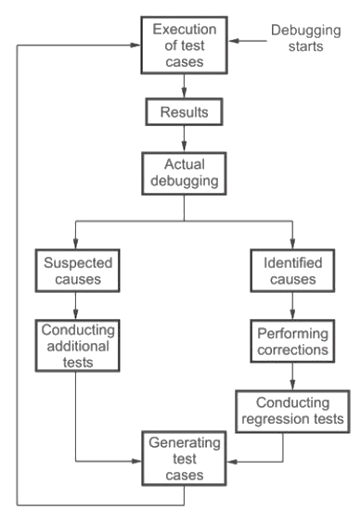
Debugging

Slide 39
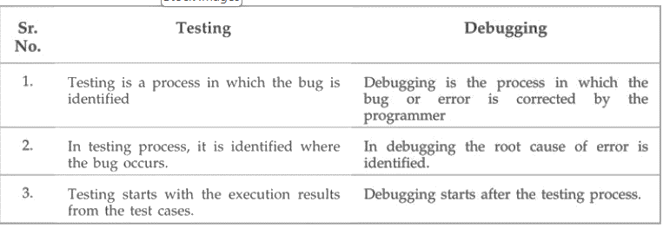
Testing Vs. Debugging

Slide 40
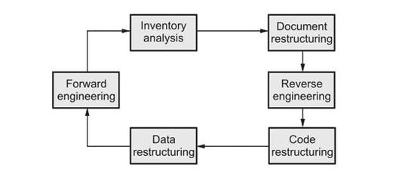
Reengineering Process Model
Software reengineering is a process of modifying the system for maintenance purpose.

Slide 41
Inventory Analysis
The software organization possess the inventory of all the required applications.
This inventory should be revisited periodically.
The resources can be allotted to the candidate applications for reengineering work.
According to the changes in the candidate applications their status need to be updated.
Document Restructuring
Documents are essential part of software project lifecycle. But inadequate or inappropriate approach of documentation leads to docu1nent restructuring activity.
Instead of having time consuming documentation, remain with weak documentation.
Update poor documentation if needed.
For the critical systems, rewrite the documents if needed.

Slide 42
Reverse Engineering
Reverse engineering is the process of design recovery.
In reverse engineering the data, architectural and procedural information is extracted from a source code.
Code Restructuring
This is an activity in which the code is analyzed.
If the programming constructs are violated then that code is restructured.
The code is rewritten in modern programming language.
Data Restructuring :
Data restructuring is large scale reengineering activity.
In this activity, data architecture is dissected and necessary data models are refined.
If data structures are weak then data are reengineered.
The changes in data demand for changes in architecture or code.

Slide 43
Forward Engineering
Forward engineering is a process m which the design information is recovered from the existing software and the overall quality of the code is improved.
Many times new functionalities are added in the existing system to improve overall performance.
Reverse and Forward Engineering
Reverse engineering is the process of design recovery. In reverse engineering the data, architectural and procedural information is extracted from a source code.
Abstraction level
Completeness level
Directionality level

Slide 44
Forward Engineering
Forward engineering is a process that makes use of software engineering principles, concepts and methods to re-create an existing application. This re-developed program extends the capabilities of old programs.
Make lot of modifications to implement the necessary changes.
Understand inner workings of the program in order to make the necessary modifications.
Redesign, recode and test small modules of software that require modifications.
Completely redesign, recode and test the entire program using re-engineering tool.
Difference between Forward and Reverse Engineering
Forward engineering is a process of constructing a system for specific purpose.
Reverse engineering is a process of de-constructing a system in order to extend the functionalities or in order to understand the working of the system.

