Slide 1
E-COMMERCE SALES REPORT
BY: KAVIYA R

Slide 2
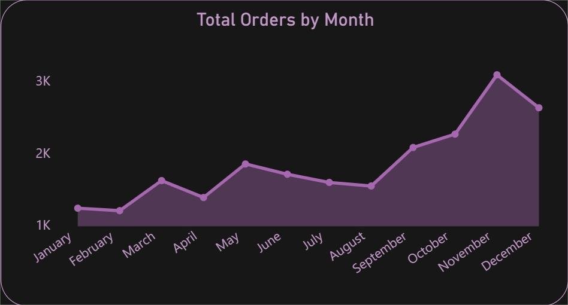
Total Orders by Month
Peak Sales Season: November and December show a significant spike in total orders, indicating strong performance during the holiday season.
Consistent Growth: From September to December, there is a noticeable and consistent increase in order volume.
Low Activity Period: January and February record the lowest number of orders, suggesting a post-holiday slowdown.

Slide 3
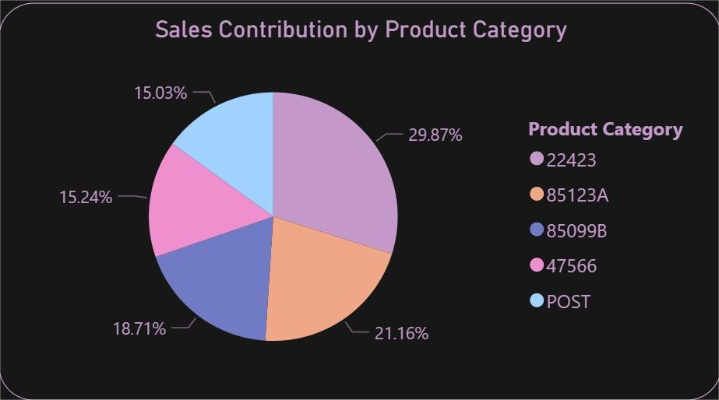

Sales Contribution by Product Category
Top Product Category: Category 22423 contributes the highest to sales with 29.87%, indicating it is the best-selling product line.
Balanced Distribution: The remaining categories are fairly balanced, with contributions ranging from 15.03% to 21.16%.
Diversified Sales: No single category dominates entirely, implying a well-diversified product portfolio.

Slide 4
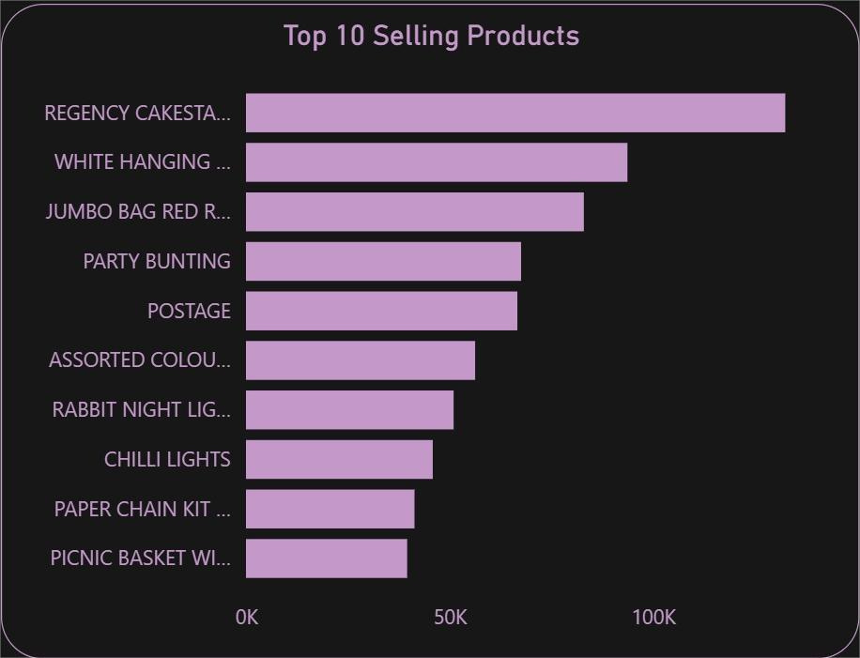
Top 10 Selling Products
Best-Selling Product: "REGENCY CAKESTAND 3-TIER" leads with the highest sales, far ahead of others.
Top 3 Drivers: The top three products (including "WHITE HANGING HEART T-LIGHT HOLDER" and "JUMBO BAG RED RETROSPOT") have significantly higher sales than the rest.
Opportunity to Boost Others: Products ranked 7–10 have lower volumes, indicating potential for marketing or bundling strategies.

Slide 5
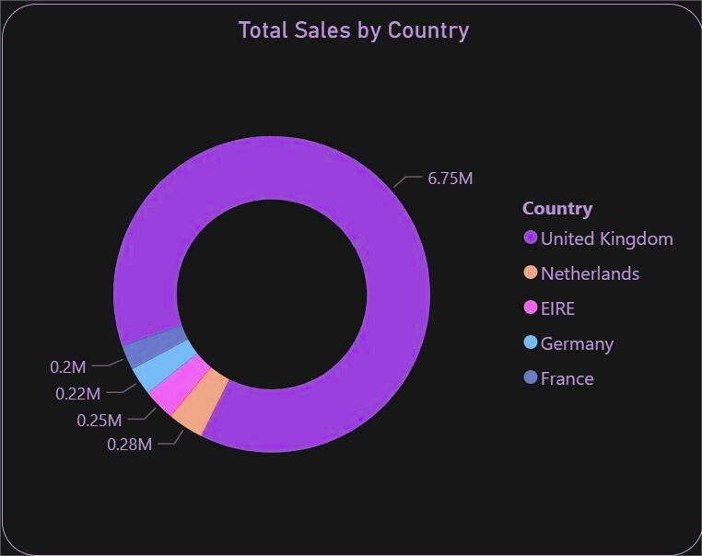
Total Sales by Country
Dominant Market: The United Kingdom is the largest contributor with 6.75M in sales—overwhelmingly higher than other countries.
Top 5 Markets: UK, Netherlands, EIRE, Germany, and France together represent the majority of total sales.
Growth Potential Abroad: Netherlands and EIRE have sales around 0.28M–0.25M, showing room for expansion compared to UK.

Slide 6
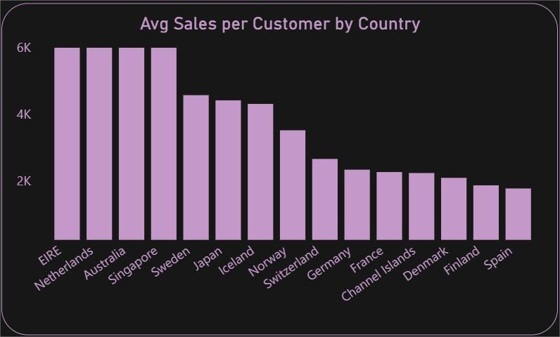
Avg Sales per Customer by Country
Highest Avg Spend: EIRE, Netherlands, and Australia have the highest average sales per customer (close to 6K), suggesting strong customer loyalty or higher order values.
Lower Avg in Key Markets: Despite high total sales, countries like Germany and France have relatively lower average per-customer sales.
Target for Upselling: Countries with low average sales per customer, like Spain and Finland, can be targeted for upselling strategies.

Slide 7
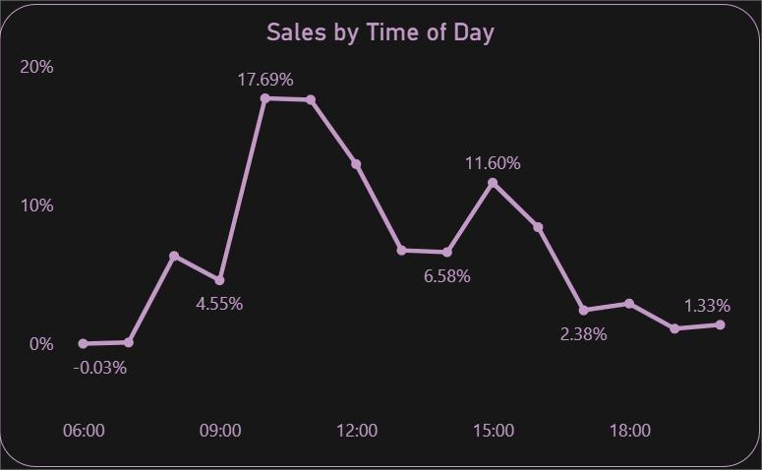
Sales by Time of Day
Peak Time: Sales peak between 10 AM and 12 PM, with the highest at 11 AM (17.69%), suggesting morning is the most active buying period.
Evening Dip: There is a noticeable drop in sales after 4 PM, especially post-6 PM.
Opportunity Window: Boosting campaigns during the 8 AM–12 PM window could maximize conversions.

Slide 8



Total Sales
Total Orders
Total Customers
High Total Sales: The platform has generated 8.28M in total sales, showcasing overall strong performance.
Order Volume: 22K total orders indicate a healthy order frequency from the customer base.
Robust Customer Base: With 4372 customers, the business has a solid base to build repeat business.

Slide 9
Thank You For Your Time and Attention

