Slide 1


The N-Queen Visualizer
A powerful tool for understanding the complexities of the N-Queen problem and the backtracking algorithm used to solve it.

Slide 2

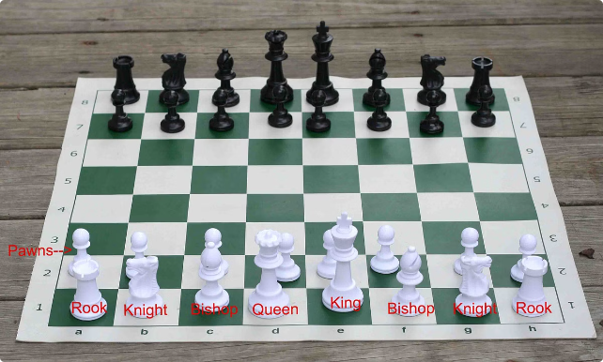
Understanding the N-Queen Problem
1
Placement Challenge
Place N queens on an N x N chessboard without any two queens threatening each other.
2
Complexity
An exponentially difficult combinatorial problem that requires advanced problem-solving skills.
3
Real-World Applications
Applicable to scheduling, resource allocation, and optimization problems in various domains.

Slide 3

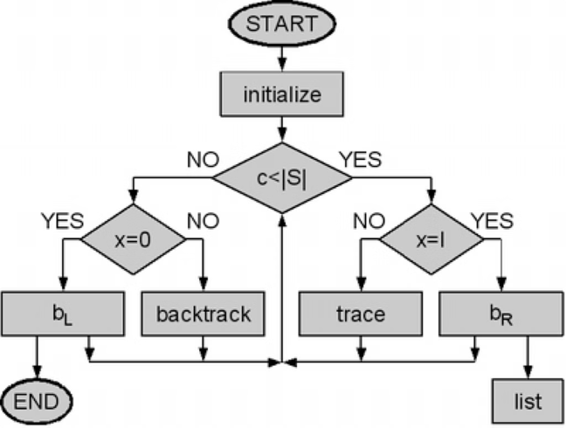
The Backtracking Algorithm
1
Placement
Place a queen in the current row, ensuring no conflicts.
2
Recursion
Recursively place queens in the next row until a solution is found.
3
Backtracking
If a solution cannot be found, backtrack and try a different placement.

Slide 4
Visualizing the Algorithm
Real-Time Feedback
Step-by-Step Tracing
Intuitive Interaction
Highlights conflicts as queens are placed, aiding in understanding the algorithm's decision-making process.
Allows users to observe the backtracking process and see how the solution is constructed.
Enables users to manipulate the board and observe the effects, fostering a deeper understanding.

Slide 5


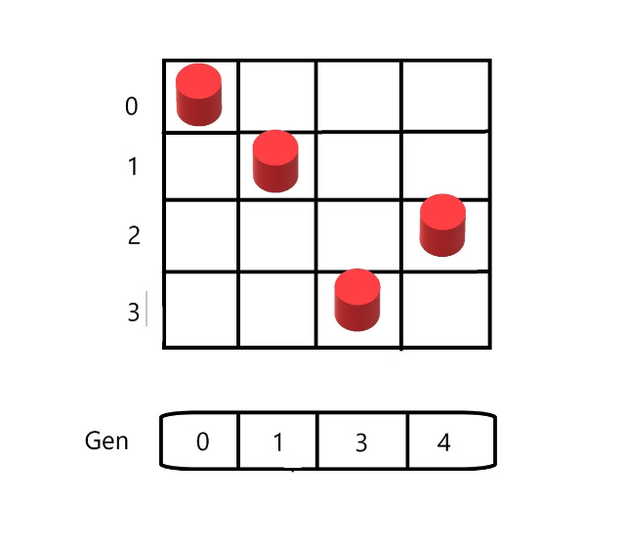


The isSafe Method
Column Check
Ensures no other queen is in the same column.
Diagonal Check
Ensures no other queen is in the same diagonal.
Row Check
Ensures no other queen is in the same row.

Slide 6

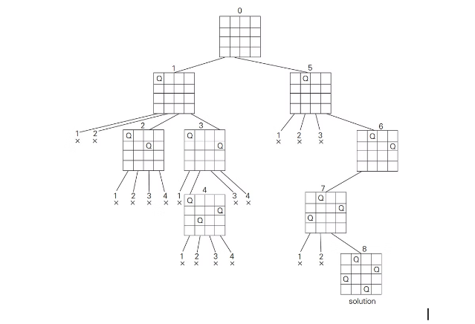
Highlighting Conflicts
Conflicting Cells
Clearly indicate the cells where queens threaten each other.
Backtracking Guidance
Help users understand where the algorithm needs to backtrack to find a solution.
Interactive Learning
Allow users to experiment and visualize the impact of different queen placements.

Slide 7


Educational Impact
Enhances Learning
The visualization helps students grasp the core concepts of the N-Queen problem and backtracking algorithms.
Promotes Engagement
Interacting with the visualization encourages active participation and problem-solving skills.
Supports Research
Researchers can use the tool to explore variations of the N-Queen problem and experiment with different approaches.

