Slide 1
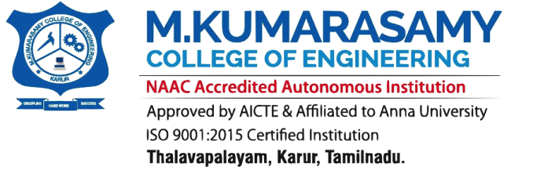

DEPARTMENT OF ELECTRICAL AND ELECTRONICS ENGINEERING
EEB1411 – PROJECT PHASE I
AI-Based Corrosion Risk Assessment and Adaptive Cathodic Protection Control for Underground Pipelines
BATCH NO:7
END SEMESTER REVIEW
PRESENTED BY:
KAVIYA G (927623BEE043)
KESAVAN A (927622BEE044)
SHARVESH S (927623BEE307)
GUIDED BY:
Dr.M.Hariprabhu, M.E.,Ph.D
Assistant Professor /EEE

Slide 2

OVERVIEW OF THE PRESENTATION
Abstract
Introduction
Literature Review
Block Diagram of Existing System
Problem Statement
Objective
Block diagram of Proposed System
Modes of Operation
Proposed System
Working
Circuit Diagram
Simulation Diagram
Result and Discussion
Conclusion
Future Scope
References

Slide 3
SDG MAPPING
SDG Goal |  | Remarks
SDG 9 | Industry, Innovation and Infrastructure | The AI-based corrosion risk assessment system promotes technological innovation by integrating sensors, Artificial Intelligence, IoT, and adaptive cathodic protection for underground pipelines. It supports reliable pipeline infrastructure through continuous monitoring, early identification of high-risk zones, and automated protection-current control.
SDG 11 | Sustainable Cities and Communities | Safe and reliable underground pipelines are essential for sustainable infrastructure. Early corrosion detection, prevention of pipeline leakage, reduced maintenance requirements, and longer pipeline lifespan help protect public safety and support sustainable communities.

Slide 4
SDG MAPPING
SDG Goal |  | Remarks
SDG 12 | Responsible Consumption and Production | The adaptive cathodic protection system promotes efficient energy utilization by adjusting protection current according to assessed corrosion risk and measured feedback. It has the potential to reduce unnecessary energy consumption, optimize resource utilization, and support sustainable pipeline maintenance.
SDG 13 | Climate Action | The AI-based corrosion risk assessment system promotes energy-efficient pipeline protection by integrating Artificial Intelligence, sensors, IoT, and adaptive cathodic protection. It adjusts the protection current according to changing pipeline conditions, helping reduce unnecessary energy consumption and supporting sustainable infrastructure operation. .

Slide 5
PROFESSIONAL BODY STANDARDS
Professional Body Standards Number | Professional Body Standards Name | Remarks
IEEE 1451.0-2024 | IEEE Standard for Smart Transducer Interfaces | Standardized interfacing between smart sensors and the control system. It supports structured sensor data exchange, helping monitor pipeline and environmental parameters for AI-based corrosion risk assessment.
IEEE 802.15.4 | IEEE Standard for Low-Rate Wireless Networks | Low-power wireless communication for sensor networks. It can support communication between distributed pipeline sensor nodes and the central monitoring system, enabling efficient data collection and remote pipeline condition monitoring when compatible communication technology is implemented.

Slide 6
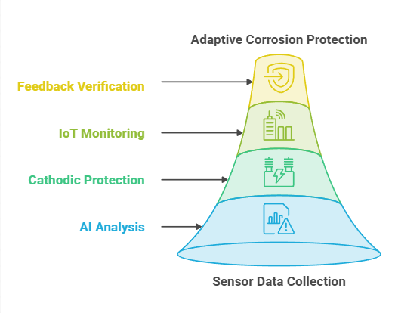
ABSTRACT
Underground pipelines are exposed to corrosion due to environmental conditions, leading to material degradation, leakage, and reduced service life.
The proposed system uses multiple sensors to monitor temperature, pH, soil conductivity, soil moisture, soil resistivity, pipe-to-soil potential, and stray current.
An ESP32 microcontroller collects sensor data and transfers it to an IoT platform for real-time monitoring and visualization.
A PWM-controlled buck-boost converter automatically regulates the protection current based on AI predictions and measured pipe-to-soil potential.
An IoT-based monitoring platform provides real-time pipeline data, risk alerts, and protection status, while closed-loop feedback verifies the protection response.

Slide 7
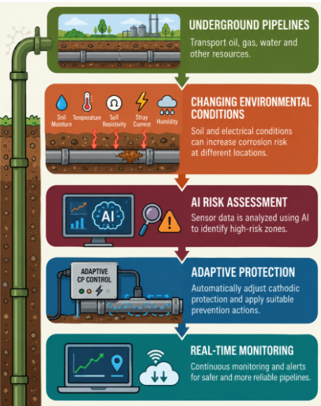
INTRODUCTION
Underground pipelines are essential for transporting oil, gas, water, and other resources, making their safety and reliable operation important.
Continuous exposure to soil moisture, soil resistivity, temperature, stray current, and other environmental conditions can increase corrosion risk at different pipeline locations.
Conventional corrosion protection methods may not continuously identify localized high-risk zones or adapt their protection response according to changing pipeline conditions.
The integration of AI, sensor-based monitoring, and adaptive protection enables intelligent corrosion-risk assessment, critical-zone identification, and timely physical prevention

Slide 8
LITERATURE REVIEW
S.No | Title | Author | Year | Research Gaps
1 | Studying and Realizing the Based-Intelligent IoT System for Pipeline Cathodic Protection | Thanh Bui Dang, Thi-Phuong Nghiem | 2023 | Limited communication coverage and dependence on reliable sensor communication for continuous monitoring.
2 | Prediction of External Corrosion Rate for Buried Oil and Gas Pipelines: A Novel Deep Learning Method with DNN and Attention Mechanism | Yu Guang, Wenhe Wang, Hongwei Song, Hongfu Mi | 2024 | Prediction performance depends on the quality and representativeness of the available corrosion dataset.
3 | Machine Learning-Based Corrosion Rate Prediction of Steel Embedded in Soil | Zheng Dong, Ling Ding, Zhou Meng | 2024 | Laboratory soil conditions may not fully represent changing field conditions in underground pipelines.

Slide 9
LITERATURE REVIEW
S.No | Title | Author | Year | Research Gaps
4 | Improvement of the Reliability of Pipelines Buried in Soil through Real-time Monitoring and Control for Cathodic Protection and Coating Defect Detection | Seung-Heon Choi et al. | 2025 | Field inspection and coating-defect detection may require additional equipment, measurements, and maintenance effort.
5 | Application of Artificial Intelligence for Asset Integrity Management of Offshore Oil and Gas Pipelines | Johnson Foyken Jones et al. | 2025 | AI-based predictions may be less reliable when sufficient, accurate pipeline data is unavailable.
6 | Integrated Corrosion Monitoring Framework for Gathering Pipelines | Xinhong Li et al. | 2026 | The model may not perform equally well under all soil and environmental conditions without further testing.

Slide 10
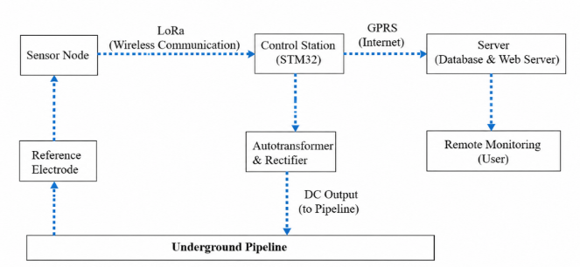
EXISTING SYSTEM BLOCK DIAGRAM
Sensor Monitoring: The reference electrode measures the pipe-to-soil potential, and the sensor node collects the measurement data.
Wireless Communication: LoRa communication transfers the sensor data from the sensor node to the STM32-based control station.
Control and Power Supply: The STM32 control station operates the autotransformer and rectifier to convert AC power into DC protection current for the underground pipeline.
Internet Communication: GPRS transfers the monitoring data from the control station to the server for storage and processing.
Remote Monitoring: The server stores pipeline data and provides access to users through a web server for remote monitoring of cathodic protection performance.

Slide 11
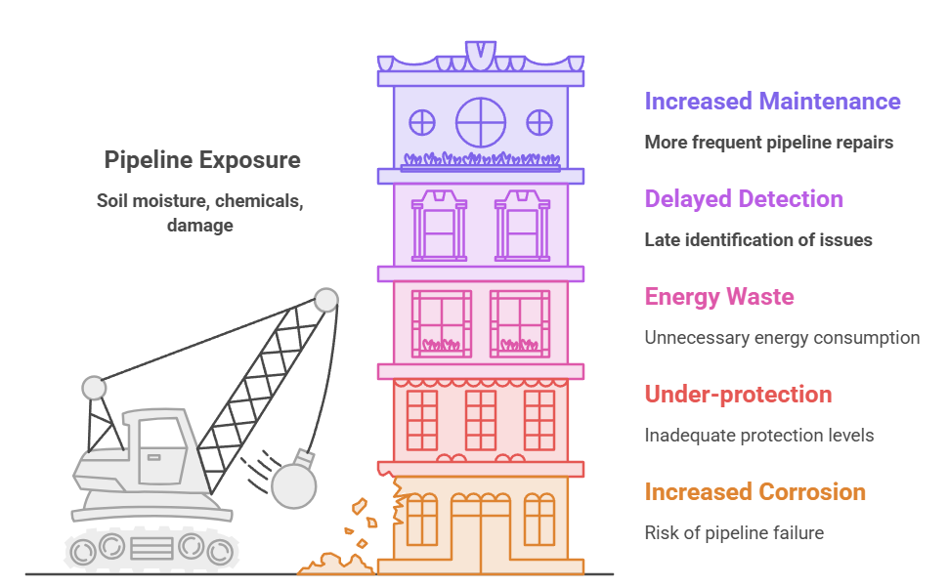
PROBLEM STATEMENT
Underground pipelines used in oil, gas, water, and chemical industries are continuously exposed to changing soil moisture, soil resistivity, temperature variations, and stray electrical currents, which can increase the risk of corrosion. Conventional cathodic protection systems generally rely on fixed or manually adjusted protection settings and periodic inspections, making it difficult to respond effectively to changing pipeline conditions and identify high-risk sections at an early stage. This may result in inadequate protection, unnecessary energy consumption, delayed risk detection, and increased maintenance efforts.

Slide 12
OBJECTIVES
To continuously monitor underground pipeline conditions and environmental factors such as pipe-to-soil potential, soil moisture, soil resistivity, temperature, and stray current that may contribute to corrosion.
To assess corrosion risk at an early stage using AI and identify high-risk pipeline zones, dominant corrosion factors, and severity levels requiring preventive action.
To provide adaptive physical protection by automatically regulating cathodic protection and activating suitable prevention mechanisms according to the detected corrosion condition.
To improve protection efficiency by providing targeted zone-wise protection, controlling excess moisture and stray-current exposure, and reducing unnecessary CP operation and energy consumption.
To enable closed-loop real-time monitoring through IoT, automatic abnormal-condition detection, alerts, and feedback verification to reduce manual inspection and support timely maintenance decisions.

Slide 13
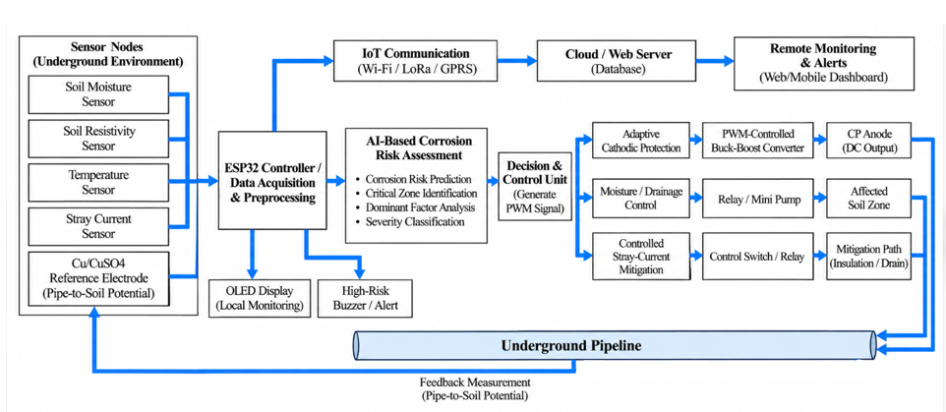
BLOCK DIAGRAM OF PROPOSED SYSTEM

Slide 14
PROPOSED SYSTEM BLOCK DIAGRAM
1. Sensor Monitoring: The system continuously measures pipe-to-soil potential, stray current, soil moisture, and temperature to understand the pipeline and surrounding environmental conditions.
2. AI-Based Risk Assessment: The collected parameters are analyzed using an AI/ML model, which evaluates the pipeline condition and classifies the corrosion risk as Low, Medium, or High.
3. Adaptive CP Control: Based on the identified corrosion risk, the controller determines the appropriate cathodic protection level for the affected pipeline section.
4. CP Output Regulation: The controller generates a PWM signal to the Buck-Boost Converter, which dynamically regulates the CP output according to the required protection level.
5. IoT & Feedback Monitoring: The system sends real-time pipeline status and risk information to an IoT dashboard, while continuous feedback helps verify the protection condition and support further adaptive control.

Slide 15
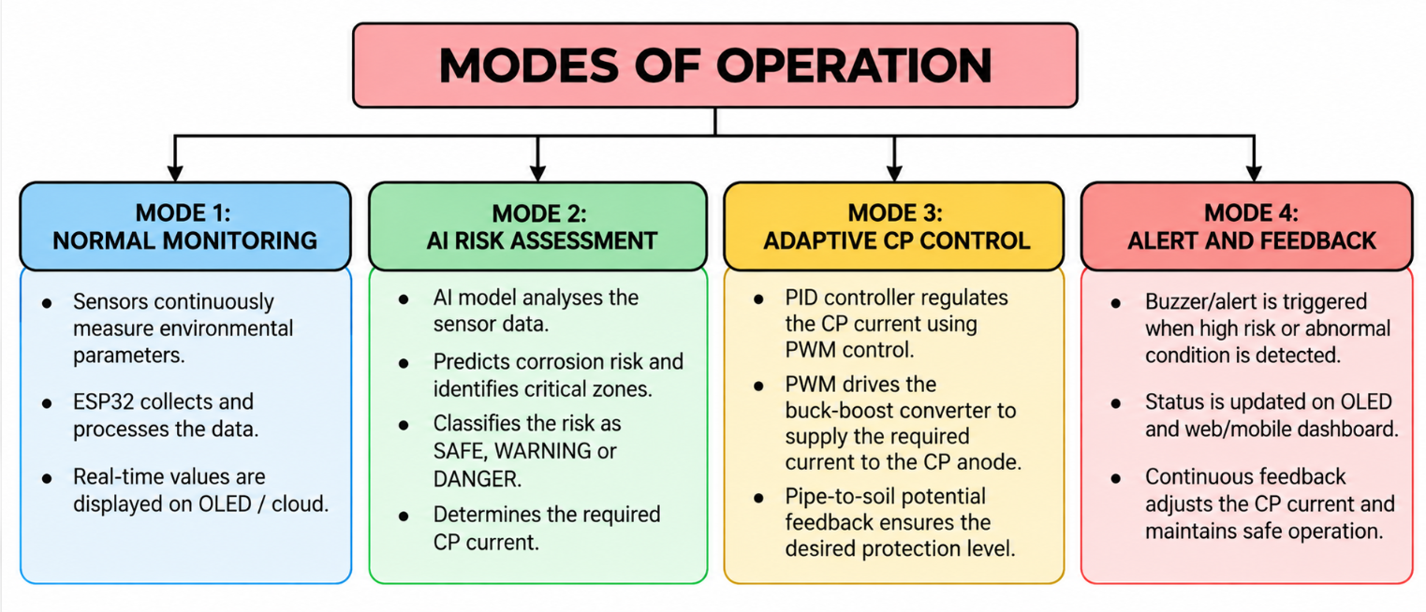
MODES OF OPERATION

Slide 16
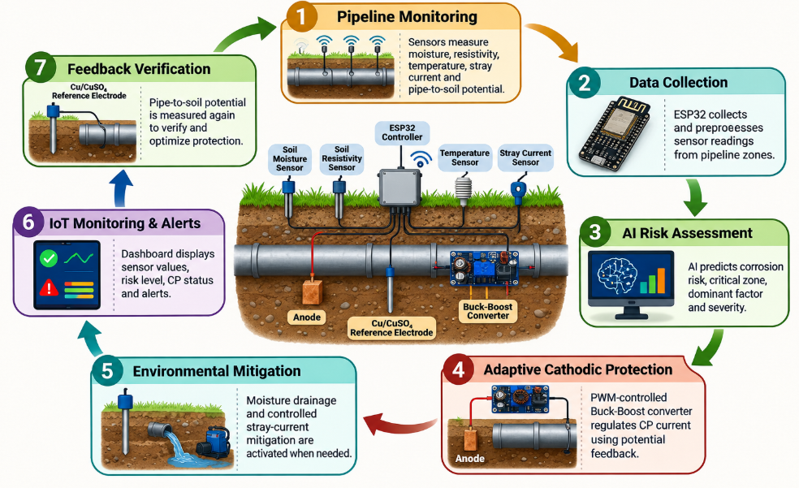
PROPOSED SYSTEM

Slide 17
WORKING
The system consists of soil moisture, soil resistivity, temperature and stray-current sensors, a Cu/CuSO₄ reference electrode, an ESP32 controller, and a PWM-controlled Buck-Boost converter.
The sensors continuously monitor underground pipeline conditions, including soil moisture, soil resistivity, temperature, stray current and pipe-to-soil potential.
The ESP32 collects and preprocesses the sensor data and sends it to the AI-based corrosion risk assessment model for analysis.
The AI model predicts the corrosion risk level, identifies critical zones and dominant corrosion factors, and determines the required cathodic protection (CP) current.

Slide 18
WORKING
Based on the AI-predicted risk and pipe-to-soil potential feedback, the decision and control unit determines the required CP current.
A PID controller generates the control response using PWM, which regulates the Buck-Boost converter to supply the required current to the CP anode.
When abnormal moisture or stray-current conditions are detected, the corresponding auxiliary mitigation mechanism can be activated, if implemented.
The system continuously monitors the protection response and updates the OLED display and IoT dashboard. Alerts are generated for high-risk conditions, and feedback is used to adjust the CP current.

Slide 19
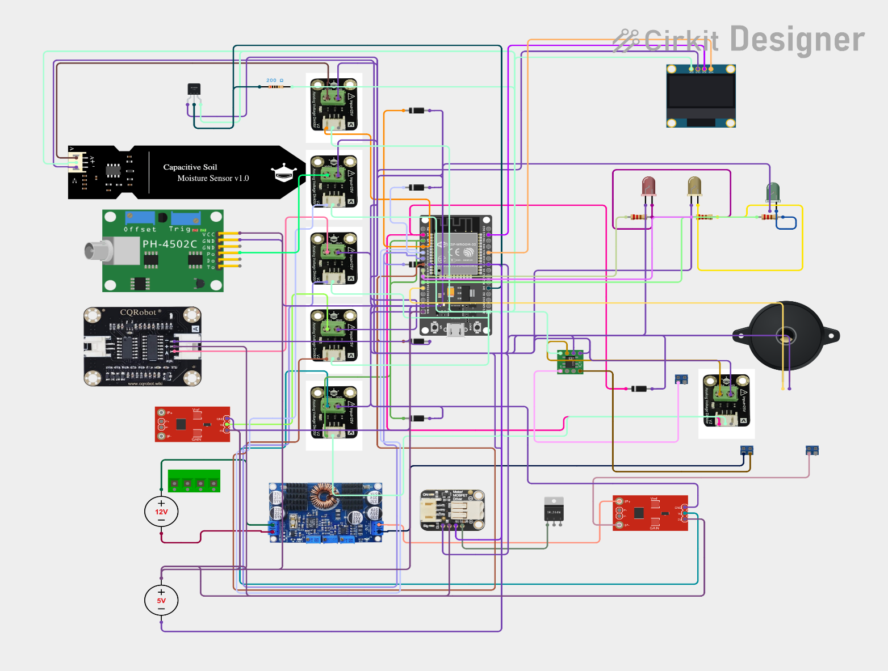
CIRCUIT DIAGRAM

Slide 20
CIRCUIT DIAGRAM EXPLANATION
Sensor Section: Temperature, soil moisture, pH, conductivity, resistivity and stray-current sensors collect environmental and electrical parameters related to pipeline corrosion.
ESP32 Controller: The ESP32 receives sensor data, processes the input parameters and acts as the main controller of the adaptive cathodic protection system.
Power Supply Section: The 12 V DC supply provides input power to the buck-boost converter, which adjusts the DC output required for cathodic protection.
Adaptive Current Control: The AI model predicts the corrosion risk and required protection current. The PWM control circuit regulates the converter output according to the predicted requirement.
Display and Alert Section: The OLED displays sensor readings and corrosion status. Red, yellow and green LEDs indicate high, medium and low corrosion risk, while the buzzer provides abnormal-condition alerts.
Pipeline Protection and Feedback: The reference electrode measures pipe-to-soil potential, and the current sensor monitors the protection current for feedback control.

Slide 21
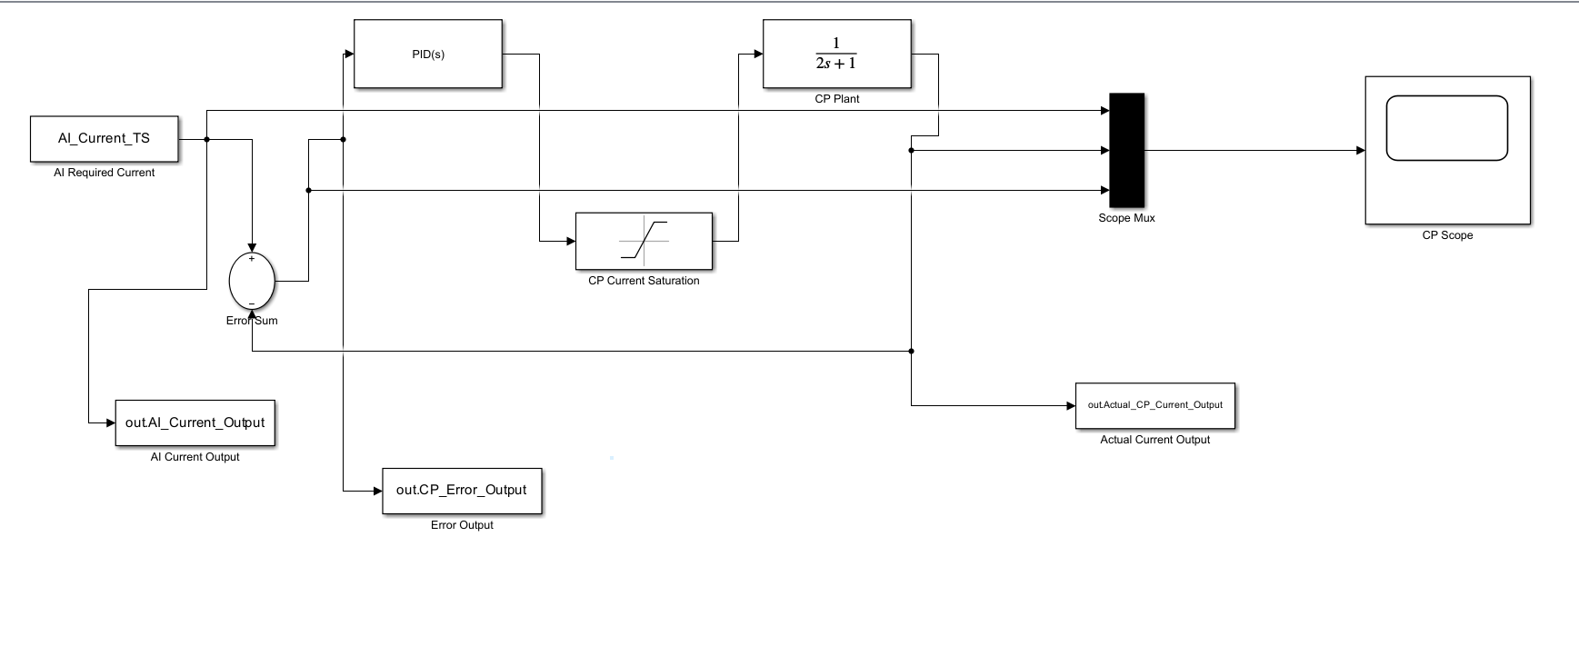
SIMULATION DIAGRAM

Slide 22
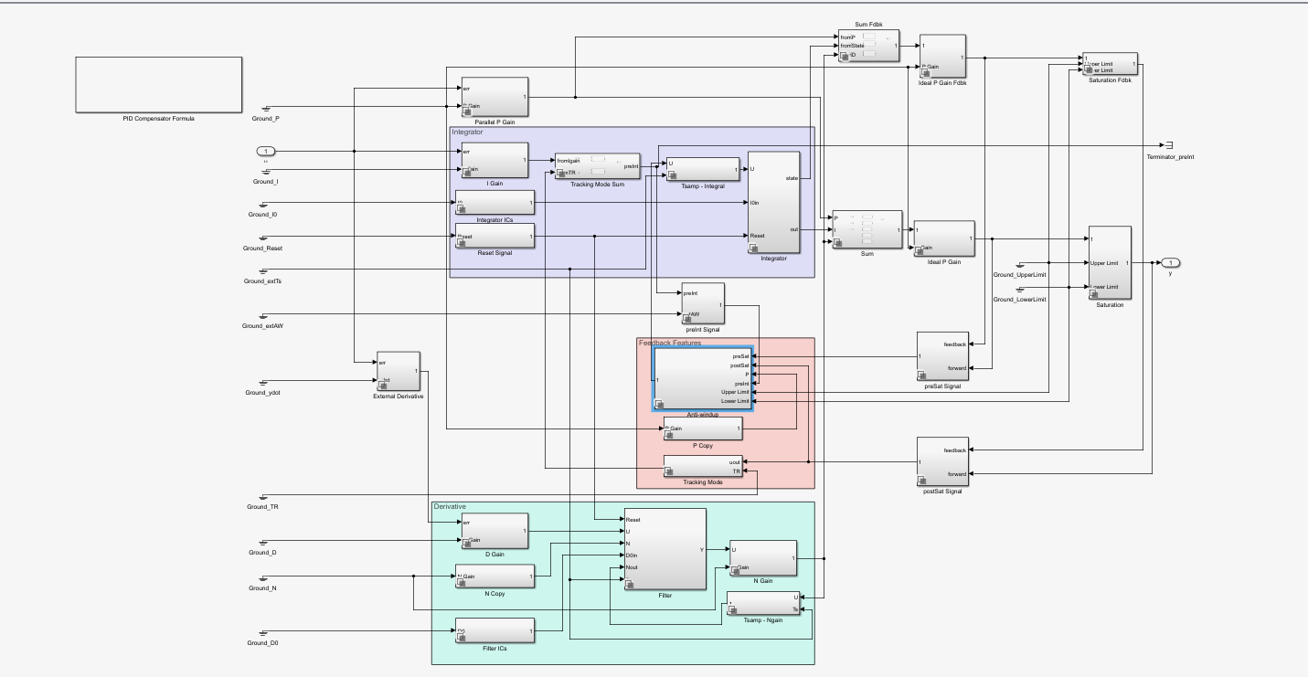
SIMULATION DIAGRAM

Slide 23
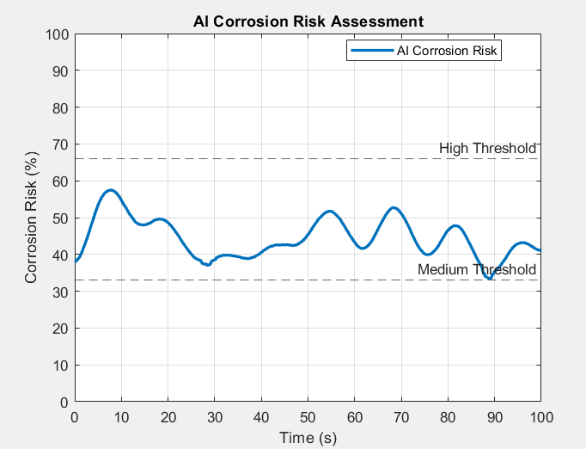
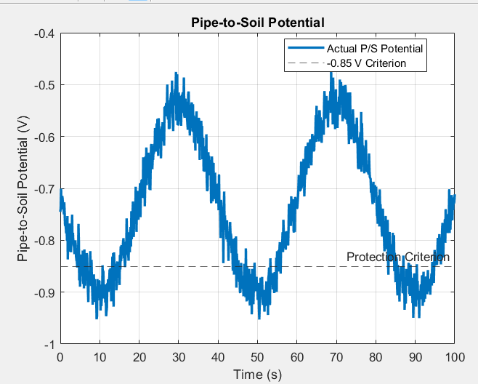
RESULTS AND DISCUSSION
1. AI Corrosion Risk Assessment
2. Pipe-to-Soil Potential Response
The graph shows the variation in corrosion risk percentage over time, helping identify changes in pipeline corrosion risk.
The graph shows the variation in actual pipe-to-soil potential compared with the selected −0.85 V protection criterion.

Slide 24
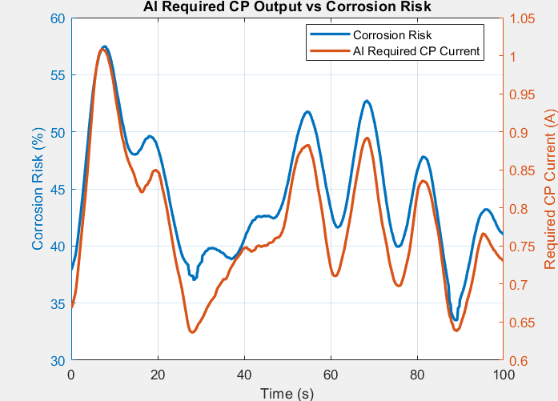
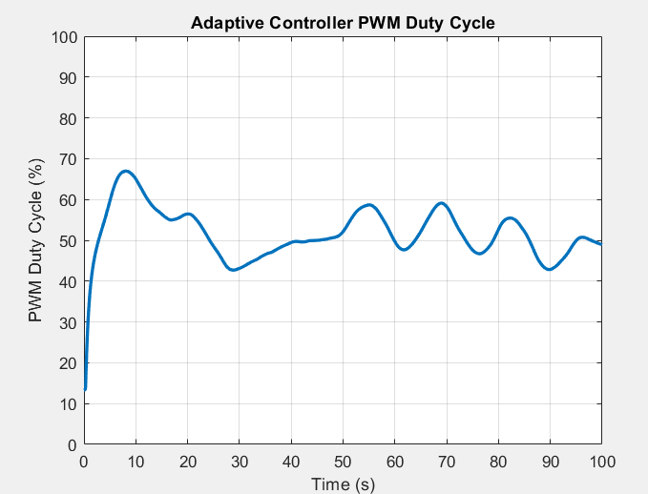
RESULTS AND DISCUSSION
Corrosion Risk and AI-Required CP Current
4. PWM Duty Cycle Response
The graph illustrates how the AI-predicted cathodic protection current requirement varies with the assessed corrosion risk.
The graph shows how the PWM duty cycle varies over time to regulate the cathodic protection power converter.

Slide 25
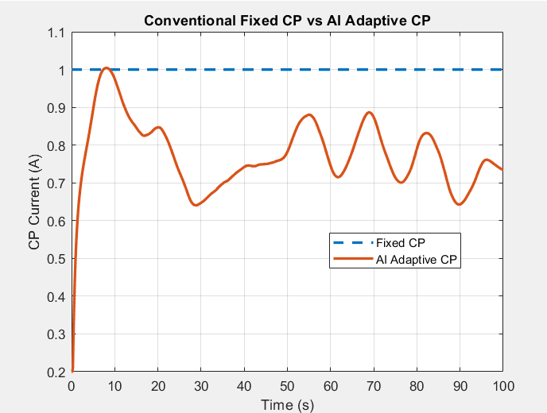
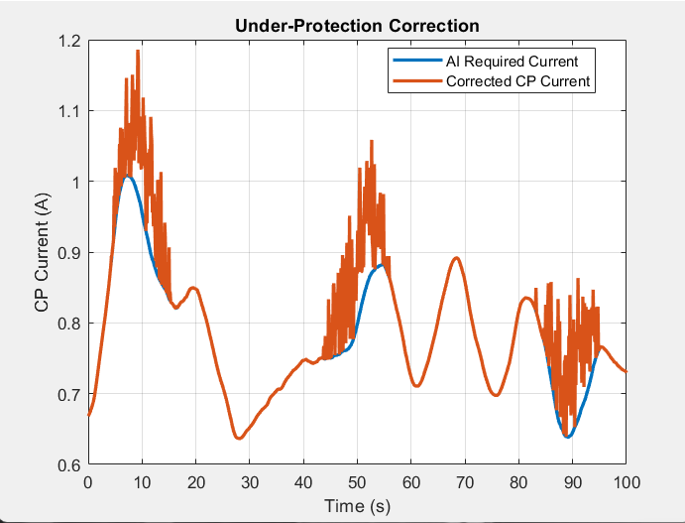
RESULTS AND DISCUSSION
5. Comparative Analysis of Fixed and Adaptive Cathodic Protection Current
6. AI-Based Adaptive Cathodic Protection Current Control
The graph illustrates the difference between constant cathodic protection current and dynamically adjusted adaptive CP current.
The graph compares the AI-predicted required current with the corrected CP current produced by the control system.

Slide 26
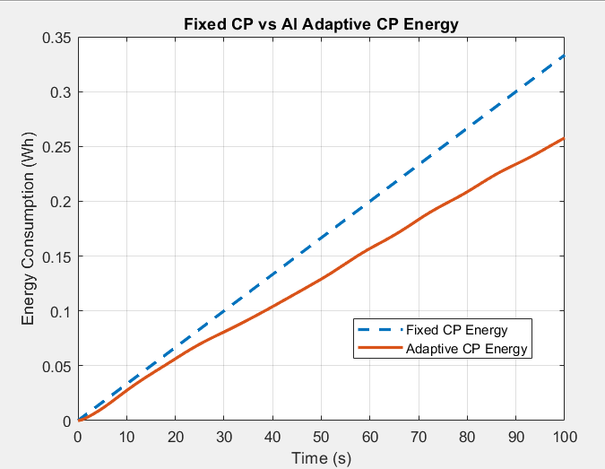
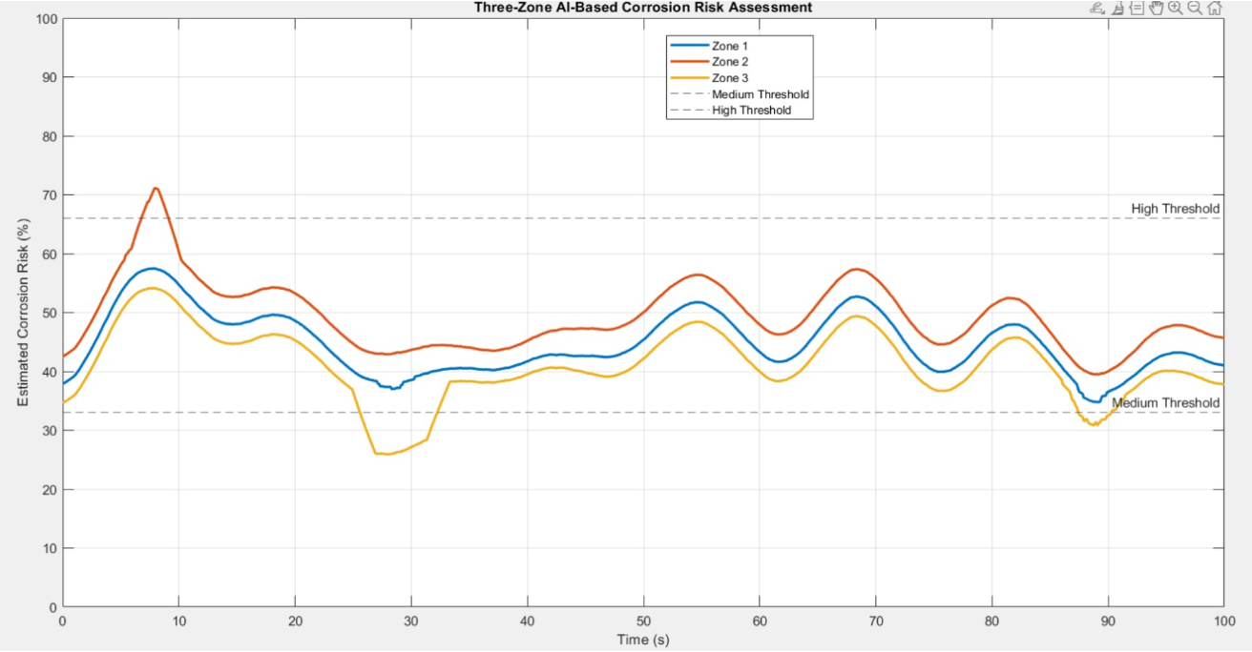
RESULTS AND DISCUSSION
8. Zone-Wise AI-Based Corrosion Risk Assessment
7. Comparative Energy Consumption Analysis
The graph shows the estimated corrosion risk variations across three pipeline zones over time, with Zone 2 exhibiting the highest risk and the dashed lines indicating the medium- and high-risk thresholds.
The graph shows lower simulated energy consumption for adaptive cathodic protection than for fixed-current protection.

Slide 27
CONCLUSION
The proposed AI-based cathodic protection system aims to improve underground pipeline protection under varying soil conditions, with a temperature operating range.
Multiple sensors monitor soil moisture (10–90%), soil resistivity, temperature and pipeline conditions using an ESP32 controller.
The AI model predicts corrosion risk and required CP current, while PWM-based control regulates the converter output.
The system targets a DC–DC conversion efficiency of approximately 85–95%, with the actual efficiency to be verified experimentally.
The adaptive approach aims to reduce unnecessary protection current and improve energy efficiency compared with fixed-output CP systems. Hardware testing and MATLAB/Simulink validation are required to confirm its performance.

Slide 28
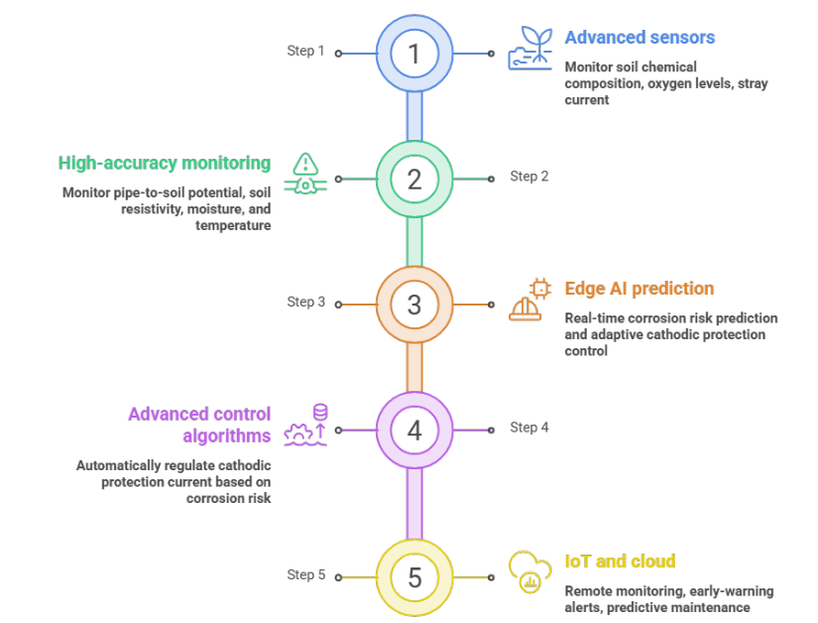
FUTURE SCOPE
Integration of advanced sensors to monitor soil chemical composition, oxygen levels, stray current, and other parameters for improved corrosion risk assessment.
Use of high-accuracy sensors to improve monitoring of pipe-to-soil potential, soil resistivity, moisture, and temperature.
Implementation of edge AI and embedded systems for real-time corrosion risk prediction and adaptive cathodic protection control.
Development of advanced control algorithms to automatically regulate cathodic protection current based on corrosion risk and pipe-to-soil potential feedback.
Integration of IoT and cloud platforms for remote monitoring, early-warning alerts, predictive maintenance, and future hardware testing under real-world conditions.

Slide 29
REFERENCES
1. T. B. Dang and T.-P. Nghiem, “Studying and realizing the based-intelligent IoT system for pipeline cathodic protection,” Smart Systems and Devices, vol. 33, no. 3, pp. 24–32, 2023.
2. I. E. K. Mekki, A. Kessar, and R. Mouaz, “Design of a printed circuit board for real-time monitoring and control of pipeline’s cathodic protection system via IoT and a cloud platform,” International Journal of Engineering, vol. 36, no. 9, pp. 1667–1676, 2023.
3. Y. Guang et al., “Prediction of external corrosion rate for buried oil and gas pipelines: A novel deep learning method with DNN and attention mechanism,” International Journal of Pressure Vessels and Piping, vol. 209, Art. no. 105218, 2024.
4. Z. Dong et al., “Machine learning-based corrosion rate prediction of steel embedded in soil,” Scientific Reports, vol. 14, Art. no. 18194, 2024.

Slide 30
REFERENCES
5. S.-H. Choi et al., “Improvement of the reliability of pipelines buried in soil through real-time monitoring and control for cathodic protection and coating defect detection,” Corrosion Science and Technology, vol. 24, no. 5, pp. 347–359, 2025.
6. J. F. Jones et al., “Application of artificial intelligence for asset integrity management of offshore oil and gas pipelines,” Life Cycle Reliability and Safety Engineering, vol. 14, pp. 503–530, 2025.
7. X. Li et al., “Integrated corrosion monitoring framework for gathering pipelines: Coupling simulation, IoT, and machine learning,” Journal of Loss Prevention in the Process Industries, vol. 100, Art. no. 105896, 2026.
8. A. A. Sani et al., “Data-driven ensemble machine learning for corrosion risk prediction and maintenance optimization in oil and gas pipelines,” Results in Engineering, vol. 30, Art. no. 110288, 2026.

Slide 31
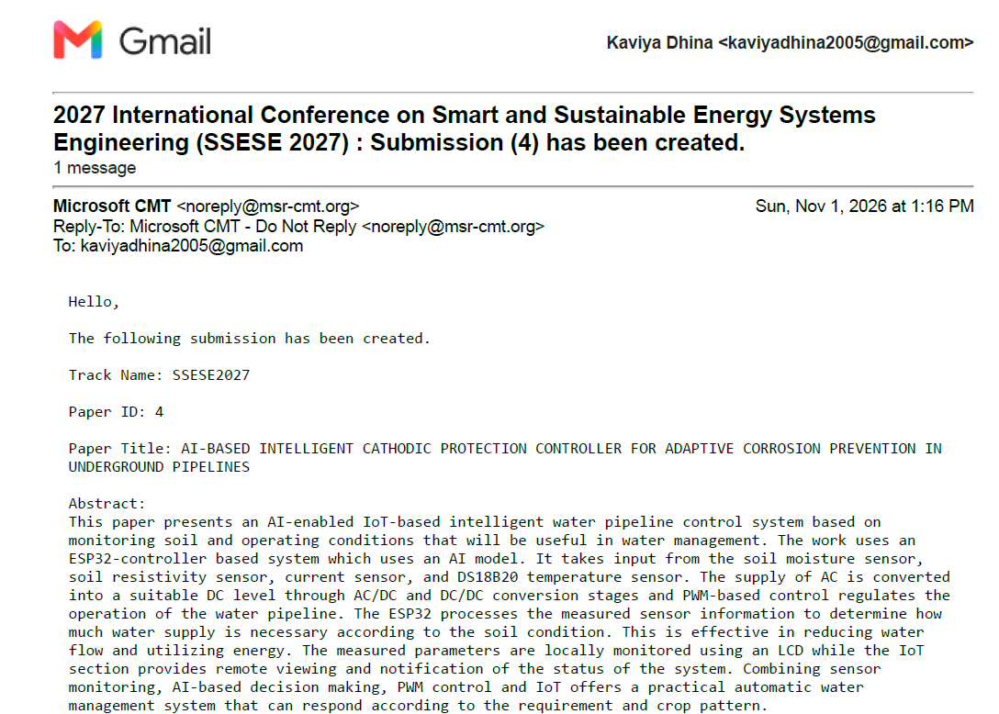
OUTCOME

Slide 32
THANK YOU!!!

