Slide 1
Superstore Sales & Profit Performance Dashboard
Task 4 – Dashboard Design
Interactive Power BI dashboard for monitoring sales, profitability, customer performance, regional performance and trends.
Data Analyst Internship • Task 4

Slide 2
Business Objective & Dataset
Interactive dashboard designed for business performance monitoring.
Objective: Present sales and profitability performance in an easy-to-understand visual format.
Dataset: Sample Superstore sales data.
Key dimensions: Date, Category, Sub-Category, Customer, Region, State and Ship Mode.
Key measures: Sales, Profit, Orders, Profit Margin and YoY Sales Growth.
Tool used: Microsoft Power BI.
Data Analyst Internship • Task 4

Slide 3
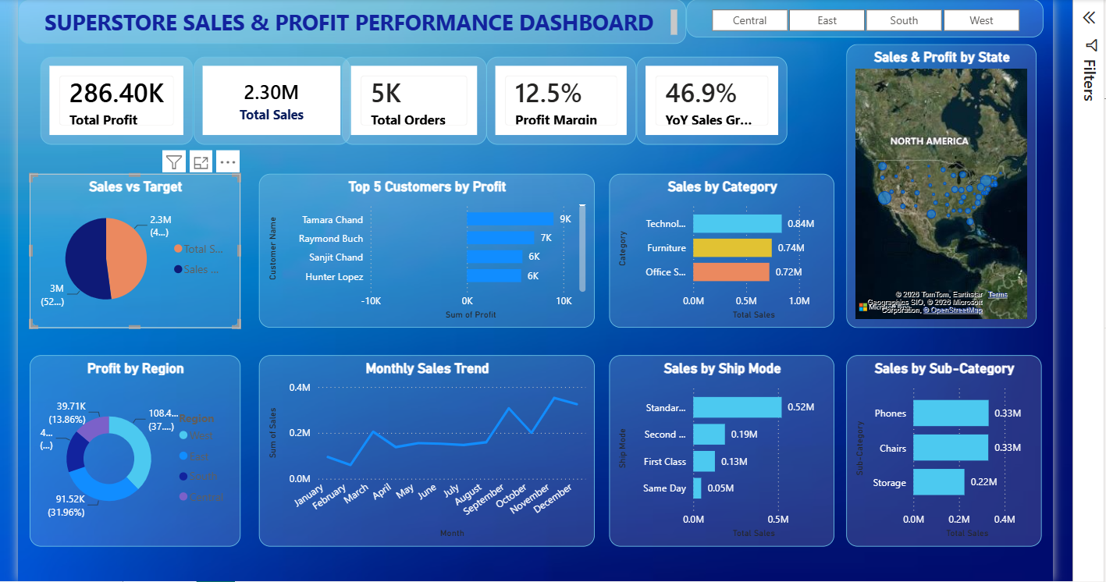
Dashboard Overview
Interactive Power BI dashboard developed for business stakeholders.
Data Analyst Internship • Task 4

Slide 4
Key Business Insights
Insights derived from the KPI cards and dashboard visuals.
Total Sales are approximately 2.30M, with Total Profit of approximately 286.40K.
Profit Margin is approximately 12.5%, so profitability should be monitored alongside sales growth.
YoY Sales Growth is approximately 46.9%, showing strong year-over-year sales improvement.
Technology is the leading category by sales in the dashboard, ahead of Furniture and Office Supplies.
The monthly trend strengthens toward the final months of the year, with a notable peak around November.
Data Analyst Internship • Task 4

Slide 5
Business Recommendations
Potential actions based on the dashboard findings.
Prioritize high-performing categories and products while protecting profitability.
Investigate regions and states with lower profit contribution to identify improvement opportunities.
Review discounting and product-level profitability to avoid sales growth that reduces margins.
Use the monthly trend to improve inventory, sales planning and seasonal resource allocation.
Monitor top customers and strengthen retention efforts for high-value accounts.
Data Analyst Internship • Task 4

Slide 6
Conclusion
The dashboard converts Superstore transaction data into a stakeholder-friendly performance view.
Combines financial KPIs, trends and business dimensions in one interactive view.
Enables filtering by region and comparison across categories, customers and shipping modes.
Highlights sales growth while keeping profitability visible through profit and margin KPIs.
Supports data-driven discussions around sales performance, regional opportunities and customer profitability.
Prepared as part of the Data Analyst Internship – Task 4
Data Analyst Internship • Task 4

