Slide 1
COMPLETE SELF DRIVING CAR
Sneha Jana RA2111026010363
Prithvi Pandaala RA2111026010364
Kaviyashruthi Thamilselvi Senthilvel RA2111026010405

Slide 2
Abstract
In this contemporary era people are continuously trying to save time in their life. People are spending lots of time driving and travelling.
They can save their time by using public transport but not every country has good facilities. So, Self-Driving Cars are a boon for humans in terms of safety and time saving.
People can do work in autonomous vehicles, or they can take a nap which helps to increase working efficiency.
Computer vision and sensor fusion are parts and parcel of the auto driving. Based on the sensors and camera results the car will be moved .It provides the best environment to check all components of a self-driving car.

Slide 3
Existing Study
As of now Volvo and Audi launched their model of cars with autopilot. Waymo One a
self-driving car was launched which was owned by Google once. It was launched as a limited taxi service in Arizona
Most of the models are not fully autonomous since fully autonomous car are not made legal in
US. So as of now, Tesla is yet to release their fully autonomous car which is expected in 2019 or in following years.
But in India there is no development of autonomous car models. Still they have partial features of self-driving like
starting from cruise control, self-parking, automatic emergency brakes, lane change assist

Slide 4
LITERATURE SURVEY
S.N O | TITLE | AUTHOR | METHODOLOGY | TECHNICAL GAP
1. | Self Driving Cars using AI (2016) | Pavan Agrawal | The race to deploy connected cars and autonomous vehicles has continued despite uncertainty surrounding the future regulatory landscape, but Washington appears to be catching up and close to setting the course for future development . | The federal preemption language will help push toward a regulatory regime that avoids a patchwork of state requirements, which could stifle the rollout of more advanced and adequately tested vehicles.
2. | Self Driving Cars be regulated (2016) | Steve Hilfinger | In the ongoing series on autonomous car technology, he’s asked what makes a self- driving car, looked at some autonomous features that already may be in your current set of wheels, considered some of the barriers to self-driving cars and explored the future of vehicle autonomy | the driver keeping an eye on the roada nd other cars and taking over when necessary.
3. | The biggest Obstacles (2017) | David Kantharos ,Todd Rumberoger | Connected cars and autonomous vehicles face different obstacles to growth, partly because the respective technologies are at different stages of development and implementation. Respondents expressed the greatest level of concern with cybersecurity and privacy issues associated with the more mature connectdar technologies. | unlike smartphones and other connected devices, cybersecurity and privacy are a significant concern for connected cars.

Slide 5
S.No | Title | Author | Methodology | Technical Gap
4. | Self Driving Cars using AI (2017) | Sunny Betz | The next 15 years will be very interesting with a mixed field of technologies and approaches offering plenty of opportunities for new players to explore disruptive approaches | Regulatory issues and discussions about liabilities will make the transition to autonomous vehicles much slower than most analysts anticipate.
5. | Self-Driving Car (2018) | TesfamichaelMolla | The algorithm uses haar cascade files to detect objects in a given images. Haar cascade file are digital image features used in object detection. They owe their name to their intuitive similarity with Haar wavelets and were used in the first real time face detector. | Programmed not to drive in unmapped areas or during severe weather. Risk of loss of privacy and security concerns, such as hackers or terrorism; concern about the resulting loss of driving-related jobs in the road transport.
6. | Growth of Self Driving Cars (2018) | Mark Aiello | Developing and fielding autonomous vehicle technology is going to become increasingly dependent on support of the federal government to develop national regulations. | It will be a long time before there will be critical mass of infrastructure capabilities and percentage of capable vehicles to make this a viable solution with broad acceptance.

Slide 6
S.No | Title | Author | Methodology | Technical Gap
7. | Self- Driving Carsusing AI (2019) | Taiwan Chen,Zirui Li, Zemen Xu | In this autonomous system of the “Smart Shark II” which won the Formula student Autonomous china (FSAC) competition in 2018 and presents the self-driving software structure of this racecar which ensure high vehicle speed and safety. In this the technology used is LIDAR based and Vision based cone detection provide a redundant perception it results in accumulated time and space by occupancy grid map | Electronic security has to be hacked
8. | A hierarchical control system for Autonomous Driving toward urban challenge (2020) | Muhammad Sualeh, Gon-wooKim | This paper focuses on how to efficiently solve the hierarchical control system of a self-driving car into practice and proposes the decision and proposes the decision making for motion planning by applying two stage Finite State Machine to manipulate mission planning and control. | Autonomous vehicle cost over $100,000times

Slide 7
S.No | Title | Author | Methodology | Technical Gap
9. | Self-Driving Cars (2021) | Shubhankar Sharma1 , Vatsala Arora | There is plethora of technology implementations being applied. Automation, artificial intelligence, computer architecture and many other technologies are combined with each other to form a fully functional. Here, the Dijkstra algorithm which allows us to find the shortest path to the destination. The car will take the shortest path and avoid collision using the compass- based angle calculation system . | Initiate the camera systems and other sensors such as laser sensors and radar sensors to perceive the surroundings of the car. This will in turn help the system to automatically take decisions to steer, brake and accelerate. Without these the car cannot be automatically drive itself
10. | Unsupervised Driving Situation Detection in Latent Space Autonomous cars (2022) | Hind Taud, Juan Irving Vasquez | A novel approach that uses the “divide and conquer “paradigm, which can detect driving situationsfrom raw data automatically using unsupervised algorithms, helping to avoid the hand engineering made by an expert and creates relatively small and efficient policies without human intervention using behavioral cloning | More infrastructures, With more autonomous vehicles on the road, especially larger trucks, more infrastructure will likely be required It also lost jobs and security.

Slide 8
Proposed System
This project plans to planning to provide a self-driving car with a system that can navigate between two places .
on the map, detect any obstacles, lane detection , accident avoidance and emergency services. And our project’s uniqueness is we are implementing traffic signal responding which is not present in Tesla and other companies car.

Slide 9
Problem Statement
Firstly, we need to understand the problem in efficient way. Self-driving car give benefits for those who cannot drive; perhaps because they are under age, have no driving license, or are not human.
Those who need stuff, but can’t go themselves; Because of health issue ,send the car to pharmacy, pay electronically.
Suppose we have to send gift to my relative then in that case self-driving car will do that work.
Those who had better not drive; my parents are getting up age. I had feel better knowing their car could pilot autonomously.
Those who prefer not to drive; because of rainy season , those who are under time pressure and those who are too lazy to drive the car.

Slide 10
Objective
The purpose of this project is to reduce number of road accidents. Self-driving cars, a future accomplishment of tech industry can also be referred as an autonomous driving vehicle.
A car which is capable of understanding and processing the surrounding environment and capable of moving soundly with small or no human intervention.
This information is used to check for navigation and differentiate between a stationary object and a moving object.
The main purpose of self-driving cars is to remove the need of human intervention with automatic decision-making system fully capable of controlling the car.
Many automobile companies like BMW, Bosch , Tesla, NVIDIA, Qualcomm started investing in Self-driving cars.

Slide 11
System Architecture
This section provides information on communicating with cars electronics and how using that information car .The Robot operating system(ROS) is used to develop the software.
The sensor get the information about the environment and send it to the control module of the frame . The control act as brain of architecture and its responsible for generating the required command.
The car is web based simulation tool running on python ,which communicates with the ROS core using API.
Generic USB cameras has been used to collect images of surrounding at 60 fps, the lightweight and easy for integration.
Navigation system is compact ,single enclosure GNSS+INS receiver capable of delivering up to centimeter level accuracy.
Drive kit sends control commands to vehicle ,read control message from the vehicle OBD-II CAN network and forward report.

Slide 12
Methodologies
The methodology carried out in this model is self-driving car it needs to be able to identify its location. This can be easily solved via car’s own navigation system or a mobile device connected to the system of a car.
GPS help the car to receive the longitude and latitude information of the car via satellite. Self-driving car rely on sensors, actuators, complex algorithms, machine learning systems, and powerful processors to execute software
Autonomous cars create and maintain a map of their surroundings based on a variety of sensors situated in different parts of the vehicle.
Radar sensors monitor the position of nearby vehicles. Video cameras detect traffic lights, read road signs, track other vehicles, and look for pedestrians. Lidar (light detection and ranging) sensors bounce pulses of light off the car’s surroundings to measure distances, detect road edges, and identify lane markings. Ultrasonic sensors in the wheels detect curbs and other vehicles when parking.

Slide 13
Modules
The potential for connected vehicles during the interim , however ,is an exciting ,multi-faceted and high growth area in IoT’s development enabling enhanced road safety.
Smart traffic management , advanced navigation assistance , passenger entertainment and much more , set out the promises vehicles , assesses the technical and commercial challenge they face and considers the road ahead.
It is, of course, not a safe idea to do any of these things if you had to navigate your car through the busy morning commuter traffic. But if our cars could drive us autonomously, we could spend the freed-up time in more pleasant or productive ways.

Slide 14
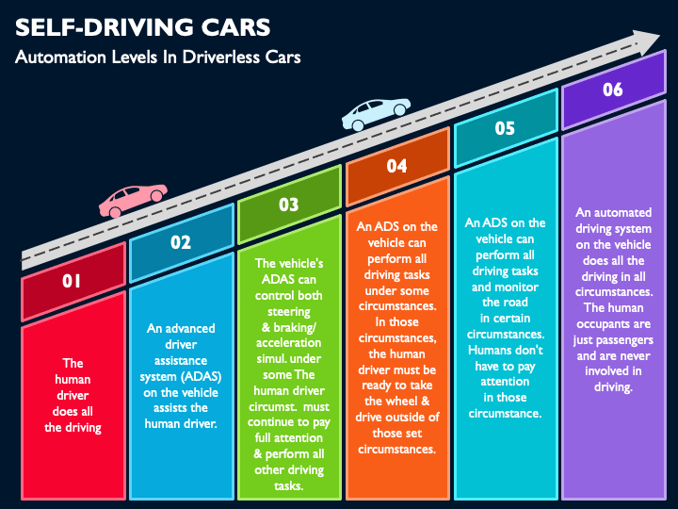
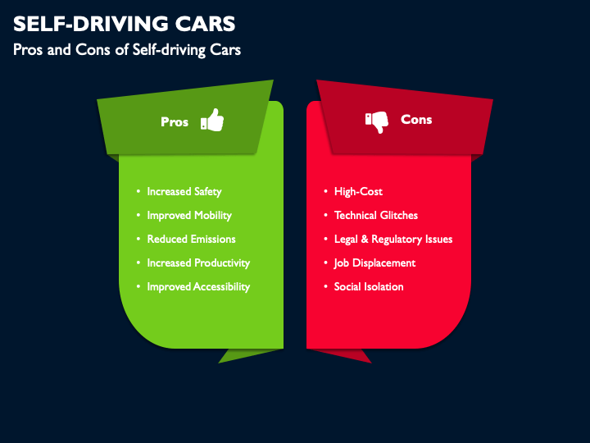

Slide 15
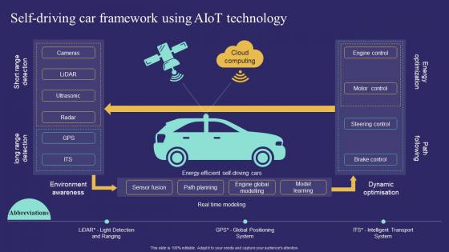
Result
Driverless cars are going to make mobility more accessible for those currently unable to drive. It would allow senior citizens, people with disabilities and potentially even children, greater access to independent commuting. Also, safer road travel, in general, would reduce the chances of injury due to accidents.

Slide 16
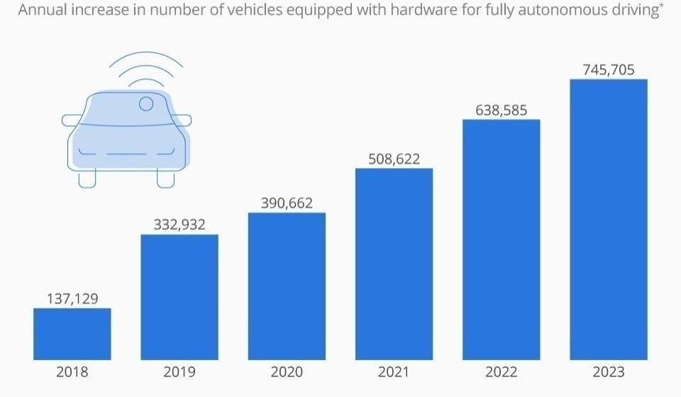
Graph

Slide 17
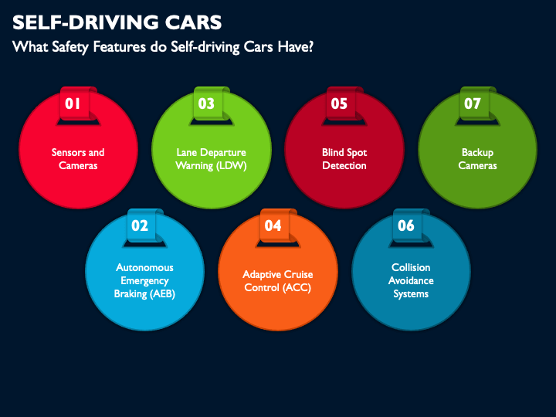
Conclusion
We conclude that by using machine learning techniques validating
the usage of self-driving cars using machine learning with this we
can filter the people as technology expands throughout the world,
self-driving cars will become the future mode of transportation
universally.AI technology is used to power driverless cars by
predicting the car’s surrounding environment for safe navigation.
Technology has been on the rise in the recent past and promises
to a better future transport sector. The major demerit of this is
about the technology is the loss of jobs and skills among many
drivers. However, the technology is yet to be fully implemented
to achieve fully autonomous cars, hence further research.

Slide 18
Future Enhancement
Researchers anticipate that 50 percent of total cars sold in 2030 with be AI driverless, which are fully autonomous. However, research on various aspects of the car has to be considered to achieve this.
With the data gathered through this work we can use this for creating a survey, by analyzing how much percentage of people are read for the self-driving cars in future.
When autonomous vehicles are incorporated into the system, they will run on a network that would enable communication between them and result in a well-coordinated transport system that avoids traffic jams.

Slide 19
References
[1] Batista, K. B. (2018). Self-driven cars, history, and company-driven orthodontists?
[2] Manoharan, S. (2019). An improved safety algorithm for artificial intelligence-enabled processors in self-driving cars.
[3] Simons, R. A., &amp; Malkin, A. A. (2020). The forward- lookings adoption timeline for driverless cars and corporate- owned fleets. Driverless Cars, Urban Parking.
[4] https://www.slideshare.net/ChrisMohritz/machine-learn
[5]https://www.learnpick.in/prime/documents/ppts/details/1112
/Vehicle-automation
[6] http://www.sociotechnic.com/papers/
[7] https://en.wikipedia.org/wiki/Self-driving_car

