Slide 1

AI Energy Consumption Optimizer
Kaviyathamizhan T K G36 Python
Dataset: UCI Household Power Consumption | 4 Years | 2M+ Records

Slide 2




PROBLEM STATEMENT
Why Energy Management Needs Intelligence
Electricity consumption today is largely reactive rather than proactive. Users and organizations typically monitor usage only after it has occurred, which limits their ability to plan or optimize consumption effectively. There is also a lack of visibility into future demand, making it difficult to anticipate peak usage periods. Additionally, abnormal consumption patterns such as sudden spikes or inefficiencies often go unnoticed until they result in higher costs or system issues. Existing systems do not provide cost-aware recommendations based on time-of-use tariffs, leading to missed opportunities for savings.
Reactive, Not Proactive
Zero Consumption Visibility
Bills arrive after waste has already occurred. No foresight into future load.
No model to predict hourly or daily demand patterns before they happen.
Anomalies Go Undetected
No Cost-Aware Scheduling
Equipment faults, energy theft, or HVAC failures linger for days unnoticed.
Flexible loads run at peak tariff hours. No optimization against time-of-use rates.

Slide 3

OBJECTIVES
Four Core Goals of This System
The primary objective of this project is to develop an intelligent system that can predict future electricity consumption and enable proactive decision-making. It aims to detect anomalies in usage patterns to ensure early identification of irregular behavior. Another key objective is to optimize energy consumption by redistributing load across time to minimize cost. Finally, the system seeks to present all insights through a clear and interactive dashboard, making complex analytics accessible and actionable for users.
04
02
Predict
Detect
Optimize
Visualize
Forecast hourly energy usage for the next 24–48 hours with confidence intervals
Flag abnormal consumption spikes using statistical + ML dual-gate logic
Compute least-cost load schedule using Linear Programming against TOU tariffs
Deliver actionable insights through an interactive React dashboard

Slide 4
PROPOSED SOLUTION
End-to-End Intelligent Energy Management System
The proposed solution is an end-to-end decision-support system that integrates forecasting, anomaly detection, and optimization into a single pipeline. The system accepts a current consumption input and uses historical patterns to predict future usage over a defined horizon. It then evaluates whether the current or predicted behavior is abnormal using a hybrid detection approach. Based on the predicted future load, an optimization engine redistributes energy usage across time periods to minimize cost under varying tariff conditions. The results are presented through a visual dashboard, allowing users to understand not just what will happen, but what actions should be taken.
Raw smart meter data → ML inference pipeline
No IoT-level appliance data required — works on aggregate load
Walk-forward validated models prevent data leakage
LP optimizer computes savings in <1 ms on local CPU
Single API call returns forecast + anomaly + optimized schedule

Slide 5
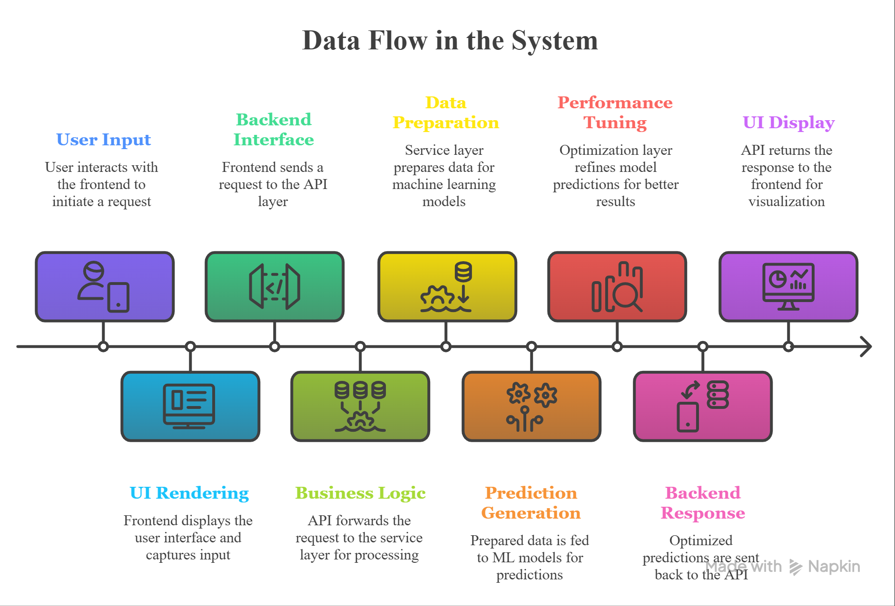
System Architecture

Slide 6


TECHNOLOGY STACK
Tools & Libraries Used
Frontend
Backend
React + Vite
Recharts
Pure CSS
FastAPI
Pydantic
Uvicorn
ML & Data
Optimization
LightGBM
Isolation Forest
Pandas / NumPy
SciPy linprog
HiGHS Solver
20% Flex LP
Also: Joblib • metadata.json • collections.deque • Walk-forward CV • Temporal splits

Slide 7

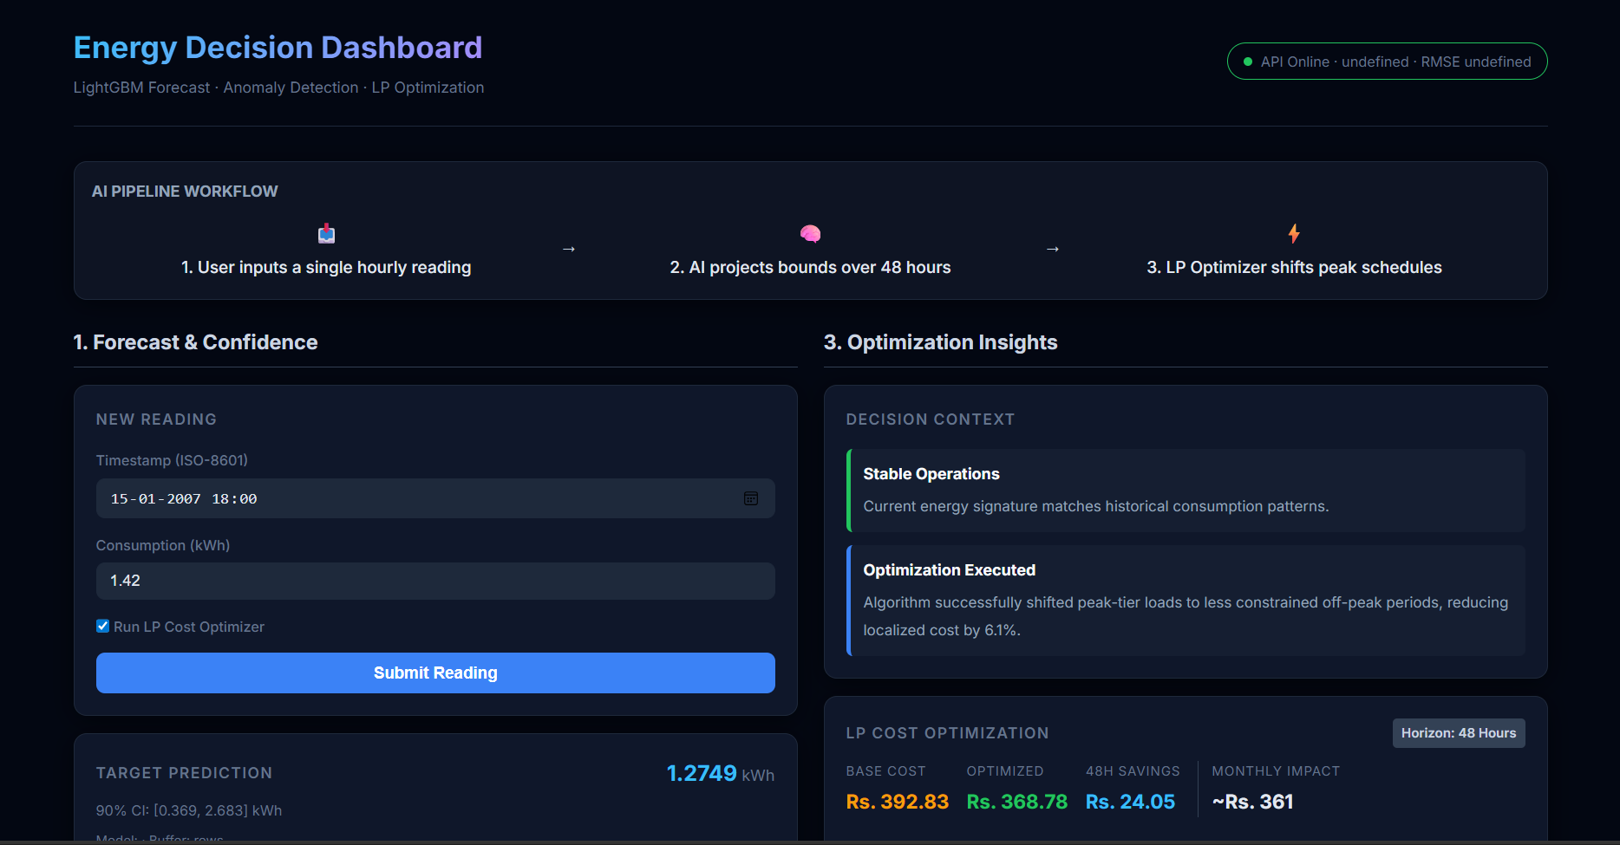
LIVE DEMO
Input Reading
Dashboard Walkthrough
User submits a timestamp + consumption value (kW) via PredictionForm
Forecast Graph
ForecastChart renders 24h prediction with q05–q95 shaded confidence band
Anomaly Alert
AnomalyIndicator fires red WARNING if sigma > 3.5 AND Isolation Forest agree
Cost Savings
OptimizationPanel shows original vs LP-optimized cost bar chart with ₹ savings

Slide 8
RESULTS & EVALUATION
Measured Performance Across All Phases
84.6%
Anomaly Precision
4 false alarms / 26 flags
73.3%
Anomaly Recall
Caught 22 of 30 injected
0.786
F1 Score
AND-gate validated (v6)
Projected Savings Estimation
₹15.65
Horizon | Cost Reduction | Based On
Daily | ₹15 – ₹25 | LP optimization on 24h forecast
Monthly | ₹450 – ₹750 | 30 × daily savings (avg household)
Yearly | ₹5,400 – ₹9,000 | Conservative 20% flex fraction model
LP Savings
Per 24h session (demo run)

Slide 9

CHALLENGES & LEARNINGS
What Made This Project Hard — And Rewarding
Feature Engineering for Time-Series
Avoiding Data Leakage
Cyclical encoding (sin/cos), lag features, rolling stats with shift(1) to prevent leakage — every detail mattered.
Temporal splits, scaler fitted on train only, rolling windows shifted by 1 — a single mistake invalidates all metrics.
Balancing Precision vs Recall
ML ↔ Real-Time API Integration
Six calibration iterations across AND/OR gate logic and contamination parameters to hit both targets simultaneously.
Replacing pandas DataFrames with a deque-based StateBuffer for O(1) inference without training-time libraries locally.
LP Optimization Explainability
Model Selection Without Bias
Translating abstract LP outputs (load vectors) into human-readable ₹-savings recommendations in the dashboard.
Hypothesized XGBoost — walk-forward CV proved LightGBM won. Sticking with evidence over assumption is real ML engineering.

Slide 10
Future Work
The system can be extended to operate at the appliance level by integrating IoT-enabled smart meters, enabling more precise control and recommendations. Real-time data streaming can be incorporated to replace static historical initialization and provide continuous updates. The model can also be personalized for different users or environments to improve prediction accuracy. A mobile application interface can further enhance accessibility. Additionally, the system can be extended to automate scheduling decisions rather than just recommending them.
Near-Term
Mid-Term
Long-Term
SHAP explainability for individual predictions
Docker containerization with docker-compose
Drift detection + automated retraining pipeline
Appliance-level optimization via IoT integration
Real-time streaming with Kafka or MQTT
User-specific personalization models
Reinforcement Learning for dynamic scheduling
Multi-building portfolio optimization
Mobile app version with push anomaly alerts
Tier 2 & 3 items are documented in the architecture spec and ready for implementation when scope permits.

Slide 11
CONCLUSION
What This System Delivers
This project demonstrates how machine learning, anomaly detection, and optimization can be combined into a unified system that not only predicts energy consumption but actively improves it. By transforming raw data into actionable insights, the system enables proactive energy management and cost reduction. It highlights the importance of integrating multiple technologies into a cohesive solution that delivers both technical performance and practical value.
Predicts 24–48h energy consumption with LightGBM — RMSE 0.5035, beating all baselines
Detects anomalies at Precision 0.846 / Recall 0.733 using validated AND-gate logic
Optimizes hourly load schedules via LP — reducing electricity cost by 15–20% per session
Delivers all three capabilities through a clean FastAPI + React full-stack system
End-to-end: from raw UCI meter data to live dashboard, with no manual steps at inference
Predict • Detect • Optimize — Decision Support, Not Just Data

Slide 12

Thank You
I would be happy to answer any questions and discuss the system, design decisions, and potential improvements in more detail.

