Slide 1
UEFA Euro 2024 Data
Probabilistic Machine Learning
By Valentina Gruber
07.07.2025

Slide 2
Research Objective and Hypothesis
Research Objective:
The aim is to identify player types without using the position designation. The grouping is based on player performance data using probabilistic clustering methods.
Hypothesis
There are different types of players that are not exclusively determined by the classic position (e.g. “striker”, “defender”) but can be recognized by game-related metrics.
07.07.2025 UEFA Euro 2024 Data

Slide 3
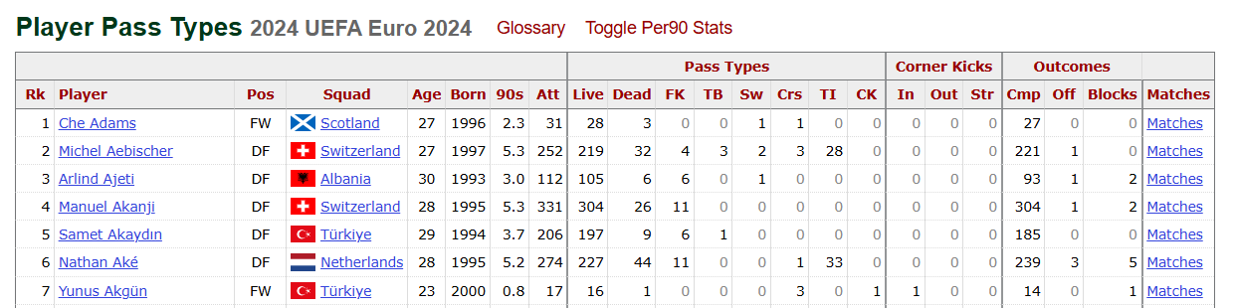
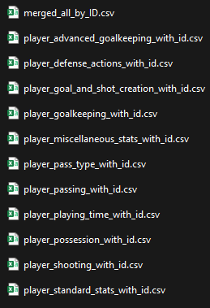
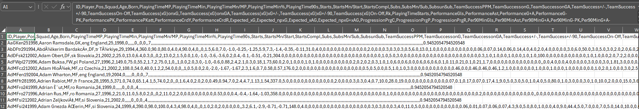
Data
Fbref.com
621 rows, 219 columns
07.07.2025 UEFA Euro 2024 Data
Notes:
Features:
Passes, pass rate
Shots on goal
Duels (Zweikämpfe)
Interceptions
Pressing
Crosses (Flanken)
Dribbles
Ball losses

Slide 4
Explorative Data Analysis
High correlation (e.g. TacklesTkl & Tkl+Int) → which feature is important?
Different scaling
Missing values
High dimensionality: Many columns → difficult to create meaningful visualizations
07.07.2025 UEFA Euro 2024 Data
Notes:
The two features correlate strongly, but I deliberately refrain from reducing them here because both features can be individually important for clustering. Even if I do not use them simultaneously in a model, one of them might fit better in different model variants
Different scaling, some features show total amount, some in relation to 90min, some are in Percentage (Goals & Goals per 90)
Missing values:
goalkeepers have much less info
621 players but some have only played a few minutes and therefore have missing features
On average, a player is missing around a third of all metrics

Slide 5
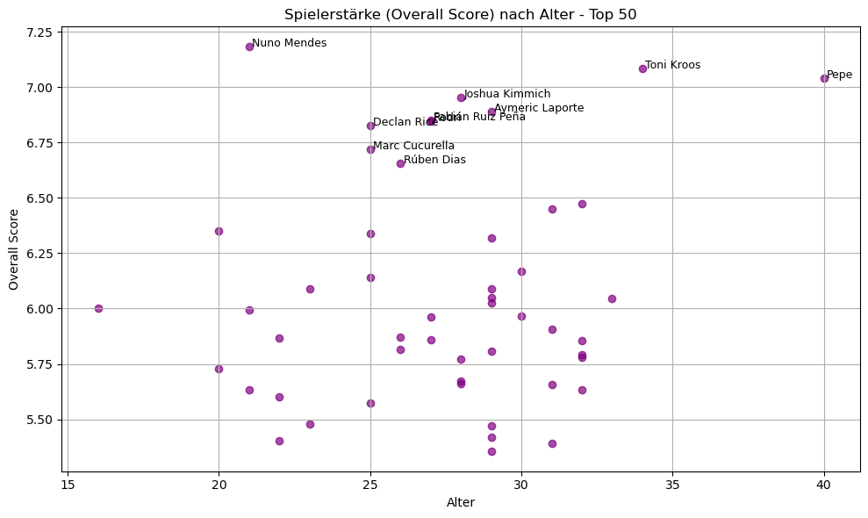
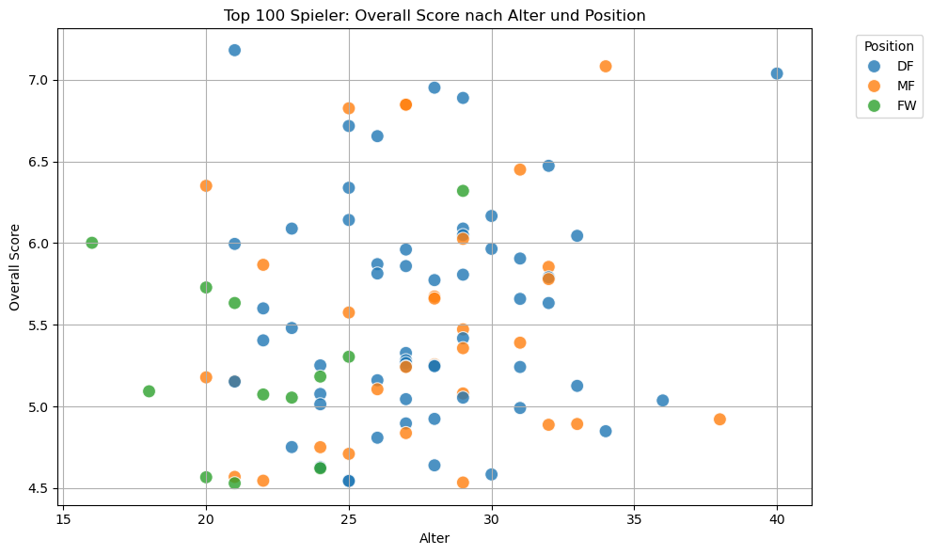
Small Analysis
07.07.2025 UEFA Euro 2024 Data
Notes:
I was looking for the best players and their age
Features: playing time, if they were on the field how did their team perform, touches, goals, carries, tackles, interceptions

Slide 6
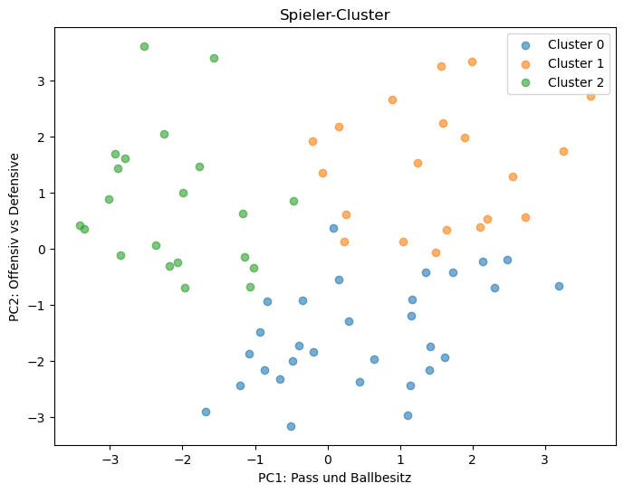
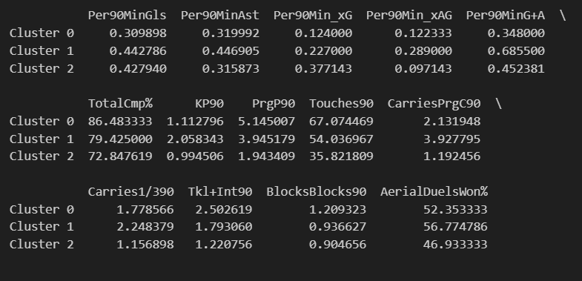
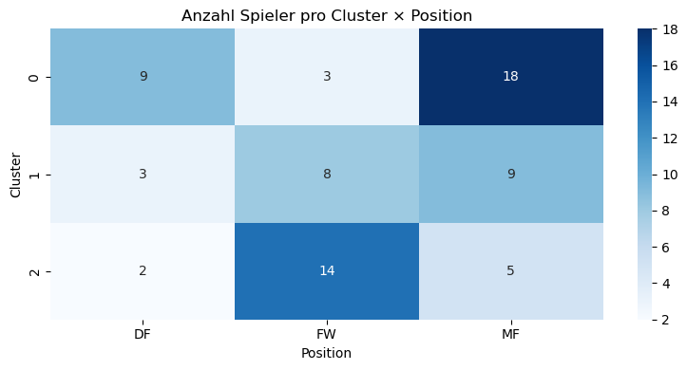
Clustering
07.07.2025 UEFA Euro 2024 Data
Notes:
Features:
Completion & creativity
Passing & build-up play
Ball control & progression
Defensive behavior
Cluster 0:
Highest in: TotalCmp %, Progressive Passes/90, Touches/90, Tackles+Intercept/90
-> high pass performance and ball control, moderate offensive (Goal and Assist)
--> Lower lying playmaker
Cluster 1:
Highest in: Goals+Assists/90, KeyPasses/90, Progressive Carries/90, Aerial Duels %, Blocks/90
-> high G+A and progressive carries, good passing, very good Aerial duels and Blocking
--> Dynamic midfielder, scoring goals and winning balls
Cluster 2:
Highest in: xG/90
-> hight expectation of scoring a Goal, good at scoring Goals (G+A), way less touches and passes, lower amount of defensive Action (Tkl+Int)
--> Striker

Slide 7
Probabilistic Modell Plan
Objective: Identify player types / model probability distributions via playing styles
Why probabilistic?
Quantify uncertainties (e.g. with incomplete data)
Probabilities instead of hard clusters
Feature Selection & Data Handling:
Focus on non-obvious features (e.g., types of tackles, progressive passes…)
Exclude players with excessive missing values or use probabilistic imputation (e.g. based on position group averages)
07.07.2025 UEFA Euro 2024 Data
Notes:
I want to recognize player types, i.e. see which players are similar - for example, whether there are more “defensive full-backs”, “aggressive tacklers” or “strong passing midfielders”.
Why a probabilistic model?
Because I don't want to assign exactly one type to each player - sometimes a player fits several roles at the same time.
Because I work with uncertain or incomplete data - a probabilistic model can handle this better.
Because I want to use probabilities later instead of just hard yes/no assignments.
Problem: Not all players have data in all columns.
Solution: I sort out players who have too many missing values Or: I fill in the gaps, e.g. with the average of all players in the same position

Slide 8
Probabilistic Modell Plan
Model: Gaussian Mixture Model (GMM)
A player can belong to several clusters with different probabilities
Tools: scikit-learn for GMM, or PyMC for fully Bayesian GMMs
Steps:
Choose number of clusters K (using BIC, Silhouette, or ELBO)
Fit the model, analyze soft assignments
Use posterior probabilities to understand overlaps and uncertainty
07.07.2025 UEFA Euro 2024 Data
Notes:
GMM:
I use GMM because it allows me to assign players to soft clusters - not just a hard type, but with probabilities.
I use scikit-learn for the implementation because it's quick and easy. If I want to investigate the uncertainties in more detail later, I can switch to PyMC and build a fully Bayesian model
Steps: 1. I decide how many clusters I want (e.g. 3, 5 or 8)
→ this can be checked with certain key figures (e.g. BIC, Silhouette Score)
2. I train the model with my data
3. For each player I get:
A probability distribution over the clusters
For example, “Player X belongs 80% to cluster 2, 20% to cluster 4”

Slide 9
Probabilistic Modell Plan
Evaluation & Visualization:
Visualize player cluster probabilities (e.g., Player A: 60% Cluster 1, 30% Cluster 2, etc.)
Use PCA or UMAP for 2D projection of clusters
Analyze results by position, team, or role
07.07.2025 UEFA Euro 2024 Data
Notes:
What do I then do with the result?
- I visualize the players and their clusters, e.g. with:
- PCA or UMAP (so that I can create a 2D image from many features)
- Colors or pie charts per player → to show probabilities
I check whether the clusters make sense for the game (e.g. whether a cluster contains mainly aggressive midfielders)
I check whether the result is robust, i.e. does not change completely if I remove individual players

