Slide 1
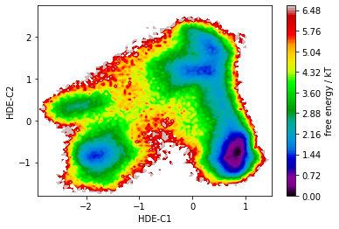
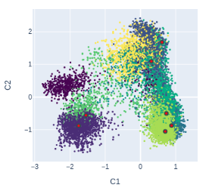
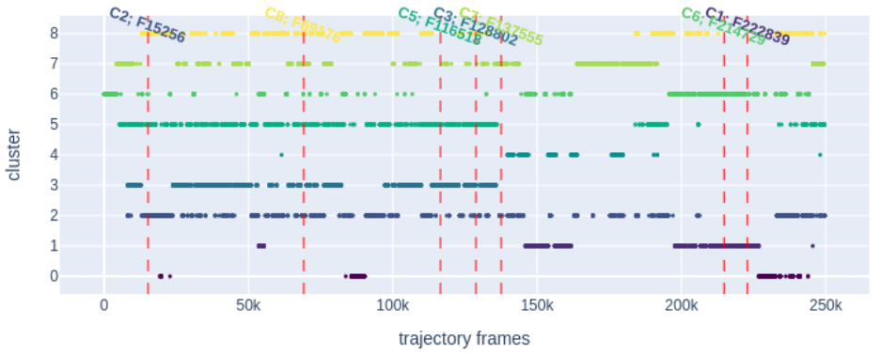
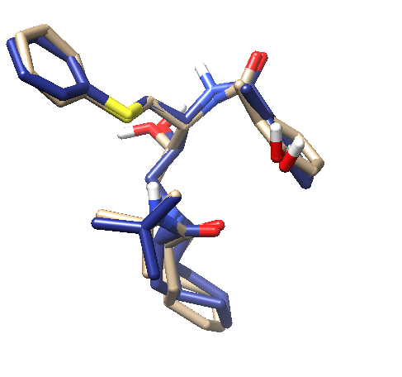
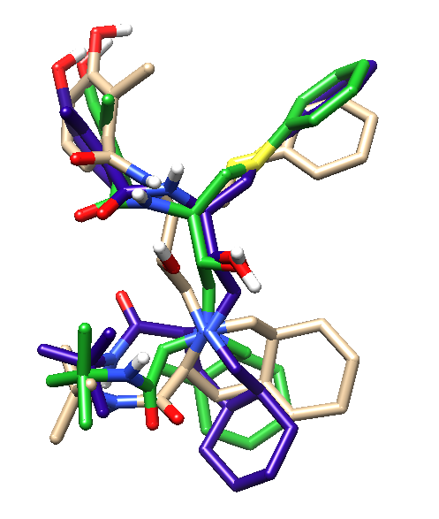
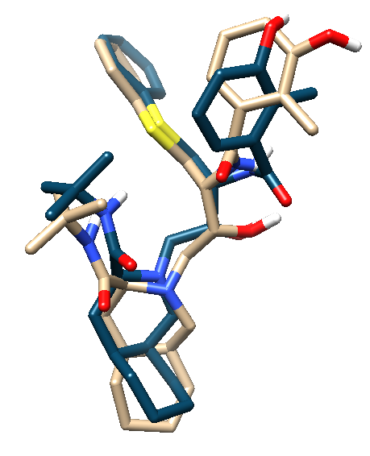
A
Figure 2. EnGens analysis of the Nelfinavir trajectory. A. Top left and right view present the projection of the conformational space into a two dimensional space after the dimensionality reduction with the SRV method. Top left plot shows the energy landscape of the projection. In the top right plot the points (frames of the MD with Nelfinavir conformations) are colored based on the cluster that they were assigned. B. The plot presents the timeline of the MD and shows which frame (F) belongs to which cluster (C) in the top. C. Three plots show the representative conformations of the clusters overlapped with the conformations found by Antunes et al. showed in pale tan color.
B
C
NF-i1 and C2
NF-i2, C1 and C6
NF-i3 and C3

