Slide 1
IBM University Engagement Project Submission
“Exploring the Power of Agentic AI with IBM Granite and LangFlow”

Slide 2
Project Title – [Recipe Preparation Agent]
Domain of Project- [ Lifestyle (Food & Nutrition) ]
Student Name | Recent Passport Photo | Email ID | Mobile number [WhatsApp]
Akkireddy Gari Kavya Sree |  | reddykavya1104@gmail.com | 9390327967

Slide 3
Problem Statement – Recipe Preparation Agent
The Challenge:
Many individuals struggle with cooking meals when they only have limited ingredients available at home. Searching for recipes online often requires exact matches, leading to wasted time and food. Existing solutions rarely adapt recipes to ingredient constraints, dietary preferences, or cultural variations. Without intelligent guidance, users either abandon cooking or waste resources by buying extra items unnecessarily.
The Objective:
Build an AI-powered Recipe Preparation Agent that helps users cook meals using only the ingredients they already have. The solution should:
Ingredient-Based Recipe Suggestions – Generate recipes tailored to the groceries user input.
RAG Retrieval of Recipes – Fetch and adapt recipes from trusted cooking databases and food blogs.
Substitution & Adaptation – Suggest alternatives when ingredients are missing (e.g., “use yogurt instead of cream”).
Dietary & Cultural Preferences – Adjust recipes for vegetarian, vegan, gluten-free, or regional cuisines.
Step-by-Step Cooking Guidance – Provide clear instructions with cooking tips and timing.
Food Waste Reduction – Encourage sustainable cooking by maximizing use of available pantry items.
Multi-Agent System:
Recipe Retrieval Agent – Finds and summarizes relevant recipes.
Ingredient Adaptation Agent – Suggests substitutions and modifications.
Dietary Preference Agent – Personalizes recipes based on health or cultural needs.
Cooking Instruction Agent – Generates step-by-step guidance for preparation.
Visualization Dashboard:
Show recipe options, preparation steps, cooking time, and nutritional highlights.
Track saved recipes and user feedback for continuous improvement.

Slide 4
Technology Used:
Tech Stack:
IBM watsonx Orchestrate – The core technology used to design, deploy, and manage the Recipe Agent. It provides a unified orchestration layer that connects profile, knowledge, toolset, and behavior modules into a single intelligent agent.
Embedded Agent Interface – Allows the Recipe Agent to be integrated into websites or applications using JavaScript embed code.
Conversational AI Workflow – Powers recipe retrieval, adaptation, and generation through structured orchestration of agent behaviors.
Tech Stack Used:
IBM watsonx Orchestrate

Slide 5
Proposed Solution – AI Powered Recipe Preparation Agent
The proposed solution is a streamlined AI‑powered Recipe Preparation Agent built using IBM watsonx Orchestrate to provide intelligent, real‑time cooking guidance. The system focuses on addressing challenges in meal preparation, ingredient limitations, and food waste reduction through a simple but effective orchestration architecture.
At its core, the solution uses Orchestrate to connect user queries with the Recipe Agent’s knowledge and toolset. This setup allows the agent to process requests, reason about available ingredients, and generate recipe suggestions or cooking steps directly.
System Flow:
User Query (Chat Input) – Users enter their available ingredients or recipe queries.
IBM watsonx Orchestrate – Manages the workflow, applies reasoning, and coordinates the agent’s behavior.
Recipe Agent Response (Chat Output) – Delivers clear, step‑by‑step cooking guidance back to the user.
Technology Role:
IBM watsonx Orchestrate – Provides the orchestration environment, connecting profile, knowledge, toolset, and behavior modules into a single intelligent agent.
Embedded Agent Interface – Enables integration into websites or applications via JavaScript embed code.
Conversational AI Workflow – Powers recipe retrieval, adaptation, and generation through structured orchestration.
Outcome:
This solution demonstrates how even a minimal orchestration pipeline (User Query → Orchestrate → Recipe Agent → Response) can deliver intelligent recipe assistance, reduce food waste, and make everyday meal preparation smarter and easier.

Slide 6
Orchestrate Components Used:
System Components:
Chat Input – Interface where users enter their available ingredients, preferences, or cooking queries (text/voice).
IBM watsonx Orchestrate Agent – The core AI agent that processes user input, applies reasoning, and generates personalized recipe suggestions and cooking guidance.
Chat Output – Displays AI‑generated responses such as recipe options, substitutions, and step‑by‑step cooking instructions.
Profile Module – Stores agent identity and configuration details.
Knowledge Module – Holds recipe datasets, cooking tips, and user preferences for reuse.
Toolset Module – Connects external APIs or functions (e.g., recipe retrieval, adaptation logic).
Behavior Module – Defines how the agent responds, adapts recipes, and guides users through cooking steps.
Channels (Optional) – Enables embedding the Recipe Agent into websites or applications via JavaScript code for real‑time interaction.

Slide 7
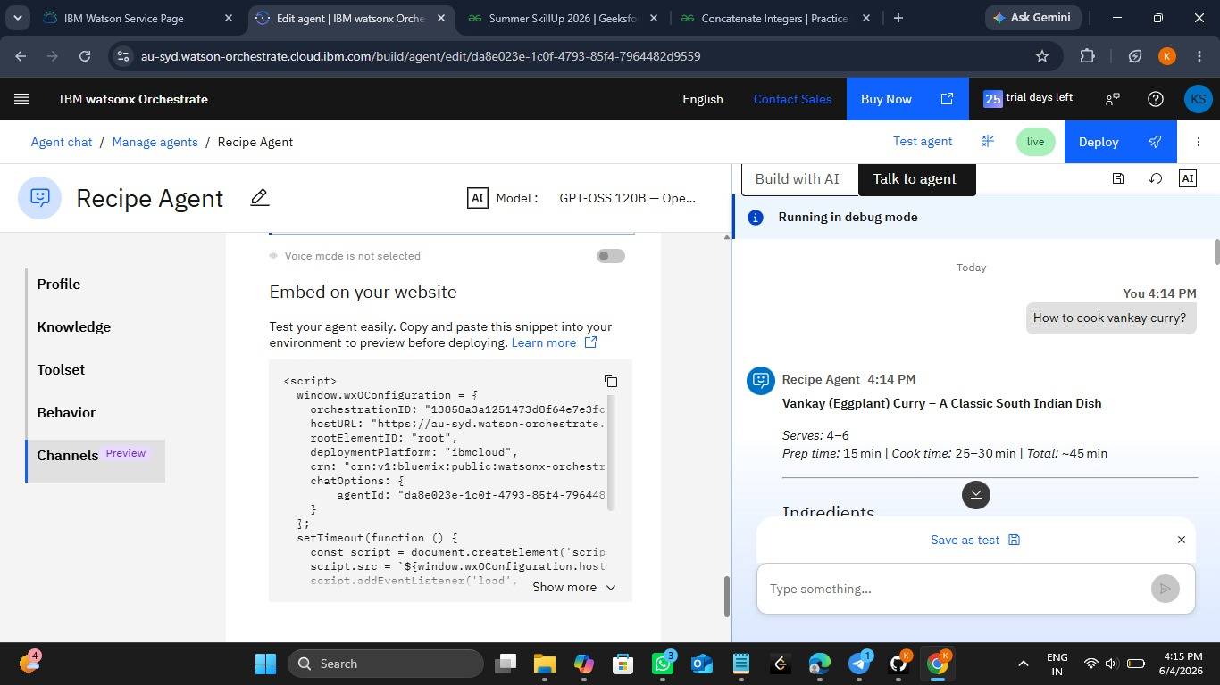
Orchestrate Screenshot:

Slide 8
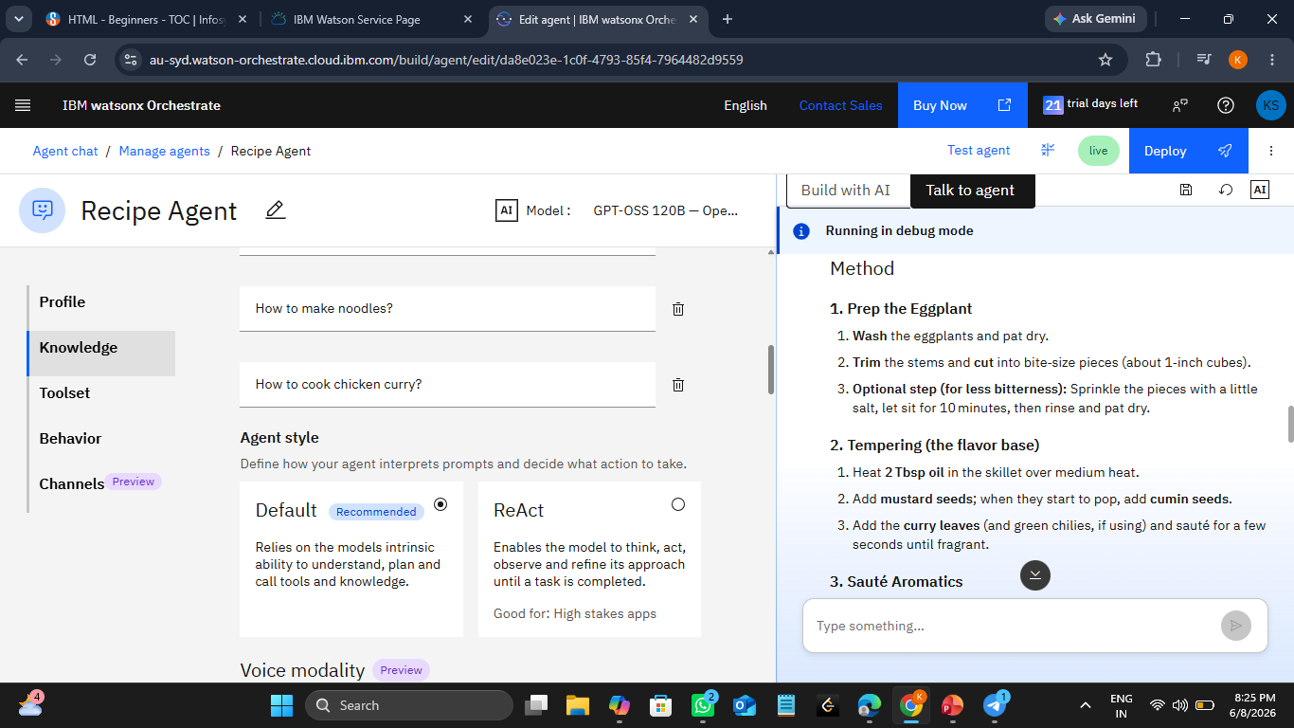
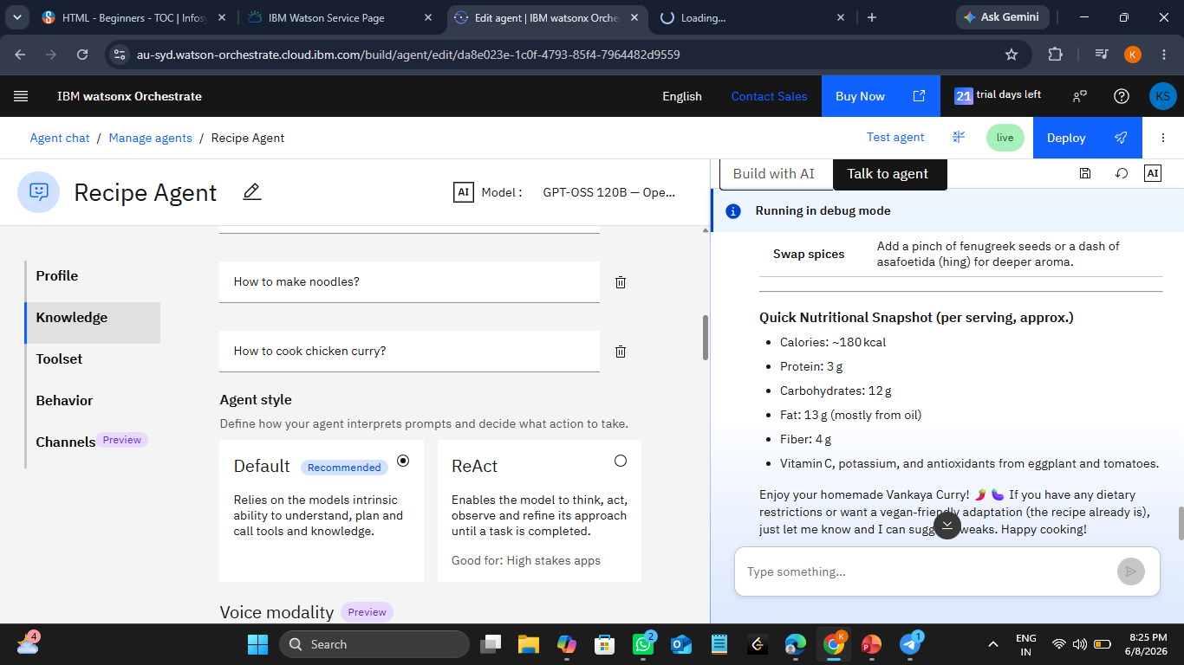
Orchestrate Screenshots:

Slide 9
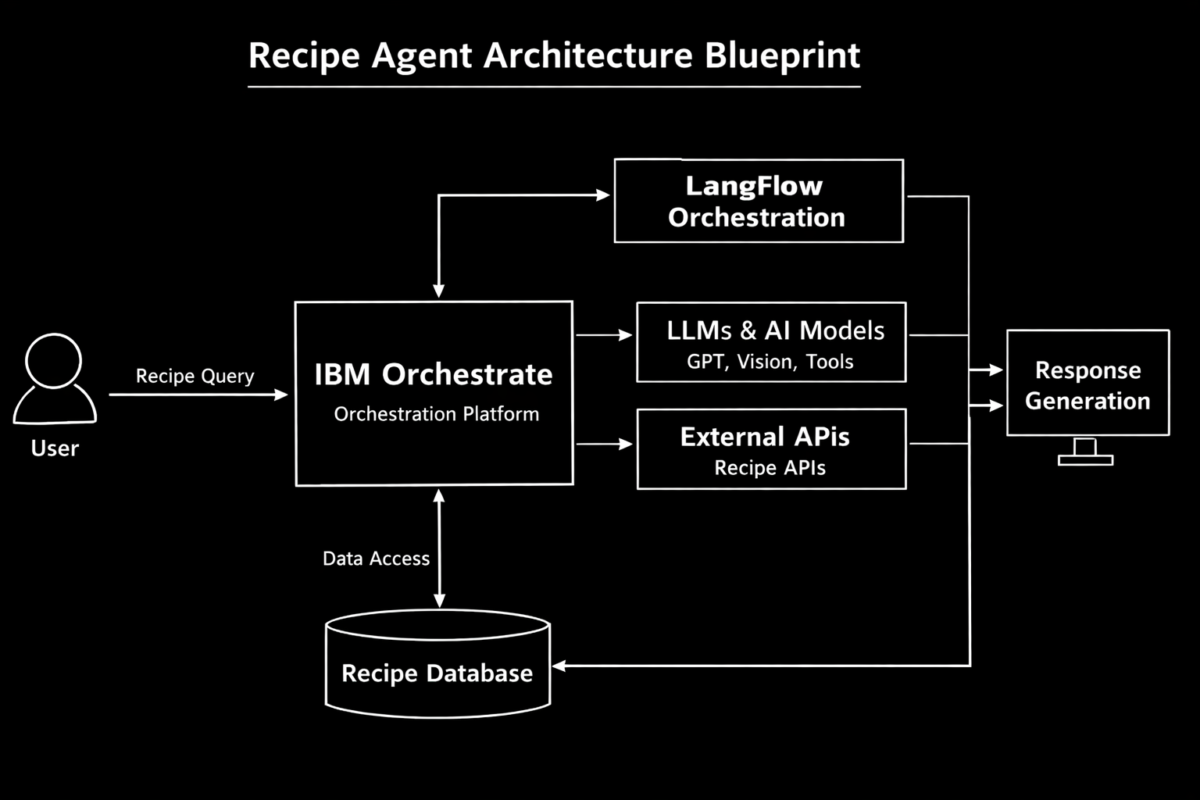
Architecture Blueprint:

Slide 10

Role of Agentic AI:
Role of Agentic AI in Recipe Agent:
Agentic AI enables the Recipe Preparation Agent to act as an autonomous, intelligent system rather than a simple chatbot. By leveraging IBM watsonx Orchestrate, the agent coordinates tasks like recipe retrieval, ingredient adaptation, and cooking guidance in a streamlined workflow.
🔑 Key Roles:
Task Specialization – Orchestrate connects modules (Profile, Knowledge, Toolset, Behavior) so the agent can handle specialized tasks such as recipe suggestions, substitutions, and cooking instructions.
Context Awareness – The agent adapts recipes based on user queries, available ingredients, and preferences (e.g., vegetarian, regional cuisines).
Real‑Time Adaptation – Suggestions evolve dynamically as users provide new inputs (e.g., “I don’t have cream, suggest a substitute”).
Workflow Coordination – Orchestrate ensures smooth communication between components, making the agent proactive and efficient.
Personalization – Recipes are tailored to user needs, reducing food waste and improving everyday cooking experiences.
📌 Outcome:
With Orchestrate, the Recipe Agent becomes proactive, personalized, and goal‑driven. Instead of just answering queries, it acts like a smart digital cooking assistant—helping users prepare meals with what they have, guiding them step by step, and promoting sustainable cooking practices.

Slide 11
Technology Used:
Technology Used – IBM watsonx Orchestrate:
IBM watsonx Orchestrate – Core platform used to design, deploy, and manage the Recipe Agent workflow. It provides orchestration across modules (Profile, Knowledge, Toolset, Behavior) to deliver intelligent cooking guidance.
Orchestrate Agent Framework – Connects user queries with the agent’s knowledge and behavior, enabling recipe retrieval, adaptation, and step‑by‑step cooking instructions.
IBM Cloud – Provides secure, scalable infrastructure for hosting and running the Recipe Agent efficiently.
Embedded Agent Interface – Allows integration of the Recipe Agent into websites or applications using JavaScript embed code for real‑time interaction.
Knowledge Module – Stores recipe datasets, cooking tips, and user preferences for reuse.
Toolset Module – Links external APIs or functions (e.g., recipe retrieval, substitution logic) to extend agent capabilities.
Behavior Module – Defines how the agent responds, adapts recipes, and guides users through cooking steps.
Channels (Optional) – Enables multi‑platform deployment, allowing the Recipe Agent to interact across different environments.

Slide 12
Novelty and Uniqueness:
Orchestrated Intelligence – Instead of a simple chatbot, the system leverages IBM watsonx Orchestrate to coordinate modules (Profile, Knowledge, Toolset, Behavior) that work together to deliver accurate and context‑aware recipe guidance.
Workflow‑Driven Accuracy – Orchestrate ensures that recipe queries are processed through a structured workflow, reducing errors and providing trustworthy cooking suggestions.
Hyper‑Personalization – Recipes are tailored based on user inputs such as available ingredients, dietary restrictions (vegetarian, vegan, gluten‑free), and cultural cuisines.
Real‑Time Adaptation – Suggestions evolve dynamically as users provide new inputs (e.g., “I don’t have cream, suggest a substitute”).
Multi‑Channel Deployment (Future Scope) – The agent can be embedded into websites or extended to voice/chat platforms, enabling text, voice, even image‑based ingredient queries.
Sustainable Cooking Focus – Goes beyond recipe generation to actively reduce food waste by maximizing use of pantry items.
Scalable & Enterprise‑Ready – Built on IBM watsonx Orchestrate and IBM Cloud, ensuring reliability, governance, and adaptability for larger deployments.

Slide 13
GitHub Link:
· GitHub URL –
https://github.com/Kavya-1104-reddy/Edunet_Projects
·
·
·

Slide 14
Future Scope:
Integration with Smart Kitchen & IoT Devices – The Recipe Agent can be connected with smart appliances (ovens, induction stoves, refrigerators) to automate cooking steps and track ingredient availability.
Orchestrate workflows can adjust recipes in real time based on what’s physically present in the kitchen.
AI‑Powered Voice Assistant & Multilingual Support – Adding voice interaction and multilingual capabilities will allow users to engage naturally in their preferred language, making the solution more inclusive and accessible across diverse regions.
Nutritional Analysis & Health Recommendations – Future versions can integrate nutrition APIs within Orchestrate to analyze calories, macros, and vitamins, offering health‑focused suggestions such as diabetic‑friendly or heart‑healthy meal plans.
Community & Recipe Sharing Platform – Orchestrate can be extended to manage a community dashboard where users share recipes, substitutions, and cooking tips, fostering collaboration and sustainable cooking practices.
Multi‑Channel Input Expansion – Beyond text, Orchestrate can support voice and image‑based queries (e.g., scanning pantry items or uploading ingredient photos), making recipe generation more intuitive and user‑friendly.
Sustainable Cooking Focus – The agent continues to emphasize reducing food waste by maximizing pantry usage, aligning with eco‑friendly and sustainable living goals.
Scalable & Enterprise‑Ready – Built on IBM watsonx Orchestrate and IBM Cloud, the system ensures reliability, governance, and adaptability for larger deployments in enterprise or consumer platforms.
·
·
·

Slide 15


