Slide 1
IBM University Engagement Project Submission
“Exploring the Power of Agentic AI with IBM Granite and LangFlow”

Slide 2
Project Title – [Recipe Preparation Agent]
Domain of Project- [ Lifestyle (Food & Nutrition) ]
Student Name | Recent Passport Photo | Email ID | Mobile number [WhatsApp]
Kavya Sree Akkireddy Gari |  | reddykavya1104@gmail.com | 9390327967

Slide 3
Problem Statement – Recipe Preparation Agent
The Challenge:
Many individuals struggle with cooking meals when they only have limited ingredients available at home. Searching for recipes online often requires exact matches, leading to wasted time and food. Existing solutions rarely adapt recipes to ingredient constraints, dietary preferences, or cultural variations. Without intelligent guidance, users either abandon cooking or waste resources by buying extra items unnecessarily.
The Objective:
Build an AI-powered Recipe Preparation Agent that helps users cook meals using only the ingredients they already have. The solution should:
Ingredient-Based Recipe Suggestions – Generate recipes tailored to the groceries user input.
RAG Retrieval of Recipes – Fetch and adapt recipes from trusted cooking databases and food blogs.
Substitution & Adaptation – Suggest alternatives when ingredients are missing (e.g., “use yogurt instead of cream”).
Dietary & Cultural Preferences – Adjust recipes for vegetarian, vegan, gluten-free, or regional cuisines.
Step-by-Step Cooking Guidance – Provide clear instructions with cooking tips and timing.
Food Waste Reduction – Encourage sustainable cooking by maximizing use of available pantry items.
Multi-Agent System:
Recipe Retrieval Agent – Finds and summarizes relevant recipes.
Ingredient Adaptation Agent – Suggests substitutions and modifications.
Dietary Preference Agent – Personalizes recipes based on health or cultural needs.
Cooking Instruction Agent – Generates step-by-step guidance for preparation.
Visualization Dashboard:
Show recipe options, preparation steps, cooking time, and nutritional highlights.
Track saved recipes and user feedback for continuous improvement.

Slide 4
Technology Used:
Tech Stack (Mandatory):
Lang Flow – For building the agent workflow visually and managing RAG pipelines.
IBM watsonx.ai – Provides the AI services and integration environment for deploying the agent.
LLaMA Models (Meta) – Core large language models used for recipe retrieval, adaptation, and generation.
Tech Stack Used:
LangFlow + IBM watsonx.ai + LLaMA Models

Slide 5
Proposed Solution – AI Powered Recipe Preparation Agent
The proposed solution is a streamlined AI-powered Recipe Preparation Agent built using LangFlow, IBM watsonx.ai, and LLaMA models to provide intelligent, real-time cooking guidance. The system focuses on addressing challenges in meal preparation, ingredient limitations, and food waste reduction through a simple but effective architecture.
At its core, the solution uses a Language Model (LLaMA) connected between a Chat Input and Chat Output node. This setup allows the agent to process user queries, reason about available ingredients, and generate recipe suggestions or cooking steps directly.
System Flow:
Chat Input – Users enter their available ingredients or recipe queries.
LLaMA Model – Processes the input, applies reasoning, and generates adaptive recipe suggestions.
Chat Output – Delivers clear, step-by-step cooking guidance back to the user.
Technology Role:
LangFlow – Provides the visual workflow builder and orchestration environment.
IBM watsonx.ai – Ensures scalable deployment and integration of the LLaMA models.
LLaMA models – Handle reasoning, substitution suggestions, and recipe generation.
Outcome:
This simplified solution demonstrates how even a minimal agent pipeline (Chat Input → LLaMA → Chat Output) can deliver intelligent recipe assistance, reduce food waste, and make everyday meal preparation smarter and easier.

Slide 6
LangFlow Components Used:
System Components:
Chat Input – Interface where users enter their available ingredients, preferences, or cooking queries (text/voice).
IBM watsonx AI Agent – Processes user input using LLaMA models to generate personalized recipe suggestions and cooking guidance.
Name of Model Used – LLaMA (Meta) → Efficient for reasoning, recipe adaptation, and step‑by‑step instructions.
Chat Output – Displays AI‑generated responses such as recipe options, substitutions, and cooking steps.
File Component (Optional) – Stores and retrieves recipe datasets, user preferences, and saved cooking history for reuse.
Additional Component (Optional) – Vector Database (FAISS or Chroma) → Used to embed and store recipe data for Retrieval‑Augmented Generation (RAG), enabling quick and accurate recipe retrieval.

Slide 7
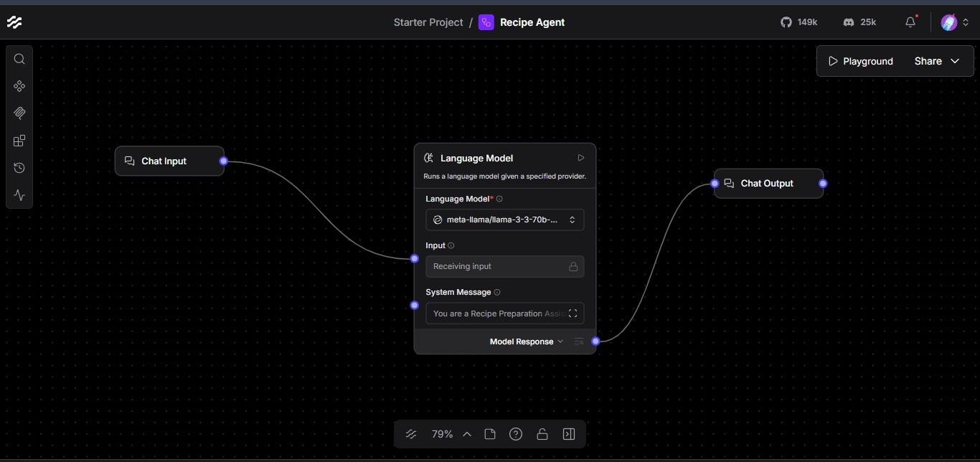
Langflow workflow:

Slide 8
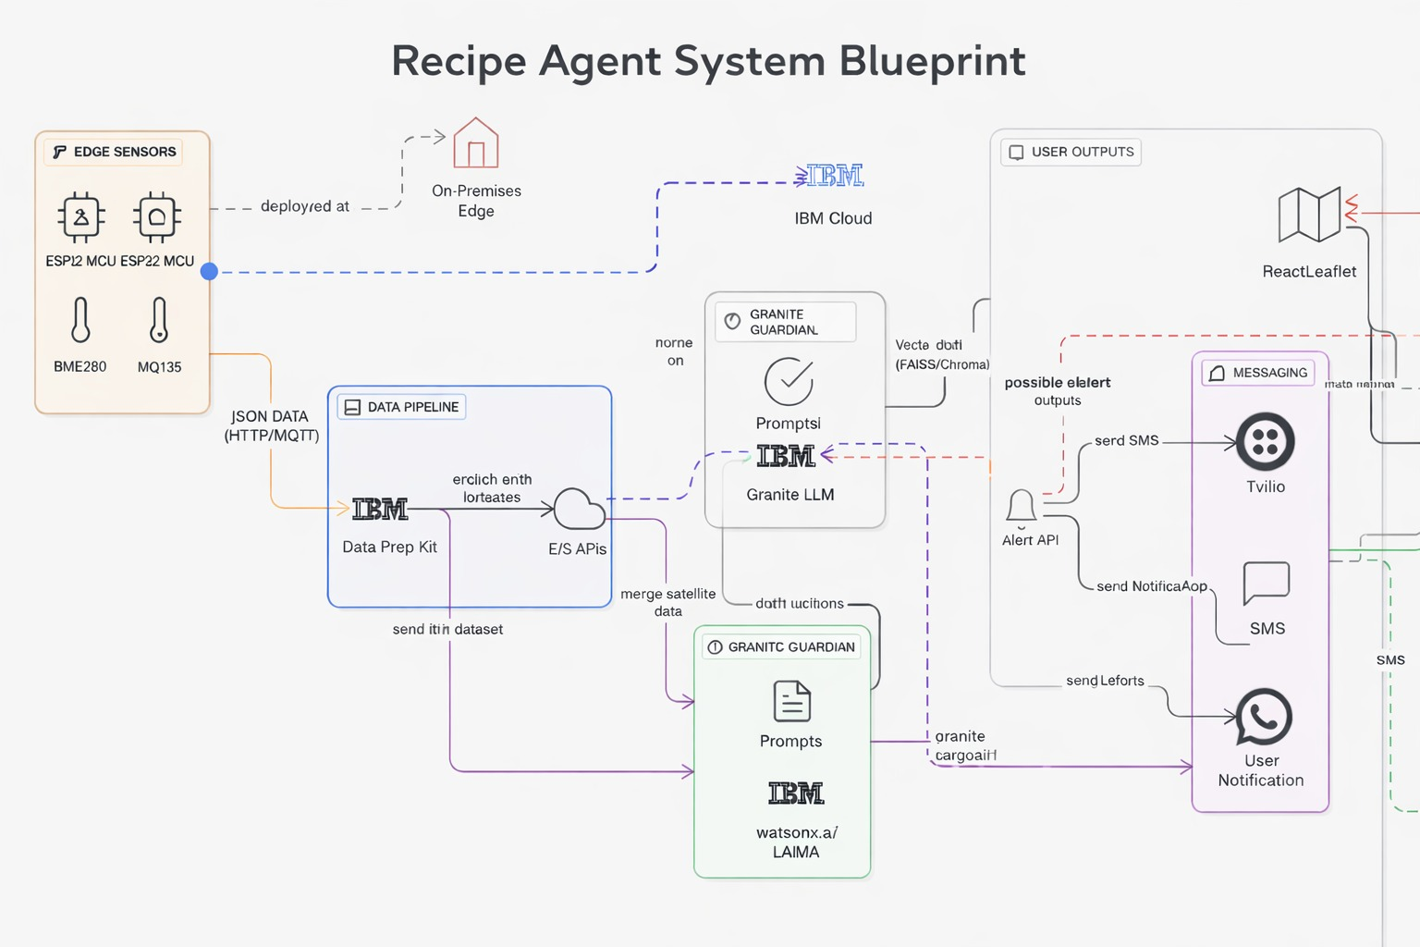
Architecture blueprint:

Slide 9

Role of Agentic AI in the solution:
Role of Agentic AI in Recipe Agent:
Agentic AI enables the Recipe Preparation Agent to act as an autonomous, intelligent system rather than a simple chatbot. By combining LangFlow orchestration, IBM watsonx.ai integration, and LLaMA models, the agent coordinates specialized tasks to deliver adaptive recipe guidance.
Task Specialization – Even in a minimal setup (Chat Input → LLaMA → Chat Output), the agent can be extended into specialized roles such as recipe retrieval, ingredient adaptation, dietary personalization, and cooking instruction.
Context Awareness – The agent can adapt recipes based on user inputs like available ingredients, dietary preferences (vegetarian, vegan, gluten-free), or cultural cuisines.
Real-Time Adaptation – Suggestions evolve dynamically as users provide new inputs (e.g., “I don’t have cream, suggest a substitute”).
Collaboration Between Agents – When expanded, multiple agents (retrieval, adaptation, preference, instruction) can communicate to ensure accurate and efficient recipe generation.
Personalization – LLaMA models provide reasoning and summarization, tailoring recipes to user needs while reducing food waste.
Outcome:
Agentic AI makes your Recipe Agent proactive, personalized, and goal-driven. Instead of just answering queries, it acts like a smart digital cooking assistant—helping users prepare meals with what they have, guiding them step by step, and promoting sustainable cooking practices.
.

Slide 10
Technology Used:
LangFlow – Used for designing and orchestrating the agent workflow visually. In your setup, it connects
Chat Input → LLaMA Model → Chat Output to handle recipe queries and responses.
LLaMA Model (Meta) – Core large language model for natural language understanding, reasoning, and personalization. It generates recipe suggestions, substitutions, and step‑by‑step cooking instructions.
IBM Cloud – Provides the infrastructure to build, deploy, and scale the Recipe Agent efficiently. Ensures a reliable, secure, and scalable environment for deployment.
RAG (Retrieval-Augmented Generation) – Enables the agent to fetch real recipe data first, then generate intelligent answers. This makes the Recipe Agent more trustworthy and effective.
IBM watsonx.ai – Handles model deployment, embeddings, and AI governance. It integrates the LLaMA model into the workflow and ensures scalability.
Vector Database (FAISS/Chroma) – Stores recipe embeddings for RAG-based retrieval. Allows quick and accurate recipe searches and adaptations based on user inputs.

Slide 11
Novelty and Uniqueness:
Multi-Agent Intelligence – Instead of a simple chatbot, the system can be extended into multiple specialized agents (retrieval, adaptation, dietary preference, cooking instruction)
that collaborate to deliver accurate and context‑aware recipe guidance.
RAG‑Based Accuracy – Integrates real‑time recipe retrieval with AI generation, reducing misinformation and ensuring trustworthy cooking suggestions.
Hyper‑Personalization – Tailors recipes based on available ingredients, dietary restrictions (vegetarian, vegan, gluten‑free), and cultural cuisines.
Real‑Time Adaptation – Continuously updates recipe suggestions as users provide new inputs (e.g., missing ingredients or substitutions).
Multi‑Modal Input (Future Scope) – Can be extended to support text, voice, or image‑based ingredient queries for better usability.
Sustainable Cooking Focus – Goes beyond recipe generation to actively reduce food waste by maximizing use of pantry items.
Scalable & Enterprise‑Ready-Built on IBM watsonx.ai with LLaMA models, ensuring reliability, governance, and adaptability for larger deployments.

Slide 12
Git Hub Link
· Please create public github repository (Enable Add README button while creating repository) with format –
Please test and Paste the working Github URL –
Make sure you have Uploaded following three files into your github repository 1) app.json file , 2) yourproblemstatement.pdf file 3) your projectpresntation.pptx file 4)any other files
·
·
·

Slide 13
Future Scope:
Integration with Smart Kitchen & IoT Devices – The Recipe Agent can be connected with smart kitchen appliances (like ovens, induction stoves, or refrigerators) to automate cooking steps and track ingredient availability. This will enable real-time recipe
adjustments based on what’s physically present in the kitchen.
AI-Powered Voice Assistant & Multilingual Support – Adding a voice-enabled assistant with multilingual capabilities will allow users to interact naturally in their preferred language. This makes the solution more inclusive and accessible, especially in regions with diverse linguistic backgrounds.
Nutritional Analysis & Health Recommendations – Future versions can analyze the nutritional value of recipes (calories, macros, vitamins) and provide health-focused suggestions, such as diabetic-friendly or heart-healthy meal plans.
Community & Recipe Sharing Platform – Users can share their customized recipes, substitutions, and cooking tips within a community dashboard. This fosters collaboration and builds a knowledge base of sustainable cooking practices.
Multi-Modal Input Expansion-Beyond text, the agent can support voice and image-based inputs (e.g., scanning pantry items or uploading ingredient photos) to make recipe generation more intuitive and user-friendly.
·
·
·

Slide 14


