Slide 1
Safe Algorithm Evolution for OpenROAD
A correctness-gated framework for placement, routing and timing closure research VLSI EDA Optimisation BTech Thesis

Slide 2
Research focus
A small algorithm with full-flow consequences
Target
OptimizeMirroring::mirrorCandidates in OpenDP detailed placement
Evolved decision
Candidate ordering based on two bounded coefficients:
priority = a log1p(local HPWL) + b log1p(pin degree)
Why it matters
Cell orientation changes propagate through placement, clock-tree synthesis, routing, extraction and OpenSTA timing analysis.
The policy ranks legal attempts. Existing OpenDP checks still decide whether a cell may flip.

Slide 3
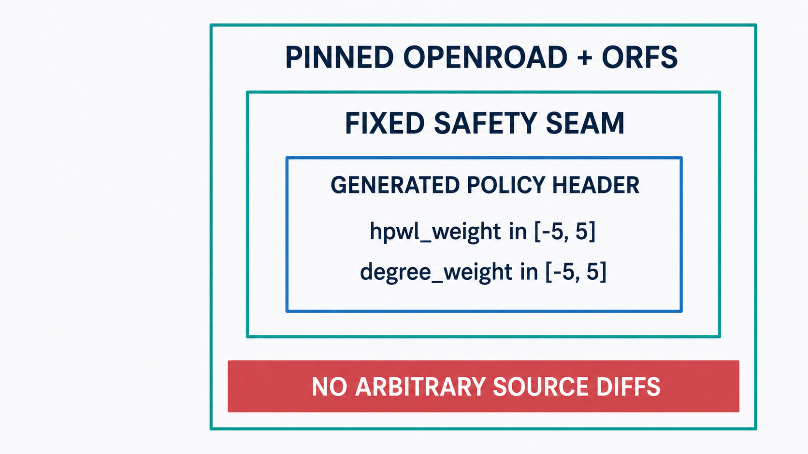
Source containment

Slide 4
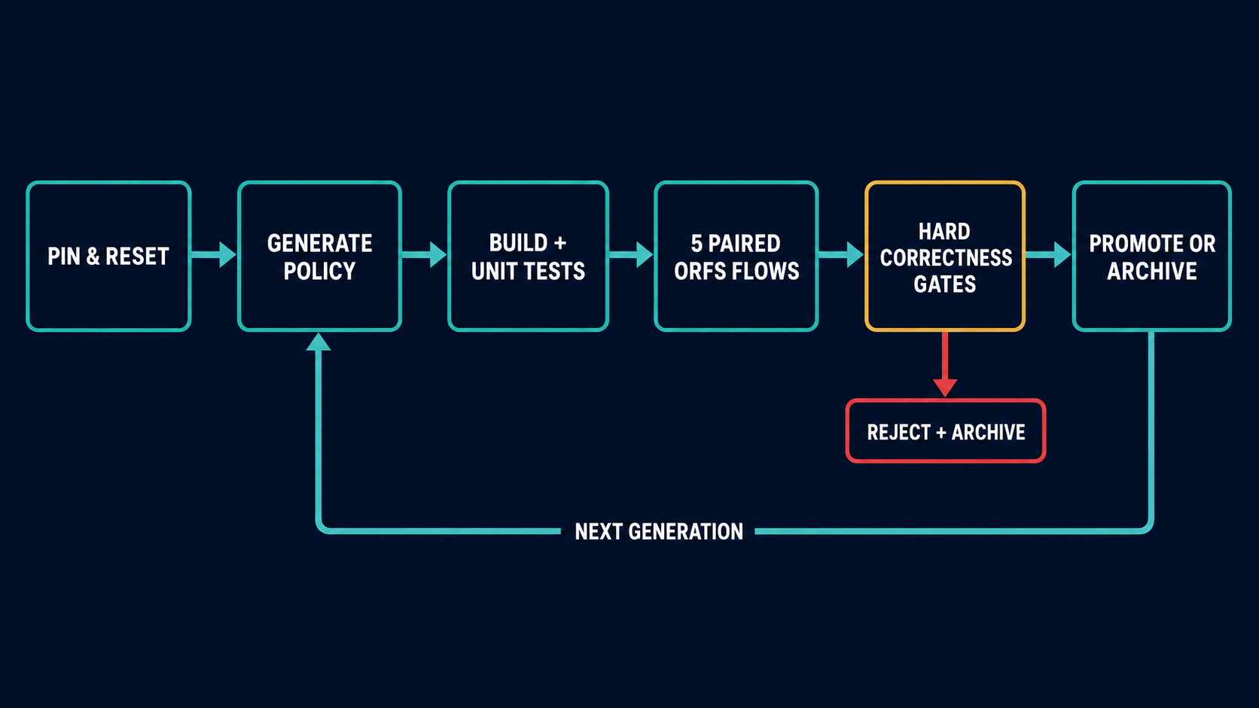
Automated evolution loop

Slide 5
Correctness gates
Layer | Required result
Source integrity | Pinned OpenROAD and ORFS revisions, clean tracked flow files, exact OptMirror.cpp hash
Build | Candidate OpenROAD executable compiles
Regression | mirror1, mirror2, mirror3 and mirror_edge_spacing pass
Full flow | Five paired seed-controlled ORFS runs complete
Physical validity | Placement violations = 0, DRC errors = 0, antenna violations = 0
Timing and reporting | Setup/hold WNS and TNS, routed wirelength and runtime are finite

Slide 6
Any failed gate rejects the candidate and records the evidence.

Slide 7
Quality score and promotion
Bounded composite score
S = .30 Δsetup-WNS + .25 Δsetup-TNS + .15 Δhold-WNS + .15 Δhold-TNS + .10 Δwirelength + .05 Δruntime
Each normalized term is clipped to [-1, 1]. A near-zero baseline cannot dominate the score.
Training promotion requires
no median setup or hold timing regression
routed wirelength regression no greater than 0.5 percent
runtime regression no greater than 10 percent
positive composite score on every paired seed
paired percentile-bootstrap lower bound above 0.002

Slide 8
Evidence and research claim
Held-out verification
The verify command reruns a training-promoted policy on nangate45/aes and nangate45/ibex with the same gates and seed set.
Evidence retained
Exact generated header, source revisions, config digest, flow seeds, logs, METRICS2.1 results and rejection reasons.
Claim boundary
The framework supports a reproducible empirical result on selected ORFS benchmarks. It does not claim universal correctness across every design, PDK, corner or silicon implementation. The framework never merges candidate code into upstream OpenROAD automatically.
Sources: project README.md, DESIGN.md, pinned OpenROAD and ORFS sources, and the supplied AlphaEvolve, Autonomous EDA Tools, EvoDRC and VPR-Evolve papers.

