Slide 1

Coffee Chain Sales Dashboard
Interactive Dashboard for Business Insights
Tools used : Tableau

Slide 2
Objective: Design an interactive dashboard to track key KPIs and help stakeholders make data-driven decisions.
Dataset: Coffee Chain Sales Dataset (from Kaggle)
KPIs Tracked:
Total Sales
Total Profit
Profit Margin

Slide 3
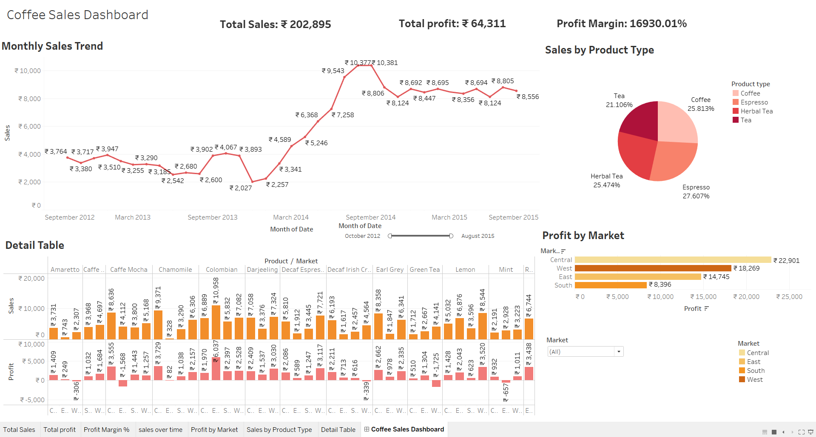

Slide 4
Key Insights from Dashboard:
Sales showed steady growth from early 2014 to late 2014, peaking at ₹10,381 in September 2014.
A drop is visible in late 2013 and early 2015, suggesting seasonal dips or demand variation.
Espresso(27.6%) leads sales , closely followed by Coffee(25.8%) and Herbal Tea(25.5%).
Tea (21.1%) has the lowest share, suggesting less preference among customers.
Central region generated the highest profit (₹22,901).
South region lags with the lowest profit (₹8,396), despite having decent sales in some products.
Profit-negative products such as Green Tea and Caffe Mocha need attention for portfolio review.

