Slide 1

WEATHER ANALYSIS
AUSTRALIA
TEAM MEMBERS
KAVYA S PES1201801445
SONAM SHENOY PES1201801282
MOHIT SAI PES1201800281

Slide 2
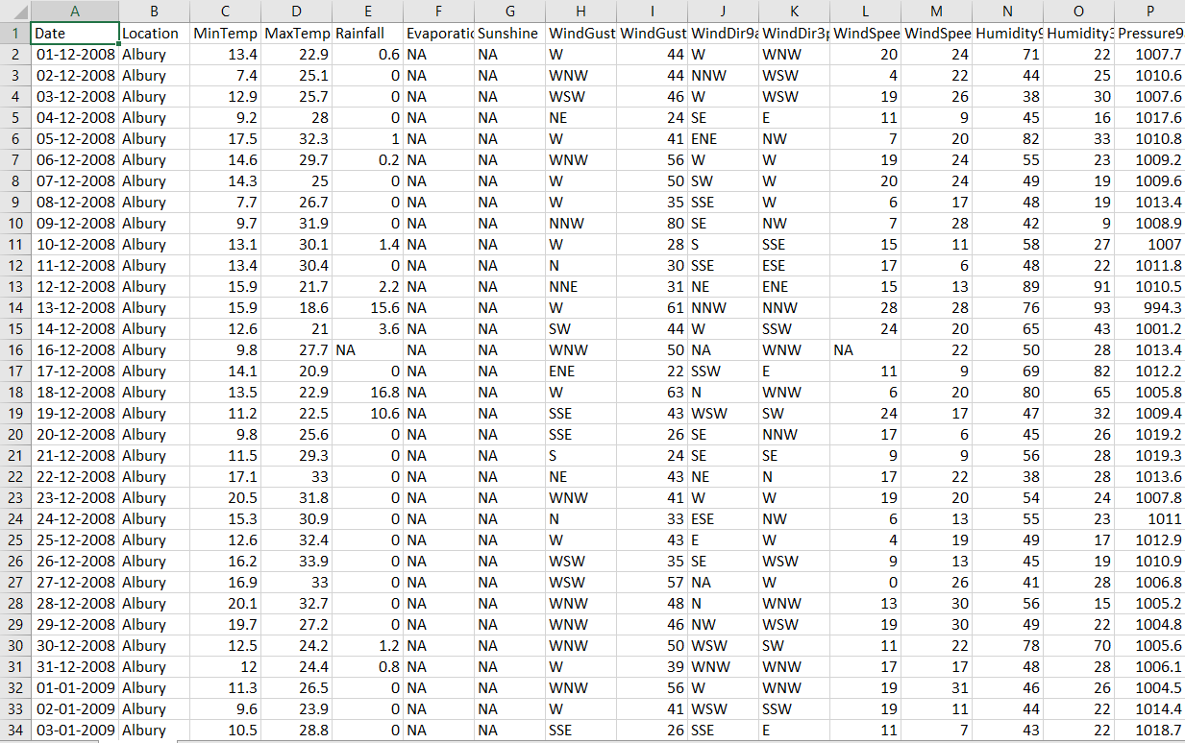
DATASET
Number of columns : 24
Numerical : 17
Categorical : 6
Number of rows : 142193
NaN values : 9.27%
Missing values : 3%
This dataset contains about 10 years of daily weather observations from numerous Australian weather stations.

Slide 3
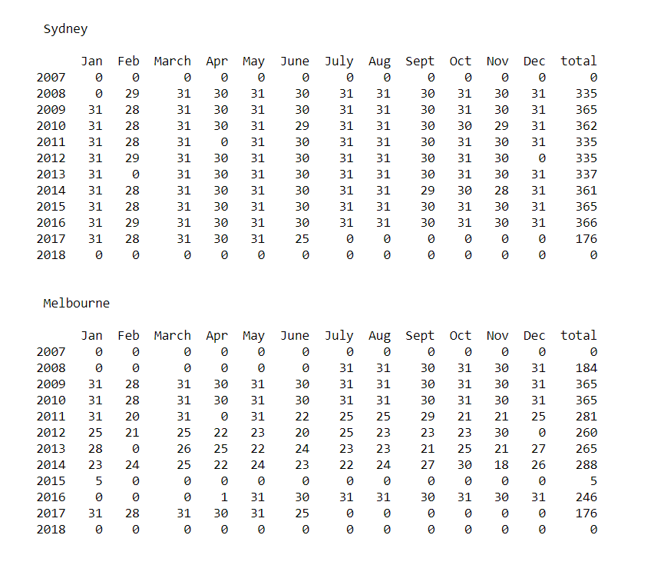
DATA CLEANING
Dropped columns such as Evaporation, Sunshine, Cloud3pm, Cloud9am with 50% NaN values.
Major cities : Sydney, Melbourne, Brisbane, Canberra, Adelaide and Perth were chosen for analysis
Specific years chosen based on the availability of data.
NaNs in numerical columns were interpolated.
NA in categorical columns replaced by the values in the previous row.

Slide 4
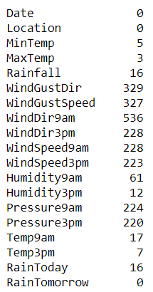
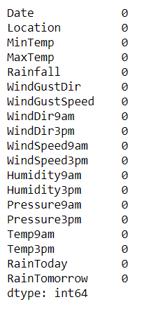
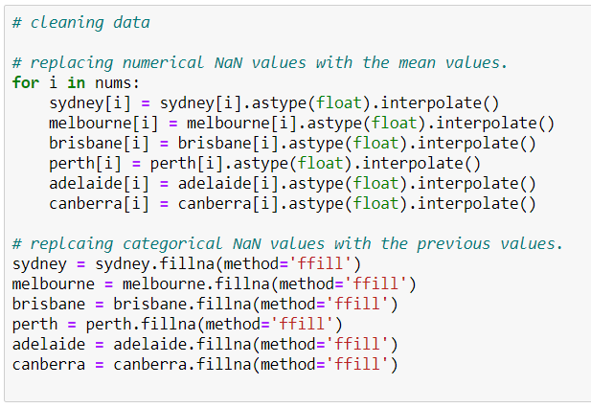
DATA CLEANING
Number of NA values
CODE
Before
After

Slide 5
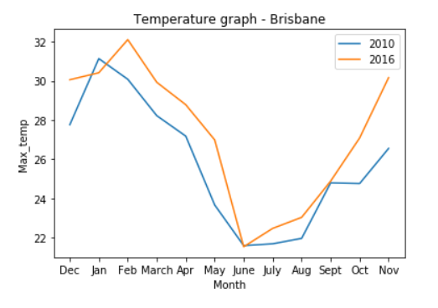
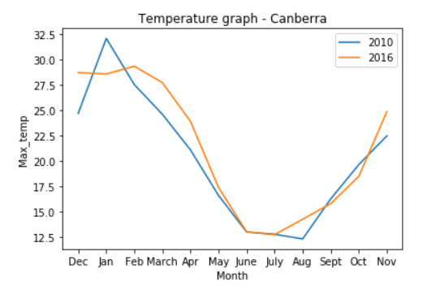
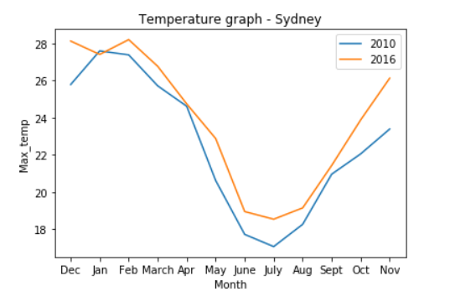
GRAPH VISUALIZATIONS
The line graphs show an increase in the average temperature at various locations such as Brisbane, Canberra and Sydney. This could be a result of global warming.

Slide 6
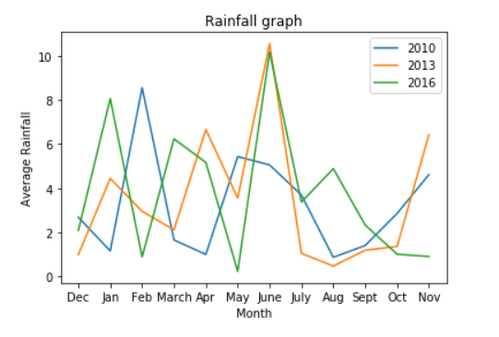
GRAPH VISUALIZATIONS
Rainfall in Australia is highly variable, largely because of large-scale atmospheric and oceanic drivers that affect the region.

Slide 7
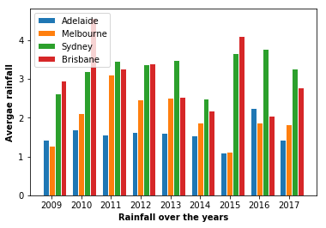
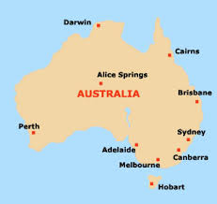
GRAPH VISUALIZATIONS
Adelaide and Melbourne have always received lower rainfall than Sydney and Brisbane. Turns out that Adelaide is Australia's driest capital. East coast lows (tropical cyclones that develop on the eastern coastline of Australia) bring large amounts of rainfall to eastern cities.

Slide 8
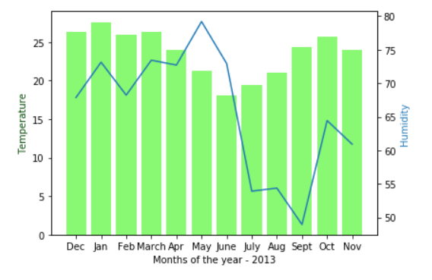
GRAPH VISUALIZATIONS
Relative humidity represents a percentage of water vapor in the air that changes when the air temperature changes. As air temperature increases, air can hold more water molecules, and its relative humidity decreases. When temperatures drop, relative humidity increases.

Slide 9
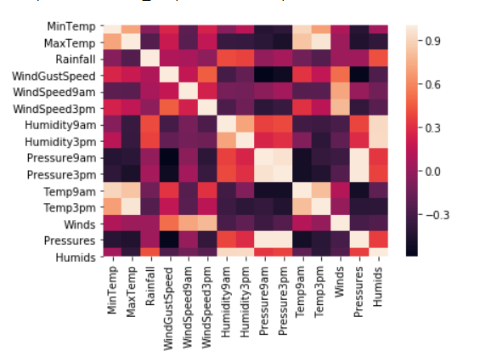
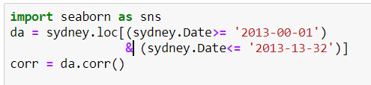
CORRELATION
The heatmap shows how the columns are related to each other on a scale from -1 to +1

Slide 10
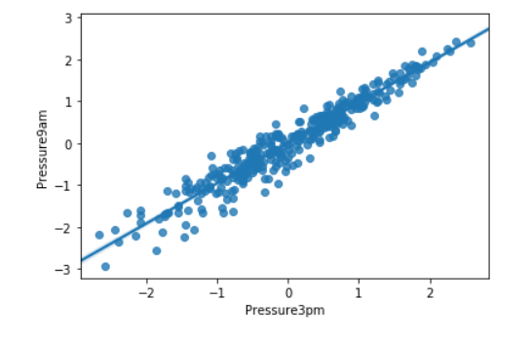
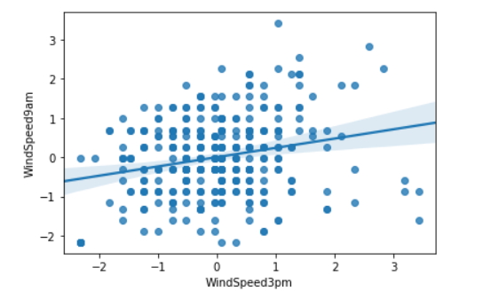
CORRELATION
Correlation co-efficient :
0.961
Correlation co-efficient :
0.2367

Slide 11
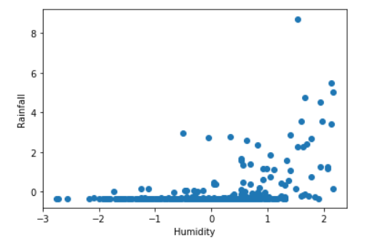
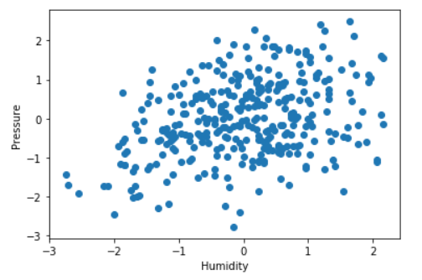
CORRELATION
Correlation co-efficient :
0.4771
Correlation co-efficient :
0.3574

Slide 12
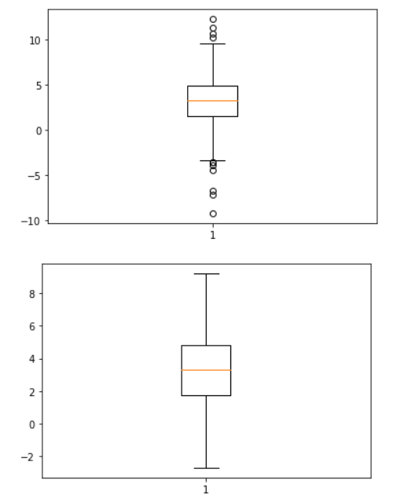
HYPOTHESIS TESTING

Slide 13
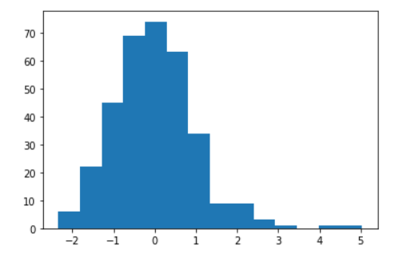
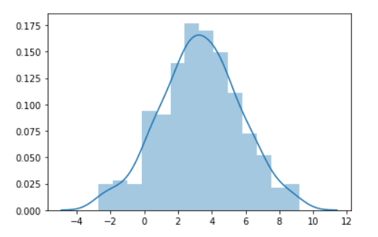
HYPOTHESIS TESTING

Slide 14
HYPOTHESIS TESTING

Slide 15
THANK YOU!

