Slide 1
Policy and Claims Copilot
Built using LangChain, FAISS & RAG
Presented by:
Kavya T - 51835763

Slide 2
Agenda
Introduction
Objective
LLM vs RAG
Architecture
Workflow
Implementation
Technology
Demo
Benefits
Conclusion

Slide 3
Business Problem & Objective
Problem:
“Policy & Claims Copilot” (Customer support + Claims pre-check)
Goal: Help customers, agents, and claims teams get instant, consistent answers about:
what’s covered / not covered
Limits & sub-limits
waiting periods
claim submission steps + timelines
documents needed
Objective:
Build a source-backed AI assistant using RAG.

Slide 4
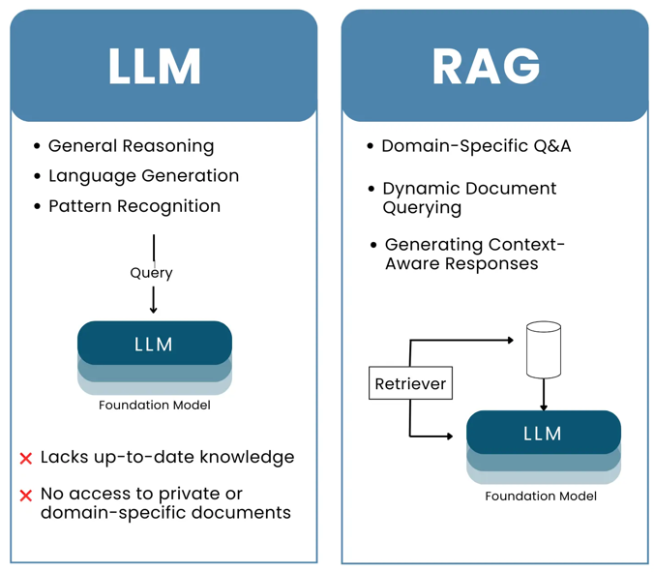
Plain LLM vs RAG
A traditional LLM answers only from its pretrained knowledge, which may lead to hallucinations or outdated responses.
RAG searches external data first (databases, documents, APIs) and then generate information based on retrieved data.. This results in more accurate, explainable, and source-backed answers."
Source : https://trigma.com/artificial-intelligence/llm-vs-rag/

Slide 5
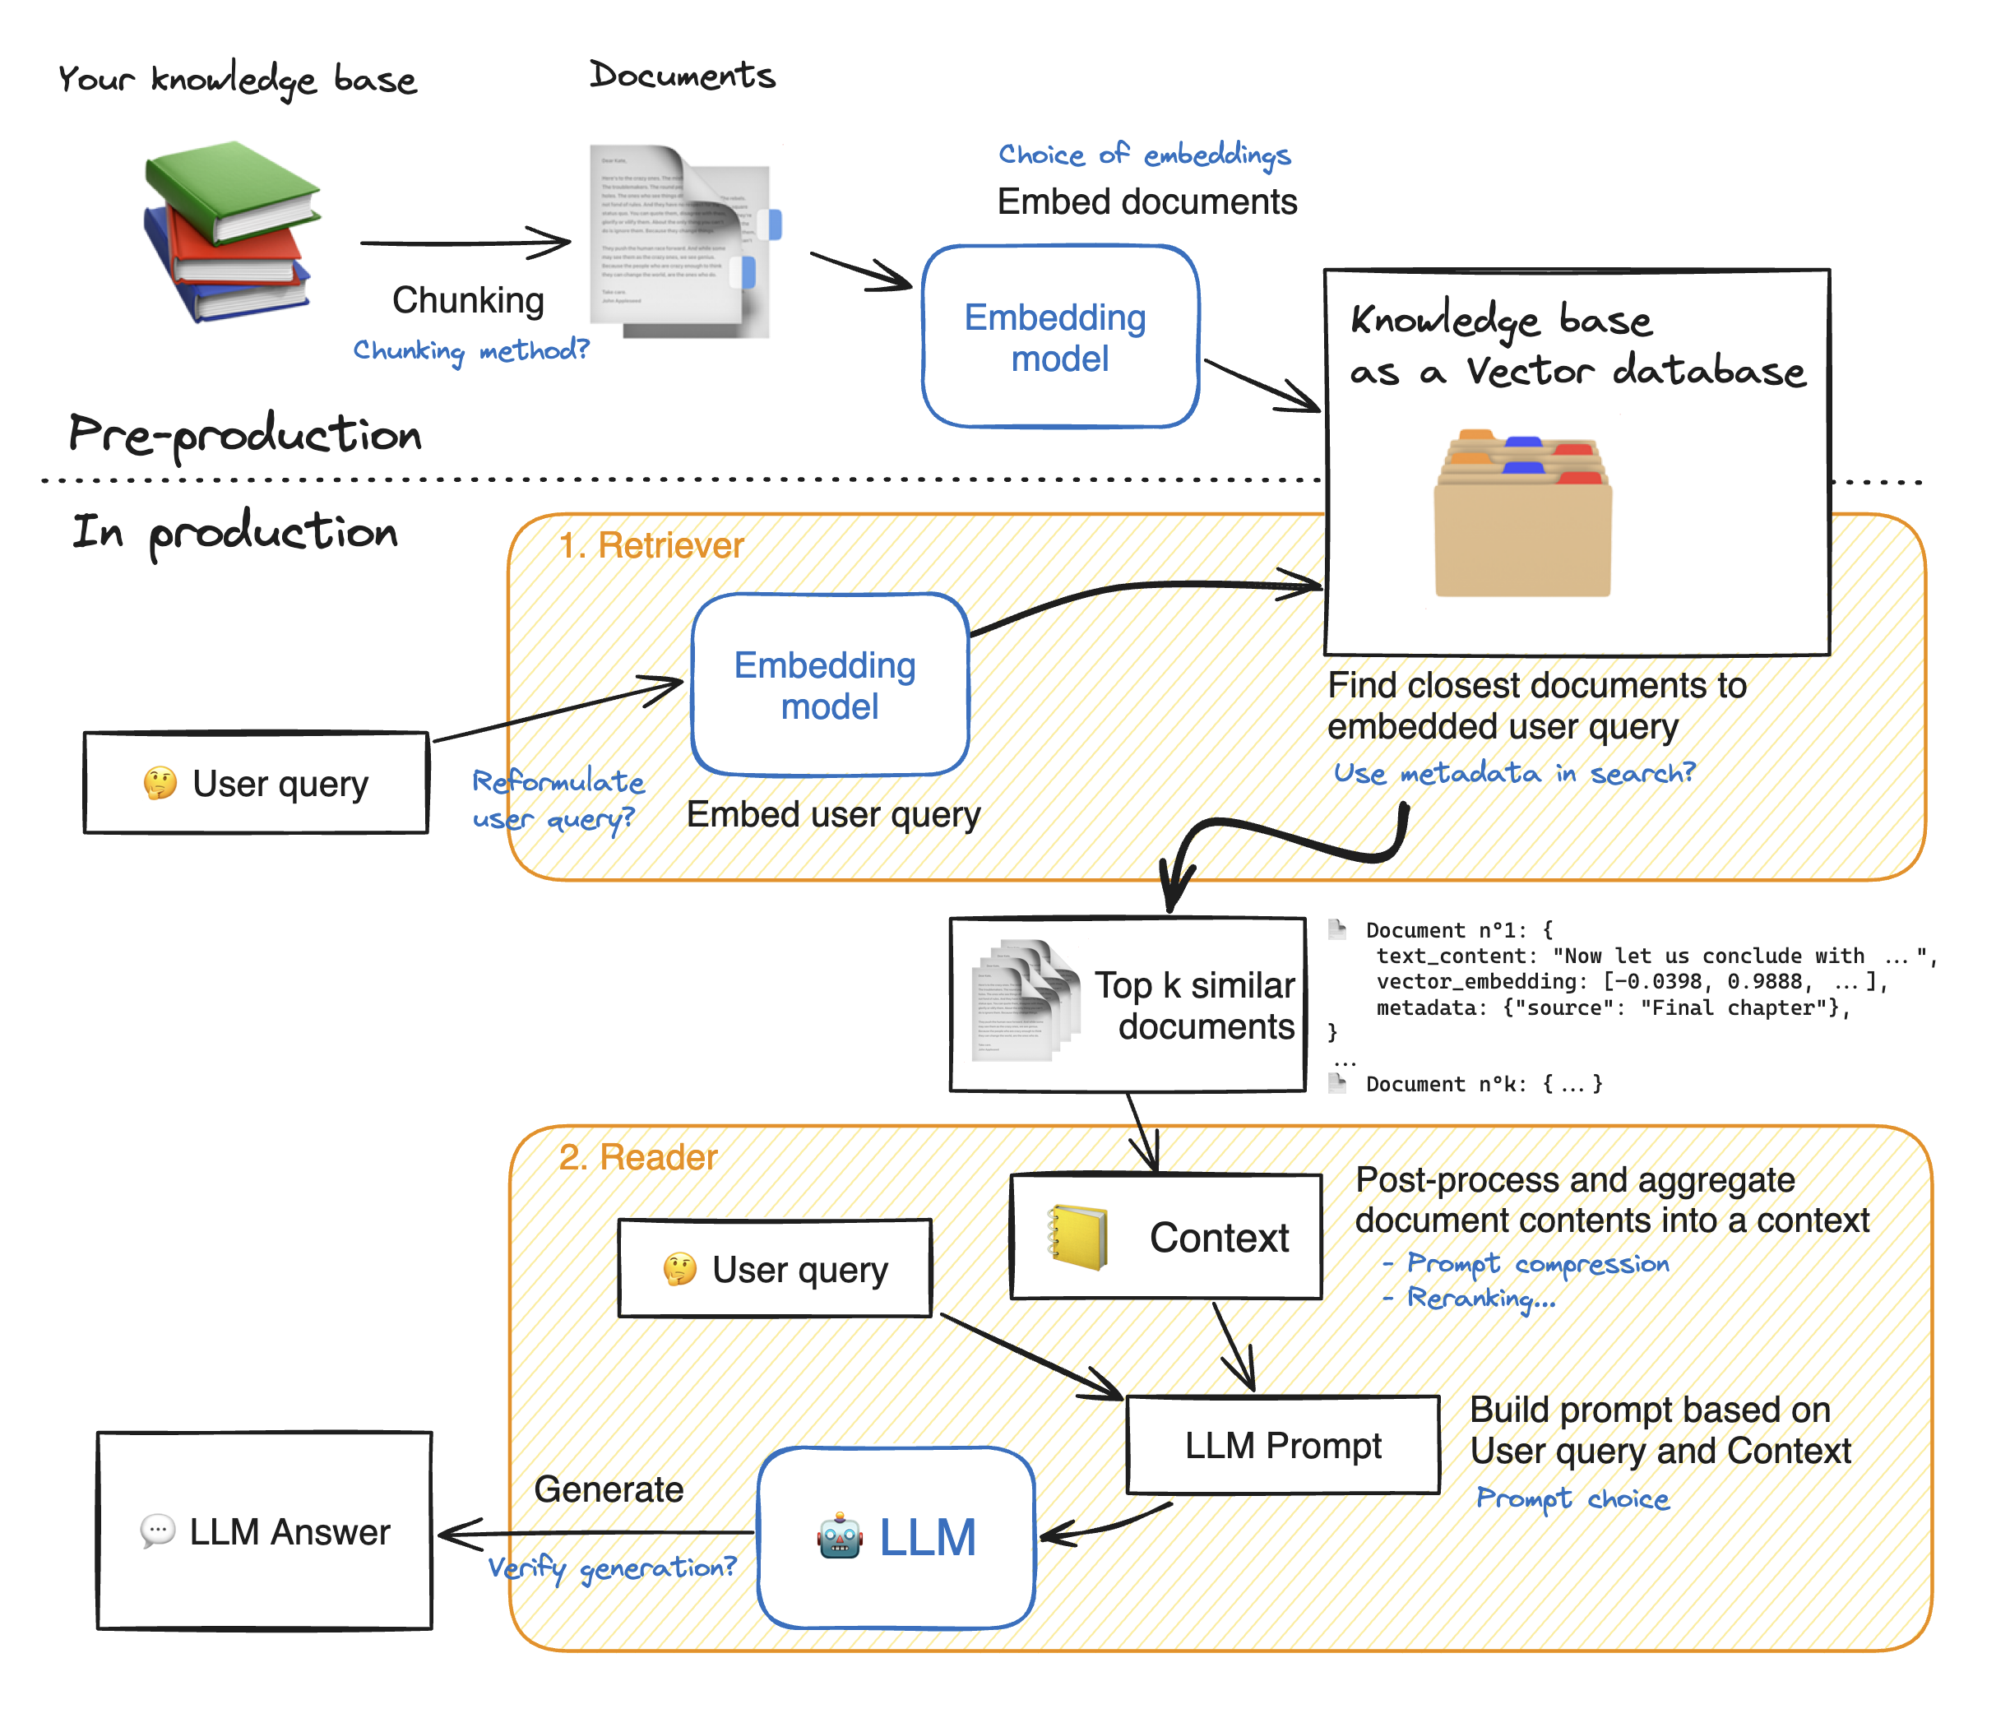
RAG Architecture
Source - https://huggingface.co/learn/cookbook/advanced_rag

Slide 6
Implementation Steps
👤 USER
Ask Insurance Query
📄 Upload Policy PDF
(health-companion.pdf)
📖 PyPDFLoader
Read & Extract Text from PDF
✂ RecursiveCharacterText
Split into Text Chunks
🧠 HuggingFace Embeddings
all-MiniLM-L6-v2 Model

Slide 7
Implementation Steps Cont..
🗄 FAISS Vector Database
Store Vector Embeddings
🔍 Retriever (Top-K = 3)
🤖 Google FLAN-T5 Base Generate Context-Based Answer
💬 Final Answer + Source Page

Slide 8
Technology Stack
Category | Technology Used
Programming Language | Python 3.12
Development Environment | Google Colab, Jupyter Notebook
AI Model | Google FLAN-T5 Base
Framework | LangChain
Embedding Model | all-MiniLM-L6-v2
Vector Database | FAISS
Document Loader | PyPDFLoader
Text Chunking | RecursiveCharacterTextSplitter

Slide 9
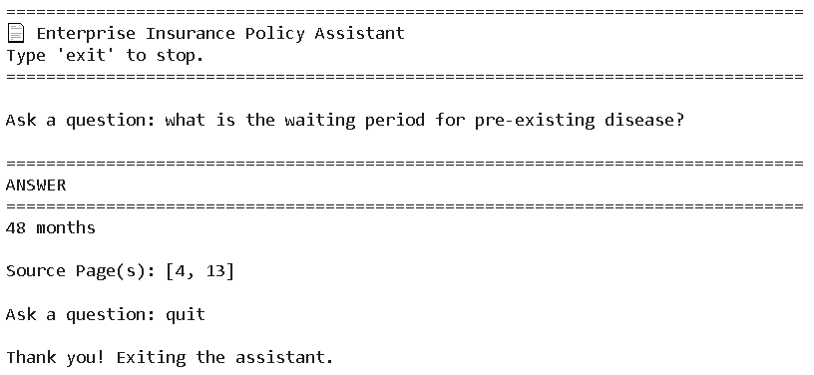
Output

Slide 10
Conclusion
This project demonstrates how Retrieval-Augmented Generation (RAG) can enhance traditional Large Language Models by integrating semantic document retrieval with contextual answer generation, resulting in accurate, explainable, and reliable responses for enterprise insurance policy documents.

Slide 11
Future Enhancements
🌐 Deploy with Streamlit
📚 Support multiple insurance policies
🗣 Voice-based querying
🤖 Upgrade to Llama or Mistral

Slide 12
Questions?
Thank You

