Slide 1


DETECTION OF WEB ATTACKS BASED ON LOGS USING DEEP LEARNING
GLOBAL ACADEMY OF TECHNOLOGY
Ideal Homes Township, Rajarajeshwari Nagar, Bengaluru – 560 098
Final Project Presentation
Domain Name: Group Number:
Cyber security and deep learning G-3
Presented By: Guided By:
Architha.J 1GA17IS001 Prof.Deepthi.V.S
B.U.Kavya 1GA17IS005
Sri Harsha.A. 1GA17IS038
Varsha Venkatesh 1GA17IS045

Slide 2
INTRODUCTION
Today’s interconnected world makes everyone more susceptible to cyber-attacks.
Many authorized institutions like the financial institutions, military, government agencies etc. have confidential data that's stored on computers and transmitted to networks.
With growing cyber-attacks, it has become necessary to safe guard this sensitive data and private information.
As cybercriminals are getting more advanced, there is a requirement to know their change in target, how are that affecting organizations, and their methods used in targeting.
Web applications do raise variety of security issues from improper cryptography. Serious vulnerabilities permit criminals to gain direct access to databases so as to steal sensitive data – this is often known as web attack.
17ISP85

Slide 3
INTRODUCTION
Few security issues with web applications are XSS attacks, SQL injection, Local file inclusion, Path traversal and many more. Among these, SQLi and XSS are the two major web application attacks.
Effects of these attacks include: Authentication bypass, information disclosure, compromised data integrity, user’s session hijacking, and access cookies.
Objectives of proposed framework:
Detecting the presence of an attack on the website.
Classification of SQL injection attacks.
Classification of Cross-site scripting (XSS) attacks.
Prevention of SQL injection and Cross-site Scripting attacks.
17ISP85

Slide 4
LITERATURE SURVEY
Title of the paper and year | Methodology | Merits | Demerits
SQL Injection Detection Using Machine Learning Year: (2019, San Jose State University) | Naïve Bayes Classifier and Gradient Boosting Classifier from ensemble machine learning approaches to classify and detect SQL Injection attacks | Identifies union based, error based and Boolean SQL injections Good accuracy | Gradient Boosting approach is computationally expensive than simple classifiers in terms of memory and computation. More memory is needed to store multiple trees.
Detection of SQL Injection Attacks: A Machine Learning Approach Year: (2019, ICECTA) | a machine learning based heuristic algorithm to prevent the SQL injection attack. | system is also scalable is a sense that any enhancement can be easily implemented with minor modification. | more non-injected SQL statements need to be considered in the dataset
Log based Dynamic Intrusion Detection of Web Applications Year(2019,Indian Institute of Technology, Kanpur) | A new machine learning based IDS which feeds on the log files of the web applications to detect attacks like SQLi , XSS, CRLF etc. (LR, SVM, gradient boosting , decision trees,KNN,random forest) | proposed work gives a good average detection accuracy of 99.02% | This can be extended to all the other areas like ‘Accept-Encoding,’ ‘Cookie,’ ‘Referrer’, etc.
SQL Injection Detection for Web Applications Based on Elastic-Pooling CNN Year: (2019,School of Information and Communication Engineering) | This paper proposes elastic pooling CNN technique to detect SQL injections. | Based on the irregular matching characteristics, it can identify new attacks and is harder to bypass. | Regular technology has high recognition accuracy and speed, but it cannot identify new attacks. It is inevitable that new bypassing methods will emerge to avoid rules such as URL multiple encoding.
17ISP85

Slide 5
Title of the paper and year | Methodology | Merits | Demerits
Detection of SQL Injection Attacks by Removing the Parameter Values of SQL Query Year: (2018, IEEE ) | The proposed workflow is to Compare the static and the dynamic query, And based on the result it is detected as SQL attack or not | Combining existing SQL injection detection mechanisms to develop more strong mechanism to make web application more robust | work on efficient methods for detecting the SQL injection attack and methods to prevent it. A less time must be consumed to detect the SQL injections.
Research on SQL injection detection technology based on SVM Year:(2018, MATEC Web of Conferences) | SVM algorithm word2vec method is selected to process the text data of HTTP requests | The proposed method effectively solves SQL injection mutation and overcomes the defects of the existing rule matching methods | Large numbers of dataset required Word2vec consumes large memory
Detecting Cross-Site Scripting Attacks using Machine Learning Year: ( 2018, City, University of London Institutional Repository) | This paper detects using KNN, RF, SVM algorithms and compares them to provide better accuracy. | Structural and behavioral functions of XSS are checked and therefore accuracy increased | Future works: Neural network classifier
Detecting Web Attacks Using Multi-Stage Log Analysis Year:(2017, San Jose State University, USA) | This work proposes a multi-stage log analysis architecture, which combines both pattern matching and supervised machine learning methods. | The trained model had good accuracy with less probability of false alarm | The techniques used are not compactable with the updated technologies.
17ISP85

Slide 6
Title of the paper and year | Methodology | Merits | Demerits
CROSS SITE SCRIPTING (XSS) attack detection using intrusion detection system Year: (2017,ICICCS) | Here they are introducing snort rule that can detect XSS Attack efficiently and create an alert entry for it in snort alert file. | After successful implementation of rule, XSS attack was able to be detected through Alert File containing details of the attack and attack was also logged in the form of dumps. | Few false-positive were generated, not able to see the rejected packets on Iptables output.
XSS Classifier: An Efficient XSS Attack Detection Approach Based on Machine Learning Classifier on SNSs Year: (2017,Journal of information processing systems) | The proposed methods is usage of AD Trees and decorate algorithms to detect the attack. | The features selected are URL, HTML tags. In addition, The Social Networking services (SNSs) features are added to provided to enhance the accuracy. | Enhancement in feature set and usage of Advance learning algorithm such as deep learning.
17ISP85

Slide 7
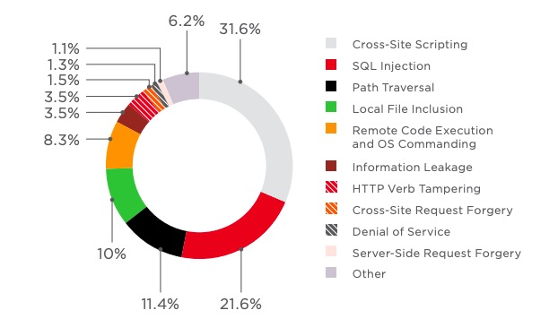
PROBLEM STATEMENT
In today’s technical environment, cyber attacks have increased dramatically over the last decade, exposing sensitive personal and business information.
The threat of attacks on web applications to extract data or to distribute malicious code persists.
Few major security issues of web applications are XSS, SQL injection.
Effects :Alter or modify the normal application behavior, authentication bypass, information disclosure, compromised data integrity, user’s session hijacking, access cookies.
17ISP85

Slide 8
SYSTEM REQUIREMENTS
Hardware:
Processor: Intel Core i5 , RAM: 4GB or more , Hard disk: 50 GB or more ,
Display: Monitor(1024*768 pixels) or higher resolution monitor with 32 bit color settings.
Software:
Operating System: Kali Linux, Windows
Languages:
Programming language: Back - End: PYTHON
Programming language: Front - End: HTML,CSS,PHP
Tools:
Development Environment: SUBLIME/ ANY OTHER PYTHON IDE
Application Server: XAMPP
Database: MYSQL
17ISP85

Slide 9
PROPOSED SYSTEM
User input
Web portal
Extraction of user input and log file in desired format
Intrusion Detection Model
Classification of XSS/SQLi attacks
Grant or revoke access
Security model
17ISP85

Slide 10
DATA FLOW DIAGRAM
Level -0
User data and log data
user data
Website
User
Anomaly detection system
17ISP85
Grant access or block
Sqli/xss/no threat

Slide 11
Level -1
Web Portal
User
User data
Login
Search data
Add data
Admin
Computed output
Creates
Log Data
Input User query
Input Log Data
Grant
access
Deep Learning Algorithm
Learning Algorithm
Revoke
access
17ISP85
17ISP78
Classification
SQLi / XSS / no threat
Classification
SQLi / XSS /robot/DOS
Malicious
or not
Anomaly Detection System

Slide 12
GANTT CHART
Task Name | Oct 2nd week | Oct 2nd week-4th week | Nov 1st week-4th week | Dec 1st week- 4th week | Jan 1st week-4th week | March1st week-4th week | April 1st week-4th week | May 1st week – june 4th week | July 2nd week
Identification of problem statement
Approval of title and project synopsys
Literature survey
Design
Coding and Implementation
Testing and debugging
Reporting and documentation
17ISP85

Slide 13
DETAILED DESIGN
Module - 1
  Module Name: Classification of query string
  Description: Analysis of query string and classifying it into sqli, xss or a normal input.
  Methodology:
  Sub module 1: Detection of SQLi
  A dataset was prepared using the kali-Linux tool “sqlmap”. Sqlmap allows injecting malicious queries into our website, since some queries cannot be included by the tool these are included manually.
  The dataset is preprocessed through CountVectorizer available in sklearn.feature_extraction.text. The CountVectorizer provides a simple way to both tokenize a collection of query statements and build a vocabulary of known words. This encoded vector is a sparse matrix that is provided as input to the multilayer neural network for training and testing.
17ISP85

Slide 14
  This model is saved into a JSON file and weights are stored in the hdf5 file.
  The model is loaded to predict the preprocessed test instance into a binary classification. Based on the result provided to the front end, web portal can grant or deny access to the user.
  Sub module 2: Detection of XSS
  A dataset was prepared using the kali-Linux tool “owasp”. Since the dataset contains Chinese characters such as œ, š, ^, Ÿ, it is necessary to remove them, this can be done by converting it into ASCII characters for the preprocessing of data.
  These values are stored into numeric array are passed into convoluted neural network model for training and testing. For Further use, the model is saved into a JSON file and weights are stored in the hdf5 file and is loaded to predict the preprocessed test instance into a binary classification.
  Another model, with 63 feature set was built to detect xss attacks. The features are selected manually and passed through a multi-layer perceptron. The model is saved and loaded when the script is called.
  Input: Query string
  Output: Binary classification(Malicious or not)
17ISP85

Slide 15
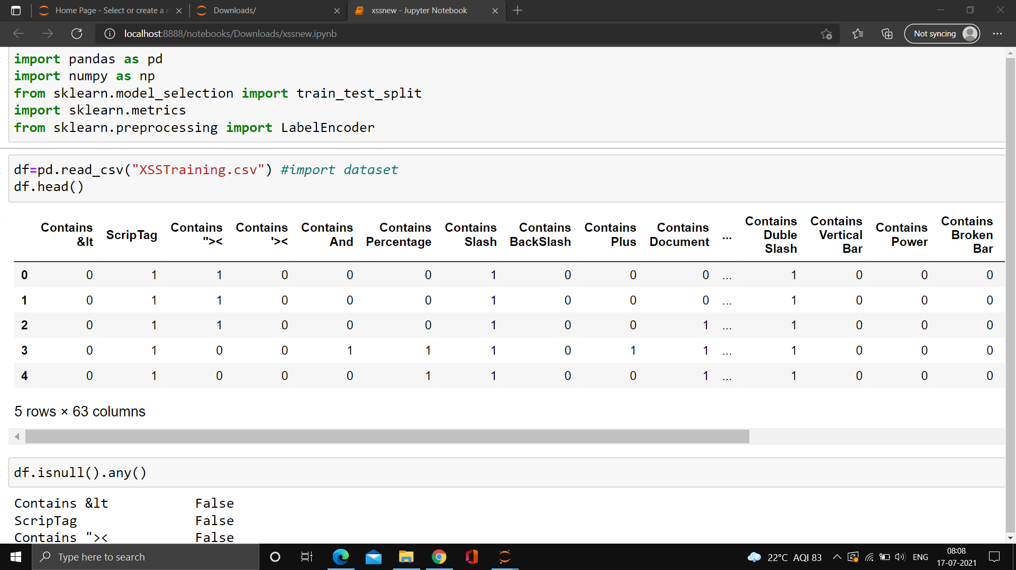
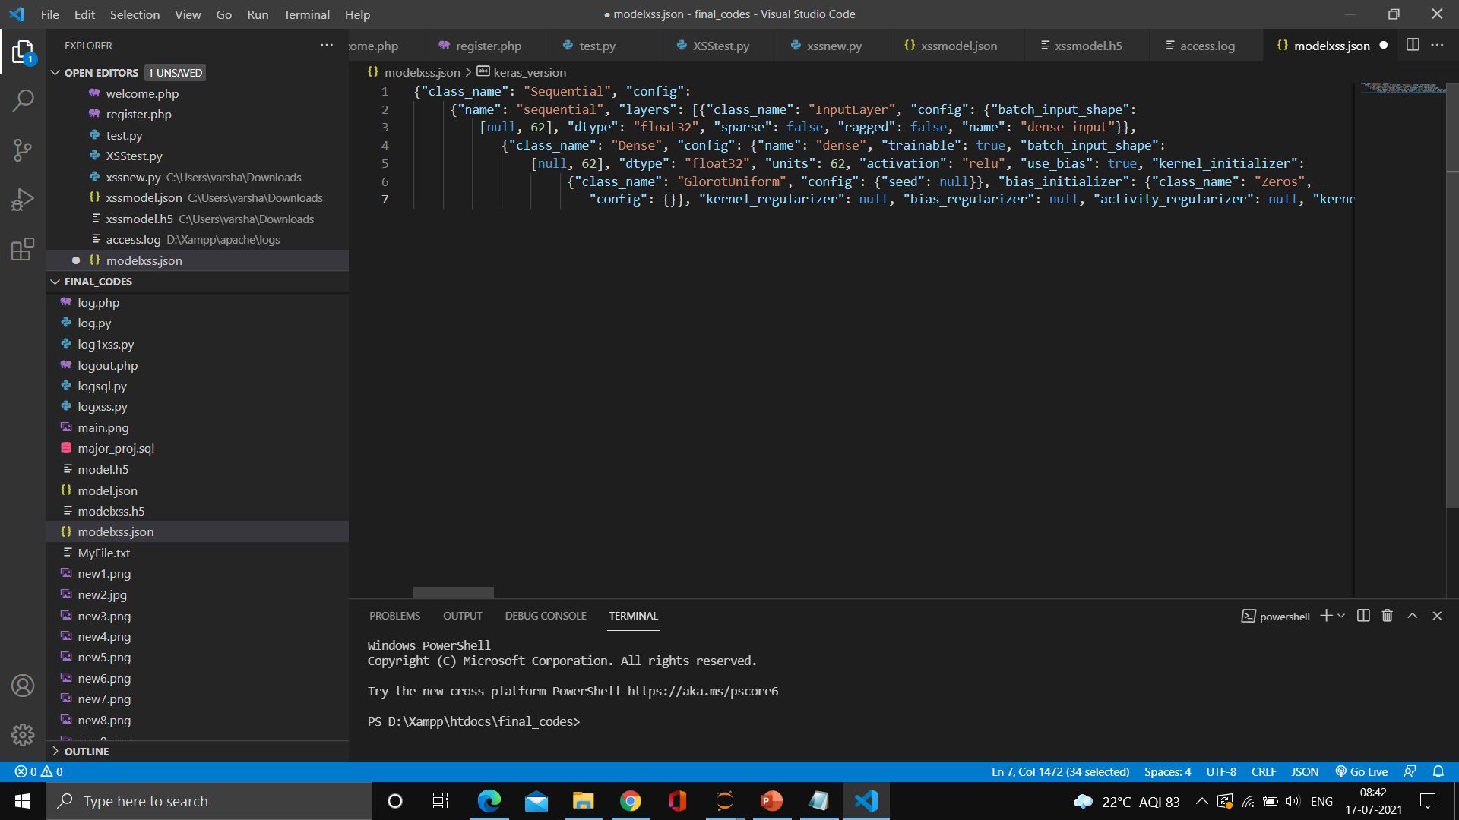
Feature set
17ISP85
.json format

Slide 16
Module - 2
  Module Name: Classification using log data
  Description: Analysis of log data from the website and classifying it into SQLi, XSSS, DOS or a normal input.
  Methodology:
  All the requests sent to a server will be stored in access.log file. Using Apache log parser, the log data is split into required format. The following fields: IP address, Date, Time, Method, Requested URL, Status code, number of Bytes received, Source URL and User agent are extracted from the log file and stored in pandas dataframe. Based on the values of different fields and patterns in log data, the log analysis is done to classify the type of request into DOS, Human, Robot, SQLi and XSS request. Based on certain features such as number of requests, source URL and other features, the requests can be classified into DDOS, robot, SQLi, XSS.
  Input: Log file data
  Output: Classification of log data into DOS, Robot, SQLi, XSS.
17ISP85

Slide 17
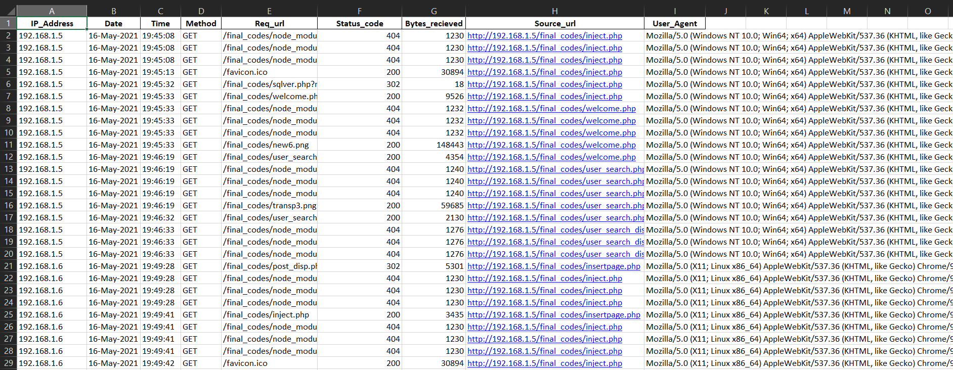
17ISP85
Log data in data.xlsx

Slide 18
IMPLEMENTATION
Detection of SQLi using Multilayer Neural network
  A multilayer perceptron (MLP) is a class of feedforward artificial neural network (ANN). This sequential model can be constructed through Keras which is a open source software library. The layers of the neural network can be constructed through “layers” module in Keras.
  The model consist of 1 input layer , 2 hidden layers and 1 output layer. The output from hidden layers are batch normalized and passed through dropout layer which removes certain neurons from a neural network at each training step to avoid overfitting of the model.
  The input layer consists of 20 neurons and ‘relu’ activation function is used. The first hidden layer consists of 10 neurons and ‘tanh’ activation function is used. The second hidden layer consists of 1024 hidden neurons with ‘relu’ activation function. The output layer consist of one neuron with sigmoid activation function to classify as Malicious or not.
17ISP85

Slide 19
Detection of XSS using convoluted neural network
  A convolutional neural network is a special kind of feedforward neural network with fewer weights than a fully-connected network. TensorFlow is an open-source library of software for dataflow and differential programing for various tasks. Keras is a open source software library. A Convoluted Neural Network can be created by using Tensorflow and keras.
  A 11 layer network is constructed which consist of 1 input layer, 5 hidden layers with 3 maxpooling and 1 flatten layer, and 1 output layer.
  The input layer consists of 64 neurons and relu activation function. The first hidden layer has 128 neurons and second & third hidden layer consists of 256 with relu activation function. The fourth and fifth hidden layer consists of 128 and 64 hidden neurons with ‘relu’ activation function. The output layer consist of one neuron with sigmoid activation function to classify as Malicious or not.
17ISP85

Slide 20
Detection of XSS using multilayer perceptron
  The features are manually extracted through a script and these extracted features are provided to a multilayer perceptron.
  The model consist of 1 input layer , 2 hidden layers and 1 output layer.
  The model uses binary cross entropy as the loss function with adam optimizer.
  Binary cross entropy compares each of the predicted probabilities to actual class output which can be either 0 or 1. It then calculates the score that penalizes the probabilities based on the distance from the expected value. That means how close or far from the actual value.
  Adam is an optimization algorithm that can be used instead of the classical stochastic gradient descent procedure to update network weights iterative based in training data.
17ISP85

Slide 21
Log Analysis
  For identification of DOS: The Source URL, User agent will be blank and status code is 400 and number of requests from a particular IP at a particular instance of time will be more than the usual value.
  For identification of robot: The source URL will be blank. The user agent may be:
    sqlmap, owasp or any such automation tools.
    Browsers like Chromium, Firefox, etc.
  If the user agent is an automation tool the request can be classified directly into Robot. Else, The source URL will be blank and number of request will be high for both type of User agent. All request apart from robot and DOS is considered to be requested by humans.
  For identification of SQLi attack: The URL contains the data entered by the user which is decoded and passed to the deep learning algorithm to classify into malicious and benign.
  For identification of XSS attack: The URL contains the data entered by the user which is decoded and passed to the deep learning algorithm to classify into malicious and benign.
17ISP85

Slide 22
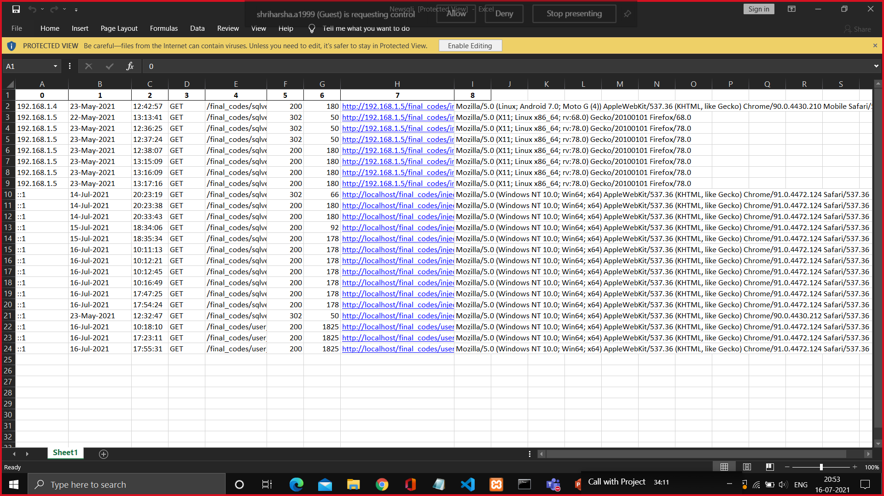
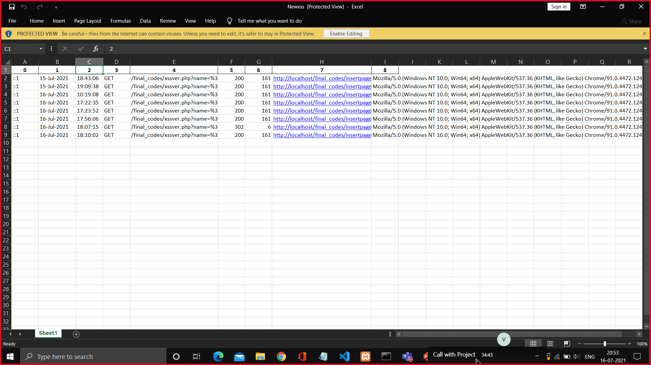
Sqli attack requests
17ISP85
Xss attack requests

Slide 23
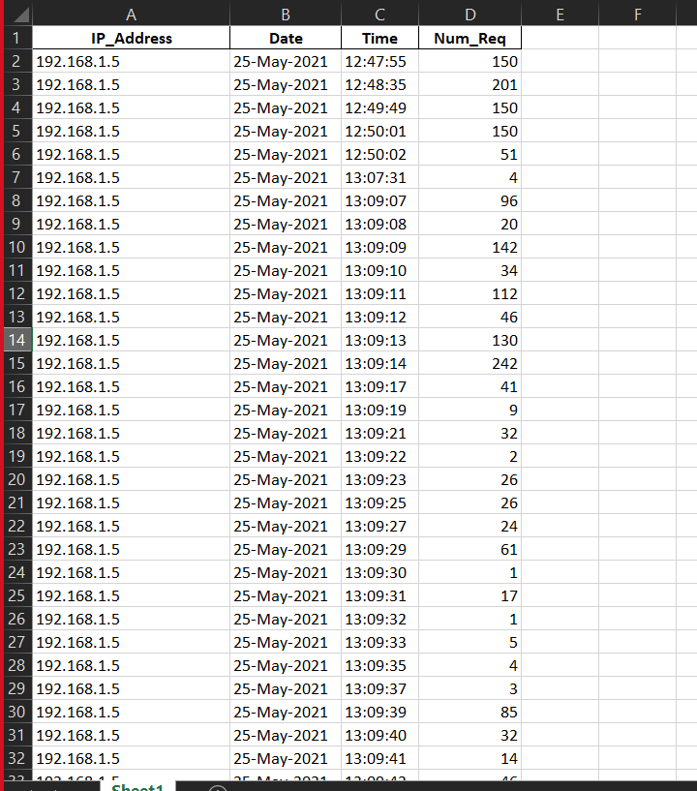
Dos attack requests
17ISP85

Slide 24
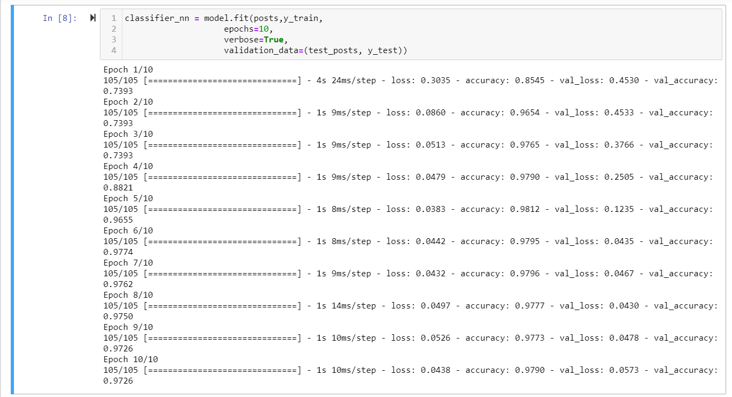
EXPERIMENTAL RESULTS
17ISP85
Multilayer Neural network
Accuracy | 0.9726190476190476
Precision | 1.0
Recall | 0.8949771689497716
Confusion Matrix | [[621, 23], [0, 196]]

Slide 25
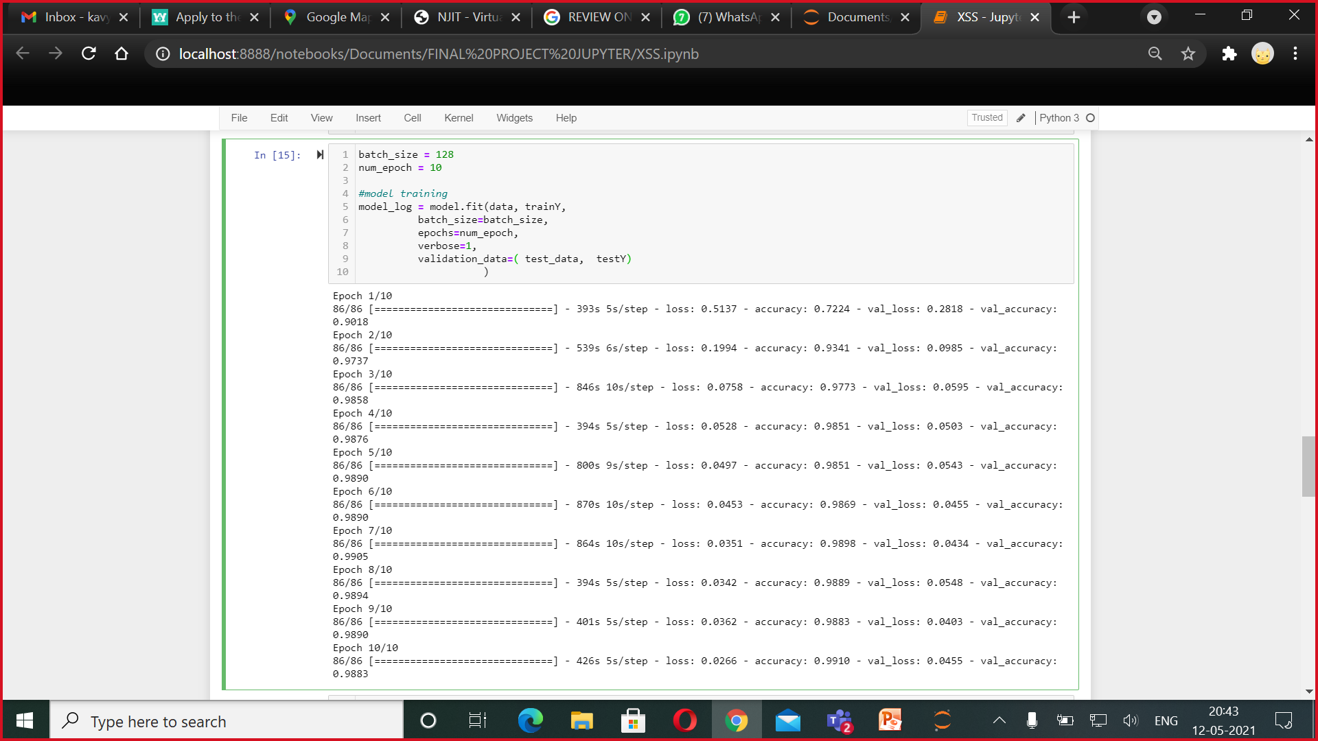
17ISP85
Convoluted Neural Network
Accuracy | 0.9883387874360847
Precision | 0.9925373134328358
Recall | 0.9891818796484111
Confusion Matrix | [[1248, 16], [11, 1463]]

Slide 26
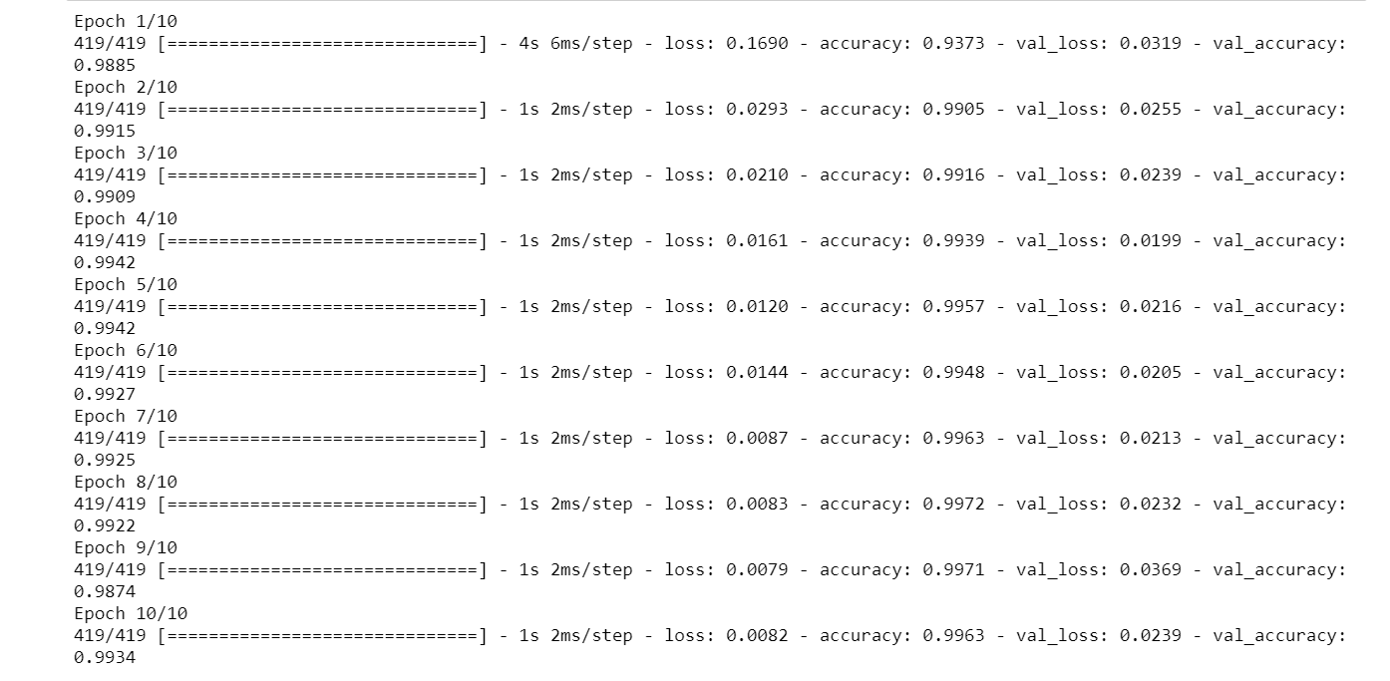
17ISP85
Multilayer Perceptron model for XSS
Accuracy : | 0.9877763290918599
Precision : | 0.9824561403508771
Recall : | 0.9936628643852978
Confusion matrix: | [[4131, 10], [28, 1568]]

Slide 27

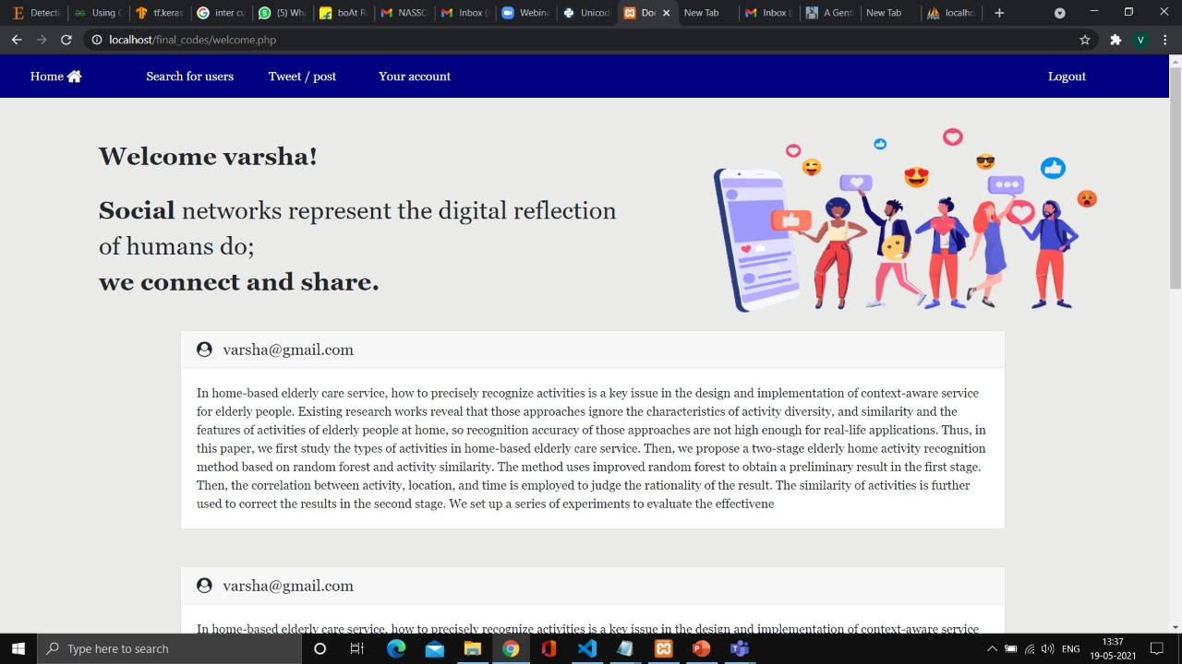
17ISP85

Slide 28

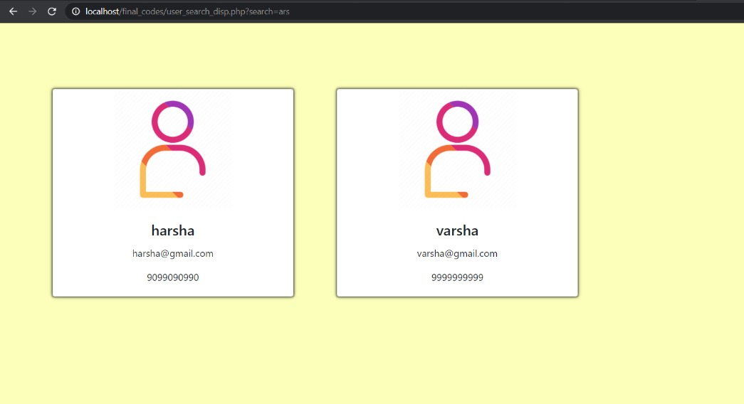
17ISP85

Slide 29
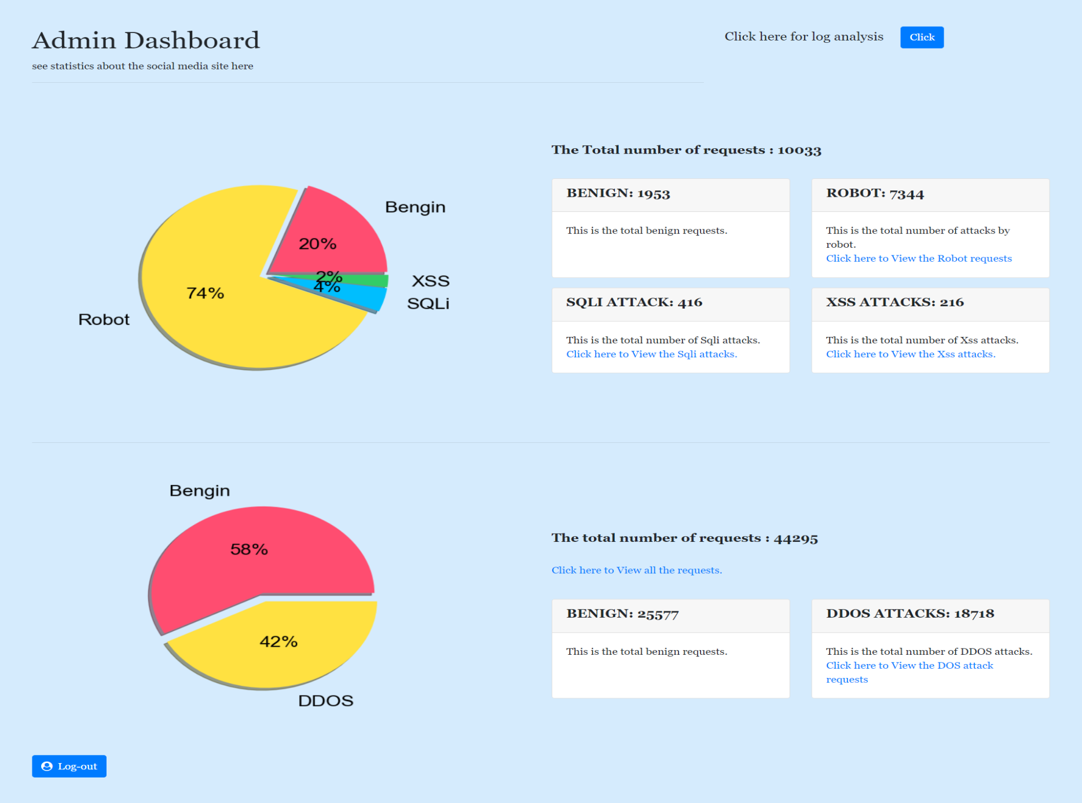
17ISP85
Log Analysis Results

Slide 30
CONCLUSION
Website on social media theme is developed in php script to analyze and demonstrate the SQLi and XSS attack in a real time environment.
The Multilayer neural network that is developed to detect SQLi yields an accuracy of 97.26%.
The Convoluted neural network that is developed to detect XSS yields an accuracy of 98.83%.
The Multilayer perceptron is developed to detect XSS with accuracy of 98.77%.
Log analysis module classifies DOS, XSS, Sqli, Robot attacks accurately.
  A survey paper on detection of SQLi and XSS attack is published in Journal of Emerging Technologies and Innovative Research.
  A paper on our implementation will be published soon.
17ISP85

Slide 31
REFERENCES
[1] Sonali Mishra, “SQL Injection Detection Using Machine Learning”, San José State University, 2019,USA.
[2] Musaab Hasan, Zayed Balbahaith, and Mohammed Tarique, “Detection of SQL Injection Attacks: A Machine Learning Approach”, International Conference on Electrical and Computing Technologies and Applications (ICECTA) , 2019.
[3] Harsh Bhagwani,“Log based Dynamic Intrusion Detection of Web Applications”, Indian Institute of Technology, Kanpur, 2019.
[4] Xin Xie, Chunhui Ren, Yusheng Fu , Jie Xu , and Jinhong Guo “SQL Injection Detection for Web Applications Based on Elastic-Pooling CNN”, 2019 IEEE.
[5] Rajashree A. Katole, Dr. Swati S. Sherekar, Dr. Vilas M. Thakare, “Detection of SQL Injection Attacks by Removing the Parameter Values of SQL Query”, Proceedings of the Second International Conference on Inventive Systems and Control (ICISC 2018) and IEEE , 2018.
17ISP85

Slide 32
[6] Zhuang Chen, Min Guo, Lin zhou, “Research on SQL injection detection technology based on SVM”, MATEC Web of Conferences, 2018.
[7] Fawaz A. Mereani and Jacob M. Howe, “Detecting Cross-Site Scripting Attacks using Machine Learning”, City, University of London Institutional Repository, 2018.
[8] Melody Moh*, Santhosh Pininti, Sindhusha Doddapaneni, and Teng-Sheng Moh, “Detecting Web Attacks Using Multi-Stage Log Analysis Year”, San Jose State University, 2017, USA.
[9] Kunal Gupta, Rajni Ranjan Singh, Manish Dixit, “CROSS SITE SCRIPTING (XSS) attack detection using intrusion detection system”, International Conference on Intelligent Computing and Control Systems, 2017.
[10] Shailendra Rathore, Pradip Kumar Sharma, Jong Hyuk Park, “XSSClassifier: An Efficient XSS Attack Detection Approach Based on Machine Learning Classifier on SNSs”, Journal of information processing systems, 2017.
17ISP85

Slide 33
PROOF OF ACCEPTANCE
  Journal Name: Journal of Emerging Technologies and Innovative Research
  Year of Consideration: 2021
  Impact Factor: 7.95
  Publication Frequency: -
  Paper Title: REVIEW ON DETECTION OF SQLi AND XSS ATTACKS
  Published Date with DOI number: 2021/05/12
17ISP85

Slide 34
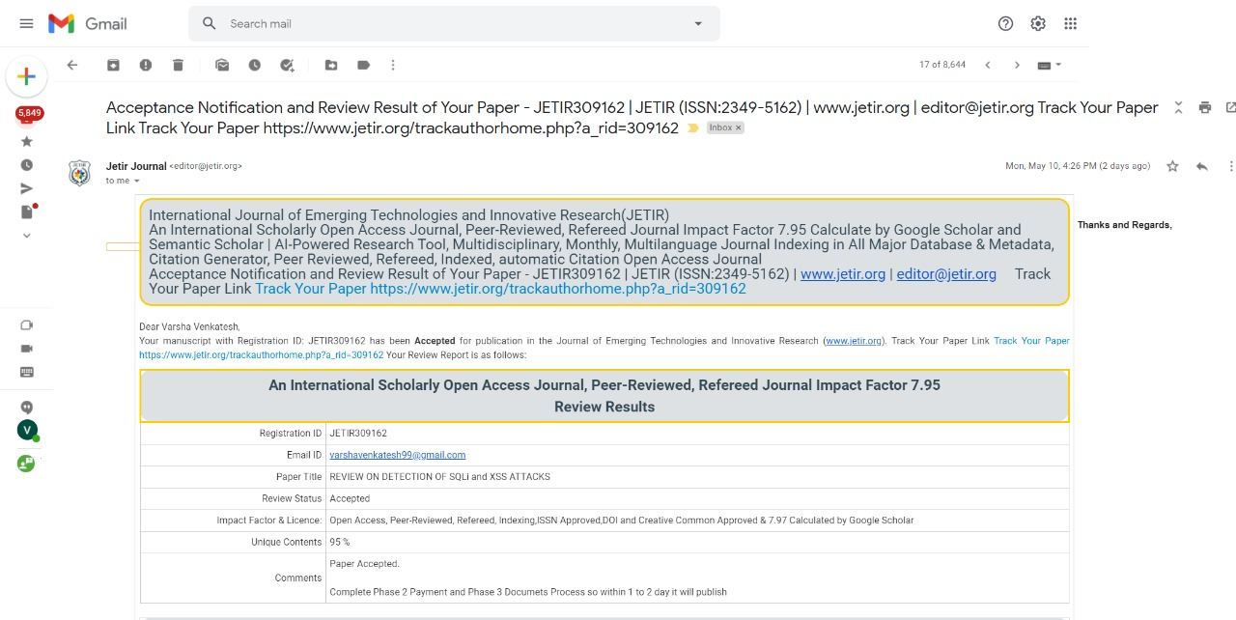
17ISP85

Slide 35
ANY QUESTIONS
THANK YOU
17ISP85

