Slide 1
Detecting Web attacks using Machine Learning
Team Members:
Prajwal Mani(pbm6)
Kavya Umashanker(kbu2)

Slide 2
What is web attack?
A web attack targets vulnerabilities in websites to gain unauthorized access, obtain confidential information, introduce malicious content, or alter the website's content.

Slide 3
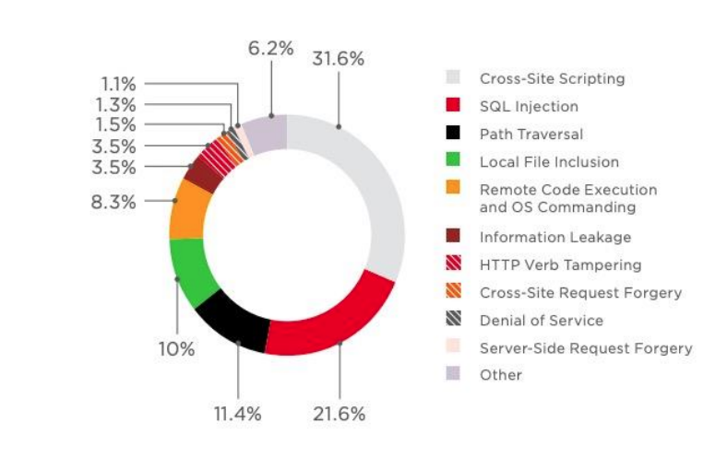
Common web attacks

Slide 4
XSS and SQLI
Cross-site scripting (XSS). This involves an attacker uploading a piece of malicious script code onto a website that can then be used to steal data. Although this strategy is relatively unsophisticated, it remains quite common and can-do significant damage.
SQL Injection (SQLI). This happens when a hacker submits destructive code into an input form. If a system fails to clean this information, it can be submitted into the database where it can change, delete or reveal data to the attacker.

Slide 5
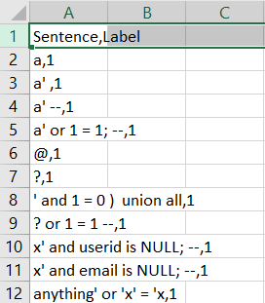
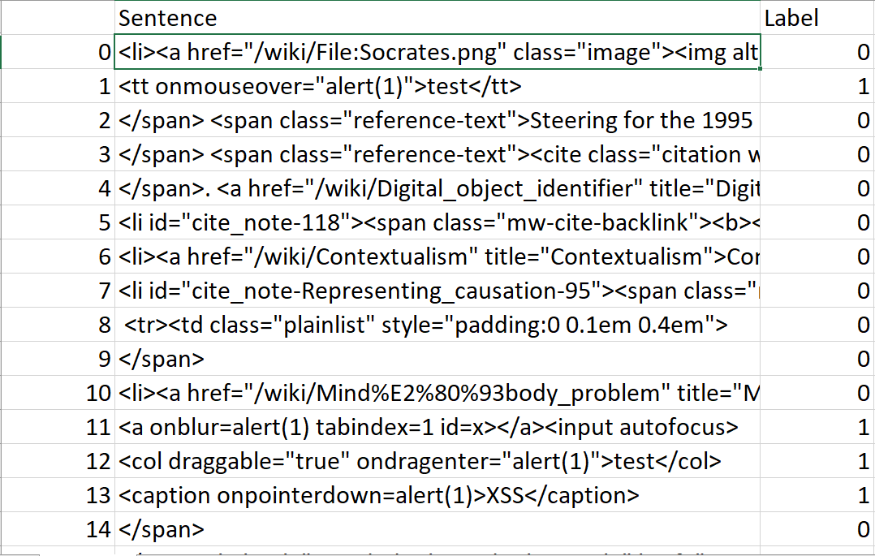
Dataset’s

Slide 6
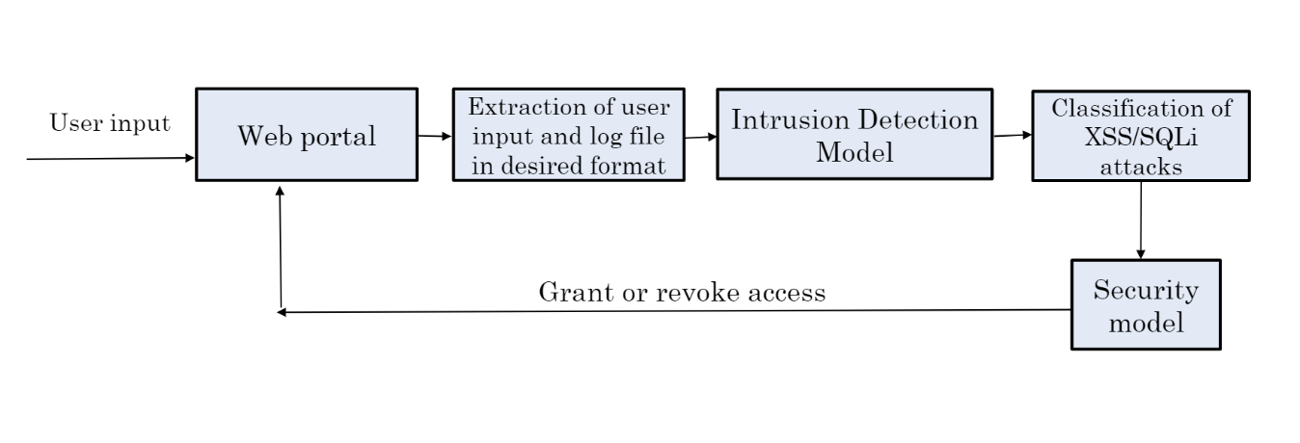
Workflow

Slide 7
Tech Stack:
Backend Language :Python
Front End: HTML,CSS and PHP
Model:Neural Networks
Database:SQL
Datasets : Kaggle
Web Attacks: SQLi and XSS

Slide 8
Models
We have used two models
Multilayer perceptron (MLP) -- SQLI
Convolutional neural network--XSS
We tried out various other models like
Random Forest
Decision Tree
Logistic regression

Slide 9
Demonstration
http://localhost/Onlinebank/home.php

Slide 10
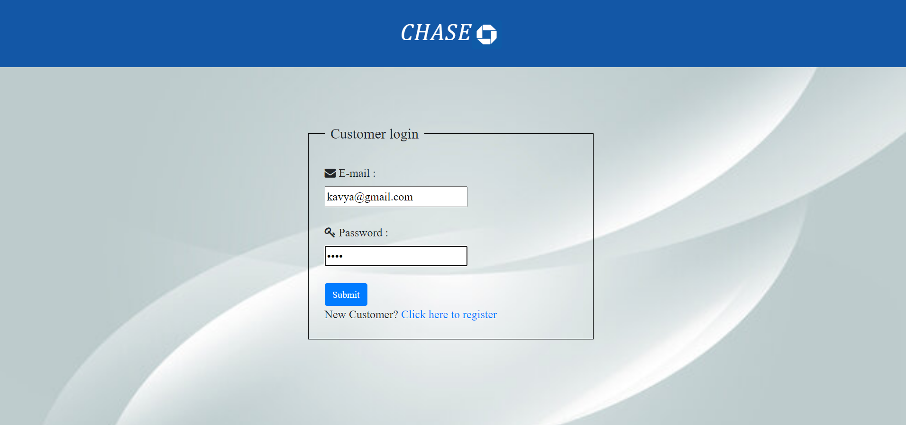
Results:
SQLI: With correct inputs

Slide 11
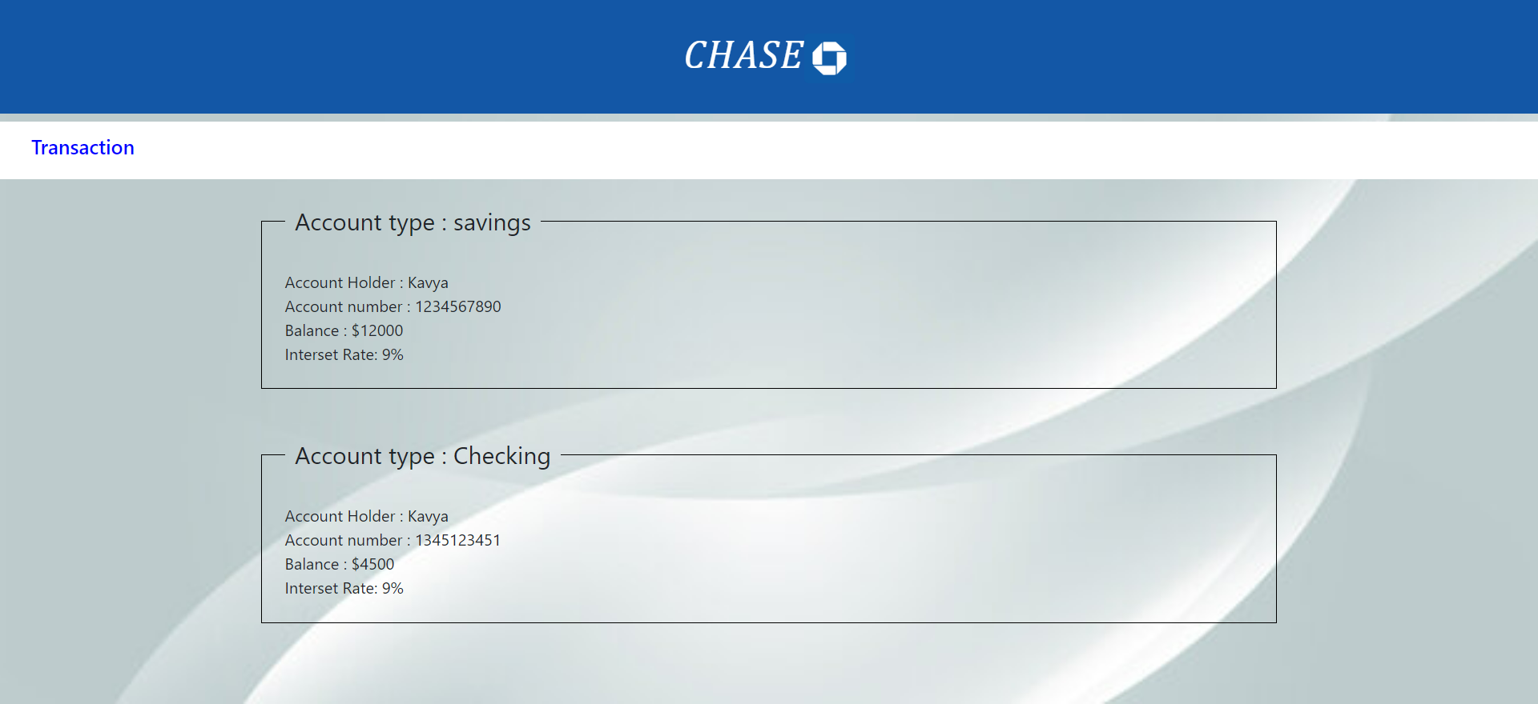

Slide 12
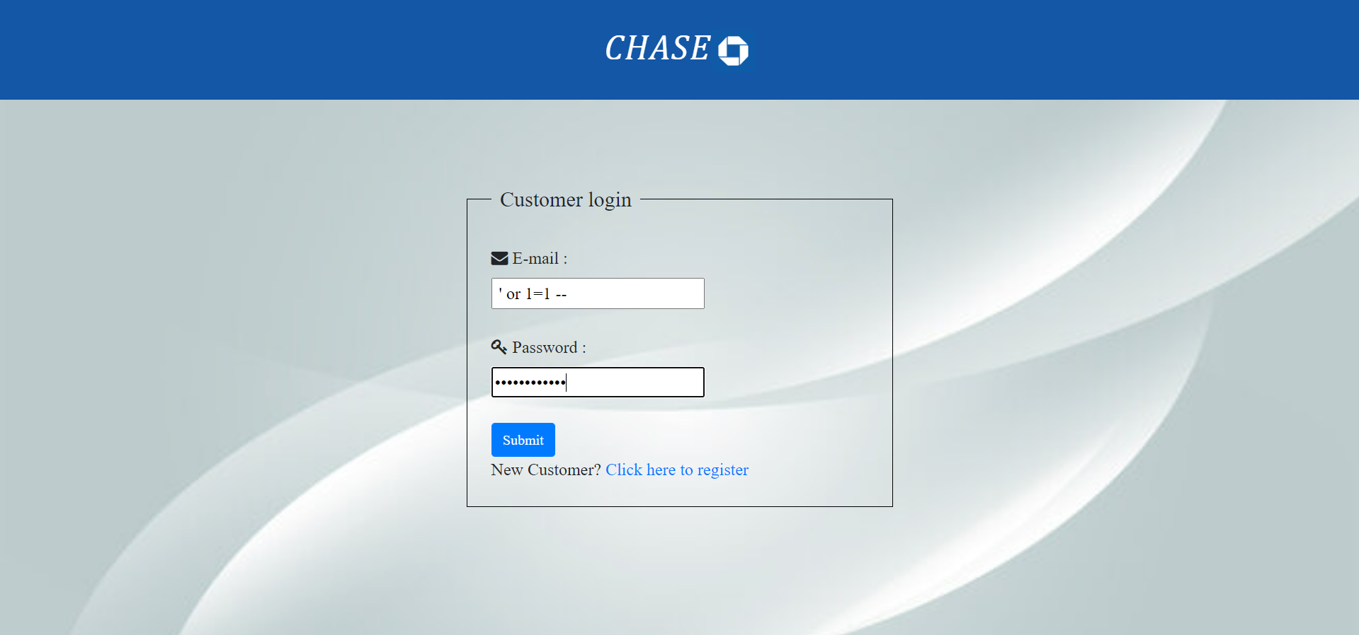

With SQLI attack

Slide 13
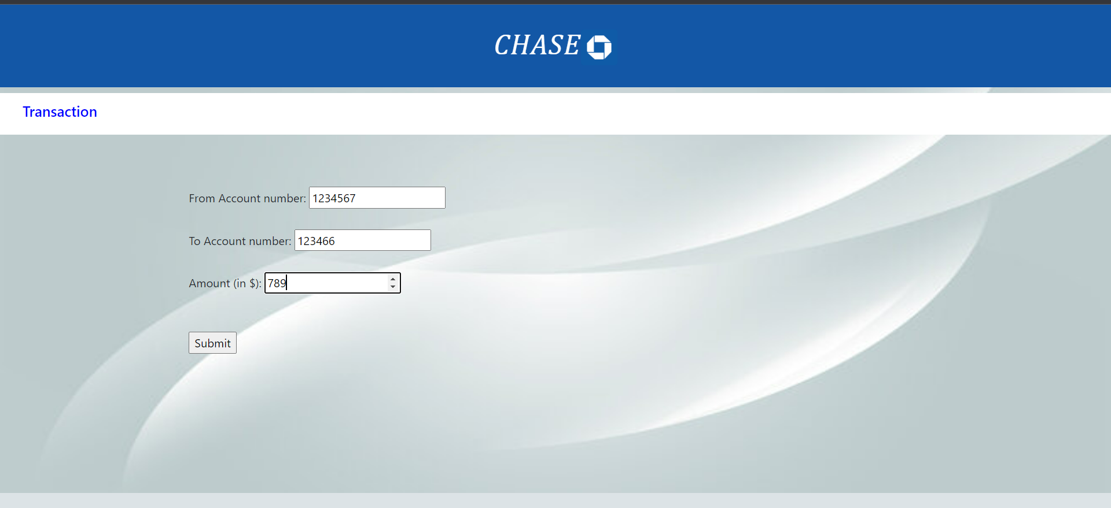
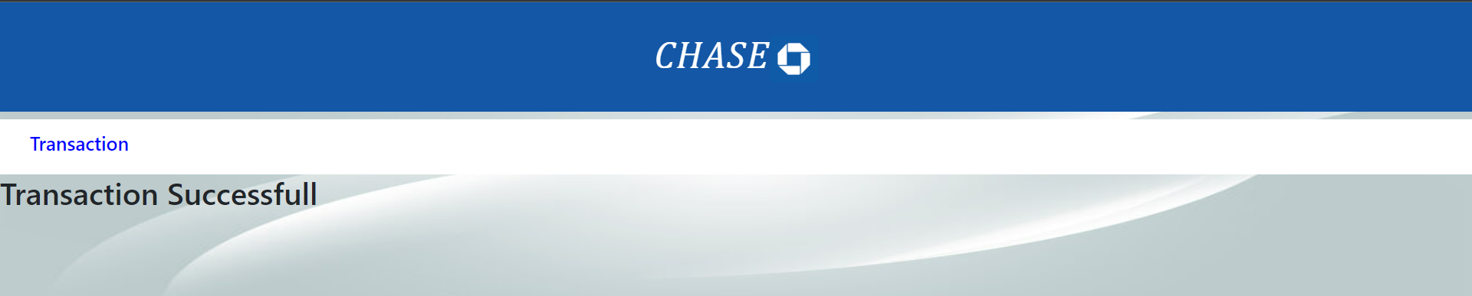
XSS: with correct inputs

Slide 14
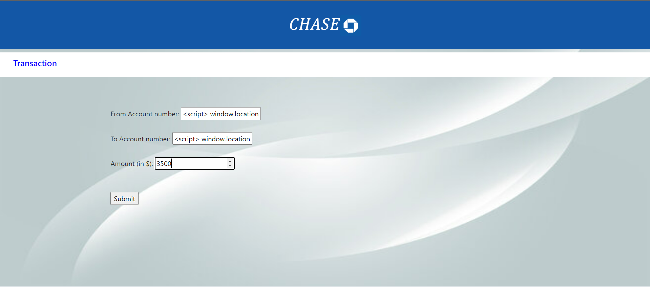

XSS attack:

Slide 15
Thank you!
Any Questions?

