Slide 1
Estimating the economic health of Singapore for 2016
Team 7:
Abhinaya M
Allen Geoffrey Raj
Kavya AK
Preethi Jennifer
Saravanan KS

Slide 2
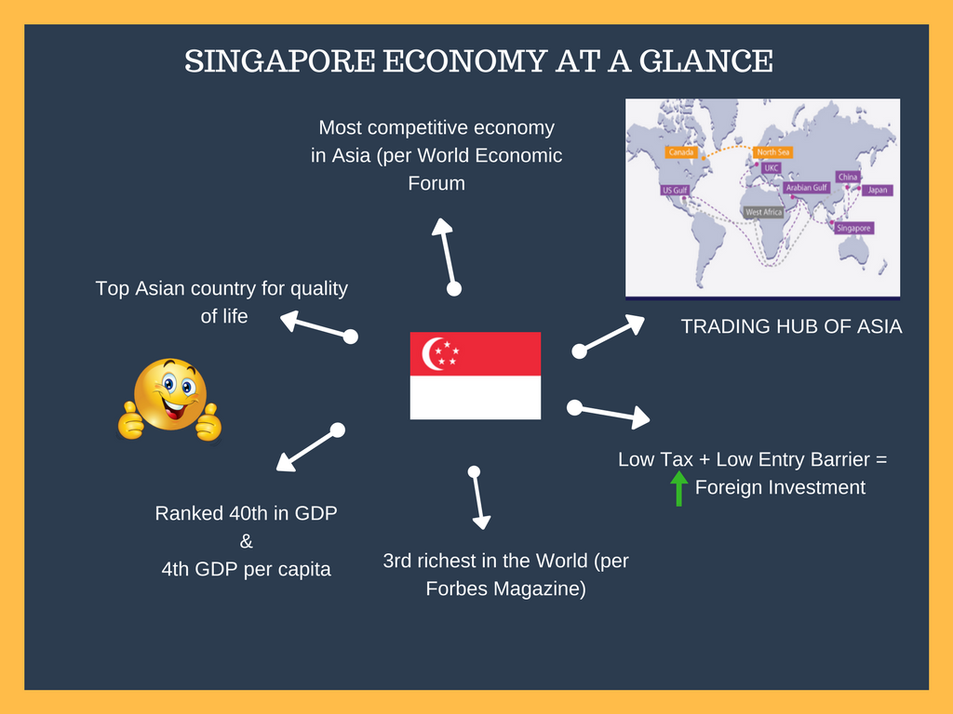

Slide 3
GOAL
Estimating the economic health of Singapore for the year 2016

Slide 4
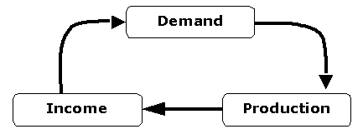

KEY INDICATORS
GDP:
Value of all goods and services produced in the country
Calculated on an annual basis
Best indicator to know about the economy of a country
Inflation:
General increase in prices of good and services
Measured by CPI (Consumer price index)
Excessive inflation and hyperinflation have negative economic consequences
http://www.economicswebinstitute.org/glossary/gdp.htm
http://en.tradimo.com/tradipedia/inflation-rate/

Slide 5
QUESTIONS
What is the GDP growth rate? Where does it stand against comparable developed countries?
Identify the sectors which are contributing the most and least to the GDP to find avenues of improvement.
Identify the biggest trading partners and their trading trend.
Compare inflation of Singapore against comparable developed countries.
To what extent are the job opportunities affecting the economic health of the country?

Slide 6
METRICS
Year wise GDP and CPI
Sector wise GDP
Country wise GDP growth rate
Import and Export growth rate
Unemployment Rate

Slide 7
DATA SOURCE
http://www.imf.org/external/pubs/ft/weo/2016/02/weodata/index.aspx
http://www.tablebuilder.singstat.gov.sg/publicfacing/createDataTable.action?refId=1062
http://www.tablebuilder.singstat.gov.sg/publicfacing/createDataTable.action?refId=1063

Slide 8
Take-aways from the Dashboard
Good
Warning
Bad
Unemployment
Current Account Balance
GDP
Inflation
②
②
⓪

Slide 9
REFERENCE
https://en.wikipedia.org/wiki/International_rankings_of_Singapore
https://en.wikipedia.org/wiki/List_of_countries_by_GDP_(PPP)_per_capita
https://www.mfa.gov.sg/content/mfa/media_centre/singapore_headlines/2012/201202/news_20120226.html
https://www.contactsingapore.sg/en/professionals/why-singapore/about-singapore/singapore-at-a-glance

Slide 10
THANK YOU ☺

