Slide 1
Consumers Goods ad-hoc Insights

Slide 2
OBJECTIVES
Assist the management team to gain more insights about the business
Taken data driven decisions to scale business.
About Data
We have 4 fact tables i.e.. Sales monthly, manufacturing cost, pre invoice deductions, gross price which have measurable metrics and have 2 dimension tables i.e,, customer details and product details.
Sales data is available for fiscal year 2020-2021

Slide 3
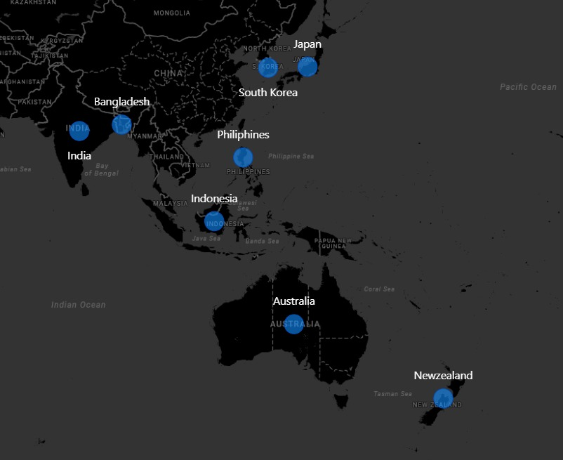
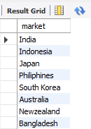
Provide the list of markets in which customer "Atliq Exclusive" operates its business in the APAC region.
Output :
Insights : Atliq Exclusive operates its business in eight countries within the APAC region.

Slide 4

2. What is the percentage of unique product increase in 2021 vs. 2020?
Output :
Insights : In the fiscal year 2020, we had total of 245 products, which increased to 334 in the fiscal year 2021, marking a 36% growth.

Slide 5
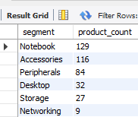
3.Provide a report with all the unique product counts for each segment and sort them in descending order of product counts
Output :
Insights: Notebooks, Accessories and Peripherals are three top segments.

Slide 6
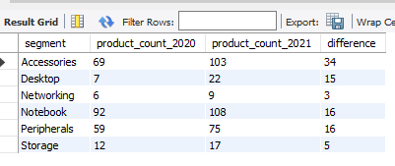
4.Which segment had the most increase in unique products in 2021 vs 2020?
Output :
Insights : Accessories segment had the most unique product in 2020 vs 2021.

Slide 7
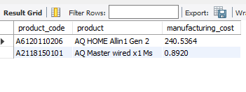
5. Get the products that have the highest and lowest manufacturing costs.
Output :
Insights : AQ HOME Allin Gen 2 has the highest manufacturing cost and AQ Master wired x1 MS has the lowest manufacturing cost.

Slide 8
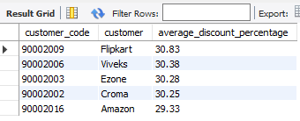
6. Generate a report which contains the top 5 customers who received an average high pre invoice discount pct for the fiscal year 2021 and in the Indian market.
Output :
Insights : Flipkart, Viveks, Ezone, Croma, Amazon are the top 5 highest average discount percentage for the fiscal year 2021 in Indian market.

Slide 9
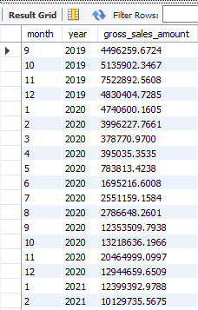
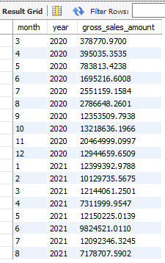
7. Get the complete report of the Gross sales amount for the customer “Atliq Exclusive” for each month. This analysis helps to get an idea of low and high-performing months and take strategic decisions.
Output :
Insights : The lowest gross sales for both the fiscal years is march(2020)
The highest gross sales for both the fiscal years is November(2020)

Slide 10
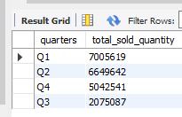
8. In which quarter of 2020, got the maximum total_sold_quantity?
Output :
Insights : The first quarter of 2020 (September , October ,November) saw the highest number of products sold.

Slide 11
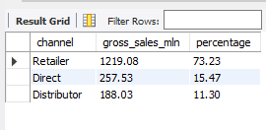
9. Which channel helped to bring more gross sales in the fiscal year 2021 and the percentage of contribution?
Output :
Insights : The retailer channel significantly boosted gross sales in fiscal year 2021,contributing 73.23%

Slide 12
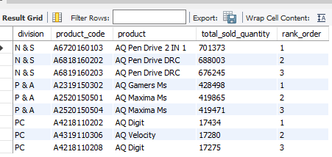
10. Get the Top 3 products in each division that have a high total_sold_quantity in the fiscal_year 2021?
Output :
Insights : The top selling products in fiscal year 2021.
N&S Division: AQ Pen Drive 2 IN 1
P&A Division: AQ Gamers Ms
PC Division: AQ Digit, AQ Velocity

