Slide 1
CampusFind: Campus Lost & Found Tracker
A Cloud-Native DevOps Implementation
Presenter: Kavya Raghavendran
CampusFind — DevOps Engineering Design Review | Slide 1 of 12
Notes:
Good morning, faculty members. Today I am presenting the engineering design and DevOps implementation of CampusFind, a cloud-native lost and found tracker. This defense covers our architectural choices across containerization, automated GitHub Actions CI/CD, Aqua Trivy container security gates, modular Terraform provisioning on AWS, Helm deployments on Kubernetes, and real-time Prometheus and Grafana observability.

Slide 2
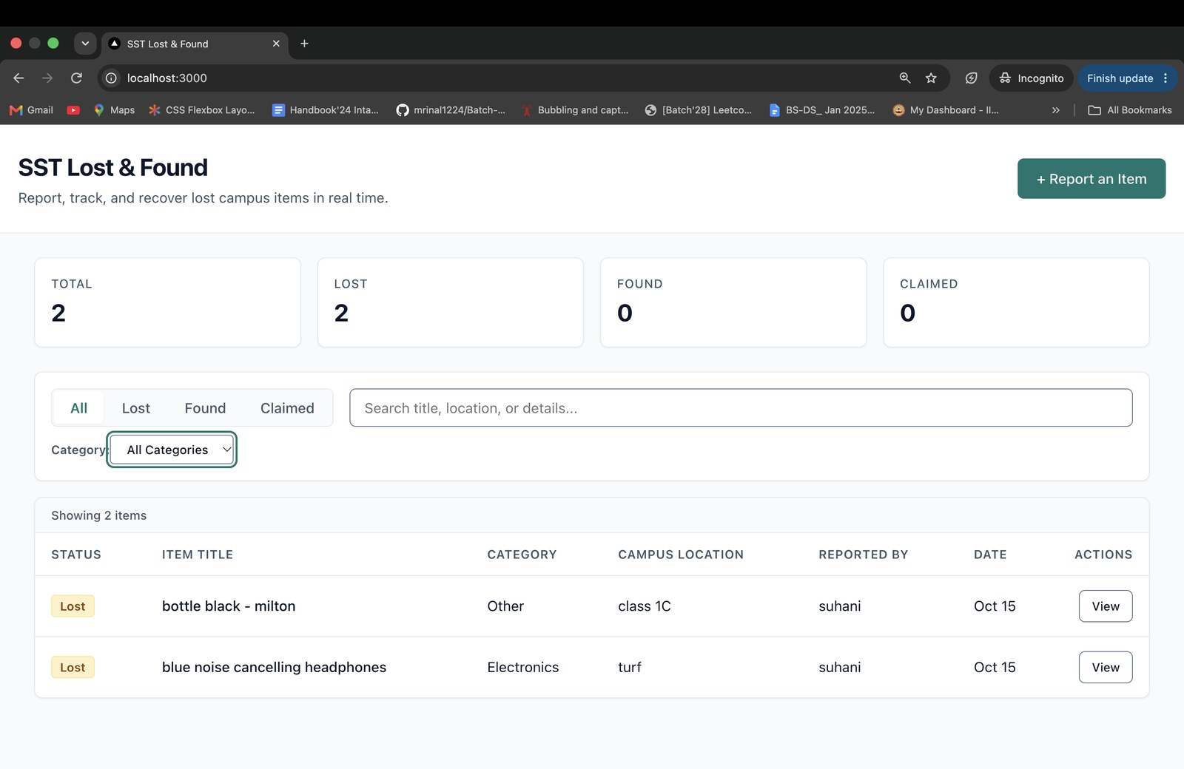
Problem Definition & Operational Scope
• Campus operational challenge: Fragmented, manual lost property records result in low item recovery rates and delayed claims
• Unified self-service portal: Centralized reporting, multi-parameter search (status, category, text), and real-time counters
• Deterministic lifecycle state machine: Strict transition rules enforce initial LOST/FOUND states to terminal CLAIMED status
• Data integrity constraints: Mandatory location tagging, item categorization, and audit timestamps across all records
• DevOps engineering scope: Codification and deployment of the complete application lifecycle from dev to cloud orchestration
Figure 1: CampusFind web user interface showing item registry, category filters, and status counters.
CampusFind — DevOps Engineering Design Review | Slide 2 of 12
Notes:
Campus lost-and-found management typically suffers from fragmented physical logs and inconsistent communication channels. CampusFind solves this by providing a unified web platform with categorical filtering and real-time inventory tracking. The system enforces a strict state machine where items begin as LOST or FOUND and can only transition forward to CLAIMED. The primary engineering objective was to establish an enterprise-grade DevOps foundation supporting this application end-to-end.

Slide 3
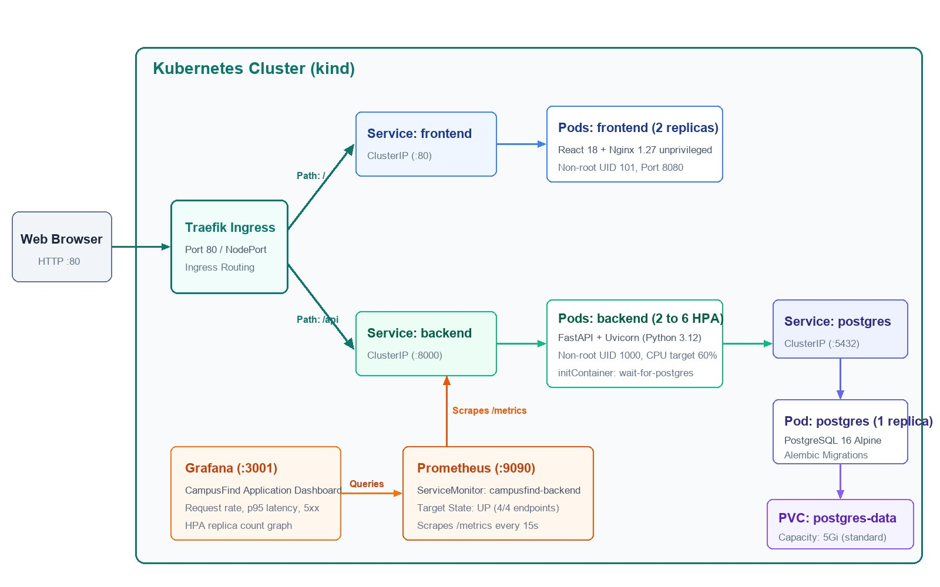
System Architecture & Technology Stack
• Edge traffic routing: Traefik Ingress controller routes external HTTP traffic on port 80 to decoupled application services
• Single-page frontend: React 18.3.1 application compiled via Vite 5.4.21, served by unprivileged Nginx 1.27 Alpine
• Stateless API tier: FastAPI 0.143.0 ASGI server running on Python 3.12-slim, handling business logic and ORM queries
• Stateful persistence: PostgreSQL 16 Alpine database with schema migrations managed and applied through Alembic 1.14.0
• Observability fabric: Prometheus Operator scrapes FastAPI /metrics every 15s; Grafana provides real-time telemetry
Figure 2: Component topology showing ingress routing, service isolation, and observability data flow.
CampusFind — DevOps Engineering Design Review | Slide 3 of 12
Notes:
The system follows a three-tier microservices architecture decoupled through Kubernetes networking. Incoming requests hit the Traefik ingress controller, which routes static asset requests to our unprivileged Nginx container and API calls to FastAPI. The backend interacts with a dedicated PostgreSQL 16 instance using SQLAlchemy ORM and Alembic migrations. Prometheus and Grafana operate concurrently within the cluster to scrape telemetry and monitor system health.

Slide 4
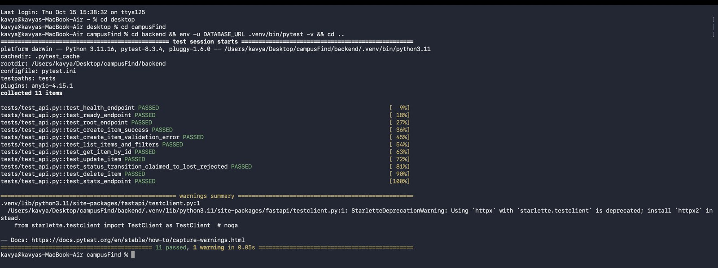
Backend Data Model, API & Test Validation
• RESTful API design: Full CRUD endpoints supporting query parameters (status, category, q) and aggregated statistics
• Operational probes: Dedicated endpoints for liveness (/health), database readiness (/ready), and metrics (/metrics)
• Schema enforcement: Strict Pydantic v2 schemas and SQLAlchemy 2.0 ORM validate payloads and enforce constraints
• In-memory SQLite isolation: Tests execute against sqlite:///:memory: via pytest fixtures, requiring zero external database
• Verified test results: 11 unit and integration tests achieve 100% pass rate in 0.05 seconds during CI pipeline execution
Figure 3: Pytest terminal execution demonstrating 11 passed integration tests in 0.05 seconds.
CampusFind — DevOps Engineering Design Review | Slide 4 of 12
Notes:
The backend API provides RESTful endpoints for item lifecycle management and operational monitoring probes. To ensure deterministic and fast test execution in CI, we decoupled the test suite from external PostgreSQL containers. By utilizing an in-memory SQLite database configured in conftest.py, all 11 pytest integration tests complete in just 0.05 seconds. This architectural decision eliminates flaky network dependencies during automated quality gate evaluations.

Slide 5
Containerization & Secure Multi-Stage Builds
• Frontend multi-stage build: Node.js 22 build stage compiles assets; unprivileged Nginx 1.27 Alpine serves static files
• Backend container hardening: Python 3.12-slim base image running under dedicated non-root system user (UID 1000)
• Attack surface reduction: Build compilers and root privileges eliminated across all final runtime container images
• Docker Compose orchestration: Wires frontend (:3000), backend (:8000), and PostgreSQL (:5432) with automated health probes
• Health check IPv6 remediation: Pinned health check target to 127.0.0.1:8080 to prevent Alpine IPv6 resolution timeout failures
Figure 4: Docker Compose container status showing healthy runtime states across all services.
Service | Host Port | Base Image / User | Health Check Probe
frontend | 3000 -> 8080 | nginx:1.27-alpine (non-root 101) | wget 127.0.0.1:8080/ (IPv6 issue resolved)
backend | 8000 -> 8000 | python:3.12-slim (appuser 1000) | curl -f 127.0.0.1:8000/health (interval 10s)
postgres | 5432 -> 5432 | postgres:16-alpine (postgres) | pg_isready -U postgres (interval 5s)
CampusFind — DevOps Engineering Design Review | Slide 5 of 12
Notes:
Both application container images are built adhering to strict container security standards. The frontend uses a multi-stage Docker build to keep developer tooling out of the runtime image, serving assets via unprivileged Nginx on UID 101. The backend runs as non-root UID 1000 on Python 3.12-slim. During local validation, we resolved an Alpine BusyBox wget timeout by explicitly specifying 127.0.0.1, ensuring health checks pass reliably.

Slide 6
Automated CI/CD Pipeline (GitHub Actions)
• Continuous integration trigger: Automated workflow executes on every push and pull request targeting the main branch
• Fail-fast sequential gates: Pytest unit tests and frontend asset builds must exit 0 before container image builds begin
• Immutable artifact tagging: Images tagged strictly with git commit SHA (${{ github.sha }}), prohibiting mutable latest tags
• Package registry publication: Dual container images pushed to GitHub Container Registry (ghcr.io/kavya100206/campusfind-*)
• Local inventory note: Evidence 5 (Actions run) and Evidence 6 (GHCR package) were verified in CI and not stored locally
Pipeline Stage | Execution Environment | Pass / Fail Criteria
1. Test & Build | Ubuntu 22.04 Python 3.12 + Node 22 | 11 pytest tests pass Vite build exits 0
2. Container Build | Docker Buildx engine Multi-stage Dockerfiles | Dual image build success Tagged with git SHA
3. Security Scan | Aqua Trivy Scanner v0.36.0 Action | Zero fixable HIGH / CRITICAL CVEs (exit 1)
4. Registry Push | GitHub Container Registry ghcr.io OCI packages | Immutable SHA tags pushed Public read visibility
Table 1: GitHub Actions CI/CD stages, execution environments, and validation gates.
CampusFind — DevOps Engineering Design Review | Slide 6 of 12
Notes:
Our deployment automation is defined in .github/workflows/ci-cd.yml and runs automatically on all commits to main. The workflow enforces a fail-fast strategy: code quality and unit tests are evaluated first, halting the pipeline immediately on test regressions. Container images are assembled with Docker Buildx and tagged exclusively with the git commit SHA. This practice ensures that every container deployed to our clusters is traceable to an exact immutable commit.

Slide 7
DevSecOps: Automated Container Security Scanning
• Vulnerability policy: Aqua Trivy scans both images, failing the build on fixable HIGH or CRITICAL CVEs (exit-code 1)
• Pipeline gate enforcement: CI Run #8 failed when Trivy detected 3 HIGH CVEs in Starlette 0.41.3 bundled with FastAPI
• Starlette vulnerability scope: CVE-2025-62727 (Range header DoS), CVE-2026-48818 (SSRF/UNC), CVE-2026-54283 (form memory bypass)
• Targeted library remediation: Upgraded to fastapi>=0.115.8 and prometheus-fastapi-instrumentator>=8.0.0, resolving Starlette to 1.8.0
• Base OS hardening & gate pass: Added apk upgrade in frontend; verified clean exit in CI Run #10 (Evidence 7 not stored locally)
Vulnerability ID | Severity & Package | Remediation & Patch Version
CVE-2025-62727 | HIGH Starlette 0.41.3 | DoS via Range header merging Patched in Starlette >=0.49.1
CVE-2026-48818 | HIGH Starlette 0.41.3 | SSRF / UNC path vulnerability Patched in Starlette >=1.1.0
CVE-2026-54283 | HIGH Starlette 0.41.3 | request.form() memory limit bypass Patched in Starlette >=1.3.1
Alpine Base Packages | HIGH libxml2, musl, tiff | Executed apk upgrade in Dockerfile Resolved in CI Run #10
Table 2: Aqua Trivy container vulnerability detections and dependency remediation summary.
CampusFind — DevOps Engineering Design Review | Slide 7 of 12
Notes:
DevSecOps principles are applied by shifting security scanning into our pull request pipeline. During initial builds, Aqua Trivy halted the pipeline in CI Run #8 due to three HIGH-severity CVEs in Starlette, which was pulled transitively by FastAPI. We remediated these vulnerabilities by upgrading FastAPI and Prometheus instrumentor versions, allowing Starlette to resolve to version 1.8.0. Additionally, we updated base Alpine packages, achieving a clean security gate in CI Run #10.

Slide 8
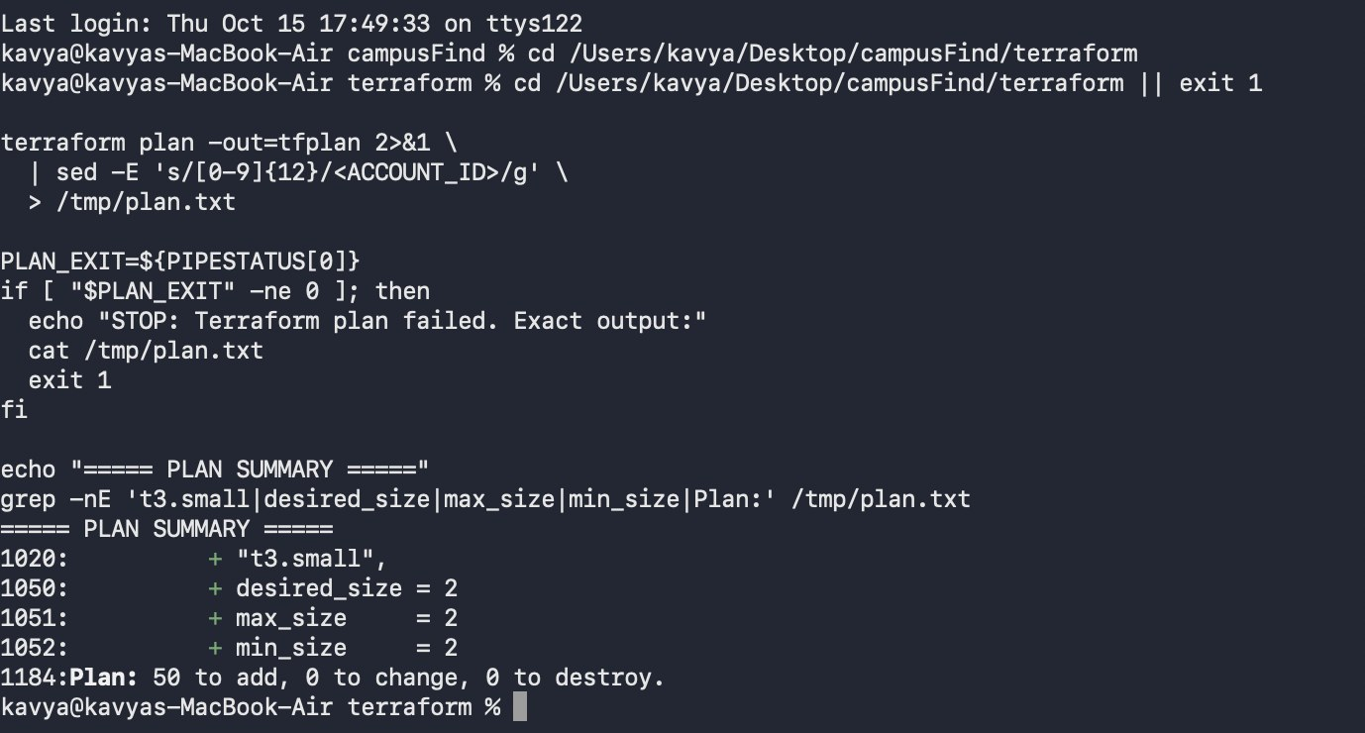
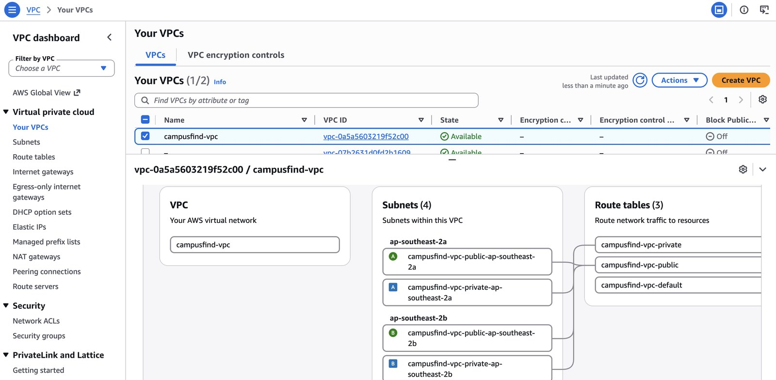
Infrastructure as Code: AWS Provisioning (Terraform)
• Modular cloud topology: Codified in Terraform to provision an isolated AWS infrastructure in Sydney (ap-southeast-2)
• Network architecture: 10.20.0.0/16 VPC, 2 public subnets, 2 private subnets across 2 AZs, Internet Gateway, and NAT Gateway
• Managed compute cluster: Amazon EKS v1.35 with managed node group of 2x t3.small instances (4 vCPUs within account quota)
• Deterministic plan: Dry-run execution verified exactly 50 cloud resources to add, 0 to change, and 0 to destroy
• Lifecycle teardown: Full stack provisioned and verified, then destroyed immediately to maintain zero ongoing cloud cost
Figure 5a: Terraform plan confirming 50 resources to add with 2x t3.small nodes.
Figure 5b: AWS VPC console resource map showing multi-AZ subnets, route tables, and NAT Gateway.
CampusFind — DevOps Engineering Design Review | Slide 8 of 12
Notes:
Our cloud infrastructure is codified using modular Terraform in the Sydney ap-southeast-2 region. The plan provisions a multi-AZ VPC, route tables, a NAT Gateway, and an EKS 1.35 cluster with two t3.small worker nodes. Because our AWS account is governed by an organization SCP that prohibits IAM OIDC provider creation, we placed IRSA and EBS CSI behind a feature flag. The entire stack was planned, applied, verified in the AWS Console, and subsequently destroyed to prevent unnecessary cloud expenditure.

Slide 9
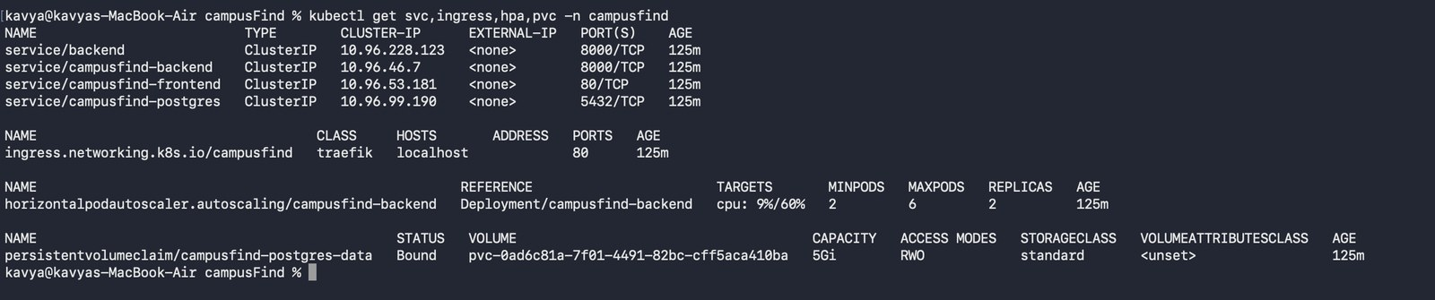
Container Orchestration & Helm Deployment (kind)
• Standardized packaging: Custom helm/campusfind chart (v1.0.0) packages deployments, ClusterIP services, secrets, and ingress
• Workload high availability: Frontend and backend deployed with 2 replicas each behind Traefik Ingress on HTTP :80
• Startup synchronization: wait-for-postgres init container polls PostgreSQL :5432, preventing backend startup race conditions
• Persistent storage: PostgreSQL state persisted via 5Gi PersistentVolumeClaim bound to standard local-path storage provisioner
• Cost-conscious execution: Workloads hosted on local kind cluster (Kubernetes v1.37.0) to eliminate recurring cloud costs
Figure 6: Kubernetes resource deployment showing active services, ingress, HPA, and bound PVC.
Deployment | Replicas | Service / Port | Storage & Probes
frontend | 2 / 2 | ClusterIP :80 Traefik Path: / | Liveness: / 8080 Readiness: / 8080
backend | 2 / 2 (HPA: 6) | ClusterIP :8000 Traefik Path: /api | Init: wait-for-postgres Liveness /health, /ready
postgres | 1 / 1 | ClusterIP :5432 Internal only | 5Gi PVC (local-path) pg_isready probe
CampusFind — DevOps Engineering Design Review | Slide 9 of 12
Notes:
Application deployment is managed via a custom Helm chart on a local kind cluster running Kubernetes 1.37. Frontend and backend deployments run with two replicas each behind ClusterIP services, routed through Traefik Ingress. To avoid startup race conditions where FastAPI crashes before PostgreSQL is ready, we implemented an init container that polls port 5432. Using a local kind cluster allowed complete validation of our Kubernetes manifests without cloud runtime costs.

Slide 10
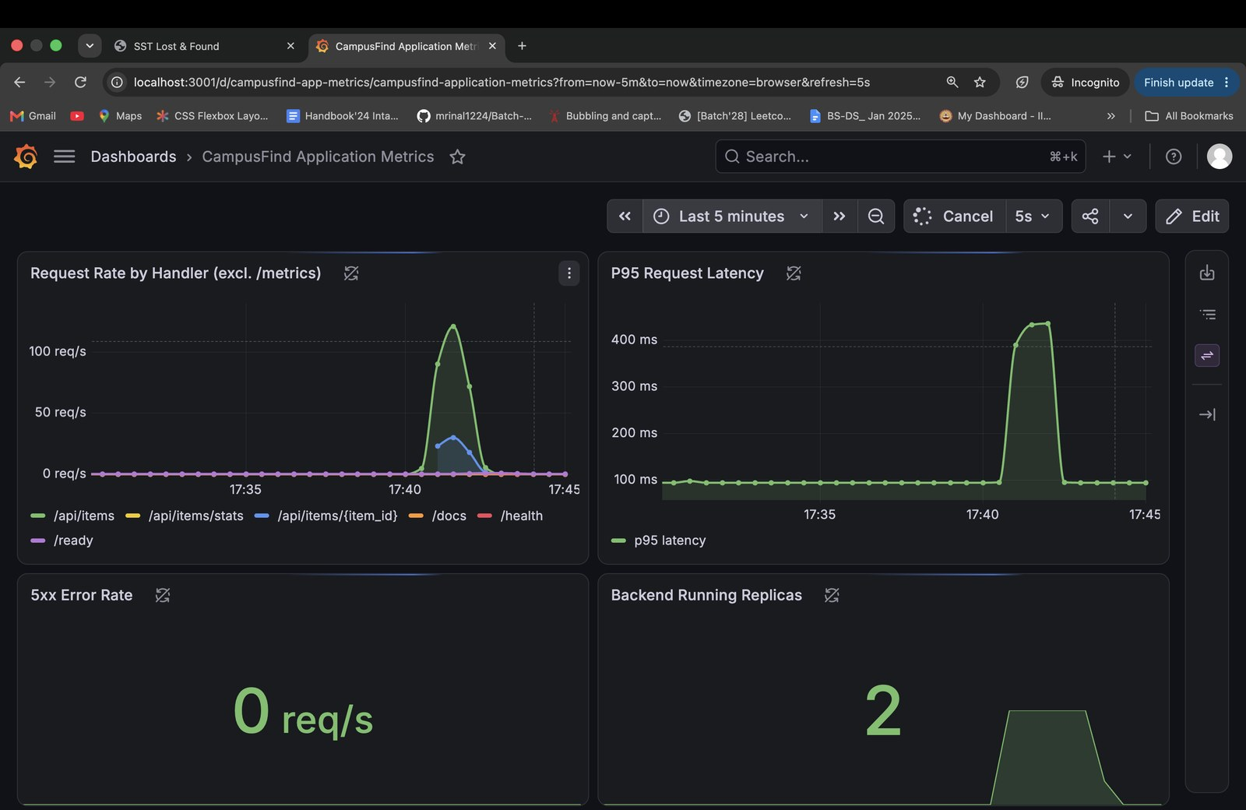
Observability: Metrics Collection & Autoscaling
• Prometheus Operator integration: Custom ServiceMonitor targets FastAPI /metrics endpoint with a 15-second scrape interval
• Application telemetry dashboard: Grafana dashboard tracks request throughput, P95 latency, 5xx error rates, and replica counts
• Stress testing execution: Executed 75-second load test with concurrency 6 (scripts/load-test.sh), peaking at ~130 requests/second
• Horizontal Pod Autoscaling: HPA (CPU utilization target 60%) dynamically scaled backend deployment from 2 to 6 replicas
• System reliability outcome: Zero 5xx server errors observed throughout peak load; P95 latency maintained at ~440ms
Figure 7: Grafana telemetry under load: ~130 req/s peak, 0 errors, and HPA scaling from 2 to 6 replicas.
CampusFind — DevOps Engineering Design Review | Slide 10 of 12
Notes:
Observability is established through the Prometheus Operator and custom Grafana dashboards. FastAPI instruments request metrics via prometheus-fastapi-instrumentator, which are scraped by a Kubernetes ServiceMonitor. During a simulated 75-second load test pushing approximately 130 requests per second, the Horizontal Pod Autoscaler triggered on CPU load. The backend successfully scaled from 2 to 6 replicas while maintaining zero 5xx errors and sub-half-second P95 latencies.

Slide 11
Troubleshooting & Engineering Resilience
• Systematic failure diagnosis: Simulated and remediated common Kubernetes, container, and cloud deployment failure scenarios
• Image pull failure diagnosis: Resolved ImagePullBackOff by correcting malformed image tags and registry credentials
• Service discovery diagnosis: Resolved 502 Bad Gateway by identifying and fixing label selector mismatches with Pod templates
• Health check resolution: Eliminated Docker Compose unhealthy state by enforcing IPv4 127.0.0.1 target over IPv6 localhost
• Governance accommodation: Isolated AWS OIDC-dependent resources behind feature flags to handle organizational SCP policies
Incident Scenario | Observed Symptom | Root Cause & Remediation
ImagePullBackOff | Pod fails to start; ErrImagePull event | Typo in image tag in Helm values. Fixed tag parameter & pull secret.
Endpoint Mismatch | 502 Bad Gateway; Empty endpoints list | Service selector app != Pod label. Aligned labels in deployment template.
Compose Health Fail | Frontend container reports (unhealthy) in Compose | Alpine wget resolved localhost to IPv6 ::1. Remediated target to 127.0.0.1.
SCP OIDC Deny | Terraform apply fails on IAM OIDC provider creation | Organization SCP blocks OIDC providers. Decoupled via enable_irsa_ebs_csi flag.
Table 3: Troubleshooting laboratory incidents, observed symptoms, and corrective actions.
CampusFind — DevOps Engineering Design Review | Slide 11 of 12
Notes:
Engineering resilience requires understanding failure modes and diagnosing them systematically. We documented and resolved multiple operational incidents, including Kubernetes ImagePullBackOff and Service selector label mismatches. In our Docker environment, we corrected an IPv6 resolution failure in BusyBox wget. Finally, encountering an organizational SCP on AWS taught us the value of modular feature flags in infrastructure code.

Slide 12
Project Outcomes, Architectural Limitations & Lessons Learned
• Measured deliverables: 100% automated CI/CD pipeline, zero fixable CVEs, verified Terraform IaC, and dynamic HPA scaling
• Local runtime limitation: Kubernetes workloads and Prometheus stack were executed on local kind to eliminate ongoing cloud costs
• IaC operational limitation: AWS EKS infrastructure was provisioned and validated via Terraform, then destroyed immediately
• Governance constraint: enable_irsa_ebs_csi defaulted to false because an organization SCP blocked IAM OIDC provider creation
• Engineering lessons: Shift-left vulnerability scanning in CI prevents supply chain leaks; strict version pinning eliminates drift
DevOps Engineering Summary
✔ End-to-End Automation
GitHub Actions pipeline builds, tests, scans, and pushes immutable container images tagged by git commit SHA.
✔ Proactive Vulnerability Management
Remediated 3 HIGH Starlette CVEs and hardened base images to maintain a strict zero-vulnerability security gate.
✔ Infrastructure as Code Discipline
Fully automated 50-resource AWS stack in Sydney; designed around enterprise SCP policies with zero leftover costs.
✔ Production-Grade Observability
Continuous Prometheus metrics scraping, custom Grafana dashboards, and dynamic HPA scaling validated under load.
Summary: Engineering deliverables, operational boundaries, and architectural conclusions.
CampusFind — DevOps Engineering Design Review | Slide 12 of 12
Notes:
In conclusion, CampusFind successfully demonstrates a complete, production-grade DevOps engineering lifecycle. We achieved automated testing, secure container publishing, codified cloud infrastructure, and dynamic autoscaling under load. We operated within realistic constraints: validating AWS provisioning via Terraform before teardown, and hosting Kubernetes on kind to manage cloud costs. Thank you for your time, and I welcome your questions on the architecture and implementation.

