Slide 1
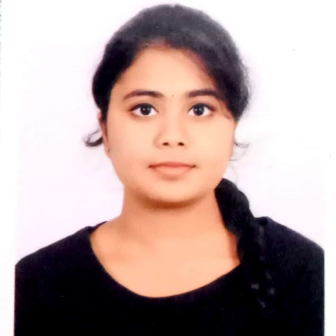


Kavya Goudar
Analyst/Software Engineer
Master of Computer Applications,
Information Technology : 2019-2022
Trained under: iTransform
Skills
C# | Basics, OOPS, Exception Handling ,Arrays ,Collection and Generics, Delegates and Events, File Io and Serialization.
.NET Core | ASP.NET, Dependency Injection, Exception Handling.
Entity Framework | Basics, Hands-on experience.
Database | SQL Server
Tools | GIT, Postman
UI Technology | HTML5 ,CSS & Angular
Add On Skills | Communication Skills, Team Management, UI Designing.
Bangalore
kavyagoudar8@gmail.com
+91 8884664141
A4
Full Stack Developer
Understanding of RDMS concepts using SQL Server.
Practical understanding of C# and SQL concepts using Visual Studio and SQL Server
Hands on experience in developing applications using .NET Framework, ADO.NET Core, .NET Core Web API, Entity Framework.
Understanding of HTML5 , CSS and Angular Cli
GitHub and LinkedIn Profiles
Completed case study on Hotel Management System which is a Web based System which is used to simplify the day to day processes of the hotel. The system will be able to handle many services to take care of all customers in a quick manner. As a solution to the large amount of file handling happening at the hotel, this software will be used to overcome those drawbacks. There is three End Users for this system. The End Users are Owner, Manager and Receptionist. To keep restrictions for each End User levels HMS can create different login functions.
Technologies used:
ANGULAR
ASP.NET CORE
Microsoft SQL Server
Video Link : Click

