Slide 1
Library Management System
Submitted By
KAvya P

Slide 2
Objective
The objective of the library Management System is to handle the entire activity of a library.
The software keeps track of all the information about the books and their complete details.
The system contains database where all the information will be stored safely.

Slide 3
Scope
This project will keep track of all the books and library information.
The application will be able to handle all the necessary information.

Slide 4
Requirements
Operating System: Windows 10.
Tools: Eclipse IDE - To develop the project,
My SQL – For the database.
Front End: Java Swing, AWT.
Programming Language: JAVA.
Back End: My SQL.

Slide 5
Functional requirements
Admin: Can add, view, delete . Can logout.
Librarian: Can add/view book details, can see the details of return books etc. can log out.

Slide 6
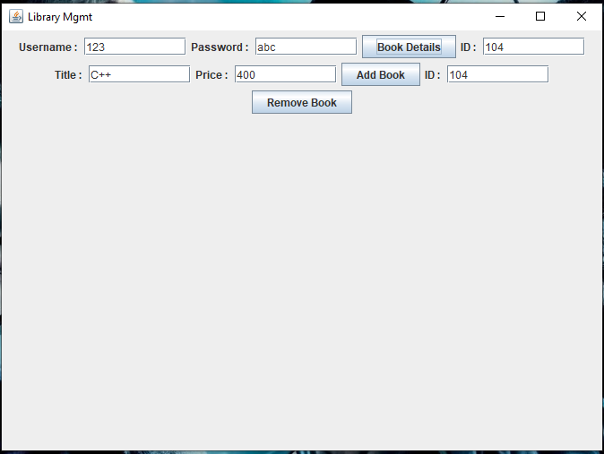
OutPut

Slide 7
