Slide 1

Bluestock Fintech
Mutual Fund Analytics Platform
Capstone Project Report
Potnuru Kavya Rupini
Bluestock Fintech Internship
June 2026

Slide 2
Project Objective
• Analyze mutual fund performance using return and risk metrics.
• Compare schemes using Sharpe Ratio, Sortino Ratio, Alpha and Beta.
• Study SIP growth trends and investor participation patterns.
• Perform advanced risk analysis using VaR and CVaR.
• Conduct investor cohort and SIP continuity analysis.
• Build an interactive Power BI dashboard.
• Develop a simple fund recommendation engine.

Slide 3
Dataset Overview
The project integrates multiple mutual fund datasets covering
fund details, NAV history, SIP inflows, industry statistics,
scheme performance, investor transactions, portfolio holdings,
and benchmark indices.
The datasets were cleaned, standardized, and loaded into
SQLite for analysis and dashboard development.
Datasets Used
• Fund Master
• NAV History
• SIP Inflows
• Category Inflows
• Scheme Performance
• Investor Transactions
• Portfolio Holdings
• Benchmark Indices

Slide 4
Project Workflow
Data Sources
↓
Data Ingestion
↓
Data Cleaning & Preprocessing
↓
SQLite Database
↓
EDA & Performance Analytics
↓
Advanced Analytics
(VaR, CVaR, Cohort Analysis, SIP Analysis)
↓
Recommendation Engine
↓
Power BI Dashboard

Slide 5

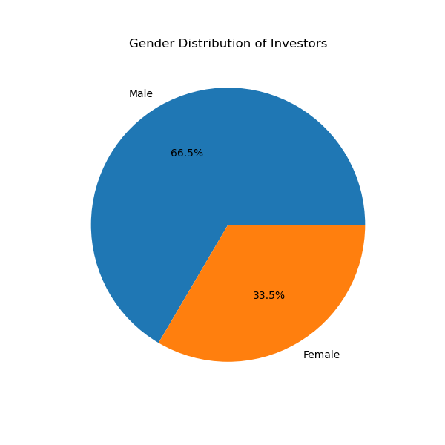
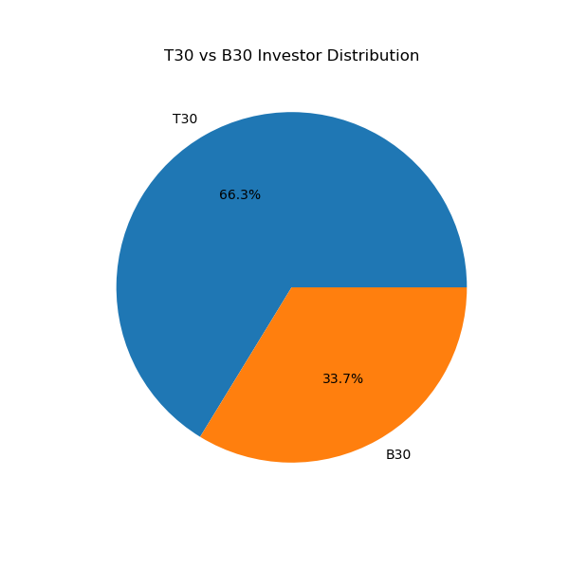
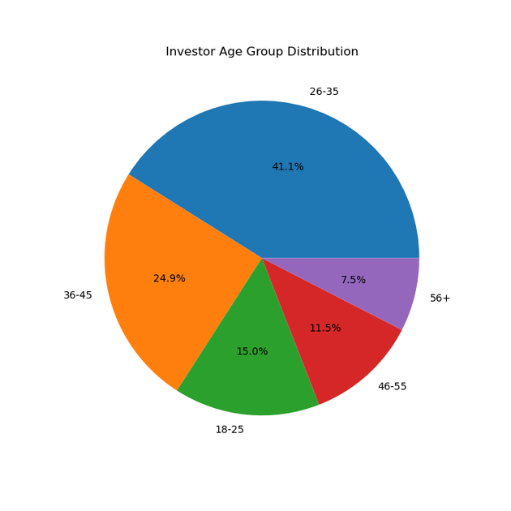
EDA Highlights
• Majority of investors belong to the 25–45 age group.
• Male investors account for approximately two-thirds of participation.
• T30 cities contribute a significantly larger share of investors than B30 cities.

Slide 6
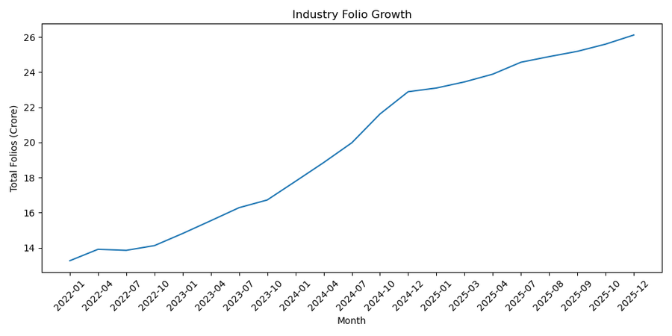
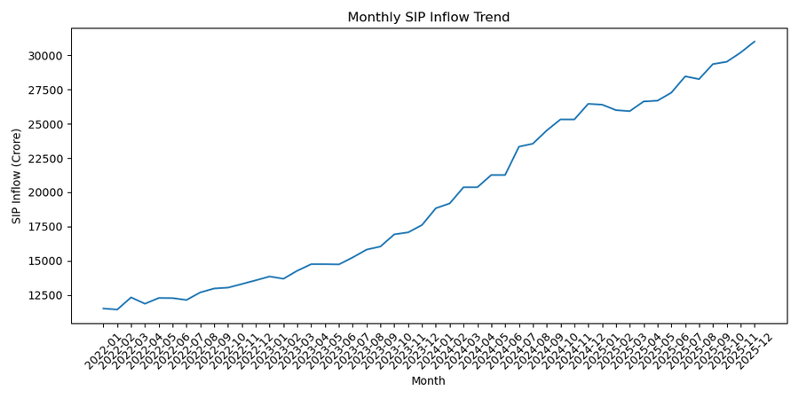
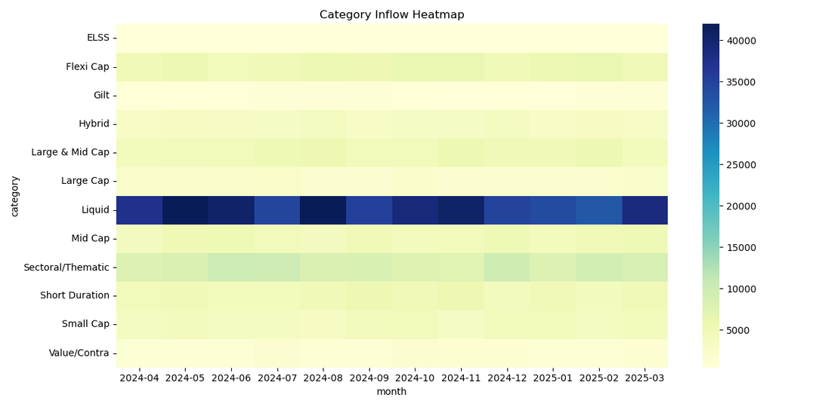
EDA Highlights (Continued)
• SIP inflows show a consistent upward trend over time.
• Industry folio counts indicate increasing investor participation.
• Category inflow analysis highlights varying investment preferences across fund categories.

Slide 7
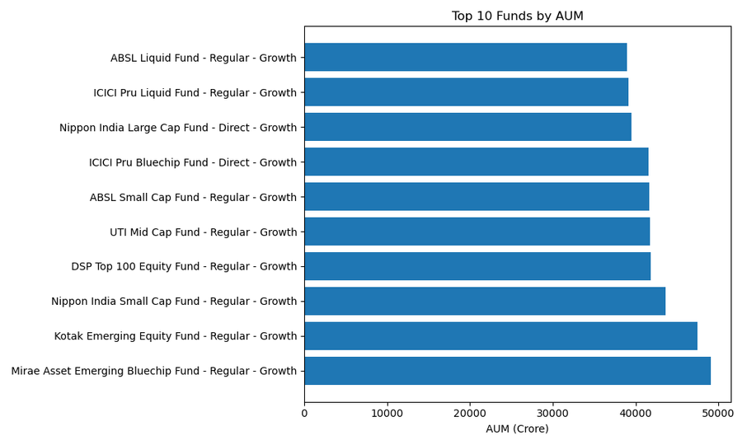
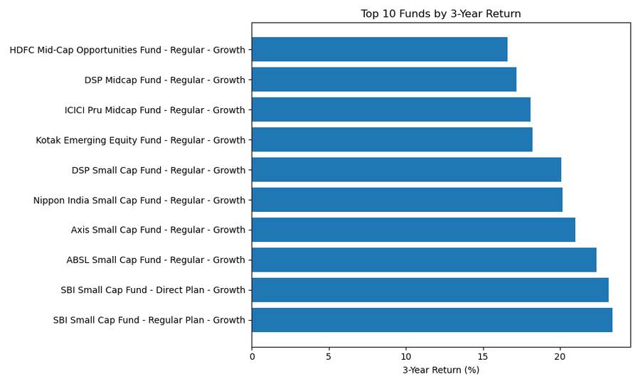
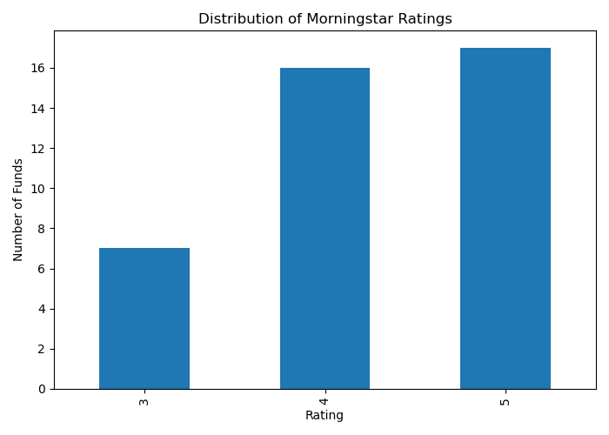
Fund Performance Analytics
• Top-performing funds generated significantly higher returns than category averages.
• AUM distribution indicates concentration among a few large mutual fund schemes.
• Most schemes fall within the 3–4 star Morningstar rating range.

Slide 8
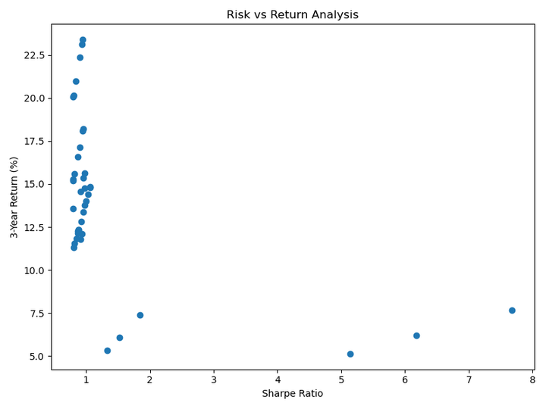
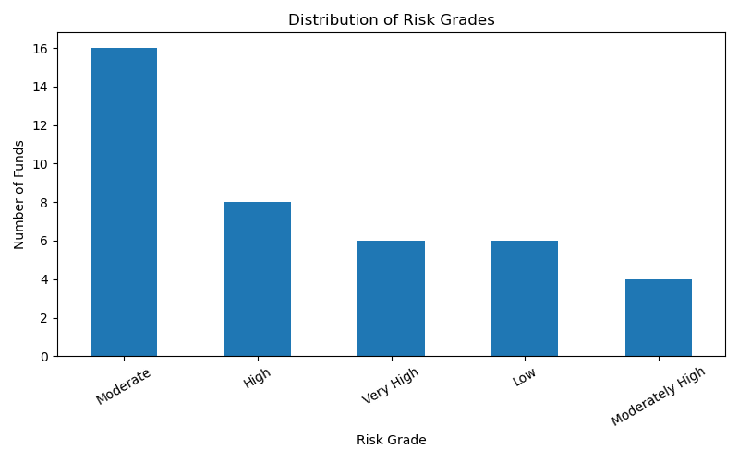
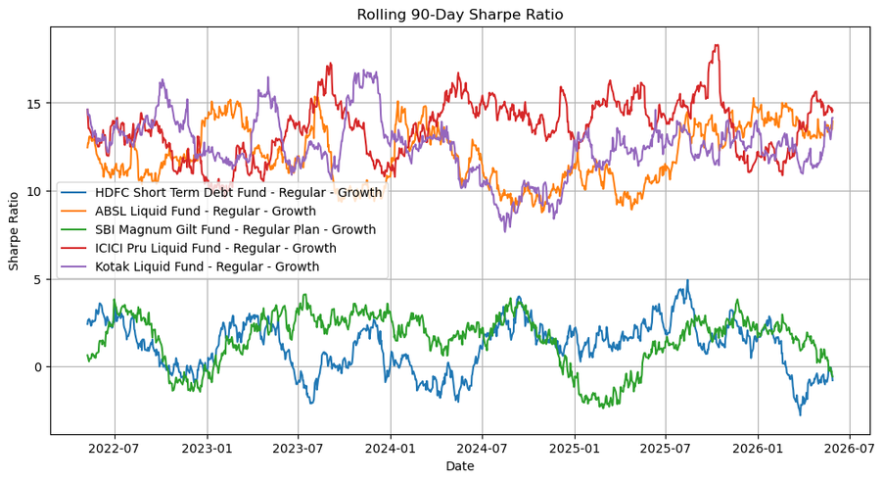
Risk Analytics
• Higher returns generally require higher risk exposure.
• Most mutual fund schemes belong to moderate-risk categories.
• Rolling Sharpe Ratio analysis reveals fluctuations in risk-adjusted performance over time.

Slide 9
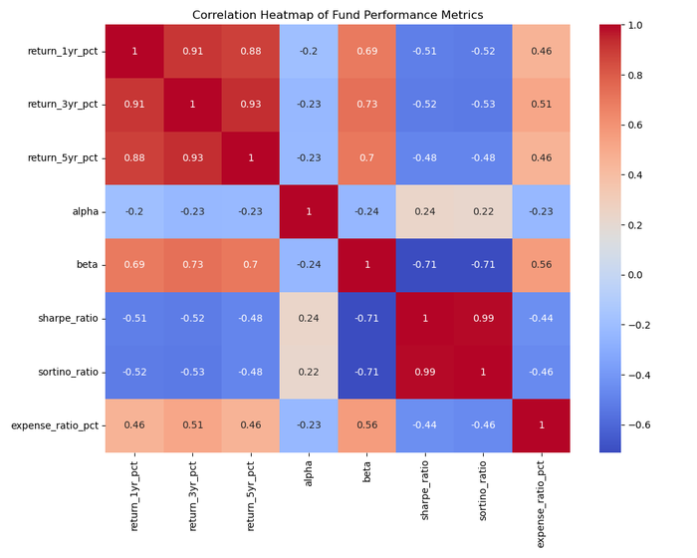
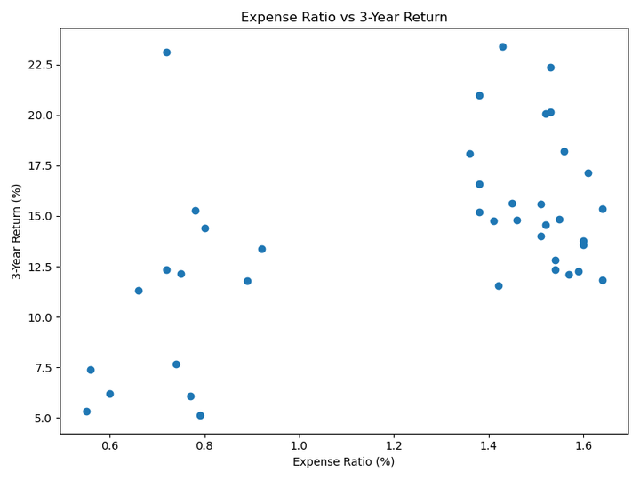
Advanced Analytics
• Correlation analysis identifies relationships between key fund performance metrics.
• Expense ratios show varying impact on fund returns across schemes.
• Category inflow patterns reveal changing investor preferences over time.

Slide 10
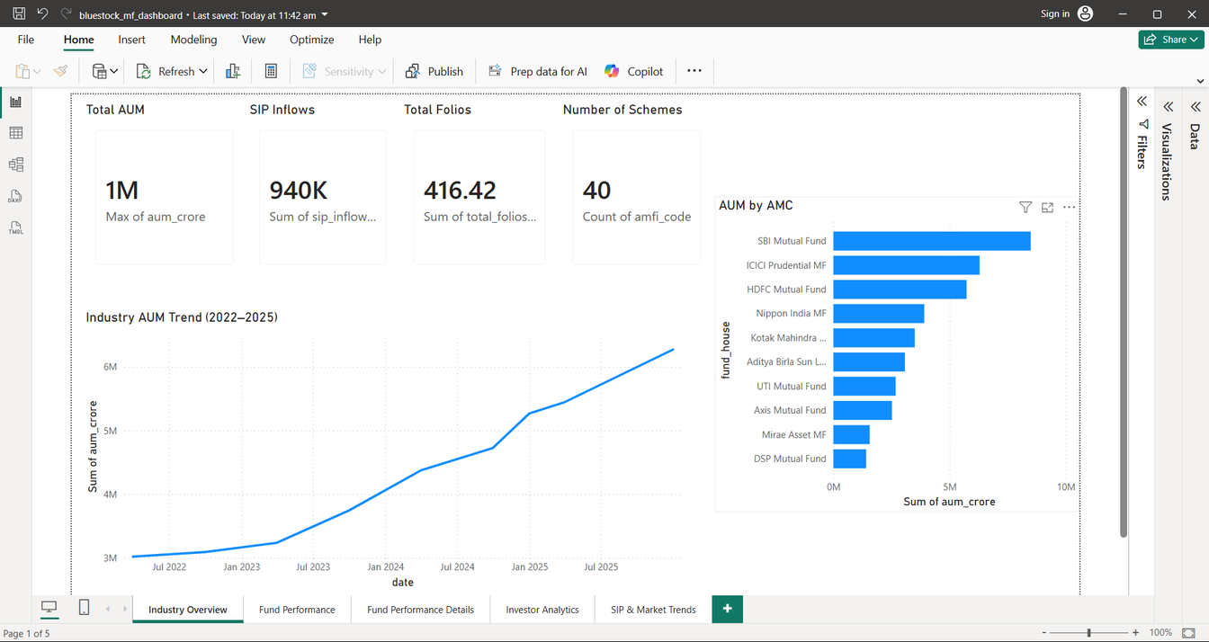
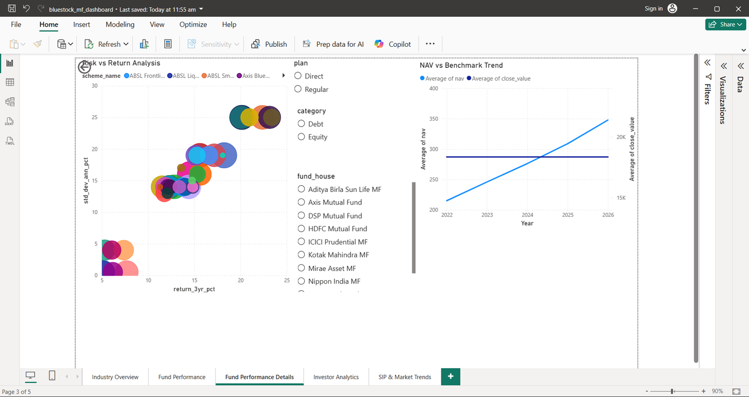
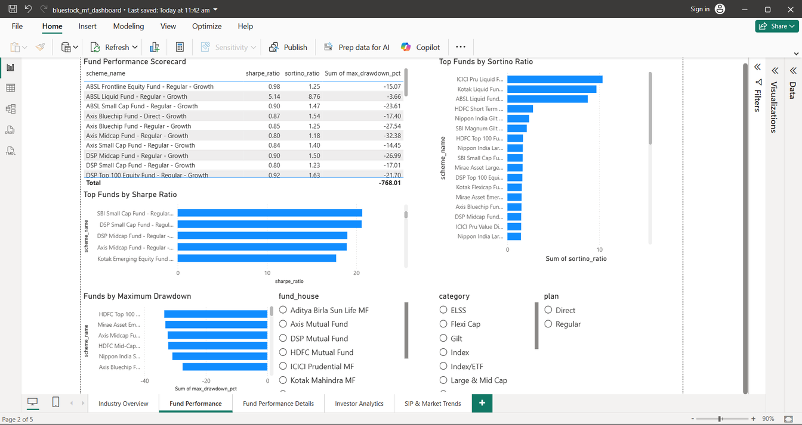
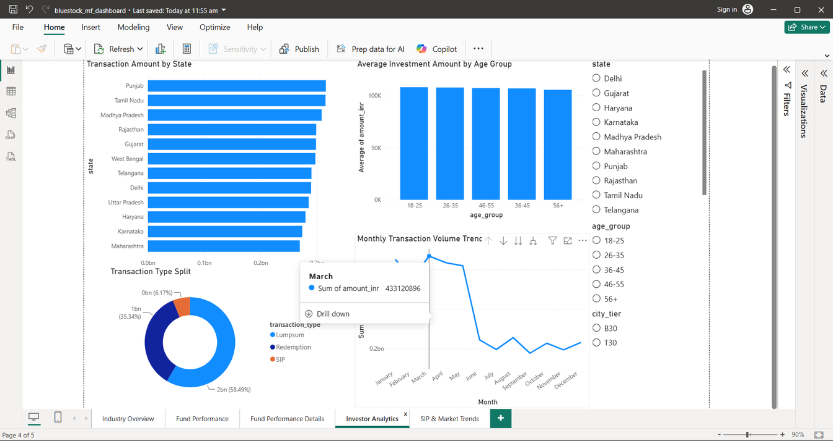
Power BI Dashboard
The Power BI dashboard integrates all analytical outputs into a single interactive platform. Users can explore investor demographics, fund performance, industry trends, and portfolio analytics through dynamic visualizations and filters.

Slide 11
Key Findings
• Investors aged 25–45 form the largest participation group.
• Male investors account for approximately 66% of total investors.
• T30 cities contribute significantly more investors than B30 cities.
• SIP inflows have shown consistent growth over the analyzed period.

Slide 12
Key Findings (continued)
• Several mutual fund schemes delivered returns above 20% over a 3-year horizon.
• Most schemes belong to moderate-risk categories.
• Fund performance varies considerably across categories and risk profiles.
• Power BI dashboards enable effective exploration of investor and fund trends.

Slide 13
Recommendations
Focus marketing efforts on high-growth investor segments.
Improve investor engagement in B30 cities.
Incorporate advanced predictive analytics for fund selection
Enhance dashboard capabilities with real-time market data.

Slide 14
Future Scope
Machine learning based fund recommendation engine.
Real-time mutual fund tracking and alerts.
Portfolio optimization using AI techniques.
Sentiment analysis using financial news and social media.

Slide 15
Conclusion
The Mutual Fund Analytics Platform successfully integrates data engineering, analytics, risk evaluation, and dashboard reporting into a unified solution. The project demonstrates how data-driven insights can support better investment analysis and decision-making.

Slide 16
Thank You
Thank you for your attention

