Slide 1

Shri Vishnu Engineering College for Women :: Bhimavaram (Autonomous) Department of Computer Science and Engineering
IV B.Tech II Sem PowerPoint Presentation
Computer Science and Engineering
CROP PEST CLASSIFICATION AND PESTICIDES RECOMMENDATION
Under the guidance of Dr.T.Gayathri (Professor)
By
20B01A0504 : Akshita Bhupathiraju
20B01A0533 : Chintapanti Kavya Peddintlu
20B01A0545 : Ganapavarapu Naga Devika
20B01A0548 : Gollapalli Srihitha
20B01A0562 : Jami Tejaswini Sai Prasanna
2023-2024 Department of Computer Science and Engineering Slide No: 1

Slide 2
Abstract
Crop pest classification and pesticide recommendation system is a model that identifies the pests and recommend the suitable pesticides based on the classified pests. The agriculture sector is crucial in meeting societal requirements in a world where there is food insecurity and malnutrition. One of the biggest issues that crops confront is pests. Pests have the potential to harm plants and impede growth. The quantity and quality of the crops are directly impacted. In an effort to manage or control diseases and pests, humans also devote a lot of time and resources to recognize and apply new pesticides. To solve this problem, this study proposes a crop pest identification method based on a multilayer network model to classify the pests and recommend the pesticides for the crop. The main aim of the project is to use the most effective method for classifying pest images and suggest pesticides that have more accuracy.
2023-2024 Department of Computer Science and Engineering Slide No:2

Slide 3
Problem Statement Identification
Motivation:
In Agriculture the main problem for farmers is the “PESTS”.
The pest will be mainly affecting on the crop yield, due to lack of information the suitable pesticides cannot be identified.
In order to help in the crop's growth the pest should be identified and pesticide should be recommended.
Based on this problem, our project is designed in such a way that the pests are identified and pesticides are recommended on multiple crops.
2023-2024 Department of Computer Science and Engineering Slide No:3

Slide 4
Problem Statement
"Crop Pest Classification and Pesticide Recommendation System" is a user-friendly web interface in which the user can get information about the pest identified, by uploading an image to the webpage.
The user can get the name of the pest and the pesticide to be used to eradicate the pest.
2023-2024 Department of Computer Science and Engineering Slide No:4

Slide 5
Existing System
The existing system is just used to identify and classify the pests. The existing system consists of the classification models that are used for the classification of the pests. But the farmers face the problem in choosing the pesticides to control the disease and pests for the crop. Pests have the potential to harm plants and impede growth. So, the existing system classifies these pests. Even though if the pests are classified efficiently, the pesticides need to be recommended accurately. Otherwise, the pests would affect the growth of the crop.
2023-2024 Department of Computer Science and Engineering Slide No:5

Slide 6
Problems in Existing System
Existing System is a manual system.
It requires lots of paper work to stores the pests and pesticides information.
It is a time consuming system.
Any searching requires so much effort manually.
Difficult to maintain huge amount of data.
2023-2024 Department of Computer Science and Engineering Slide No:6

Slide 7
Proposed System
The proposed system overcomes all the problems in the existing system. The proposed system is not only used to identify and classify the pests but also recommend the pesticides that are needed to kill the harmful pests and improve the growth of the crop.
The main aim of the proposed system is to suggest the suitable pesticides and improve the accuracy of the model.
2023-2024 Department of Computer Science and Engineering Slide No:7

Slide 8
Attainment of Objectives
Objective-1: Identification of pests.
Objective-2: Identification of multiple crops on which the pest is affecting.
Objective-3: Recommending the pesticides for each crop on which the crop is affected.
Objective-4: Increasing the crop yield by suggesting the pesticide usage percentage for each crop.
Objective-5: We have developed an interface where the user can give input by uploading the image and getting the output of identification of the pest, pest name, and pesticide recommendation of multiple crops for eradicating the pests.
2023-2024 Department of Computer Science and Engineering Slide No:8

Slide 9
Implementation
Implementation of our project includes two parts:
Frontend
Backend
The framework that we have used in our project is Django
The algorithm that we have used in backend is CNN Algorithm
2023-2024 Department of Computer Science and Engineering Slide No:9

Slide 10
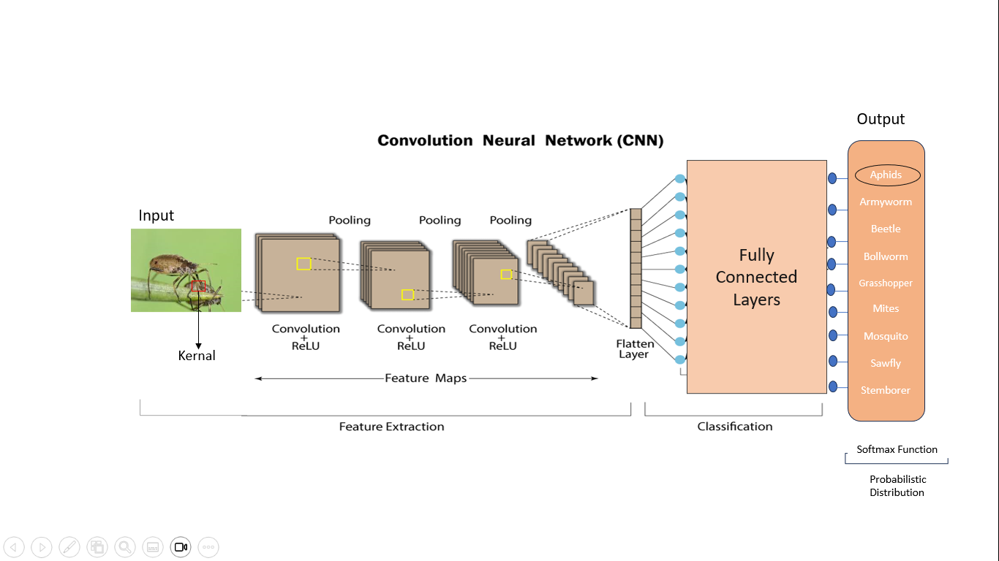
Implementation
CNN Architecture:
2023-2024 Department of Computer Science and Engineering Slide No:10

Slide 11
Implementation
Step-1: Giving input image i.e ; pest image.
Step-2: Feature extraction by convolutional and max pooling layers.
Step-3: Passing the features through flattened layer.
Step-4: Features will be taken as neurons into dense layer.
Step-5: The output will be obtained based on the activation function.
2023-2024 Department of Computer Science and Engineering Slide No:11

Slide 12
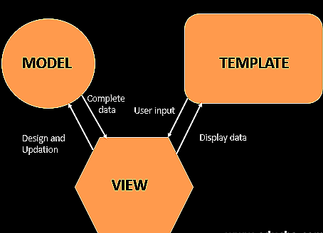
Implementation
Django Framework:
2023-2024 Department of Computer Science and Engineering Slide No:12

Slide 13
Implementation
At first, the user enters the website.
The first view of the website is the home page.
The user can redirect to the About page and upload page.
The About page contains information about the system.
The upload page is the main page where the user can upload the image.
2023-2024 Department of Computer Science and Engineering Slide No:13

Slide 14
Implementation
After entering the upload page, the user must click on choose file button.
After choosing the input image, the user must click on the submit button.
After submitting the image, the user will view the result.
The result i.e., the output will contain the pest's name and the recommended pesticide on multiple crops.
2023-2024 Department of Computer Science and Engineering Slide No:14

Slide 15
Design
UML Diagrams:
UML (Unified Modeling Language) diagrams are visual representations used to illustrate and communicate the structure and behavior of a system.
They provide a standardized way to express design concepts and relationships between components or processes.
2023-2024 Department of Computer Science and Engineering Slide No:15

Slide 16
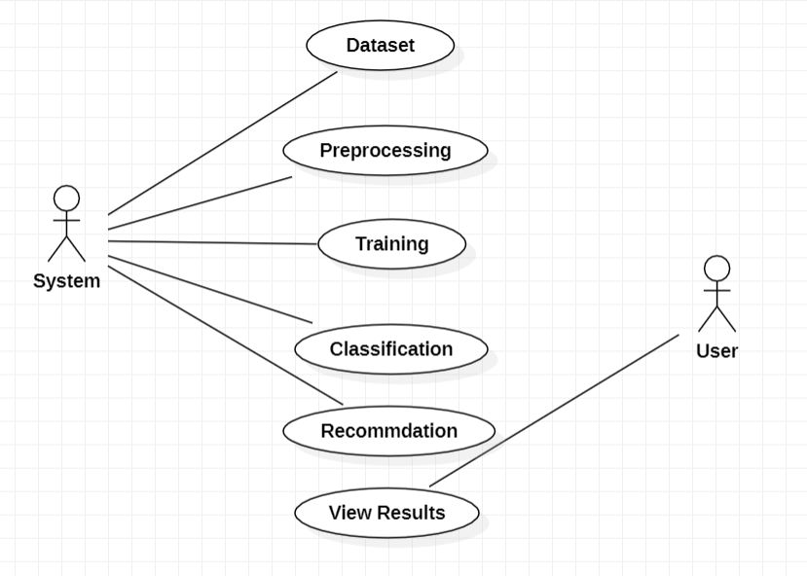
Design
USE CASE DIAGRAM:
2023-2024 Department of Computer Science and Engineering Slide No:16

Slide 17
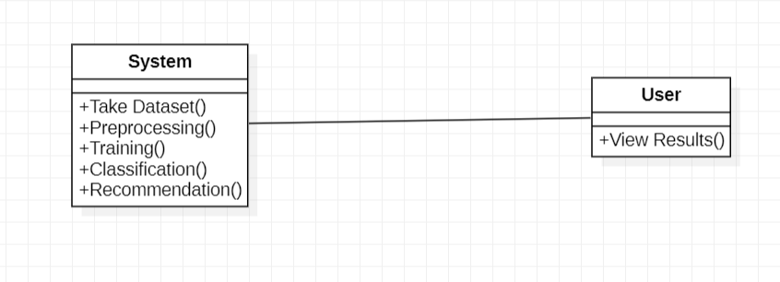
Design
CLASS DIAGRAM:
2023-2024 Department of Computer Science and Engineering Slide No:17

Slide 18
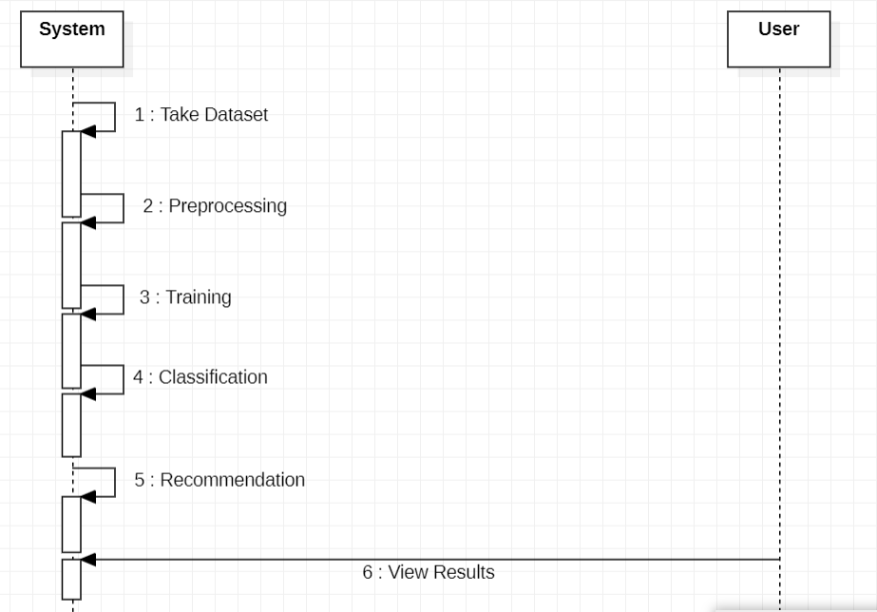
Design
SEQUENCE DIAGRAM:
2023-2024 Department of Computer Science and Engineering Slide No:18

Slide 19
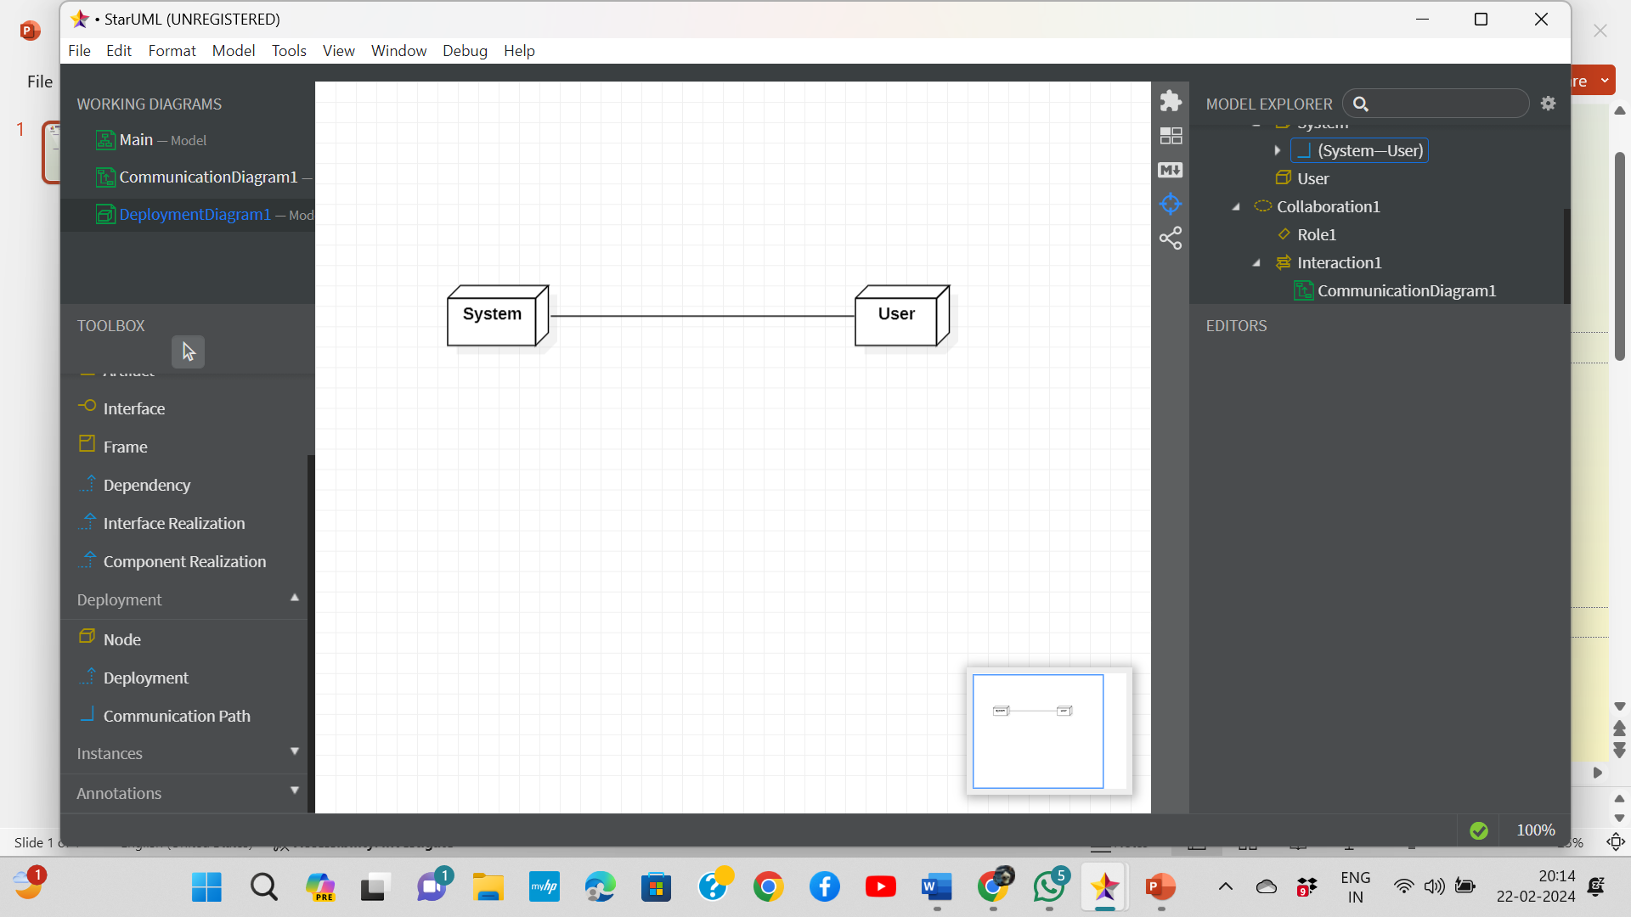
Design
DEPLOYMENT DIAGRAM:
2023-2024 Department of Computer Science and Engineering Slide No:19

Slide 20
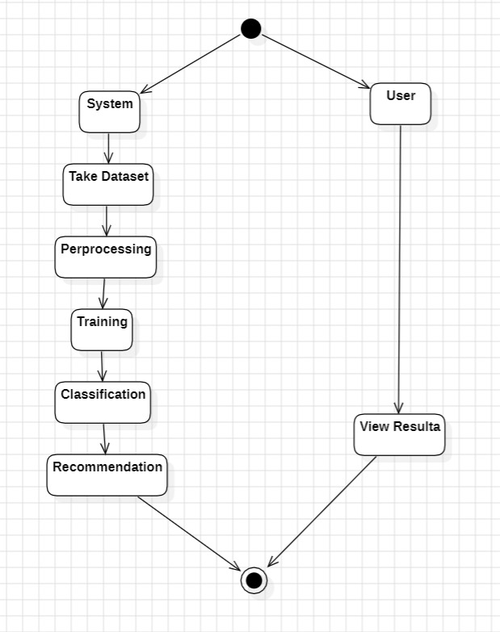
Design
ACTIVITY DIAGRAM:
2023-2024 Department of Computer Science and Engineering Slide No:20

Slide 21
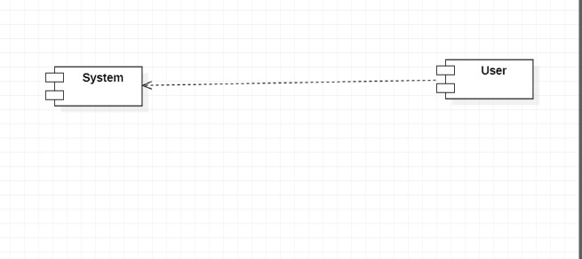
Design
COMPONENT DIAGRAM:
2023-2024 Department of Computer Science and Engineering Slide No:21

Slide 22
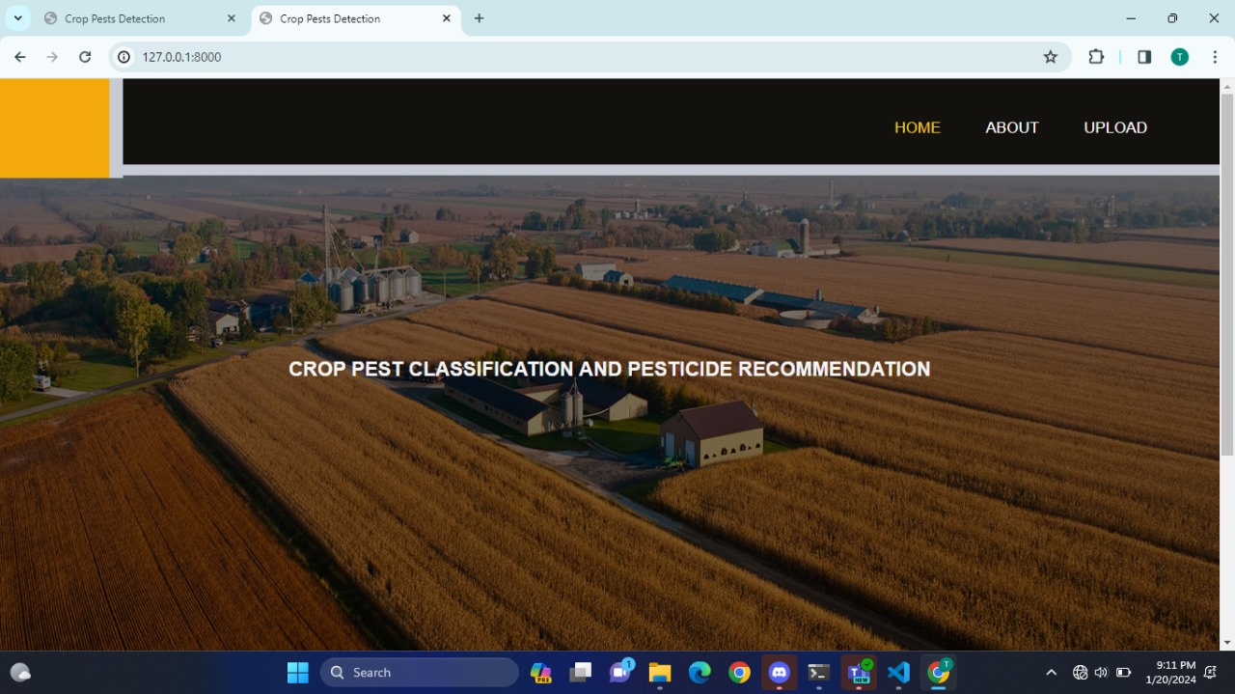
Results and Analysis
HOME PAGE
2023-2024 Department of Computer Science and Engineering Slide No:22

Slide 23
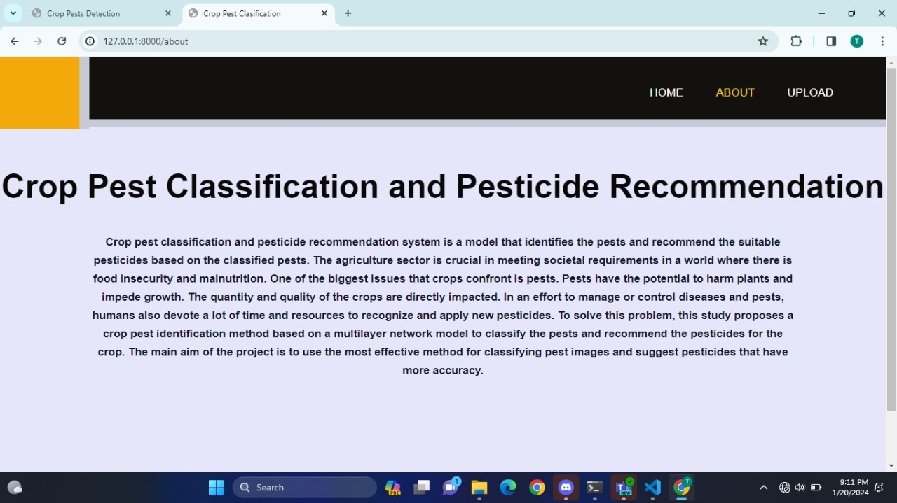
Results and Analysis
ABOUT PAGE
2023-2024 Department of Computer Science and Engineering Slide No:23

Slide 24
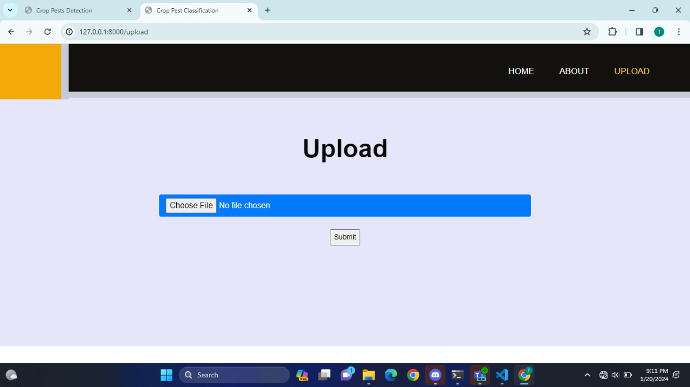
Results and Analysis
UPLOAD PAGE
2023-2024 Department of Computer Science and Engineering Slide No:24

Slide 25
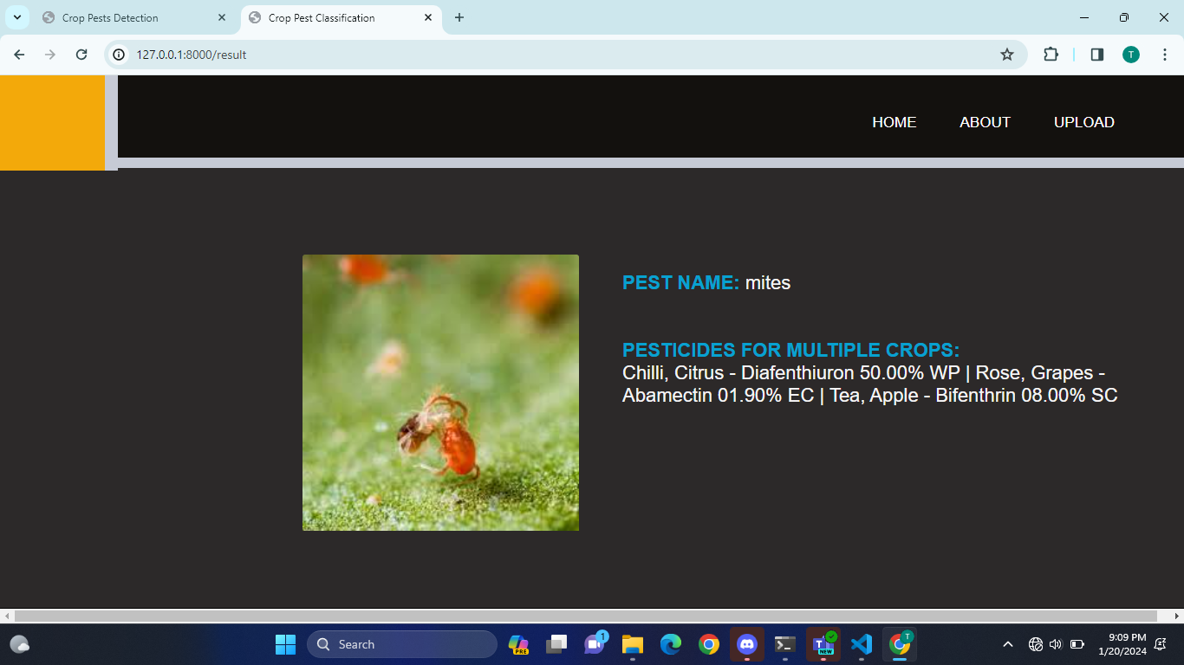
Results and Analysis
RESULT PAGE
2023-2024 Department of Computer Science and Engineering Slide No:25

Slide 26
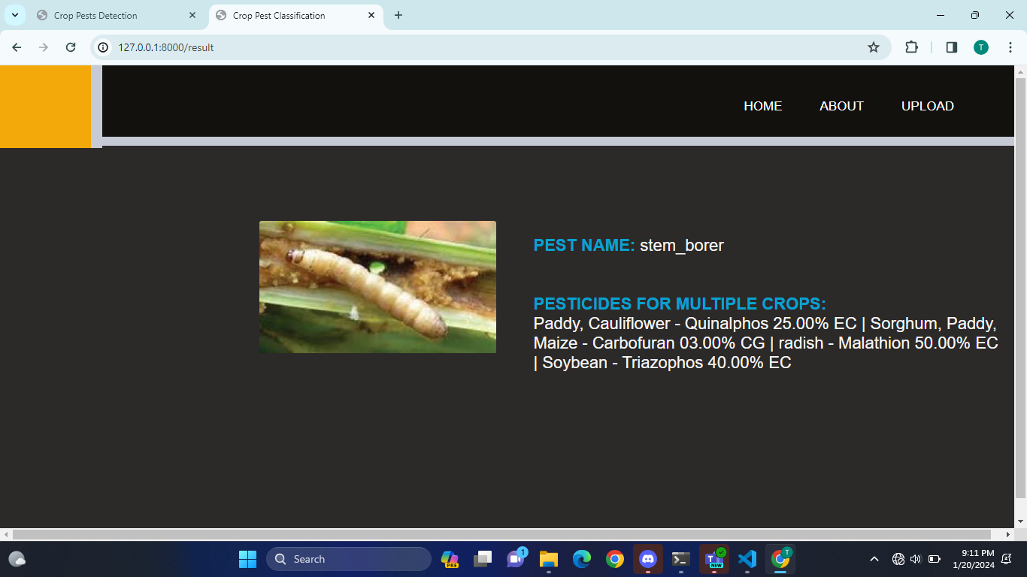
Results and Analysis
RESULT PAGE
2023-2024 Department of Computer Science and Engineering Slide No:26

Slide 27
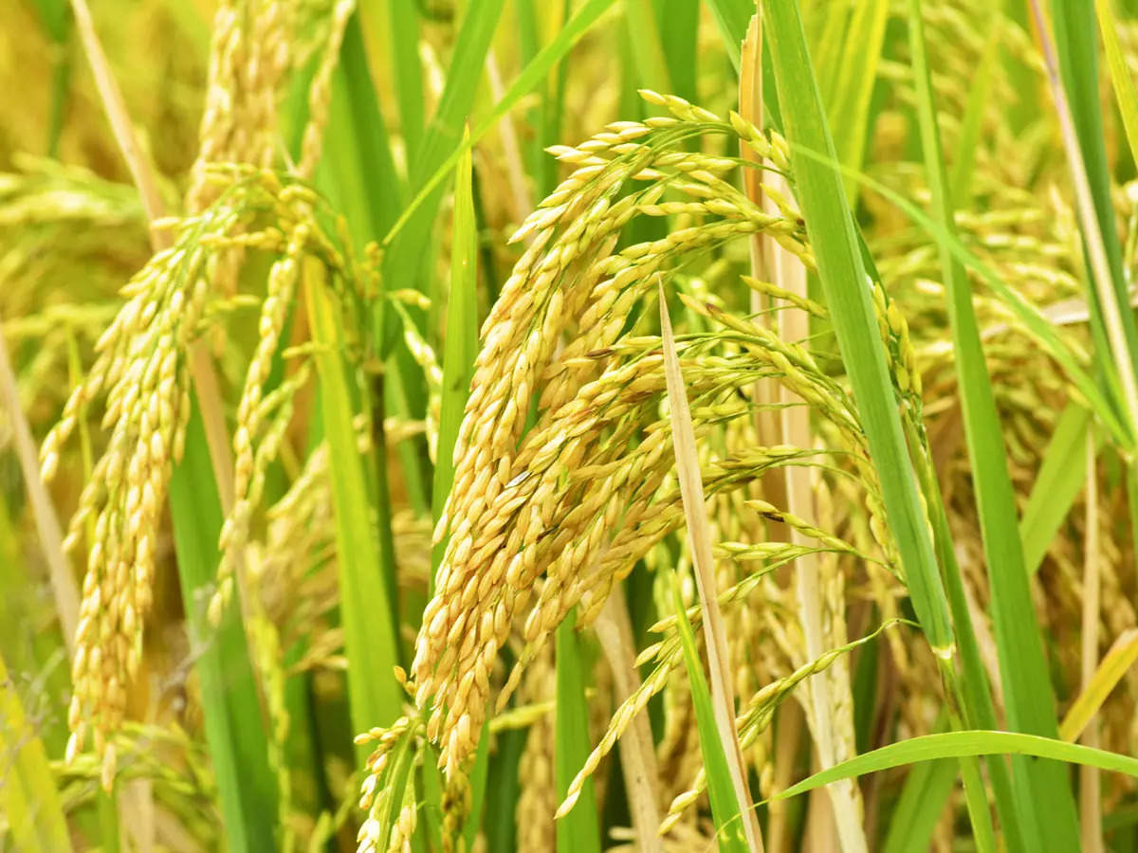
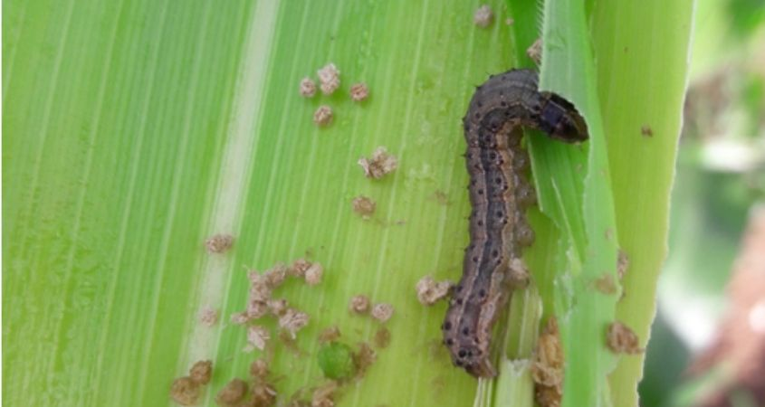

Results and Analysis
Pesticide used: Dichlorvos 76.00% EC
Paddy
Pest Name: Armyworm
Pesticide used: Trichlorfon 05.00% GR
Wheat
2023-2024 Department of Computer Science and Engineering Slide No:27

Slide 28
Conclusion
In conclusion, the “Crop Pest Classsification and Pesticide Recommendation” project has successfully addressed the critical challenge of identifying pests and recommending targeted pesticides across multiple crops. The developed system, powered by advanced commendable accuracy in pest classification, enabling precise and efficient pest management. By tailoring pesticide recommendations to specific pests for each crop, the project promotes sustainable agriculture practices, minimizing environmental impact and optimizing resource usage. The significance of this work lies in its potential to enhance crop yield, reduce pesticide usage, and contribute to a more resilient and eco-friendly farming ecosystem Moving forward , ongoing refinement and collaboration with agricultural experts its adaptability to evolving pest scenarios and reinforcing its role in promoting precision agriculture.
2023-2024 Department of Computer Science and Engineering Slide No:28

Slide 29
THANK YOU
2023-2024 Department of Computer Science and Engineering Slide No:29

