Slide 1




Team Gurls
Kavya Chowti, Sofia Han, Oliver Wu, Angela Zhao

Slide 2

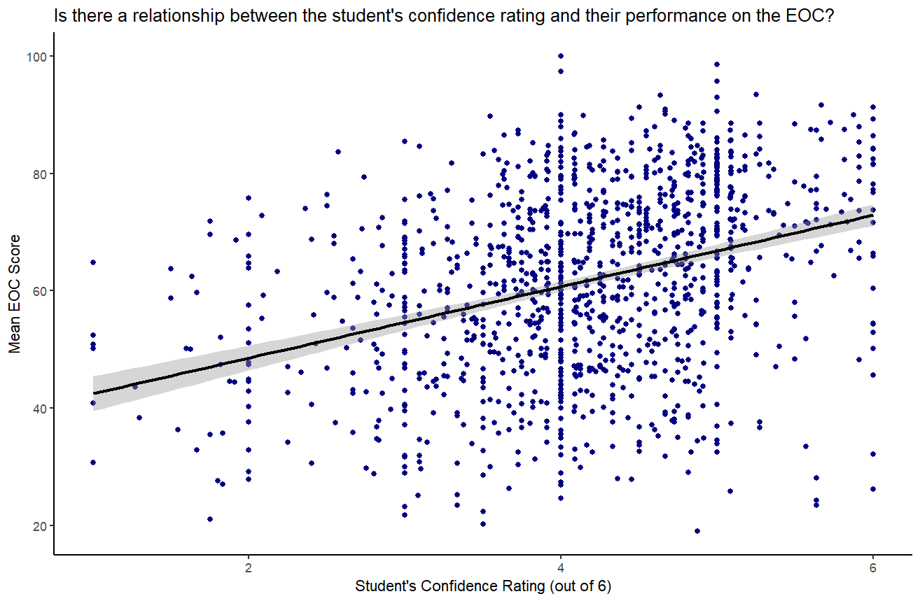
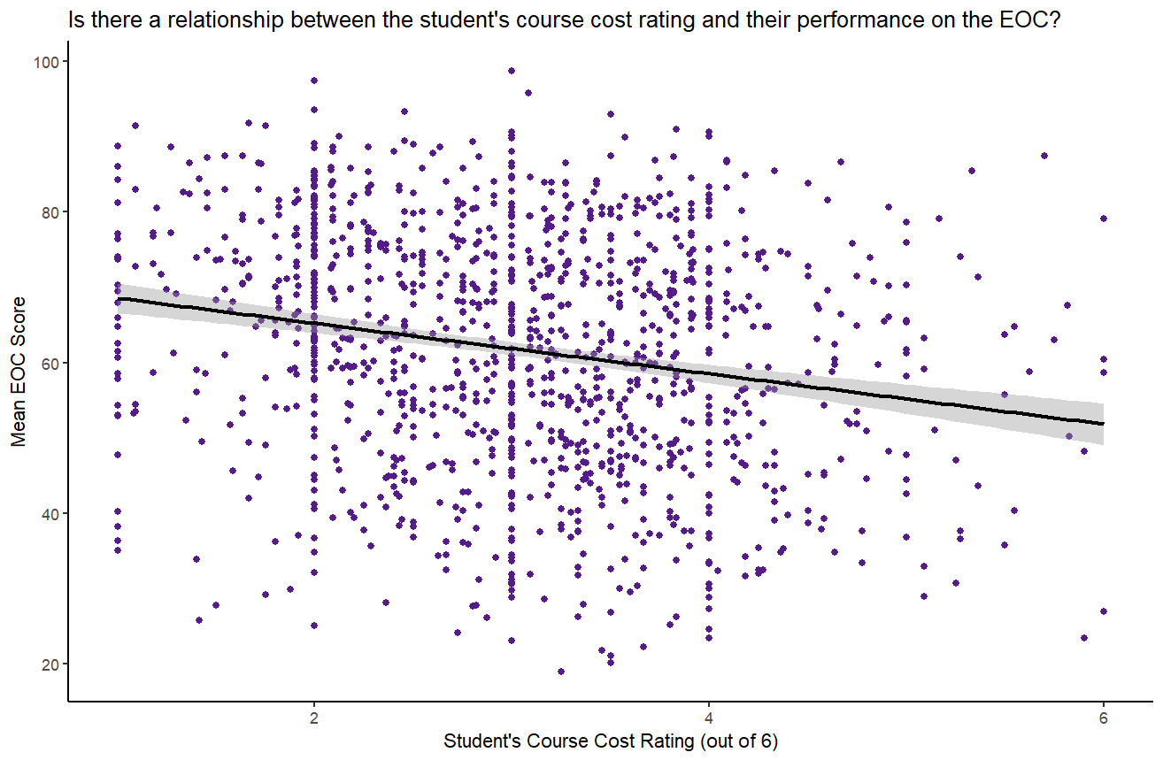
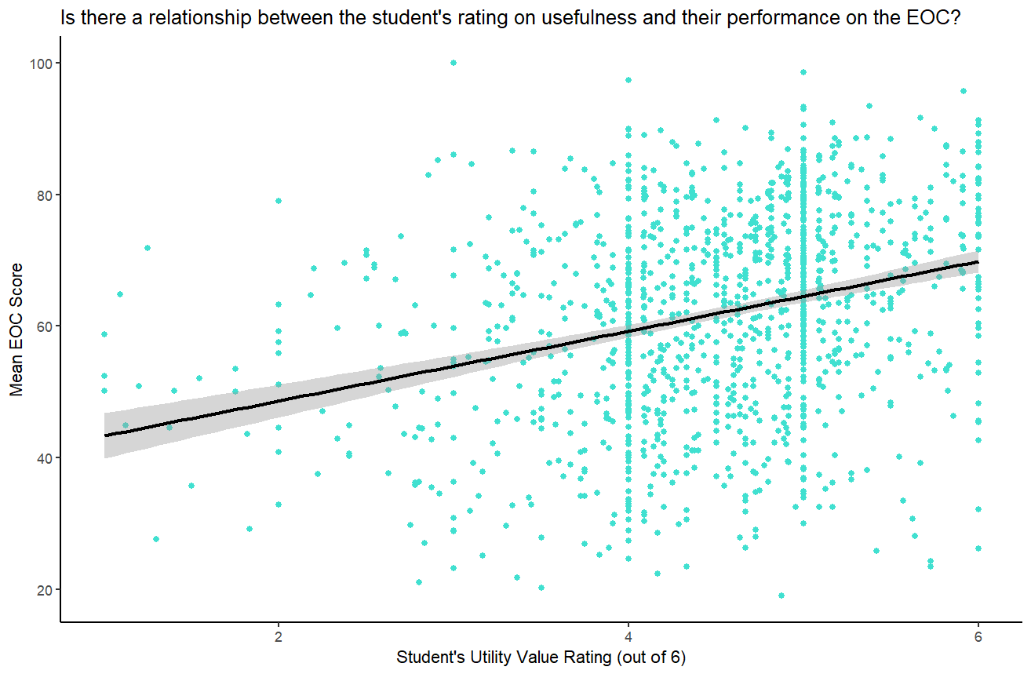
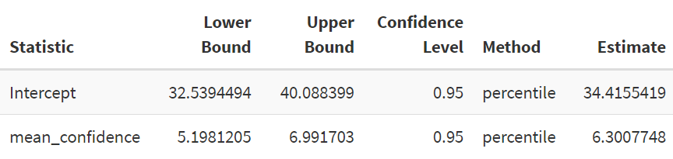
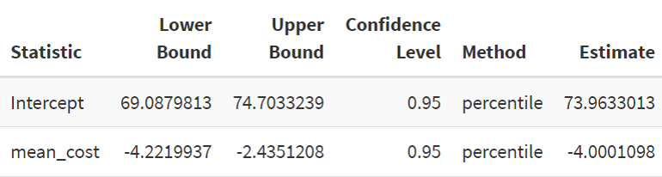
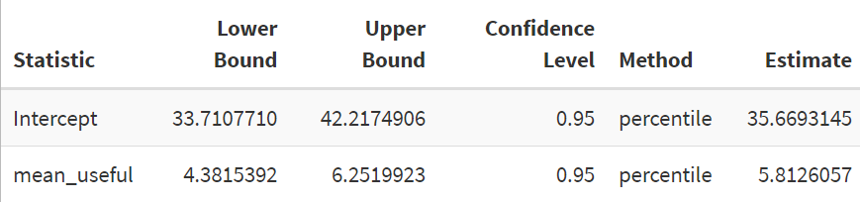
Does the student’s mental mindset before they start a chapter affect their overall performance?
1.1: The “Expectancy” Construct
1.2: The “Course Cost” Construct
1.3: The “Utility Value” Construct
Correlation: 0.3488957
Correlation: -0.2053103
Correlation: 0.2944996

Slide 3

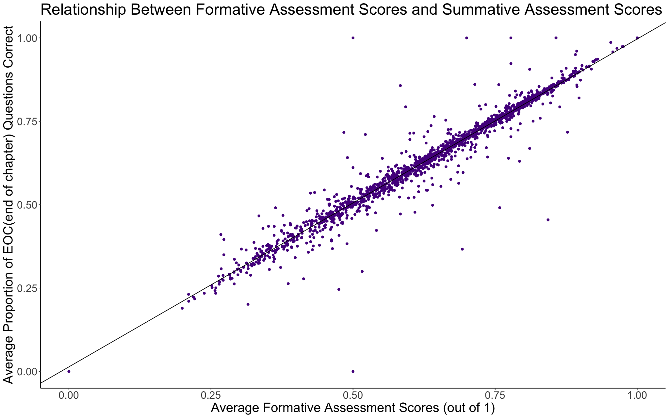
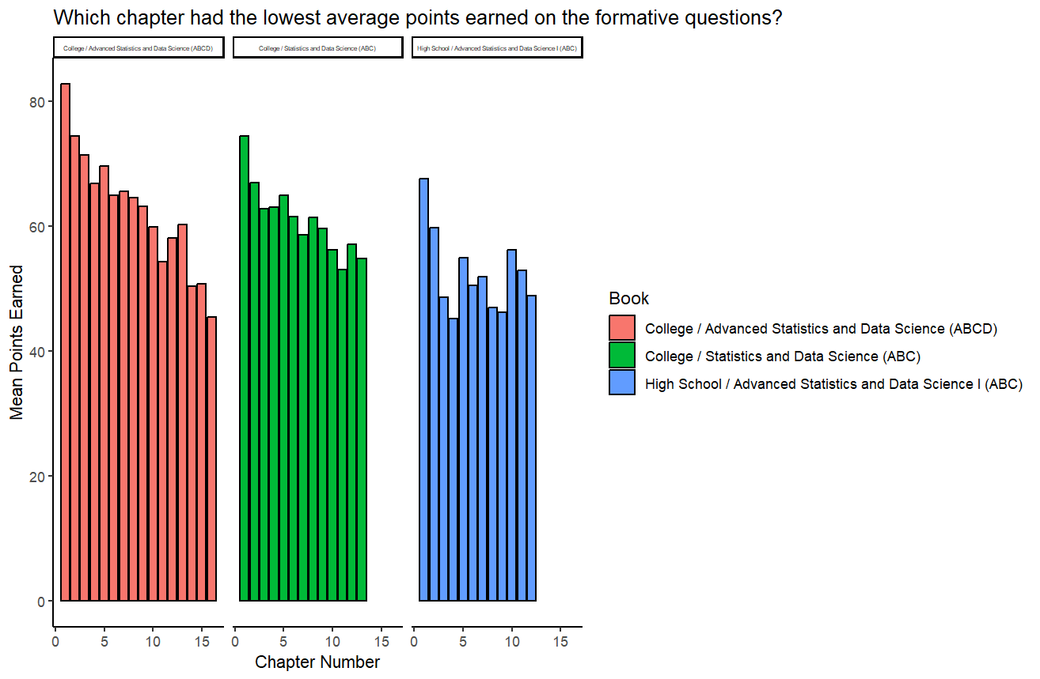
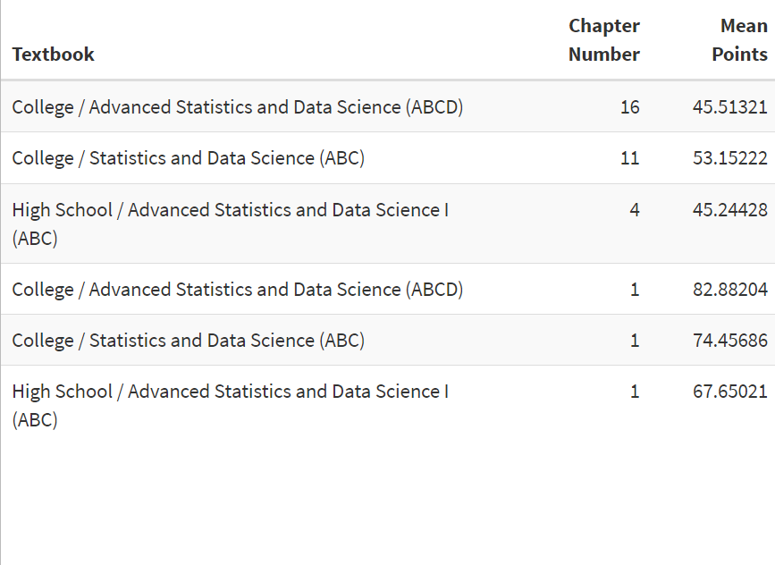
2. How did the formative questions throughout the chapters affect overall student performance?
Did students who performed better on the formative assessments also perform better on the summative(eoc) assessments?
Which chapter for each book had the lowest/highest scores for the formative questions?
Correlation: 0.969

Slide 4
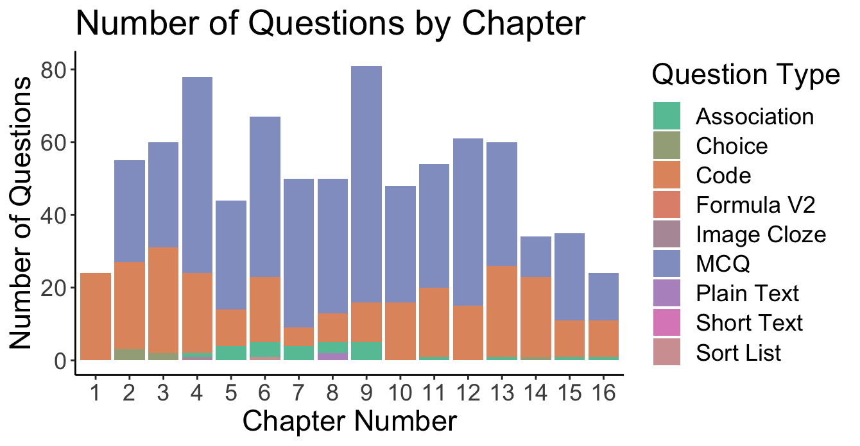
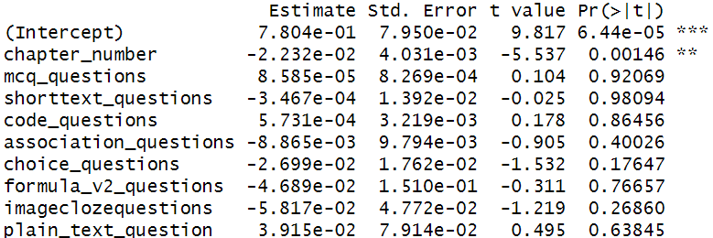
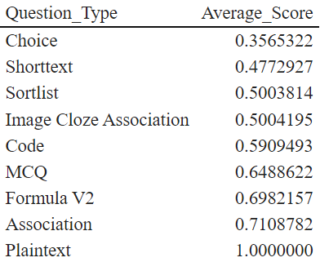
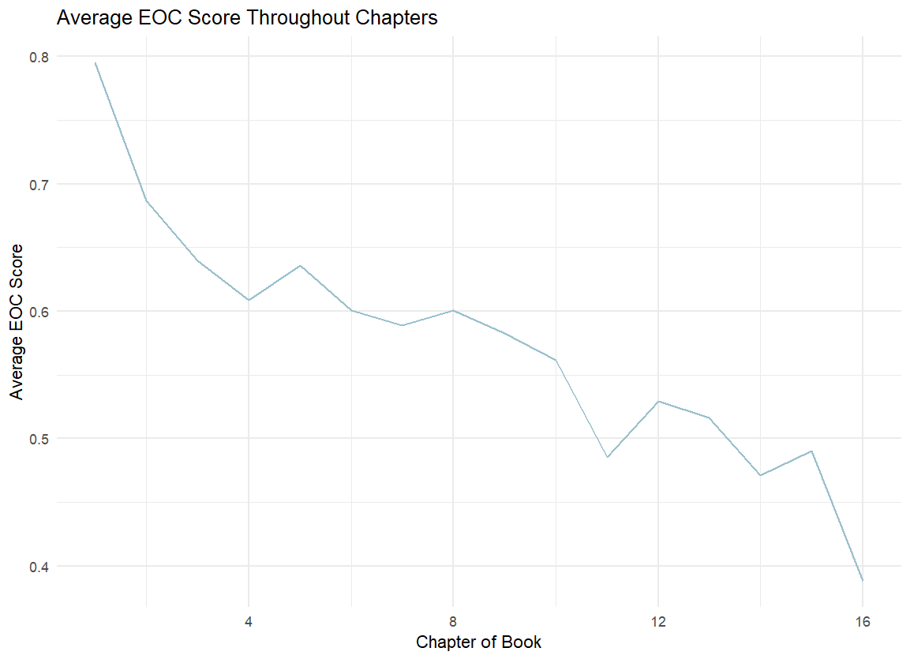
Does the type of question affect the student’s overall performance?
3. Which Question Type resulted in the lowest scores?

Slide 5
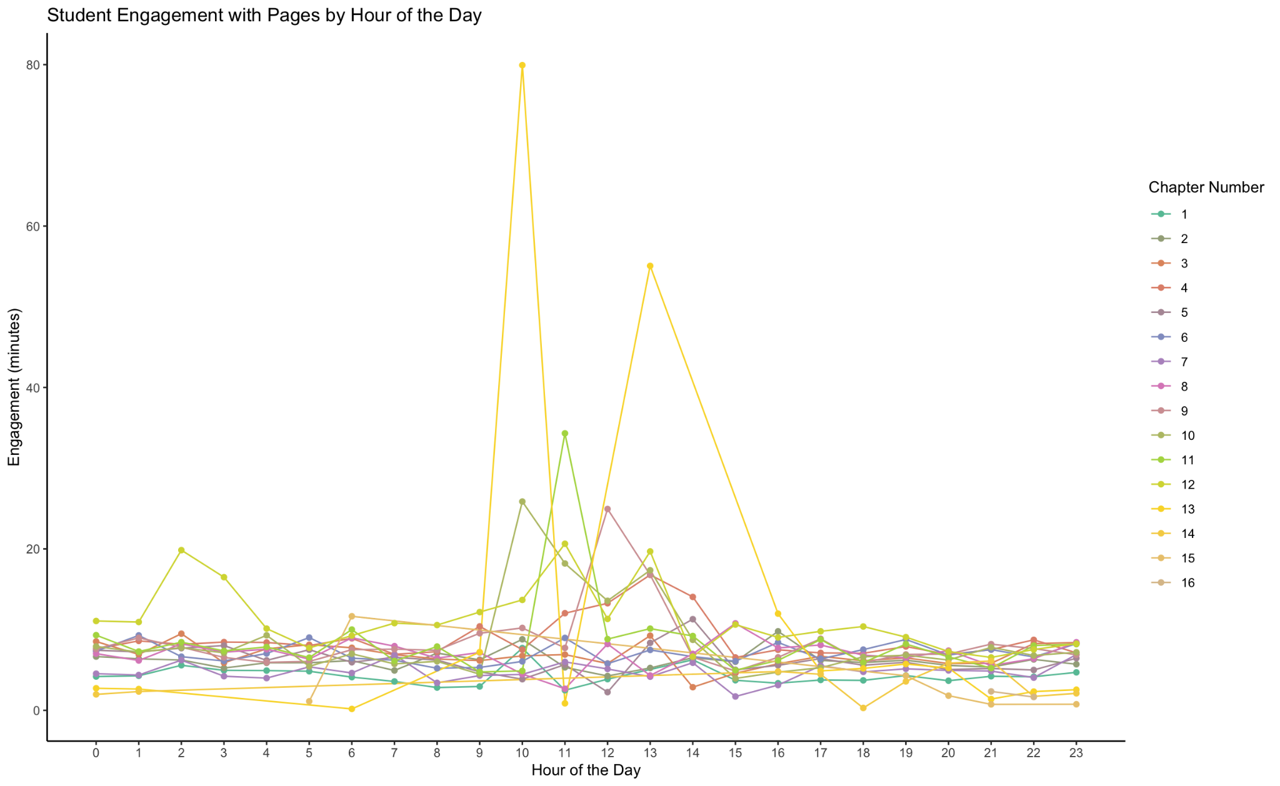
Additional Notes
Which chapters did students engage with throughout the day?

