Slide 1
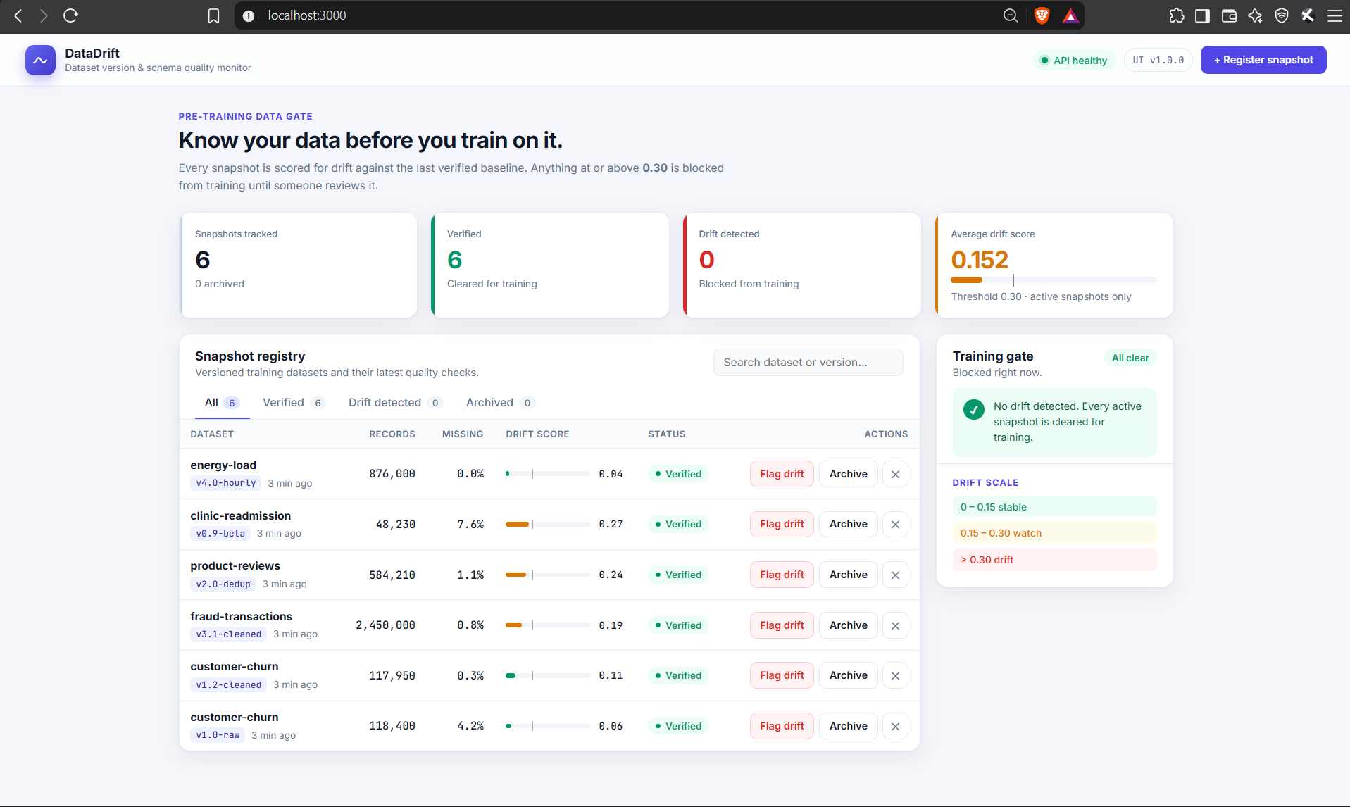
DataDrift
DEVOPS CAPSTONE PROJECT
Dataset version & schema quality monitor
Kavya Dhyani
github.com/KavyaDhyani/datadrift-capstone
Notes:
Hi, I'm Kavya, and this is my DevOps capstone, DataDrift. DataDrift is a registry for machine-learning training datasets. The application is intentionally small: the focus of the project is the DevOps pipeline around it — tests, Docker, CI/CD with a security scan, Terraform for AWS, Kubernetes with Helm, and monitoring with Prometheus and Grafana.

Slide 2
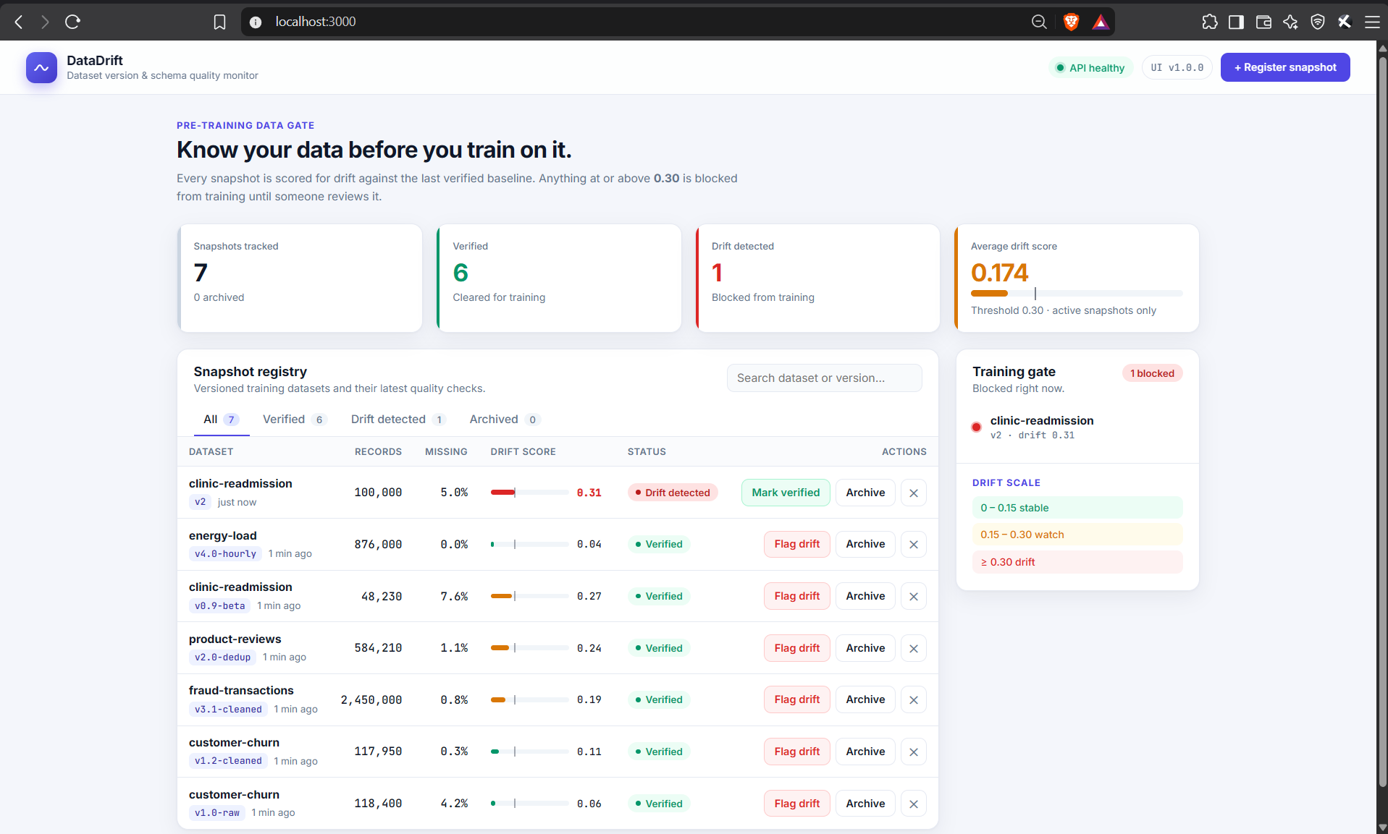



Know your data before you train on it
THE APPLICATION
Register every snapshot
Each dataset refresh is stored with its version tag, record count, missing values and a drift score from 0 to 1.
Gate drifted data
A score of 0.30 or more marks the snapshot DRIFT_DETECTED and blocks it from training until reviewed.
Alert the team
Flag drift in the UI and a Prometheus alert fires; Grafana turns red within about 30 seconds.
A snapshot registered at drift 0.31 is flagged and blocked automatically
0 – 0.15 stable
0.15 – 0.30 watch
≥ 0.30 drift
Notes:
Every time a dataset is refreshed, we register the new snapshot with its version tag, record count, missing-value percentage and a drift score between zero and one. The drift score says how far the data has moved from the last verified version. Anything at or above 0.30 is flagged drift detected and blocked from training until someone reviews it. Here a snapshot registered at 0.31 was flagged automatically and appears in the training gate on the right.

Slide 3
From git push to a monitored cluster
ARCHITECTURE
Developer
git push to main
GitHub Actions
ruff · pytest · build
Trivy scan
fail on HIGH / CRITICAL
GHCR
image : <commit-sha>
Argo CD
syncs the Helm chart
GitOps
Kubernetes · kind locally, EKS on AWS (Terraform: VPC + EKS)
Monitoring
Frontend
React + Nginx · 2 pods
Prometheus
ServiceMonitor · alert rules
/
/metrics every 15 s
Ingress
nginx
Backend
FastAPI · 2–5 pods (HPA)
PostgreSQL 16
StatefulSet + PVC
Grafana
dashboard + drift alert
/api
Notes:
Here's the architecture. When I push to GitHub, GitHub Actions runs the tests, builds both Docker images, scans them with Trivy and pushes them to the GitHub Container Registry, tagged with the commit SHA. CI then writes the new tag into the Helm values in Git, and Argo CD deploys it into Kubernetes: kind on my laptop, or EKS on AWS, which Terraform describes. The Ingress sends slash to the React frontend and slash api to the FastAPI backend, which stores data in PostgreSQL. Prometheus scrapes the backend's metrics every 15 seconds, and Grafana shows the dashboard and the drift alert.

Slide 4
Ten modules, one pipeline
RUBRIC COVERAGE
Module | Points | What I built
M1 Application | 10 | FastAPI + PostgreSQL 16 + Alembic, React dashboard, GET/POST/PUT/DELETE API
M2 Testing | 10 | 14 pytest tests on a throwaway SQLite database, ruff lint and format
M3 Git and GitHub | 5 | Public repository, 30+ descriptive commits, .gitignore for secrets and build output
M4 Docker | 10 | Non-root images, multi-stage frontend, Compose with health-checked startup
M5 CI/CD | 15 | GitHub Actions: test → build → scan → push to GHCR with SHA tags → GitOps tag bump
M6 DevSecOps | 5 | Trivy gate on HIGH/CRITICAL; 43 base-image CVEs found and fixed
M7 Terraform | 15 | VPC, subnets, NAT, IAM, EKS cluster and node group: 25 resources
M8 Kubernetes + Helm | 15 | Helm chart deployed by Argo CD (GitOps): Deployments, StatefulSet, Services, Ingress, HPA
M9 Observability | 10 | ServiceMonitor, drift alert rule, auto-loaded Grafana dashboard
M10 Presentation | 5 | README, plus slides and video in demo/; live push → pipeline → Argo CD rollout
Notes:
This is how the project maps onto the ten rubric modules. I'll walk through them in this order, and finish with the live change through the pipeline.

Slide 5
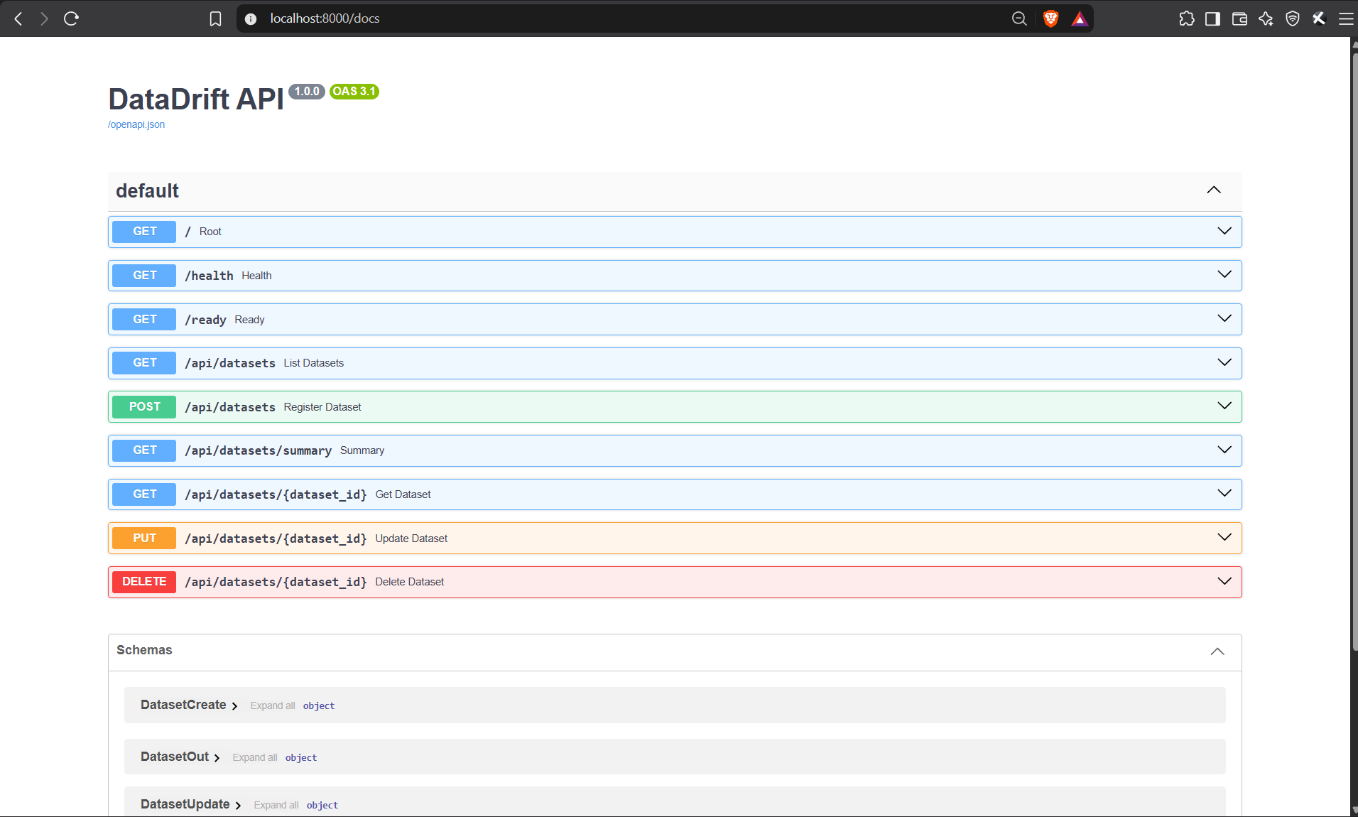



A small API with a real database
M1 · APPLICATION · 10 PTS
FastAPI backend
GET, POST, PUT and DELETE on /api/datasets, plus /health, /ready and /metrics. Status follows the drift score.
PostgreSQL 16 + Alembic
Migration 0001 creates the table with unique and range constraints; an advisory lock stops replicas migrating at once.
React dashboard
KPIs, a searchable registry, a register form, and one-click Flag drift / Mark verified.
Swagger UI at /docs: every endpoint, generated by FastAPI
Notes:
The backend is FastAPI with SQLAlchemy. It has a REST API with GET, POST, PUT and DELETE on /api/datasets, plus /health for liveness, /ready for readiness, which checks the database, and /metrics for Prometheus. The data lives in PostgreSQL 16 and the schema is managed by an Alembic migration. Because Kubernetes runs two backend replicas, the migration takes a Postgres advisory lock so they never migrate at the same time. DELETE archives a snapshot by default and purge=true removes it permanently.

Slide 6
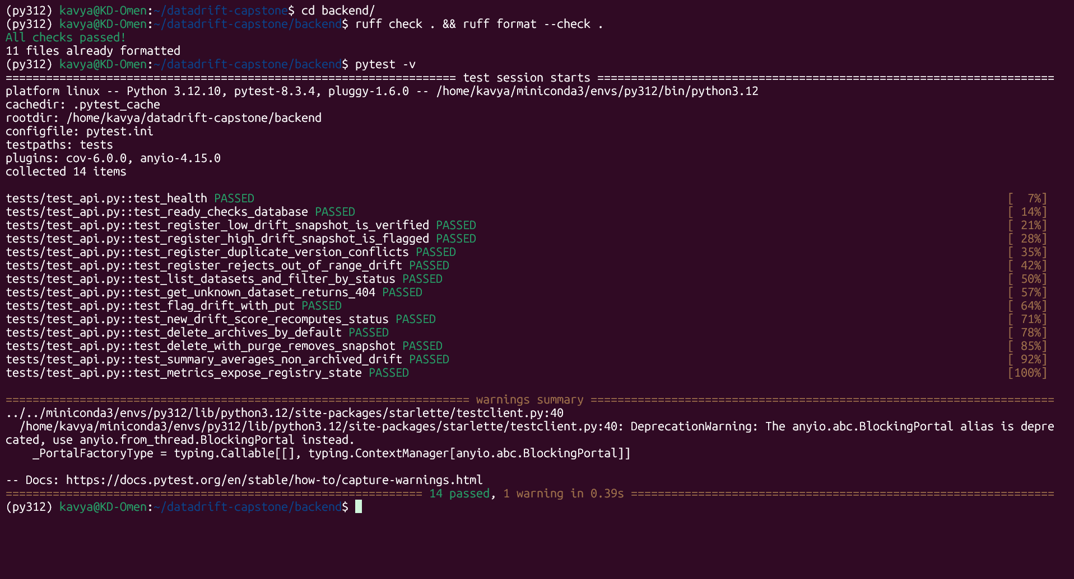
14 tests guard every build
M2 · TESTING · 10 PTS
14 / 14
tests passing in 0.39 s
9
endpoints covered, including errors
SQLite
throwaway test database, never Postgres
ruff check, ruff format --check and pytest -v
ruff and pytest run first in CI: a failing test stops the pipeline before any image is built.
Notes:
Before anything is built, the code has to pass two gates: ruff for linting and formatting, and pytest. There are 14 tests covering every endpoint: validation errors, duplicate versions returning 409, automatic drift flagging, archive versus purge, and the metrics output. The tests never touch the real database: conftest.py points the app at a temporary SQLite file and recreates the tables for every test.

Slide 7
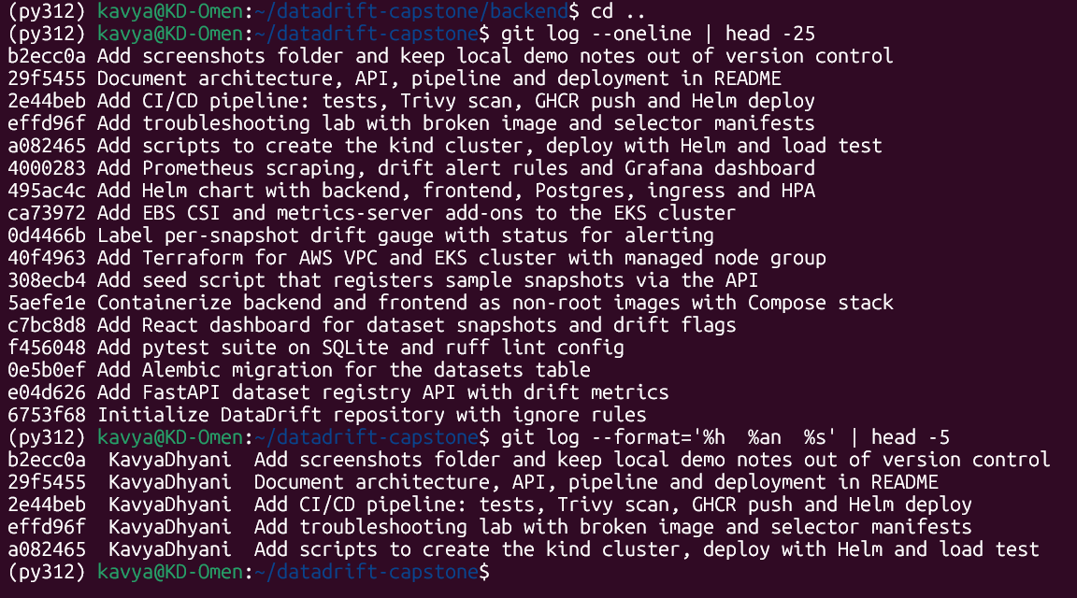



One commit per step, in the open
M3 · GIT AND GITHUB · 5 PTS
Public repository
github.com/KavyaDhyani/datadrift-capstone
23 descriptive commits
Each message says what changed: no “update” or “fix”.
Secrets stay out
.gitignore covers .env, .venv, __pycache__, node_modules, kubeconfig, *.tfstate and *.tfvars.
git log: each commit is one logical step
Notes:
The repository is public on GitHub. I committed after each step with a message that says what changed, so the history reads like the build log of the project. The .gitignore keeps secrets and build output out of Git: env files, virtual environments, node_modules, kubeconfigs, and Terraform state and variable files. No credentials are in the history.

Slide 8
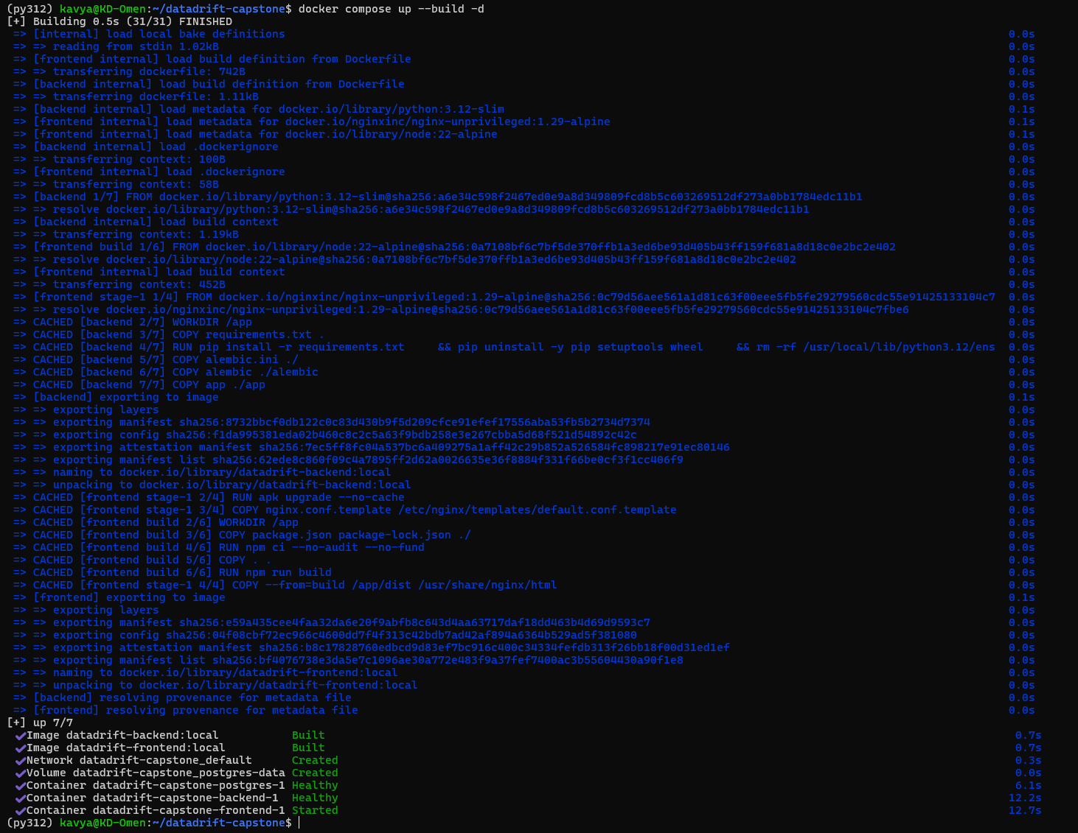



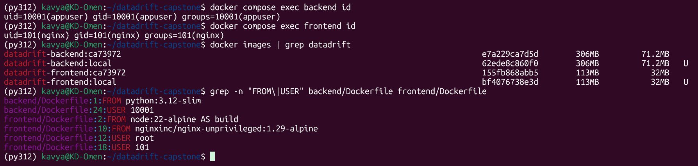
Small, non-root images
M4 · DOCKER · 10 PTS
Backend image
python:3.12-slim, runs as uid 10001, pip and setuptools removed, built-in health check.
Multi-stage frontend
node:22-alpine builds the React app; nginx-unprivileged serves it as uid 101 on port 8080.
One-command stack
docker compose up --build starts Postgres, then the backend (after migrating), then the frontend.
docker compose up --build: all three services healthy
Notes:
Locally the whole stack runs with one command, docker compose up --build: Postgres, backend and frontend. The backend waits until Postgres is healthy and runs the Alembic migration before it starts. Both containers run as non-root users: uid 10001 for the backend and uid 101 for Nginx. The frontend Dockerfile is a multi-stage build: the first stage uses Node to build the React app, and the final image only contains Nginx and the static files, so no build tools ship to production.

Slide 9
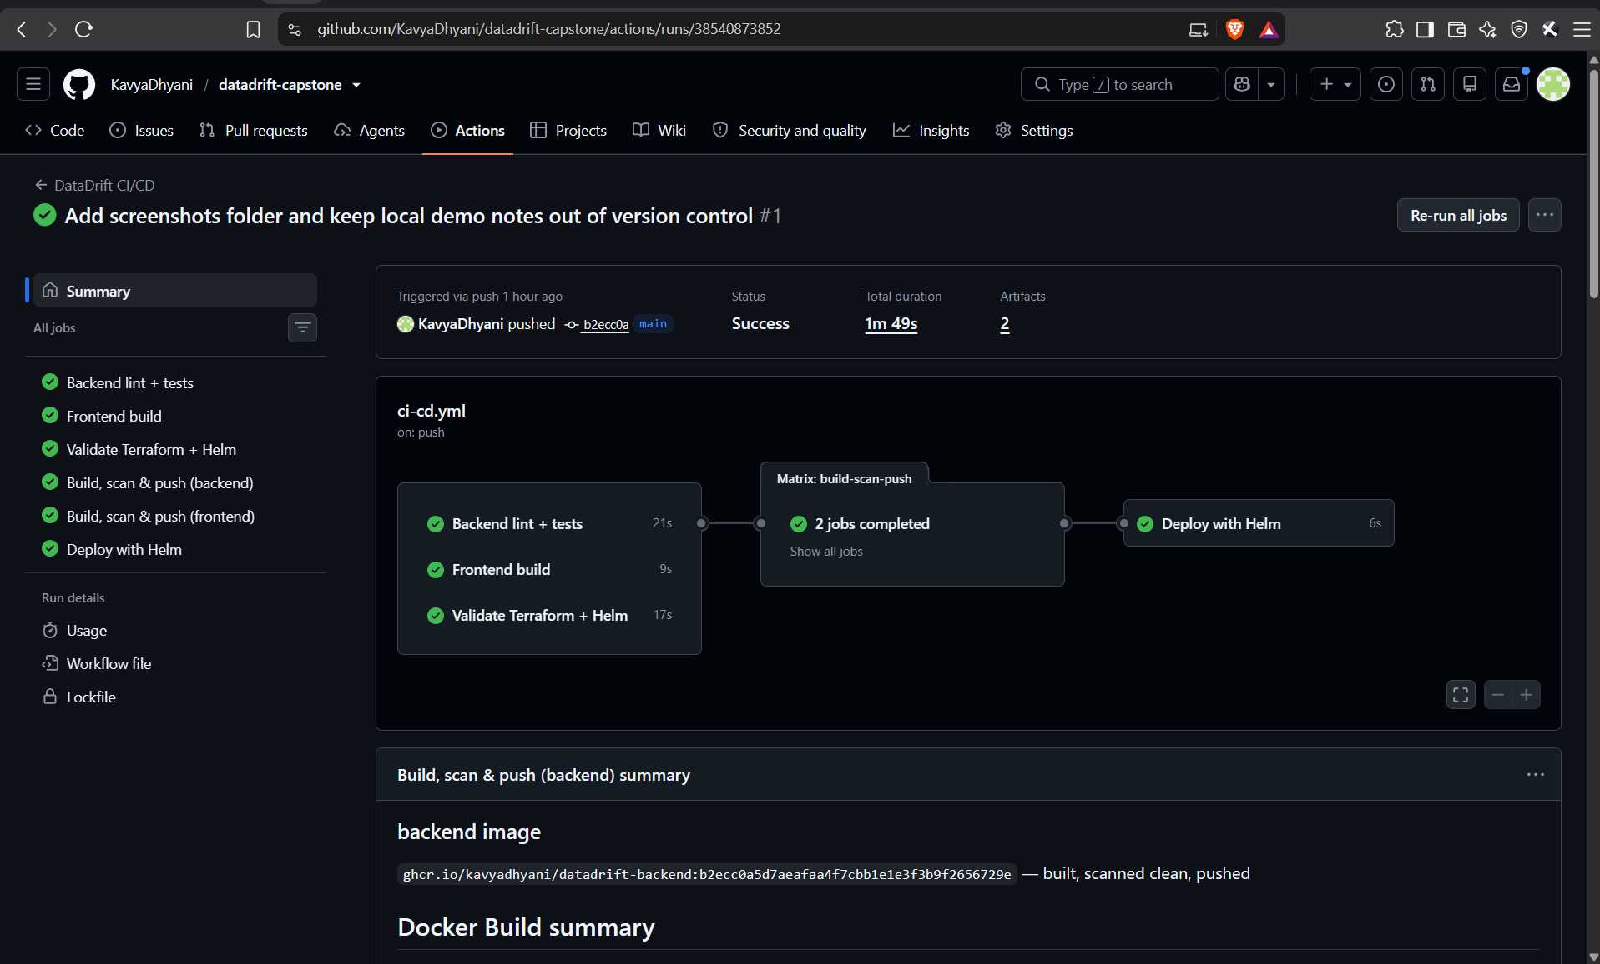


Every push: test, build, scan, ship
M5 · CI/CD · 15 PTS
Test
ruff + pytest
Frontend
npm build
Validate
terraform, helm
Ship images
Trivy → GHCR
GitOps
tag → Argo CD
1
2
3
4
5
Tagged with the commit SHA
ghcr.io/kavyadhyani/datadrift-backend:<sha>, never latest: every pod traces back to a commit.
Gates in order
Steps 1–3 run in parallel; images are built only if all pass. Pull requests build and scan but never push.
Hand-off to Argo CD
The last job commits the new SHA to values-gitops.yaml; Argo CD deploys it.
Notes:
This is the GitHub Actions pipeline. It runs on every push and pull request to main. Three jobs run in parallel: backend lint and tests, the frontend build, and validation of the Terraform and Helm code. Only if all three pass do we build the images. The build job runs once for the backend and once for the frontend: build, Trivy scan, then push to the GitHub Container Registry. The images are tagged with the full Git commit SHA, never latest. The last job is the GitOps hand-off: it commits the new SHA into the Helm values file in Git, and Argo CD in the cluster picks that up and deploys it. The pipeline itself never touches the cluster.

Slide 10

The scan found real CVEs, and the build fixed them
M6 · DEVSECOPS · 5 PTS
Frontend · nginx-unprivileged base
Backend · python:3.12-slim
43
0
HIGH
0
HIGH CVEs in Alpine packages (c-ares, curl, …)
CVEs in pip’s vendored urllib3 and in setuptools
Fix: apk upgrade --no-cache in the runtime stage
Fix: uninstall pip, setuptools and wheel after installing dependencies
Example: CVE-2026-33630
The gate in CI
A use-after-free in c-ares, the DNS library curl uses. A fixed package existed, so upgrading removed it.
--severity HIGH,CRITICAL --ignore-unfixed --exit-code 1: a fixable vulnerability fails the build.
Notes:
Trivy scans container images for known vulnerabilities in OS packages and language libraries. When I first scanned the frontend, the Nginx base image had 43 HIGH CVEs in its Alpine packages. One example is CVE-2026-33630, a use-after-free bug in c-ares, the DNS library that curl uses. Fixed versions existed, so I added apk upgrade to the Dockerfile. The backend had HIGH CVEs in libraries bundled inside pip, such as urllib3, and in setuptools. The application never uses pip at runtime, so the Dockerfile removes them. Now both images scan clean. In the pipeline Trivy runs with exit code 1 on fixable HIGH or CRITICAL findings, so a vulnerable image can never be pushed.

Slide 11
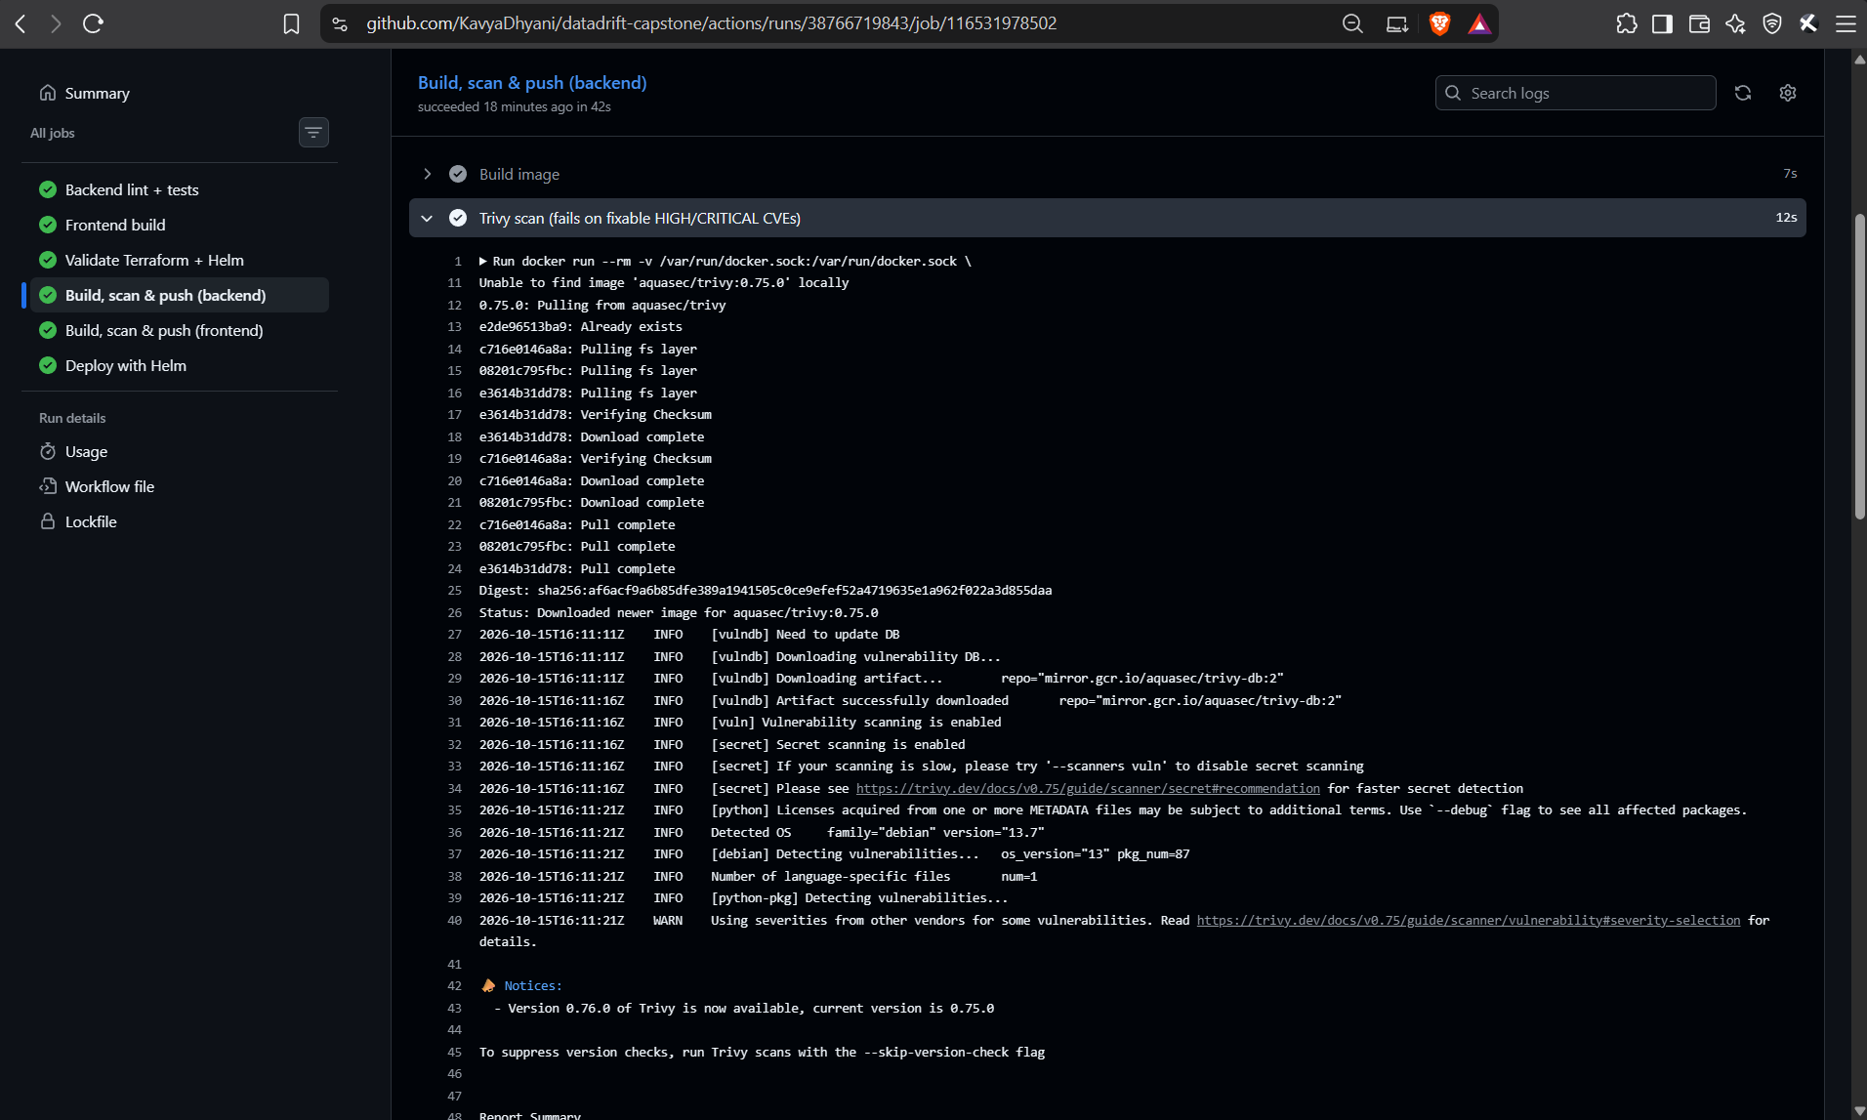
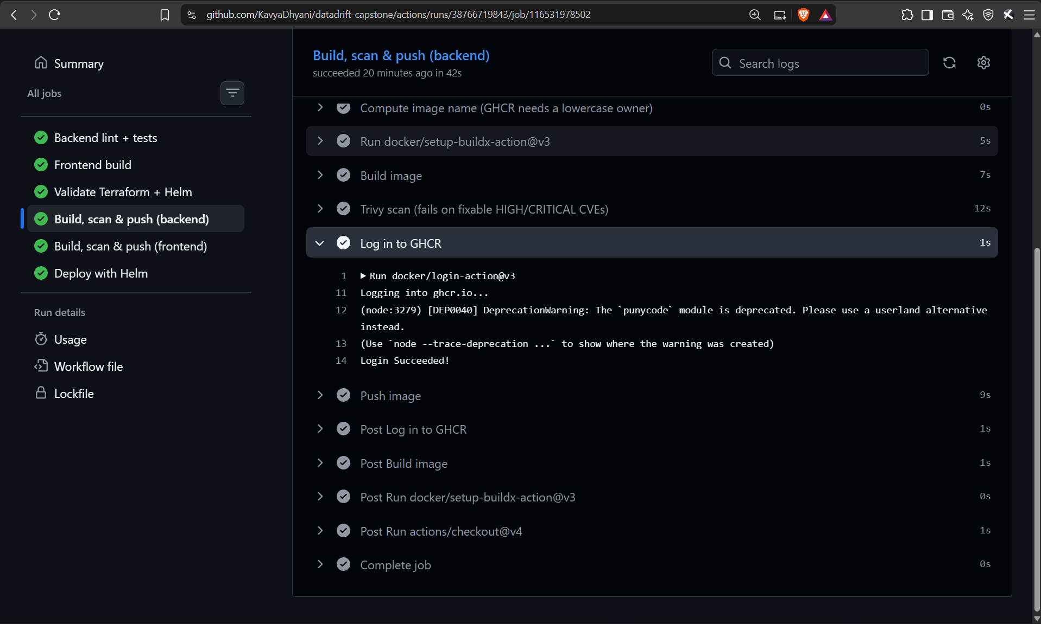
Scanned first, pushed only if clean
M5 + M6 · PIPELINE EVIDENCE
Trivy scan step: fresh vulnerability DB, OS + Python packages, secrets
Then the job logs in to ghcr.io with GITHUB_TOKEN and pushes
The Trivy step runs with --exit-code 1 before the GHCR login: a fixable HIGH or CRITICAL CVE stops the job, so a vulnerable image is never pushed.
Notes:
This is the evidence from a real pipeline run. On the left is the Trivy step inside the backend build job: it pulls Trivy 0.75, downloads the latest vulnerability database, and scans the Debian packages, the Python libraries and any secrets in the image. The step passed, so there were no fixable HIGH or CRITICAL CVEs. Only then does the job log in to the GitHub Container Registry with the workflow's built-in GITHUB_TOKEN, shown on the right, and push the image tagged with the commit SHA. If Trivy had found a problem, the job would have stopped before the push.

Slide 12
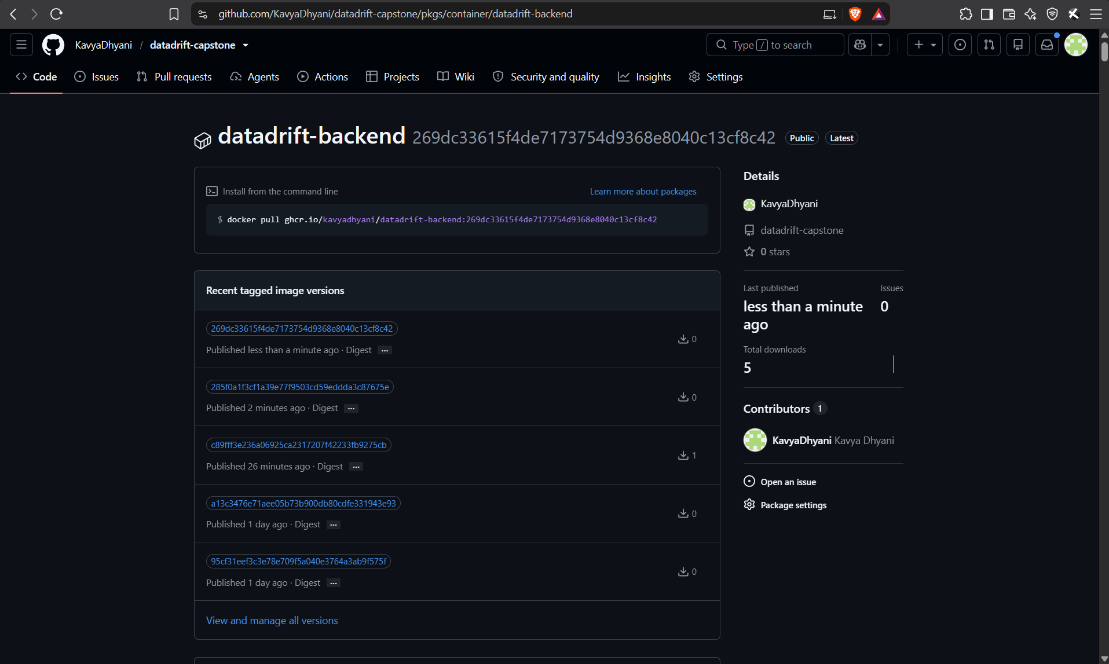
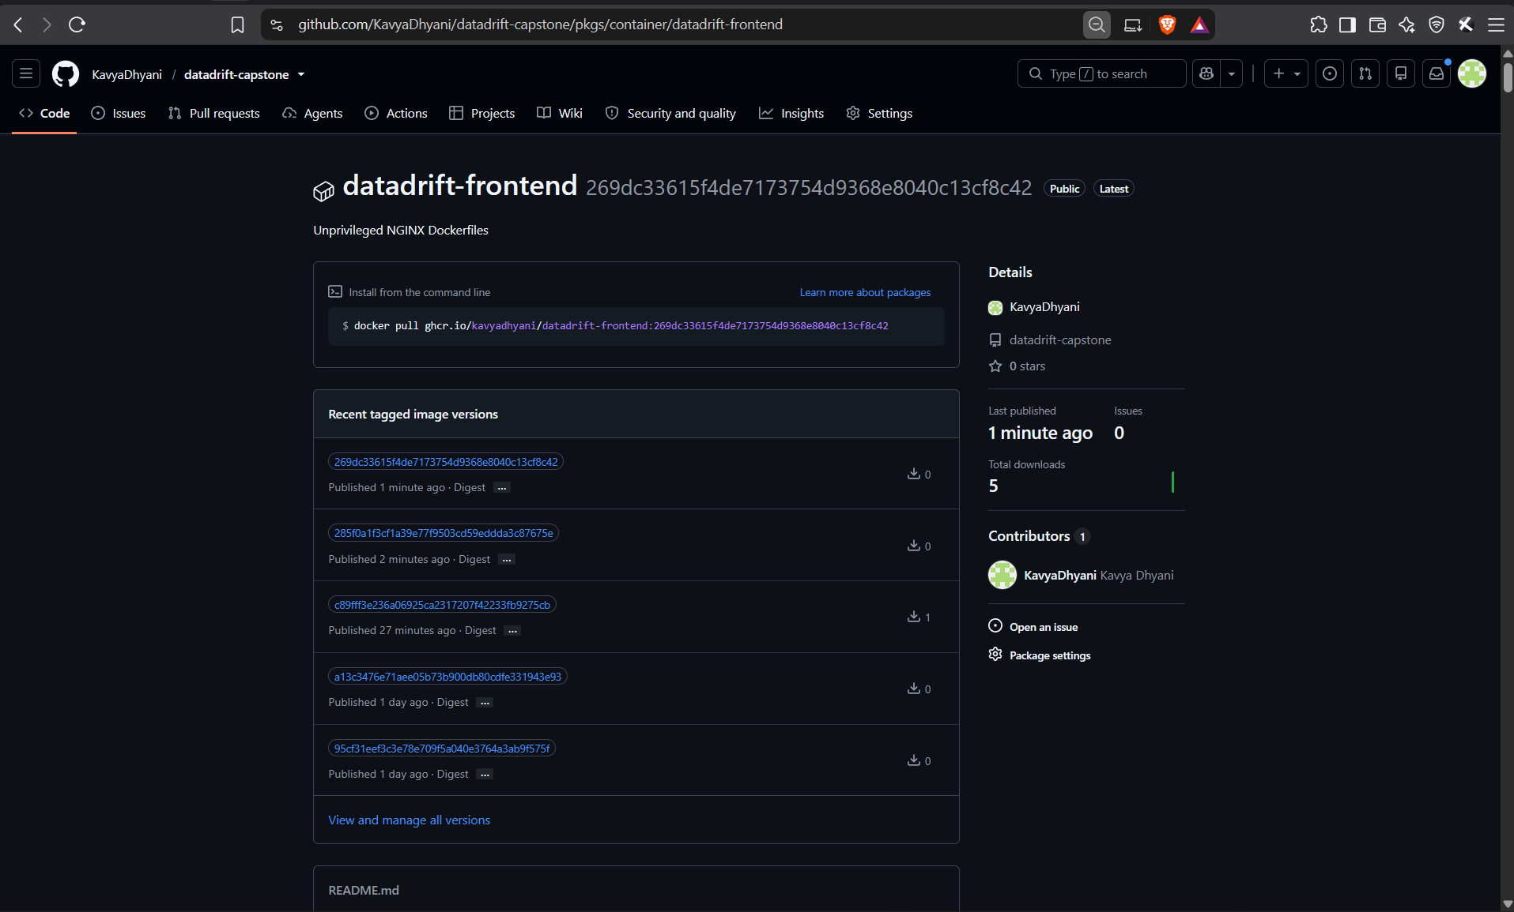
Every image is tagged with its commit
M5 · CONTAINER REGISTRY
ghcr.io/kavyadhyani/datadrift-backend: one tag per commit SHA
ghcr.io/kavyadhyani/datadrift-frontend: the same SHAs
Both packages are public, so the cluster pulls them anonymously. A running pod’s image tag points straight back to the commit that built it, and no image is ever tagged latest.
Notes:
These are the two packages in the GitHub Container Registry. Every version is tagged with the full Git commit SHA that built it, so the newest tag here, 269dc33, is the commit I pushed last. There is no latest tag: the Latest badge is only GitHub's label for the newest version. Because each tag is a commit, I can look at any running pod and know exactly which code it runs, and roll back to any earlier SHA with Helm. The packages are public, so the kind cluster pulls them without credentials.

Slide 13
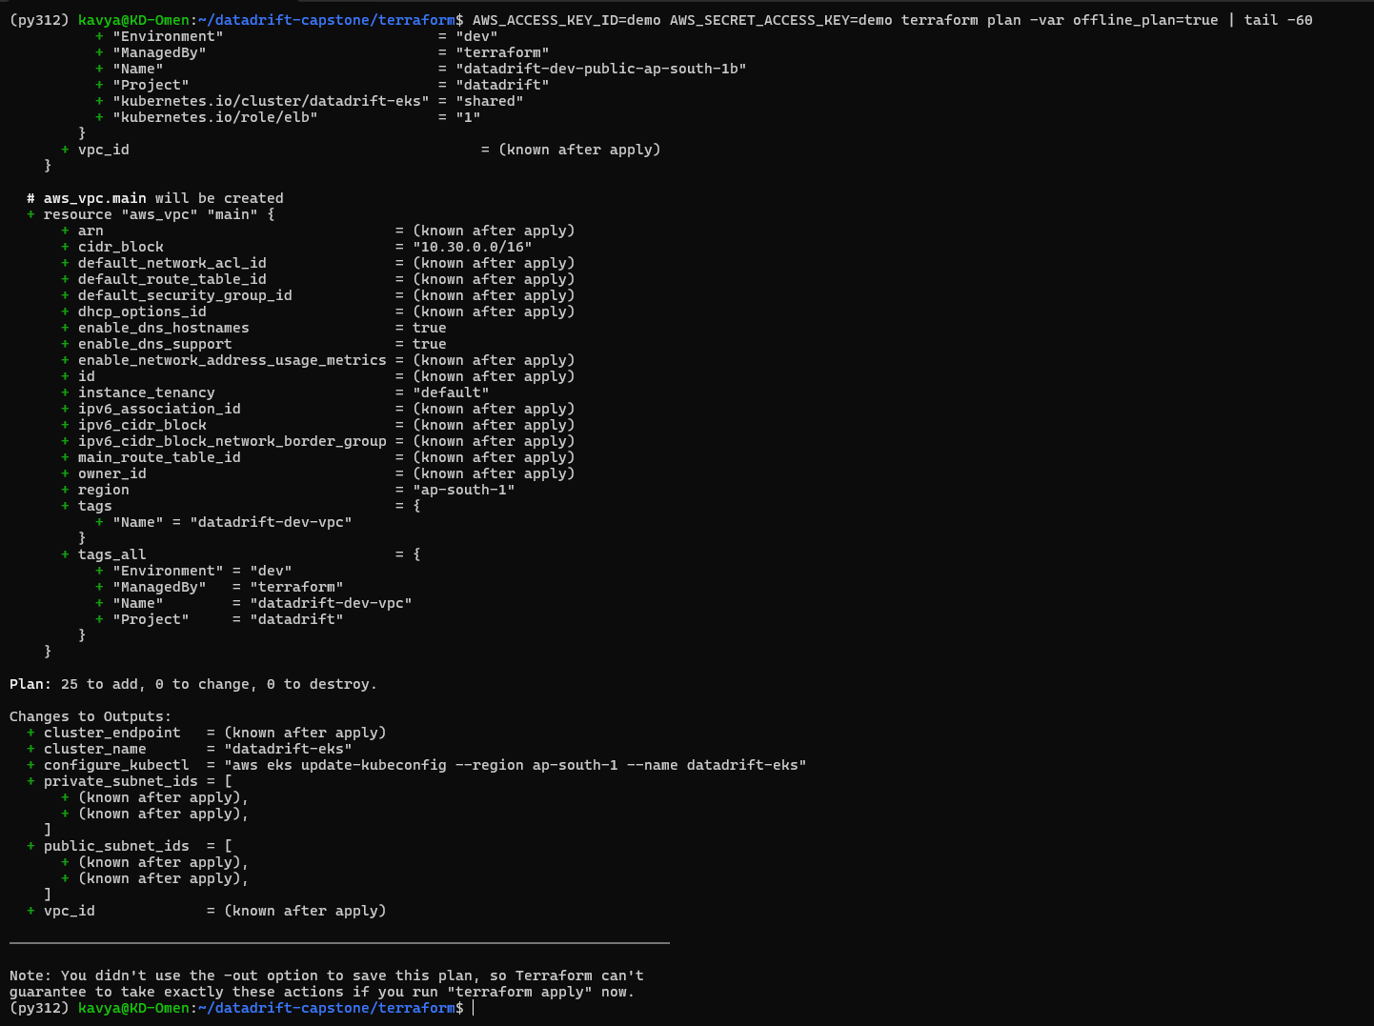


AWS VPC and EKS, written as code
M7 · TERRAFORM · 15 PTS
25
2 AZs
resources planned
ap-south-1a / 1b
Network
VPC 10.30.0.0/16, two public and two private subnets, internet gateway, NAT gateway, route tables.
EKS
Cluster, IAM roles, managed node group of 2–4 × t3.medium in private subnets, EBS CSI and metrics-server add-ons.
Planned, not applied: no AWS account was used, so plan runs offline with dummy keys. Nothing was created, so nothing costs money; plan -destroy confirms it.
terraform plan: 25 to add, 0 to change, 0 to destroy
Notes:
The AWS infrastructure is Terraform code. vpc.tf creates a VPC with two public and two private subnets across two availability zones, an internet gateway, a NAT gateway and route tables. iam.tf creates the roles, and eks.tf creates the EKS cluster, a managed node group of two to four t3.medium nodes in the private subnets, and the EBS and metrics-server add-ons. An EKS cluster and NAT gateway cost money every hour, so for this demo I run the plan in offline mode with dummy credentials. Terraform shows exactly what it would create: 25 resources. With a real account it's terraform apply, then aws eks update-kubeconfig, and terraform destroy when finished. No credentials are in the repository.

Slide 14
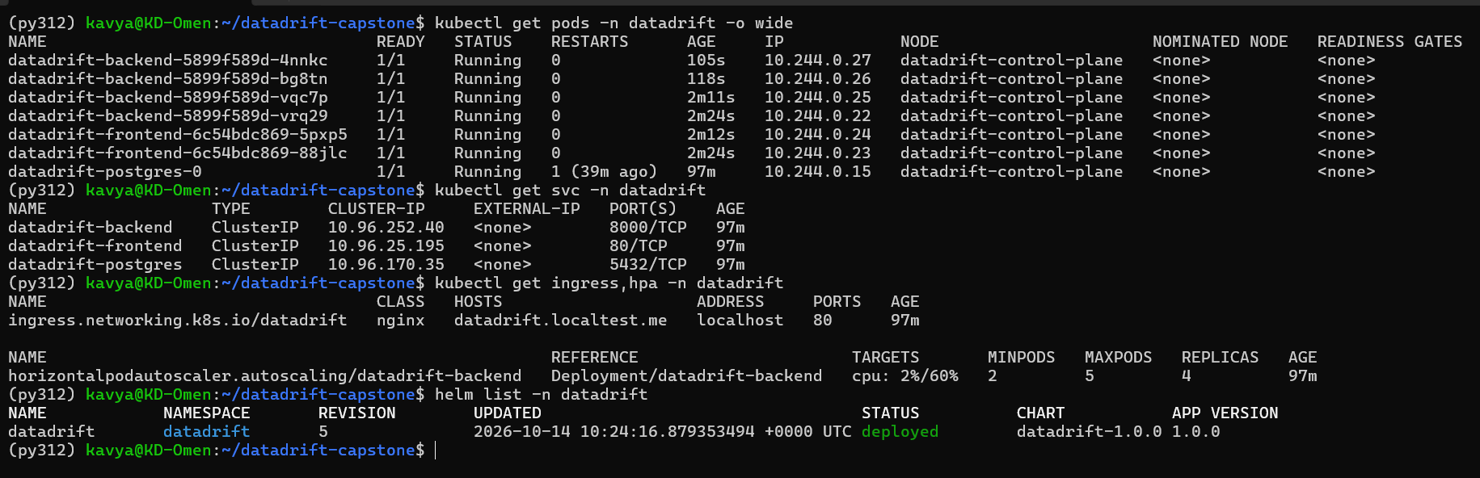
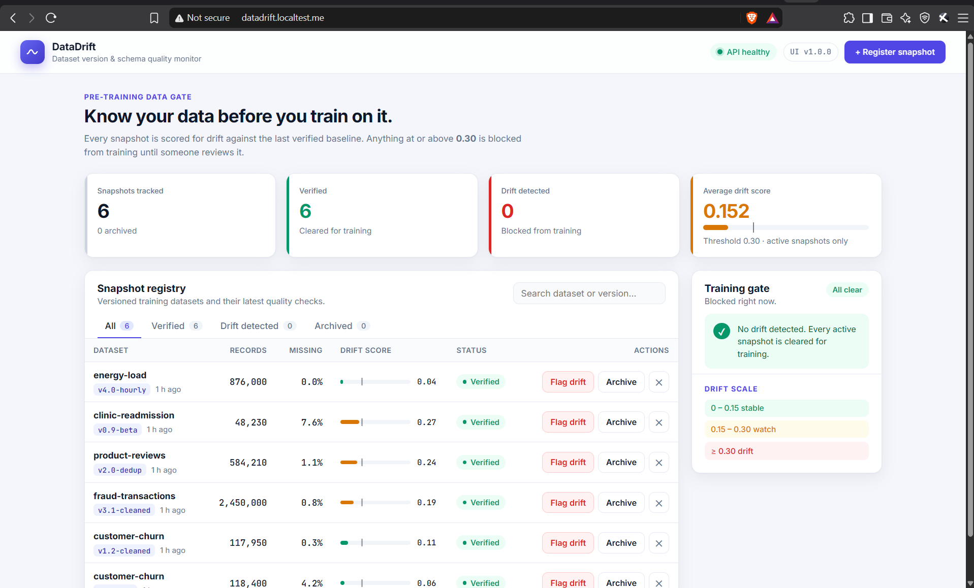

One Helm chart, running on kind
M8 · KUBERNETES + HELM · 15 PTS
Deployments
backend 2–5 pods, frontend 2 pods; rolling updates with maxUnavailable 0
StatefulSet
PostgreSQL 16 with a 1 Gi persistent volume
Services + Ingress
kubectl get pods, svc, ingress, hpa and helm list
ClusterIP services; / → frontend, /api → backend
HPA
scales the backend on 60% CPU
The app through the Ingress
Notes:
Locally I use a kind cluster; the same Helm chart deploys to EKS with the production values file. One script installs the platform pieces: the ingress-nginx controller, metrics-server and the kube-prometheus-stack. The Helm release creates two backend pods and two frontend pods, Postgres as a StatefulSet with a persistent volume, ClusterIP services, and an Ingress that sends /api to the backend and everything else to the frontend. The backend has readiness and liveness probes, runs as non-root with a read-only filesystem, and waits for Postgres before starting. Here are all pods Running, the services, the Ingress host, the HPA and the Helm release, and the app through the Ingress hostname.

Slide 15

Git decides what runs in the cluster
M8 · GITOPS WITH ARGO CD
git push
code change
CI
test · scan · push
Tag commit
values-gitops.yaml
Argo CD
sees it within 1 min
Cluster
rolling update
Application = chart + values
# helm/datadrift/values-gitops.yaml
backend:
image:
repository: ghcr.io/kavyadhyani/
datadrift-backend
tag: 769f97f… # written by CI
frontend:
image:
tag: 769f97f… # same commit
argocd/datadrift-application.yaml points Argo CD at helm/datadrift and values-gitops.yaml.
Automated, self-healing sync
prune removes objects deleted from Git; selfHeal undoes manual kubectl changes.
Rollback is a git revert
Reverting the tag commit puts the previous image back. Every release is in Git history.
Notes:
Deployment is GitOps with Argo CD. Argo CD runs inside the cluster and watches this repository. The Application manifest points it at the Helm chart and a values file, values-gitops.yaml, which holds the image tags. The pipeline never talks to the cluster: its last job commits the new commit SHA into that file. Argo CD checks Git every minute, sees the new tag and syncs. Sync is automated with prune and self-heal, so if someone edits the cluster by hand Argo CD puts it back to what Git says. Rolling back is just reverting the tag commit.

Slide 16
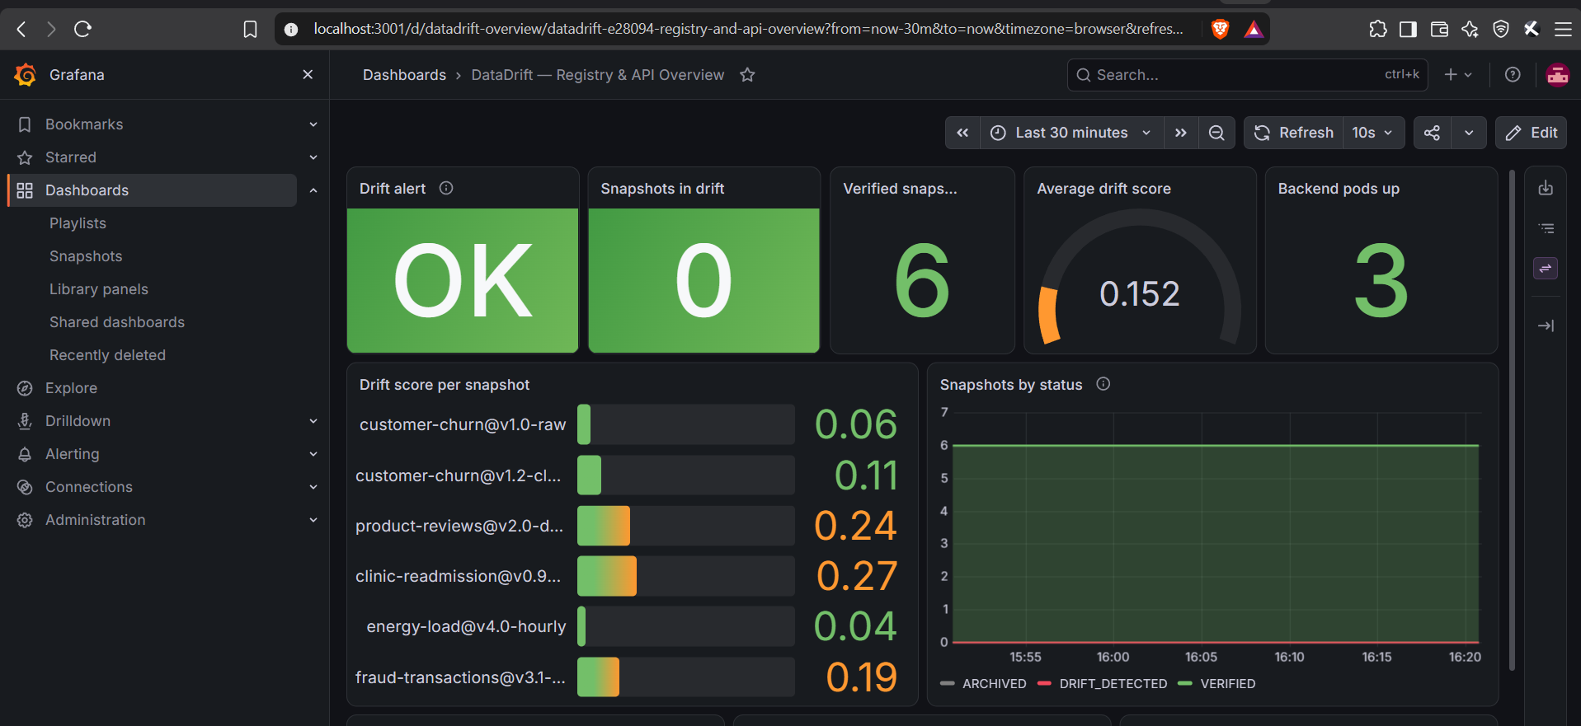
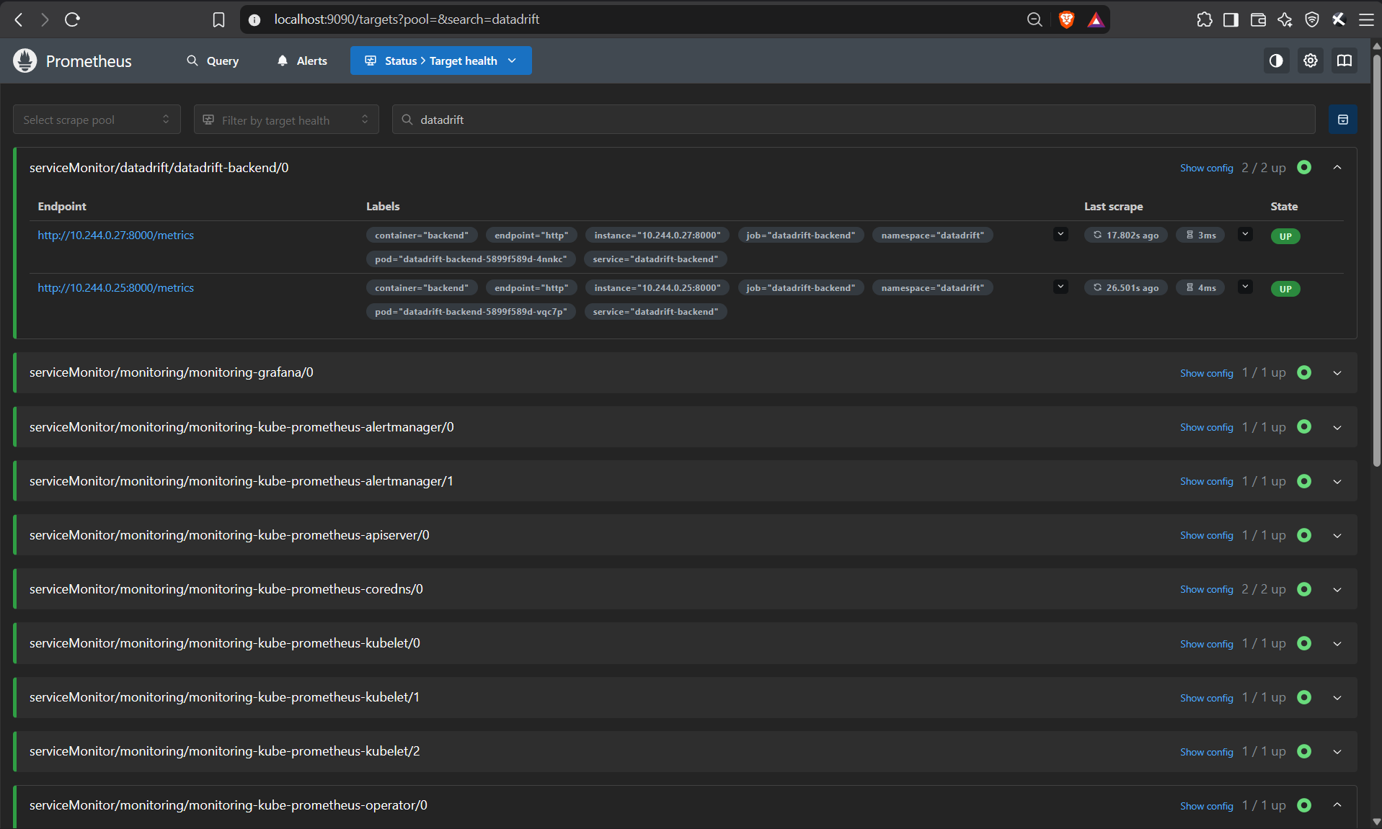
Metrics in, dashboard out
M9 · OBSERVABILITY · 10 PTS
Prometheus targets: 2/2 backend pods UP
Grafana: DataDrift — Registry & API Overview, loaded by the Helm chart
/metrics
ServiceMonitor
12 panels
requests, latency, and the drift score of every snapshot
Prometheus scrapes each backend pod every 15 s
drift, status, traffic, errors, CPU, replicas
Notes:
The backend exposes Prometheus metrics at /metrics: request counts and latencies, plus business metrics such as the drift score of every snapshot and the number of snapshots per status. A ServiceMonitor in the Helm chart tells Prometheus to scrape every backend pod; both targets are UP. The Grafana dashboard is installed by the Helm chart as well, through a ConfigMap that the Grafana sidecar loads. It shows the drift alert state, the average drift gauge, the drift score of each snapshot, request rate, p95 latency, errors, CPU and replicas.

Slide 17
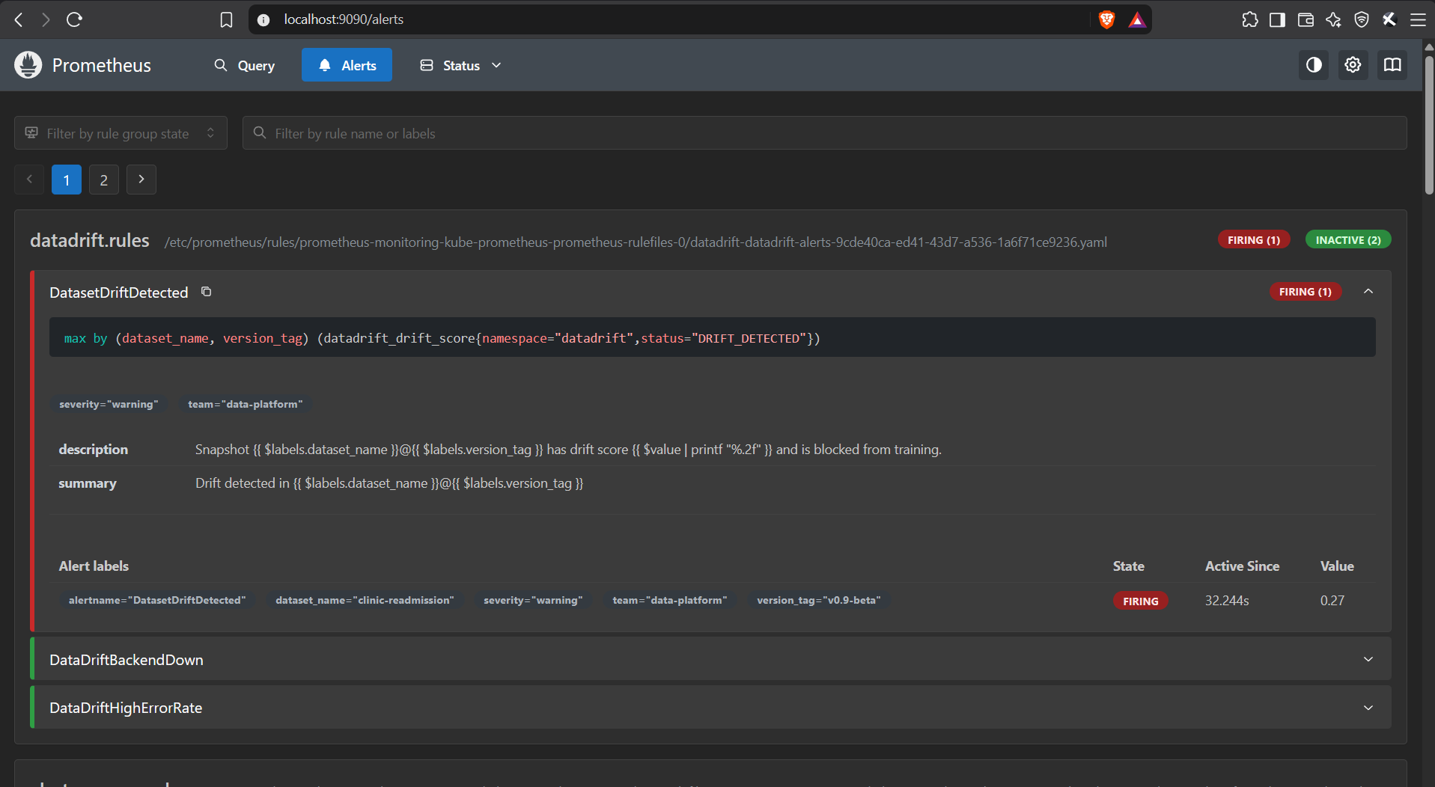
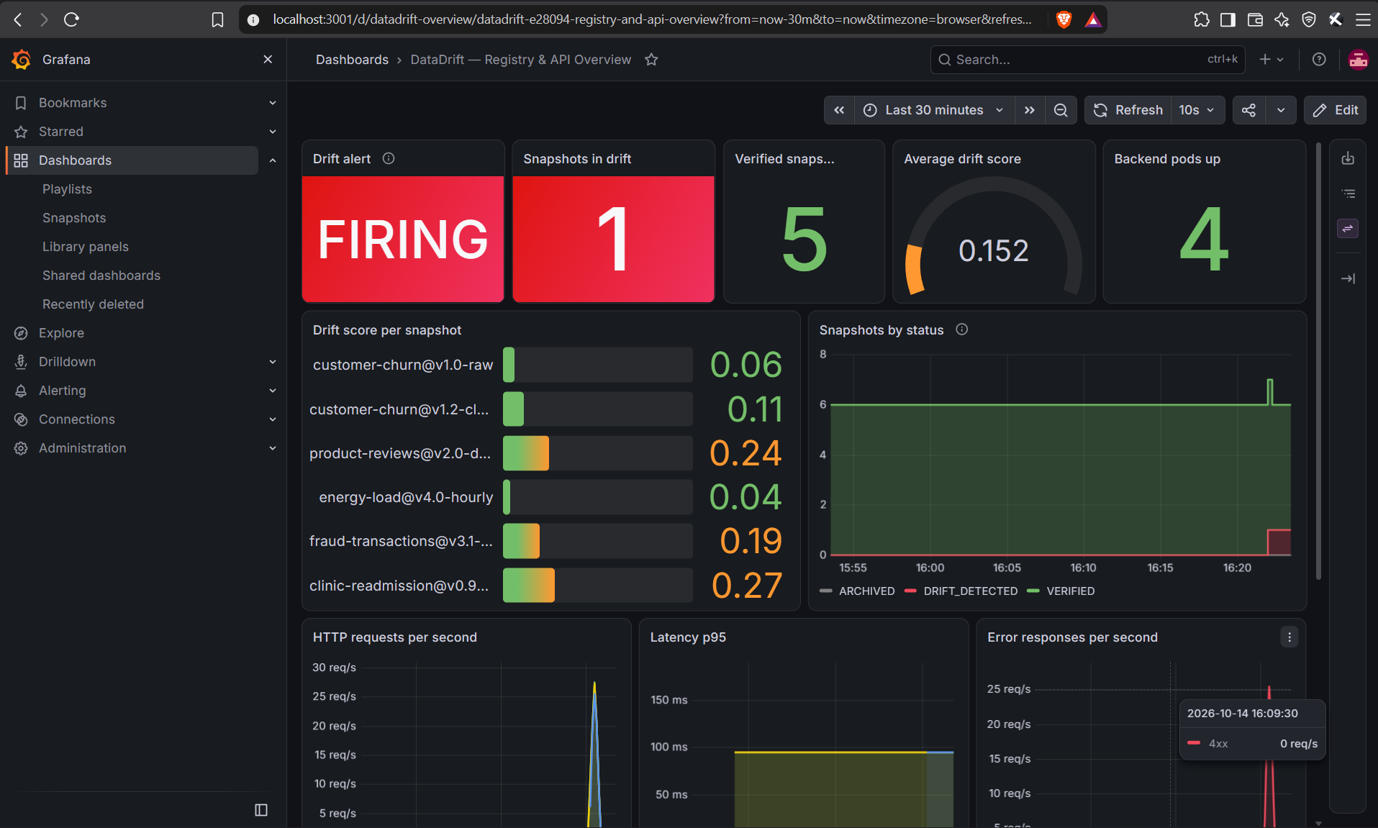
Flag drift, and the alert fires in about 30 seconds
THE HIGHLIGHT
Flag drift
PUT /api/datasets/{id}
/metrics
status = DRIFT_DETECTED
PrometheusRule
DatasetDriftDetected
Grafana
Drift alert: FIRING
Prometheus: firing, labelled clinic-readmission@v0.9-beta
Grafana: the Drift alert panel turns red
Notes:
Now the live part. I flag drift on a dataset in the UI. That sends a PUT request to the API, and the badge turns red immediately. Prometheus scrapes the new state within 15 seconds and evaluates the alert rule. The DatasetDriftDetected alert fires, labelled with the exact dataset and version, and in Grafana the alert panel turns red and the status chart steps up. In a real team this alert would page the data engineer before anyone trains a model on bad data. Once it's reviewed and marked verified, the alert resolves by itself.

Slide 18
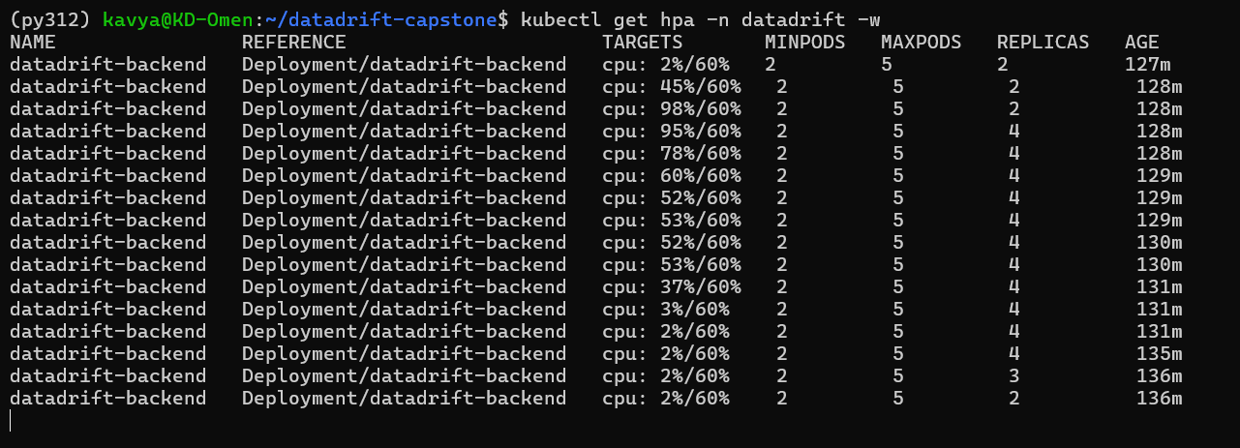
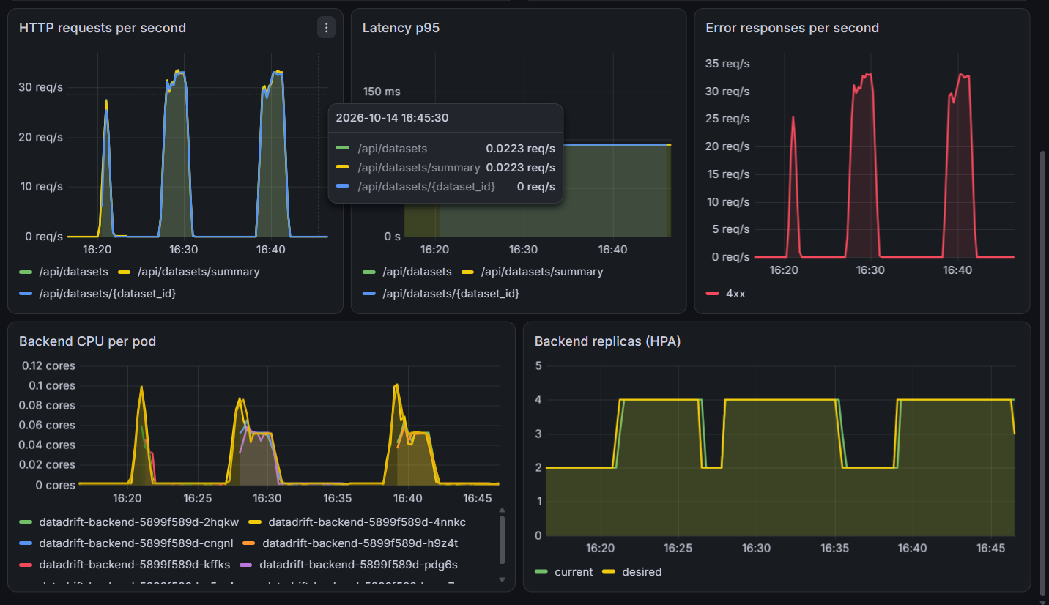
The backend scales out under load
M8 · AUTOSCALING
2 → 4
60%
5 min
backend pods under load
CPU target per pod
before scaling back down
kubectl get hpa -w: CPU 98% → 4 pods, back to 2 after the load
Three load tests in Grafana
Notes:
The HorizontalPodAutoscaler adds backend pods when average CPU goes above 60 percent of the request. During the load test CPU reached 98 percent and the HPA scaled from two to four pods. At 52 percent with four pods it stays at four, because four times 52 over 60 still rounds up to four. When the load stops, it waits for its five-minute stabilization window and then scales back to two, so a short dip in traffic doesn't remove pods that would be needed again seconds later.

Slide 19
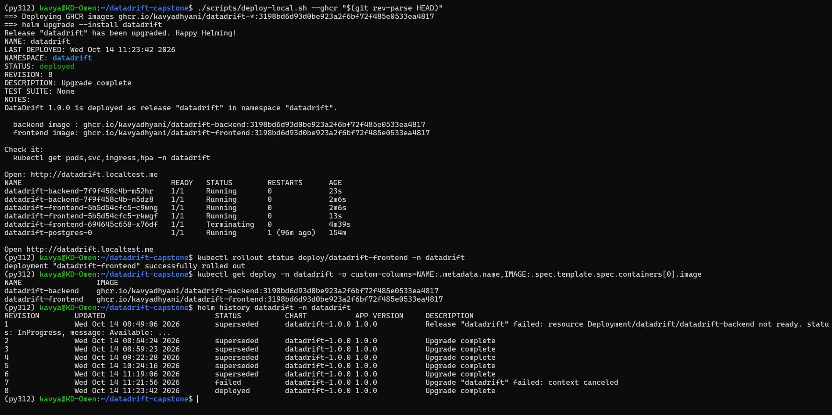

Commit to rollout, traced by the SHA
LIVE CHANGE · CI/CD + GITOPS
Edit
UI_VERSION → 1.1.0
git push
pipeline starts
CI green
image + tag commit
Argo CD sync
rolling update
Live
UI v1.1.0
The header after the rollout (zoomed)
Both Deployments run the image CI built for that commit, tagged with its SHA.
Argo CD rolls it out with maxUnavailable: 0, so the app stays up; reverting the tag commit in Git rolls it back.
Notes:
Finally, the full loop. I change the version badge in the UI from 1.0.0 to 1.1.0, commit and push. The pipeline runs tests, build, Trivy scan and push, and its last job commits the new commit SHA into values-gitops.yaml. Argo CD checks Git every minute, sees the new tag and does a rolling update with no downtime, because maxUnavailable is zero. The pods now run the image tagged with the new commit SHA, and the dashboard shows the new version. To roll back, I revert that commit in Git and Argo CD puts the previous image back.

Slide 20
What broke, and what I learned
CHALLENGES
Vulnerable base images
Two replicas, one migration
Trivy found 43 HIGH CVEs in a fresh nginx image. Patching in the Dockerfile and removing unused tools brought both images to zero.
Both backend pods ran Alembic at startup and raced. A Postgres advisory lock lets only one migrate.
HPA that wouldn’t scale down
Infrastructure without an AWS bill
At 52% CPU it kept 4 pods: the replica formula still rounds to 4, and scale-down waits 5 minutes by design.
An offline_plan variable lets terraform plan run with dummy keys, and CI deploys only when a cluster secret exists.
Notes:
A few things that didn't work the first time. Trivy failed my first build: a brand-new nginx base image had 43 HIGH CVEs, fixed by upgrading packages in the Dockerfile. With two backend replicas, both tried to run the database migration at startup; an advisory lock in Alembic fixed the race. The autoscaler didn't scale down at 52 percent CPU, which taught me how the replica formula and the stabilization window work. And to show Terraform without an AWS bill, I added an offline plan mode, and the CI deploy job only runs when a cluster secret is configured.

Slide 21
Thank you
Notes:
To sum up: DataDrift goes from a commit to a tested, scanned, versioned image in a registry, deployed to Kubernetes with Helm on infrastructure defined in Terraform, and monitored with Prometheus and Grafana, with an alert that fires when a dataset drifts. If I took this further, I would move Postgres to Amazon RDS, add Argo CD so the cluster pulls deployments automatically, and send the drift alert to Slack through Alertmanager. Thank you, I'm happy to take questions.

