Slide 1
MACHINE LEARNING MODELS
TEAM - E
Presented By :- Amarnath Kommineni Kavya Gurram Sandeep Borwal Vikas Kumar Reddy

Slide 2
Kavya Gurram

Slide 3
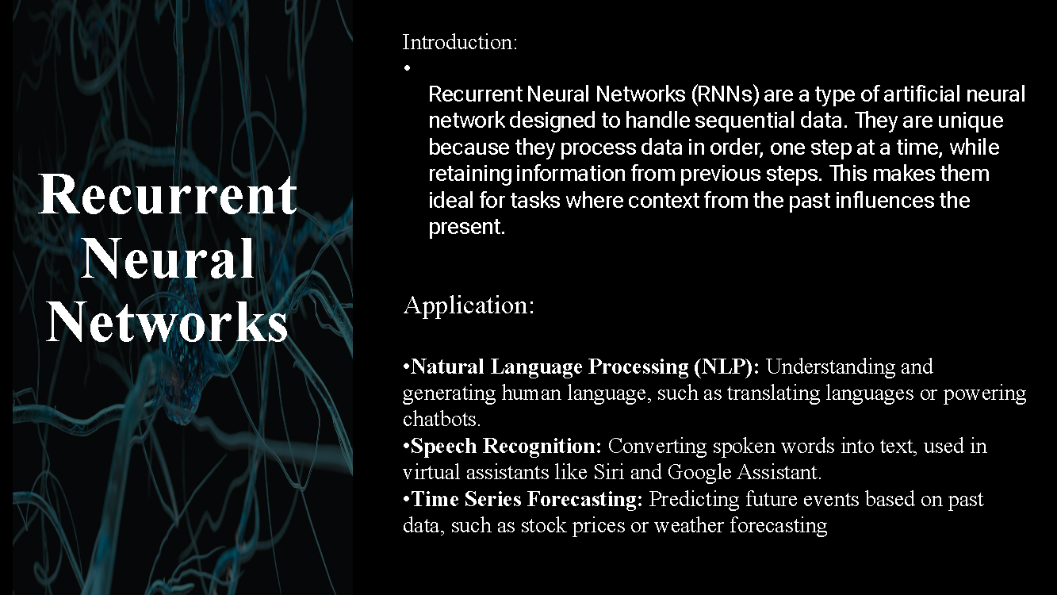

Slide 4
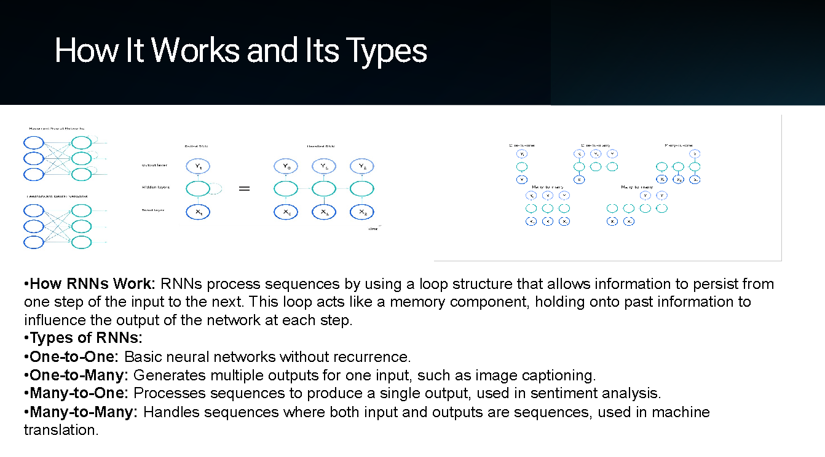

Slide 5
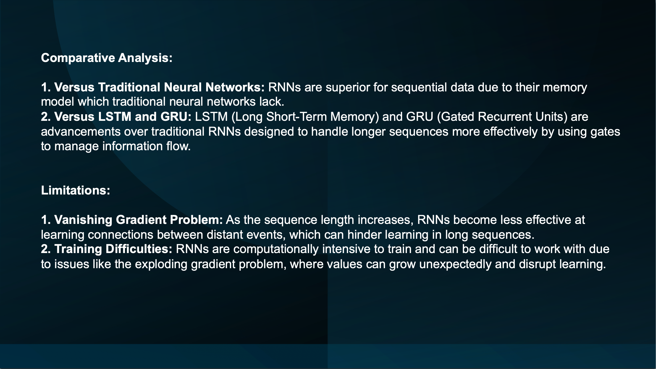

Slide 6
Amarnath Kommineni

Slide 7
Partial Least Squares(PLS) Regression
Introduction :
Partial Least Square Regression is powerful method powerful method for dealing with High dimensional data and High Collinearity. This is multivariate dimensionality reduction tool.
This is more useful when predictors are highly collinear or when there are more predictors than observations. This technique reduces the number of explanatory variables to smaller set of uncorrelated variables.
This technique generalizes and combines features from Principal Component Analysis and Multiple Regression. Can model several response variables at the same time considering their structure. PLS finds components that maximize covariance between Predictors and response variable, leading for best Performance .
Areas/Applications Used:
Identifying biomarkers in disease classification. There are multiple biomarkers but based on disease PLS can identify which ones are strongly associated to disease.
Comparing different treatment groups in clinical studies as there can be more variables to compare treatment effects.
Chemical Data is high-dimensional with many overlapping signals. PLS can separate meaningful chemical information from noise and identify key components.
Quality control in manufacturing processes as PLS extracts key factors that predict better product quality and detect early signs of defects.

Slide 8
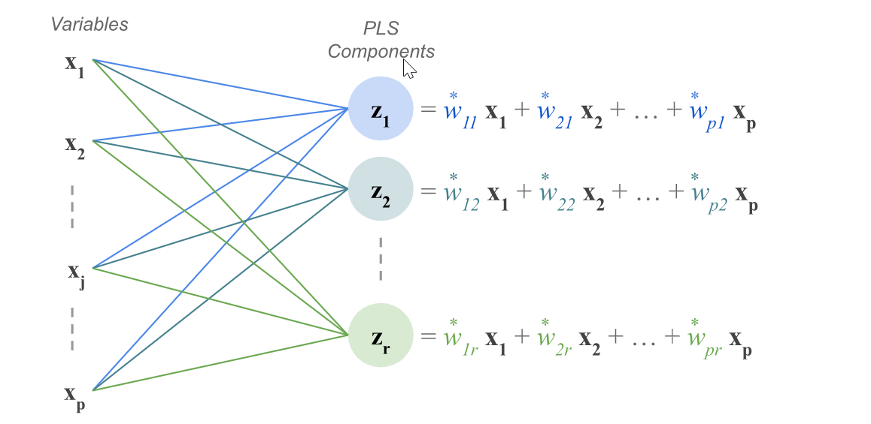
PLS Process Steps
It standardizes Predictors and Response variables.
Computes weight for each Predictor VS response variable .It Creates new set of variables called latent variables. These latent variables are linear combination of original predictors weighted by their contribution to the response variable that maximize covariance between responses and independent variables. T=XW where T is the latent variable, W is the weight matrix, and X is the original predictor matrix.
Latent Variables are used instead of raw predictors. It iterates least square regression process until it reaches stopping criteria such as maximum no of iterations or small change in weights i.e. adding more components won’t improve model .Each iteration creates new set of Latent Variables.
Y=TB+ϵ where Y is the response variable, T are the latent variables, B is the regression coefficient, and ϵ is the error term.
Result is the model that can predict response variables with less errors and strikes balance b/w pure prediction and explanation making it excellent tool for exploratory analysis.
Outputs:
Produce results of predicted values . Also produces the result of Regression Coefficients which indicate correlation b/w latent variables and response variables.
PLS also assigns score that assigns important score to each predictor showing how much it contributes to explaining Y. Higher VIP Scores indicate more influential predictors.
Produces performance metrics like R-Squared, MSE(Mean Squared Error) that shows how far predictions from actual values and RMSE helps compare real world errors.

Slide 9
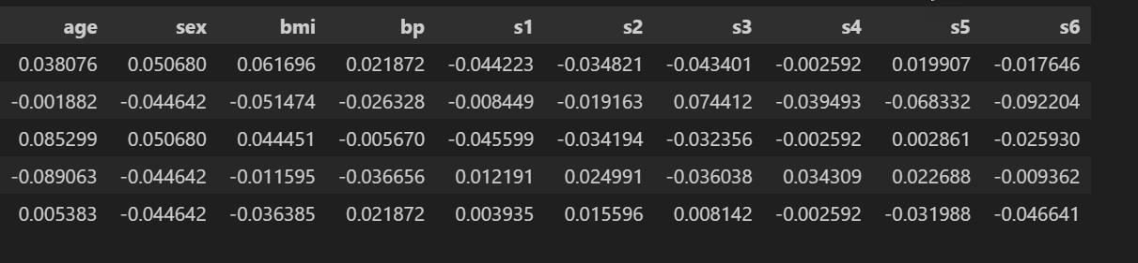
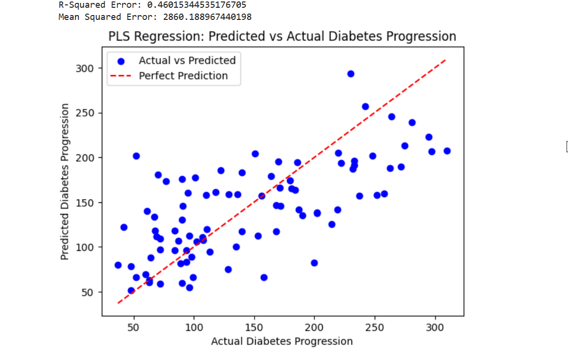
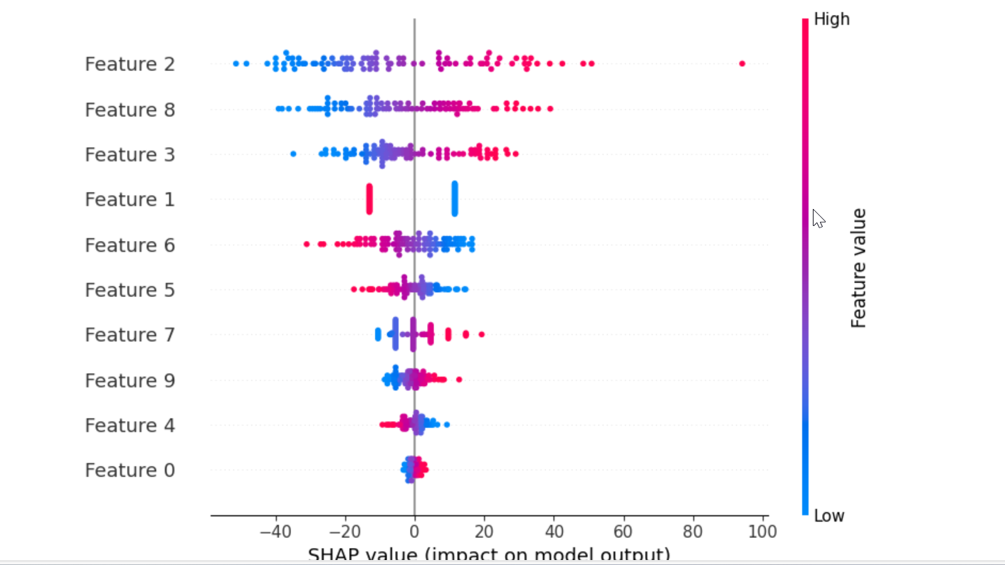
PLS Limitations :
Latent variables which are combination of originals make it hard to interpret.
Number of latent components must be carefully selected to avoid overfitting or underfitting. Cross Validation is crucial in order to avoid Overfitting which is expensive.
PLS assumes latent variables and response variables have a linear relationship.
Less commonly used in fields when compared to Ridge and LASSO methods
Python Packages:
Make use of PLSRegression package from sklearn.cross_decomposition and shap package
Build Model using PLSRegression(n_components=x); where x=1,2,3,4 gives the outputs R Squared and MSE .
We can create kernelexplainer and build shap.summary_plot to visualize the feature importance from shap package. This makes it good for Exploratory analaysis as well
Use case:
Screenshots shows how to predict diabetes progression based on multiple health related measurements where PLS is useful to build latent variables and reduce number of explanatory variables.It predicts disease progression one year after baseline

Slide 10
Vikas Kumar Reddy

Slide 11
R-CNN
Introduction to R-CNN:
Region-Based Convolutional Neural Networks (R-CNN) revolutionized object detection by integrating deep learning techniques into computer vision. Traditional object detection methods relied on handcrafted features and sliding window approaches, which were slow and lacked accuracy. Introduced in 2014 by Ross Girshick et al., R-CNN significantly improved accuracy by combining region proposal techniques with convolutional neural networks (CNNs) for feature extraction. The process involves generating multiple region proposals, extracting features from each region, classifying objects, and refining their bounding boxes. While R-CNN demonstrated significant improvements in accuracy, it had limitations, such as slow processing speed and high computational costs, leading to the development of optimized models like Fast R-CNN and Faster R-CNN, which enhanced efficiency and real-time performance.
Applications of R-CNN:
Autonomous Vehicles
Detects pedestrians, vehicles, and road signs to improve driving safety.
Assists self-driving cars in obstacle detection and navigation.
Medical Imaging
Identifies tumors, fractures, and abnormalities in X-rays, MRIs, and CT scans.
Aids doctors in diagnosing diseases with improved accuracy and early detection.
Security & Surveillance
Enables real-time facial recognition for access control and monitoring.
Detects suspicious activities and unauthorized individuals in public spaces.
Retail & E-Commerce
Powers automated checkout systems using object recognition.
Assists in virtual try-on applications for clothing and accessories.
Augmented Reality (AR) & Virtual Reality (VR)
Enhances interactive gaming and immersive experiences by detecting real-world objects.
Enables virtual object placement and tracking in real-time environments.

Slide 12
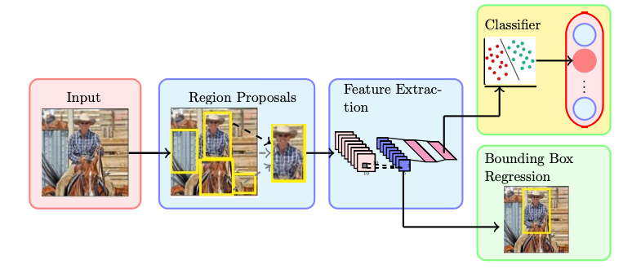
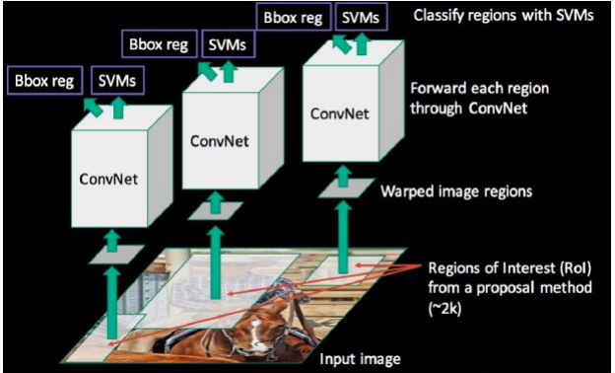
R-CNN Process Steps:
R-CNN follows a structured process for object detection. It begins by generating region proposals from an input image using Selective Search, identifying around 2,000 potential object regions. Each of these regions is cropped, resized, and passed through a Convolutional Neural Network (CNN) to extract deep feature representations. These features are then classified using Support Vector Machines (SVMs) to determine whether the region contains a specific object. Additionally, a bounding box regressor is applied to refine the object’s location by adjusting the bounding box coordinates for better accuracy.
R-CNN is that it processes each region proposal separately through the CNN, making it computationally expensive and slow. Since the model requires thousands of forward passes per image, it takes around 47 seconds per image, making it impractical for real-time applications.
Outputs:
Predicted Object Classes: Identifies and labels objects within an image (e.g., person, aeroplane, TV monitor).
Bounding Box Adjustments: Refines object detection by improving localization accuracy.
Region Proposal Confidence Scores: Assigns probability values to each detected object, determining the certainty of classification.
Performance Metrics: Evaluates detection accuracy using metrics like Intersection-over-Union (IoU) and Mean Average Precision (mAP) to measure how well objects are detected.

Slide 13
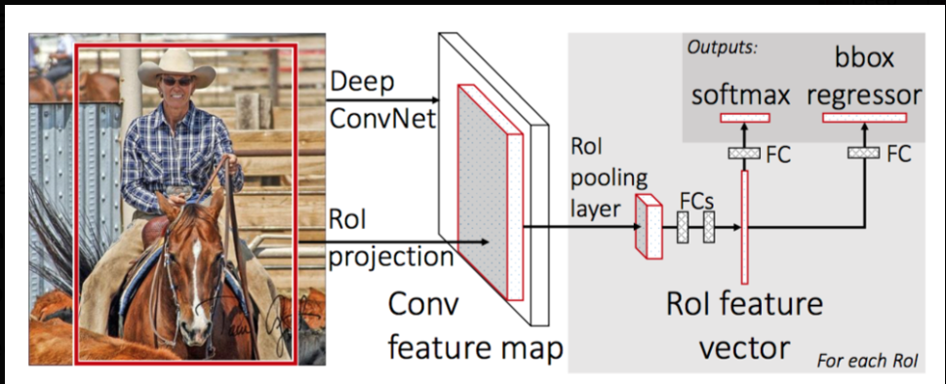
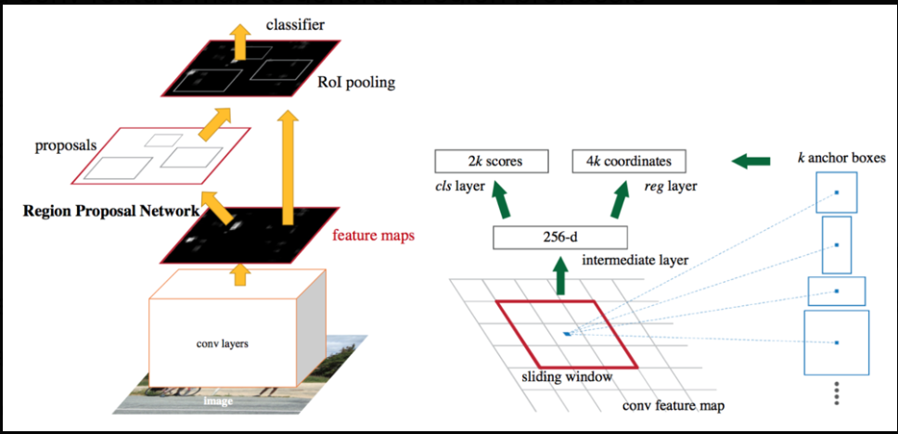
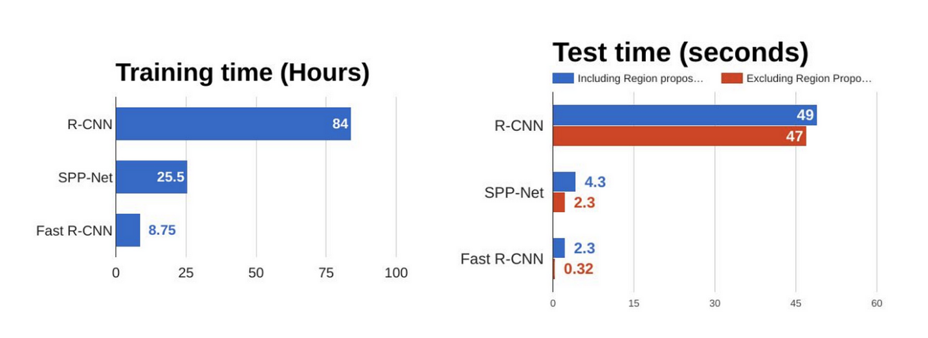
Improvements:
Fast R-CNN (2015) eliminated redundant computations by processing the entire image through the CNN only once, generating a shared feature map. Instead of running the CNN separately for each region proposal, it uses Region of Interest Pooling, reducing computation time and making detection 9× faster in training and 213× faster in inference than R-CNN.
Faster R-CNN (2015) further improved efficiency by introducing the Region Proposal Network (RPN), which replaced Selective Search with an internal neural network to generate region proposals. This removed bottlenecks, reducing inference time to ~0.2 seconds per image, enabling real-time object detection.
Limitations:
Slow Processing Speed – R-CNN requires running the CNN separately for each region proposal (~2,000 per image), making it computationally expensive and time-consuming (~47 seconds per image).
High Storage Requirements – The model extracts and stores feature maps for all region proposals, requiring significant memory space.
Not Suitable for Real-Time Applications – Due to its high computational cost, R-CNN cannot be used in applications requiring fast detection.

Slide 14
Sandeep Borwal

Slide 15
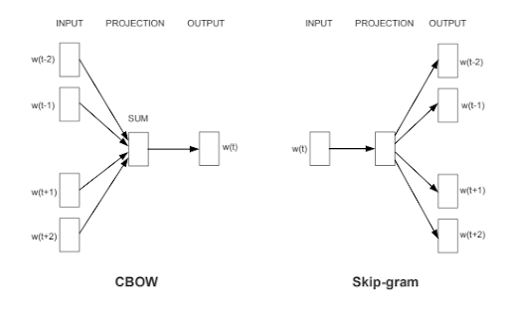
Word2Vec
Word2Vec is a word embedding technique introduced by Mikolov et al. at Google in 2013.
Converts words into numerical representations (vectors) to capture the meaning of words based on their usage in sentences.
Helps understand semantic (meaning-based) and syntactic (structure-based) relationships between words.
Words with similar meanings are positioned closer together in a multi-dimensional space.
Vector representation -> Vector("king")=[0.21,−0.56,0.33,0.89,−0.47]
Solving word analogies
"King" - "Man" + "Woman" = "Queen“
Mathematically, the model calculates:
Vector("king")−Vector("man")+Vector("woman")≈Vector("queen")
Clustering Similar Words
🐶 (dog, puppy, canine, pet, husky)
🐱 (cat, kitten, feline, pet, Persian)
🚗 (car, vehicle, automobile, sedan, Tesla)
Word2Vec Architectures:-
Continuous Bag of Words (CBOW):-
model predicts the target word from its surrounding context words.
“The cat sat on the mat,” - model will take “The”, “sat”, “on”, “the”, “mat” as context and predict the word “cat”.
Skip-Gram:-
works in the opposite way of CBOW
predicts the surrounding context words from a target word
model will take “cat” as the input and predict “The”, “sat”, “on”, “the”, “mat”
It’s computationally more expensive than the CBOW model due to its task of predicting multiple context words

Slide 16
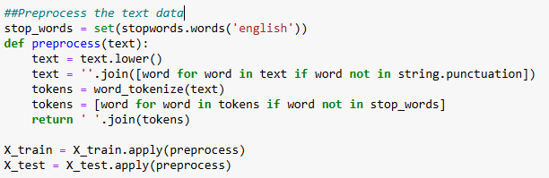

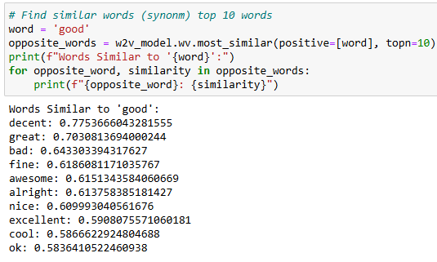
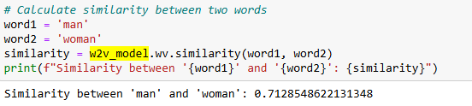
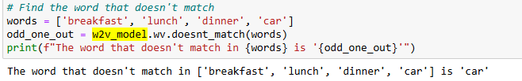
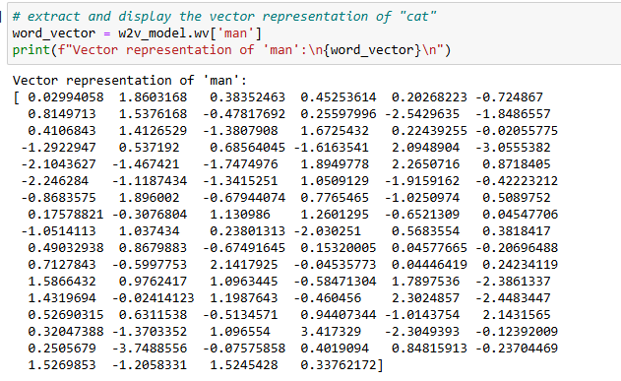
Model & Parameters
sentences = [sentence.split() for sentence in data]
w2v_model = Word2Vec(sentences, vector_size=100, window=5, min_count=5, workers=4)
Vector Size (dim): e.g., 50, 100, 300. Larger dimensions capture more semantic information but may lead to increased computational cost.
Window Size (window): Defines the context window (e.g., 5 means 5 words before & after). A larger window size captures more context, leading to broader semantic relationships.
Min Count (min_count): Defines the minimum frequency of a word to be included in the vocabulary.
hs: If 1, hierarchical softmax is used for model training.
Workers: More workers can speed up training.
sg: If 1, skip-gram is used; otherwise, use CBOW (Continuous Bag of Words).
epochs: The number of iterations (epochs) over the corpus.

Slide 17
Advantages & Limitations & Usage
Advantages of Word2Vec:
Captures Semantic Relationships: Words with similar meanings have closer vector representations. Example: "king" - "man" + "woman" ≈ "queen"
Efficient & Scalable: Can be trained on large datasets using multi-threading.
Pre-Trained Models Available: Instead of training from scratch, you can use pretrained models like Google's Word2Vec or GloVe.
Disadvantages of Word2Vec
Requires a Large Corpus: Works best with millions of words for accurate word representations.
Cannot Handle Out-of-Vocabulary (OOV) Words: If a word wasn't present in training data, Word2Vec cannot represent it.
Ignores Word Order & Syntax: Doesn't consider grammar or word order in a sentence.
Needs Tuning for Best Performance: Choosing the right parameters (vector size, window size, etc.) requires experimentation.
Practical Applications -
Text Classification: Enabling machine learning models to classify text into categories such as spam detection, sentiment analysis, and topic classification.
Machine Translation: Translating text from one language to another by capturing the semantic meaning of words and phrases, improving the accuracy of translation models.
Search Engines: Helps understand the semantic meaning of queries, improving search accuracy.
Chatbots & Virtual Assistants: Enhance understanding of user queries to generate better responses.
Recommendation Systems: Used in platforms like Amazon & Netflix to recommend content based on user behavior.

Slide 18
Thanks

