Slide 1

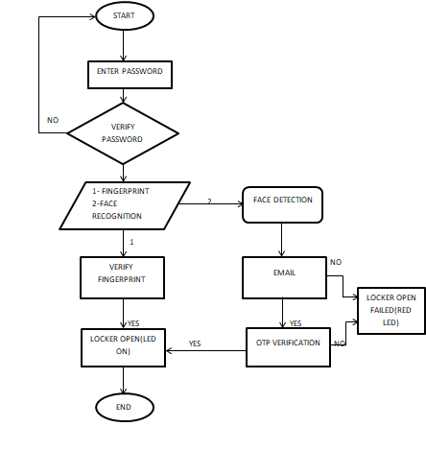
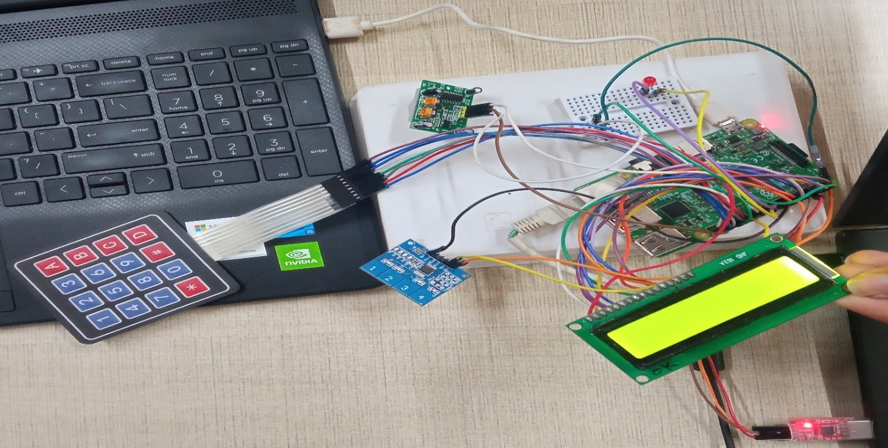
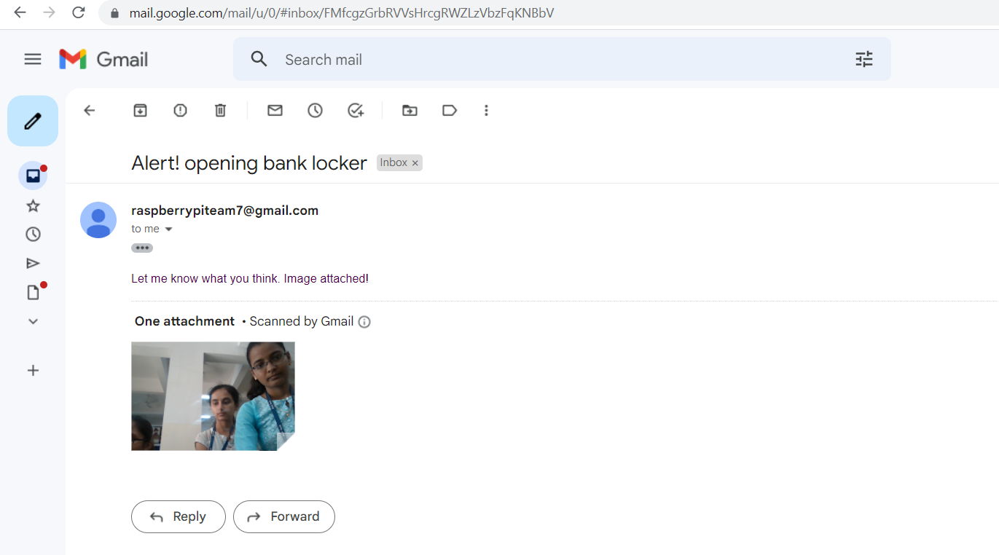
Bank Locker Security System
Guide: Dr. Sujata Kotbagi, Nagaratna Shanbhag
School of Electronics and Communication
Name: Vaishnavi U Shetti, Soumya H J, Kavya Hegde, Divya Hegde
Problem statement
Methodology
Figure [1]
The proposed system is of three level security with two different cases as shown by the work flow of flow chart in Figure[1].
Case 1: The password will be entered, if it is correct lock1 will open. The authorized user will then opens lock2 by fingerprint verification.
Case 2: After opening lock1 in the emergency case of physical absence of the user, PIR sensor detects the motion of the person and mail will be sent with captured image (Figure[2]) to the registered mail ID. OTP will be generated and sent, if it is verified the bank locker will open.
The system designed is highly secure and works in the absence of the user too.
Results
Develop a high security locker system for bank sector using IOT (internet of things) to provide secure access
only to authorized person via biometric , password and
also sending image to the user G-mail account.
Objectives
To understand the basic concepts of security with respect to bank scenario.
To understand the method behind the algorithms used and applications of the algorithms with respect to security.
Develop a model for security and validate
.
Contributions
Highly secure and reliable locker system than any other locker sytems.
Multilayer security with password,biometric, image capture,Email alert with OTP.
Figure[2]
Literature survey
Optimization details
[1] Aruna.D.Mane and Sirkazi Mohd Arif’s “Locker
Security System Using RFID and GSM Technology” May,2013.
[2] Ashish M.Jaiswal ,Mahip Bartere“Enhancing ATM
Security Using Fingerprint And GSM Technology”
April,2014.
[3] Mrutyunjaya Sahani, Chiranjiv Nanda Web-Based
Online Embedded Door Access Control and Home Security System Based on Face Recognition. Published in 2015.
A new Gmail account must created for Email alert
which had critical security problems, so one step verification is enabled and access is given to less
secure apps.
Conclusions
We have designed a highly secure bank locker system using password , biometric, image capture and OTP systems to open t he locker with multi-layer security. It is highly secure in the physical absence of the user too.
Mini Project-2022-23

