Slide 1
PRAKALP
Name : Kavya Hegde USN : 01FE20BEC093
Project : 5 pack opamp design
Notes:
1

Slide 2
Design Details
Cell Name | 5_pack _opamp
Test Bench Name | 5_pack _opamp_test
Technology | 180nm TECHNOLOGY UMC_18_CMOS
Devices | MOSFET, CAPACITORS, VOLTAGE AND CURRENT SOURCE
Simulation Area | CADENCE
Design Owner | Kavya Hegde
Reviewed By | -
Acknowledging | Dr. SUJATA KOTABAGI , SCHOOL OF ELECTRONICS AND COMMUNICATION

Slide 3
Contents
Design Details
Pin Description
Simulation plan
SCM
Schematic
Test bench
DC analysis
AC analysis
Notes:
3

Slide 4
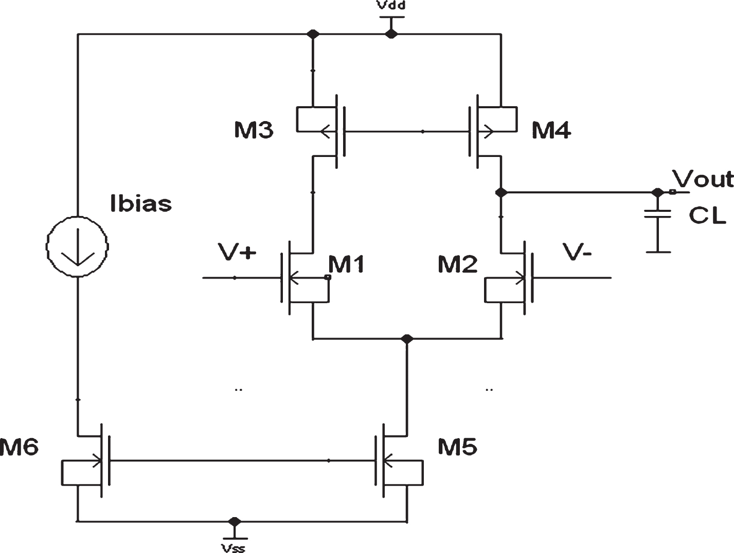
Single Stage Amplifier
High gain and high output swing
1st stage : Differential amplifier

Slide 5
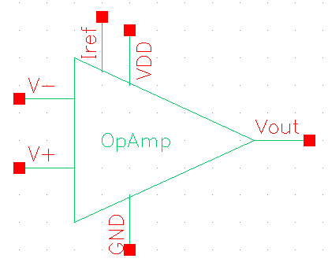
Pin Description
THE MAIN PURPOSE IS TO SHOW THE BASIC METHODS FOR DESIGNING A SINGLE STAGE OP-AMP BASED ON CADENCE, AND DC SCHEMATIC PLOT AND AC ANALYSIS SIMULATION.
Sl.No | Pin Name | Description | Input/Output/Supply
1 | V_{DD} | Supply pin V_{DD} | Supply
2 | GND | Supply pin GND | Supply
4 | I_{ref} | 50µA of reference current | Input
5 | V₊ | +ve Input | Input
6 | V₋ | -ve Input | Input
7 | V_{OUT} | Output voltage | Output

Slide 6
5_pack SCM
5_pack SCM
Specification Compliance Matrix
Parameter | Unit | Specification |  |  | PVT |  |  | Comment
 |  | Min | Typ | Max | Min | Typ | Max
V_{DD} | V | 0.8 | 1.8 | 1.6 | 0.8 | 1.8 | 1.6 | Supply Voltage
TEMP | °C | -40 | 27 | 125 | -40 | 27 | 125 | Temperature
I_{ref} | µA | 45u | 1 | 50u | 45u | 1 | 50u | Reference Current
ICMR | V | 0.8 | 0.7 | 1.60 | 0.8 | 0.7 | 1.6 | Input Common Mode Range(ICMR)
C_{L} | pF | - | 10 | - | - | 10 | - | Load Capacitance
Gain | dB | - | 40 | - | 35.72 | 40 | 36.02 | DC gain

Slide 7
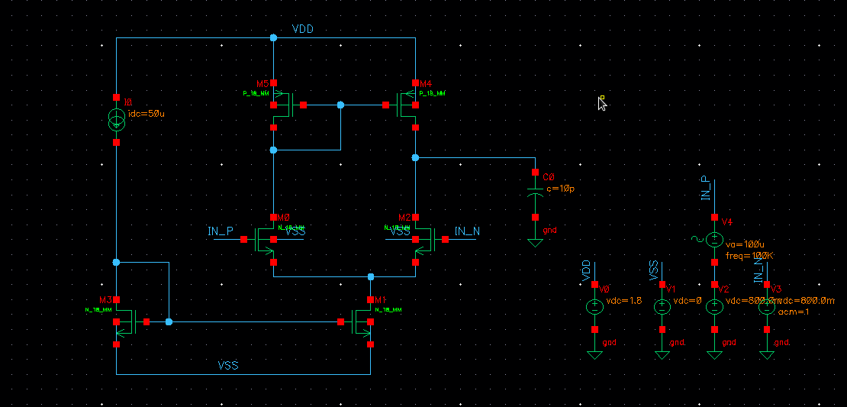
Schematic
HAND CALCULATIONS ARE BEEN DONE TO OBTAIN THE DESIGN PARAMETERS (I.E.(W/L) RATIO).

Slide 8
Bias Parameters
Parameter | M1 | M2 | M3 | M4 | M5
W (µm) | 10u | 10u | 84u | 84u | 9u
L (nm) | 1u | 1u | 1u | 1u | 1u
V_{gs} (V)
V_{ds} (V)
Bias parameters

Slide 9
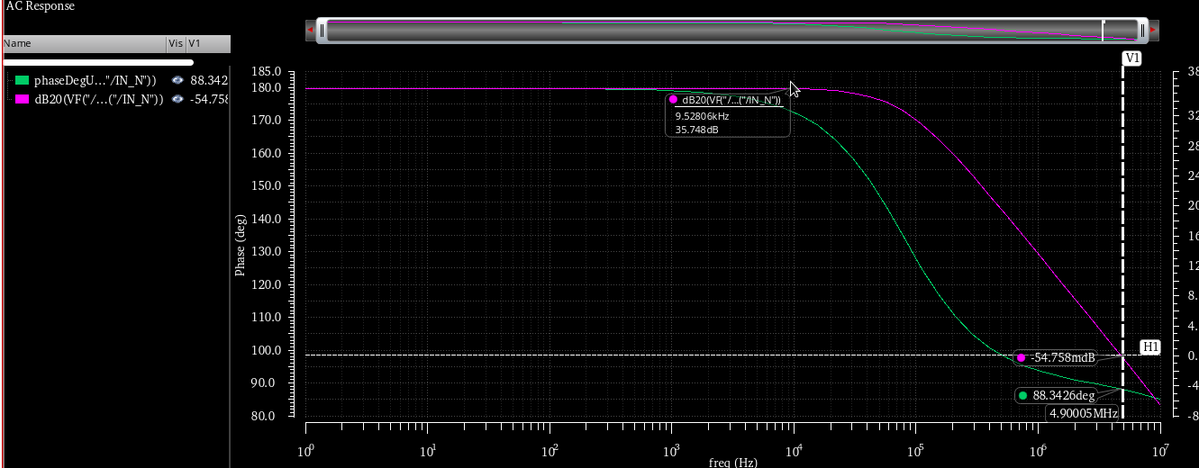
AC Analysis Gain=35.74dB,BW=4.9MHz

Slide 10
Thank you
20

