Slide 1
PRAKALP
Name: Kavya Hegde USN:01FE20BEC093
Project: 7 pack opamp design
Notes:
1

Slide 2
Design Details
Cell Name | 7_pack_opamp
Test Bench Name | 7_pack_opamp_test
Technology | 180nm TECHNOLOGY UMC_18_CMOS
Devices | MOSFET, CAPACITORS, VOLTAGE AND CURRENT SOURCE
Simulation Area | CADENCE
Design Owner | Kavya Hegde
Reviewed By | -
Acknowledging | Dr. SUJATA KOTABAGI , SCHOOL OF ELECTRONICS AND COMMUNICATION

Slide 3
Contents
Design Details
Pin Description
Simulation plan
SCM
Schematic
Test bench
DC analysis
AC analysis
Notes:
3

Slide 4
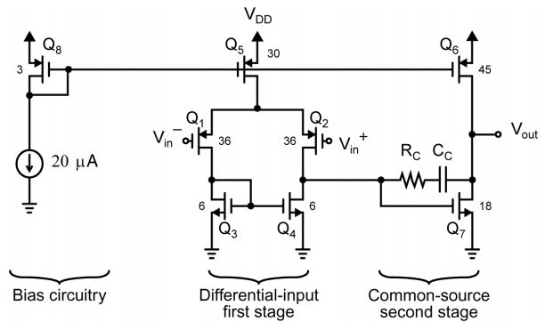
Two Stage Amplifier
High gain and high output swing
1st stage : Differential amplifier
2nd stage: Common source with PMOS load , capacitive load
Overall gain Av=A1*A2
Negative feedback increases oscillations
Need for greater PM

Slide 5
Two Stage Amplifier
OP-AMP COMPENSATION :
2 pole system
PM closes zero
Millers Compensation
C_{c} between the outputs of two stages
Pole splitting
Dominant pole compensation
P1=1 ÷ g_{m7}R₁R₂C_{c}

Slide 6
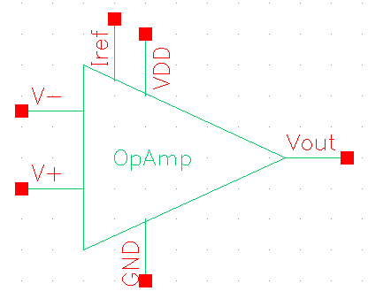
Pin Description
THE MAIN PURPOSE IS TO SHOW THE BASIC METHODS FOR DESIGNING A TWO STAGE OP-AMP BASED ON CADENCE, AND DC SCHEMATIC PLOT AND AC ANALYSIS SIMULATION.
Sl.No | Pin Name | Description | Input/Output/Supply
1 | V_{DD} | Supply pin V_{DD} | Supply
2 | GND | Supply pin GND | Supply
4 | I_{ref} | 20µA of reference current | Input
5 | V₊ | +ve Input | Input
6 | V₋ | -ve Input | Input
7 | V_{OUT} | Output voltage | Output

Slide 7
7_pack SCM
7_pack SCM
Specification Compliance Matrix
Parameter | Unit | Specification |  |  | PVT |  |  | Comment
 |  | Min | Typ | Max | Min | Typ | Max
V_{DD} | V | 1.8 | 1.8 | 1.8 | 1.8 | 1.8 | 1.8 | Supply Voltage
TEMP | °C | -40 | 27 | 125 | -40 | 27 | 125 | Temperature
I_{ref} | µA | 20 | 10 | 20 | 20 | 10 | 20 | Reference Current
ICMR | V | 0.8 | 0.7 | 1.6 | 0.8 | 0.7 | 1.6 | Input Common Mode Range(ICMR)
C_{L} | pF | - | 2 | - | - | 2 | - | Load Capacitance
Gain | dB | - | 60 | - | 66 | 60 | 60.74 | DC gain
PM | deg | - | 60 | - | 57 | 55 | 58.34 | Phase Margin
GBW | MHz | - | 30 | - | 32.2 | 30 | 32.76 | Gain Bandwidth Product

Slide 8
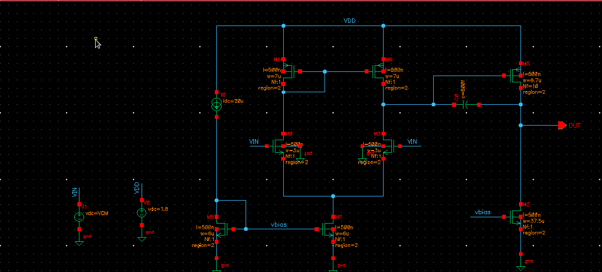
Schematic
HAND CALCULATIONS ARE BEEN DONE TO OBTAIN THE DESIGN PARAMETERS (I.E.(W/L) RATIO).

Slide 9
Bias Parameters
Parameter | M1 | M2 | M3 | M4 | M5 | M6 | M7 | M8
W (µm) | 3 | 3 | 7 | 7 | 12 | 87 | 75 | 12
L (nm) | 500 | 500 | 500 | 500 | 1000 | 500 | 1000 | 1000
V_{gs} (V)
V_{ds} (V)
Bias parameters

Slide 10
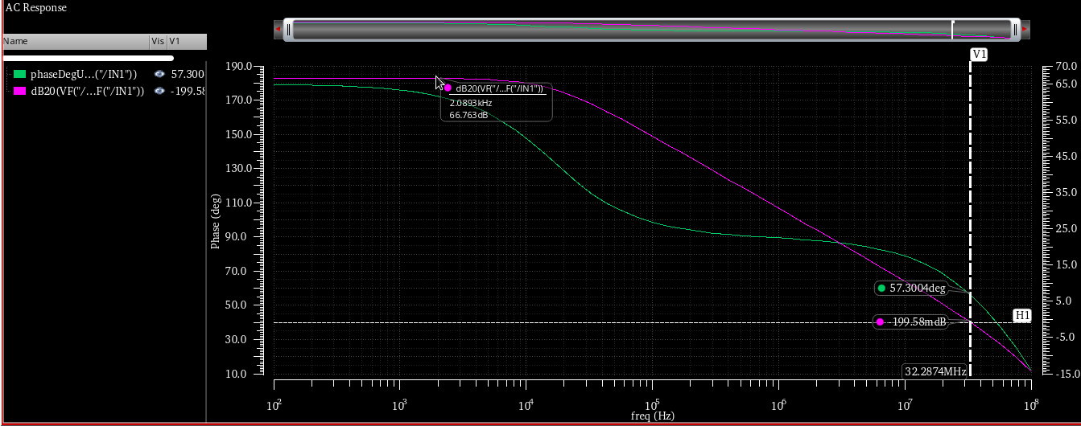
AC Analysis Gain-Phase Plot-Vin=0.8V Gain=66dB,BW=32.20MHz,PM=57degree

Slide 11
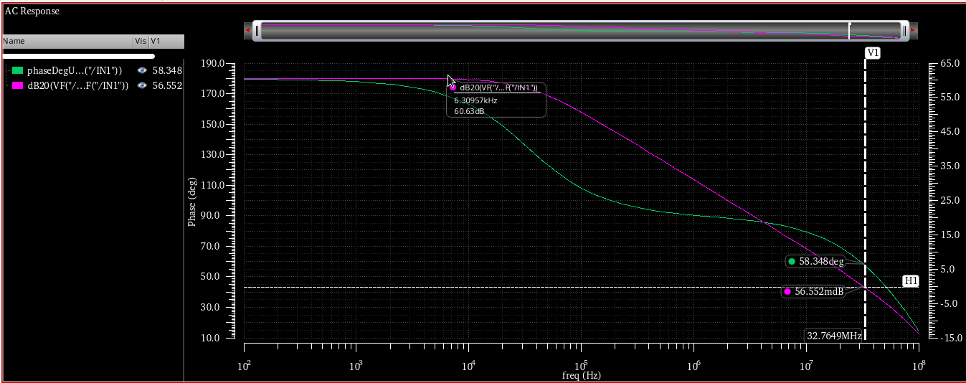
AC Analysis Gain-Phase Plot-Vin=1.6V Gain=60.74dB,BW=32.76MHz,PM=58.34degree

Slide 12
Power Dissipation
Total Power=Vdd*Sum of all currents
=1.8*(125+20)
=261uW
For Vin=0.8V
Power=273.53uW
For Vin=1.6V
Power=297.88uW

Slide 13
Thank You
20

