Slide 1
Introduction
HTML

Slide 2
HTML
HTML -> Hyper Text Markup Language
HTML is a language of the web, it is used to create websites
We use HTML tags to define the looks of a website
With understanding of these tags we can learn how to create beautiful websites

Slide 3
Why use CSS & JavaScript
HTML is used for designing the layout of a page, a backbone of the website
CSS is used to add Styling to the layout
JavaScript is used to program logic for the text page layout, e.g. what happens when user hovers over a box, when to hide or show elements

Slide 4
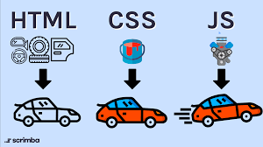
An Analogy for HTML, CSS, JS
HTML = Car Body
CSS = Car Paint, Decoration
JavaScript = Car Engine

Slide 5
Basic Structure
HTML

Slide 6
Basic Structure of HTML
<!DOCTYPE html>
<html lang="en">
<head>
<meta charset="UTF-8">
<meta name="viewport" content="width=device-width, initial-scale=1.0">
<title>Basic Structure of HTML</title>
<link rel="stylesheet" href="style.css">
</head>
<body>
content: application
<script src="script.js"></script>
</body>
</html>

Slide 7
Basic Structure of HTML
<html> & </html> are Opening and Closing tabs respectively, so are <body> & </body>, <head> & </head>
Everything inside <html> & </html> is the content of HTML
Everything inside <body> & </body> is the content of Body
Everything inside <head> & </head> is the content of Head
<!DOCTYPE html> is just for the Type of Document and is not necessary at all
<title> & </title> is the Title of Head that is used by Search Engines
<meta> & </meta> has all the keywords for a website to describe the content of a website

Slide 8
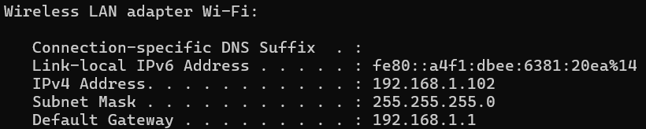
How to Preview Website in your phone
First go to cmd, type ipconfig and get your IP Address

Slide 9
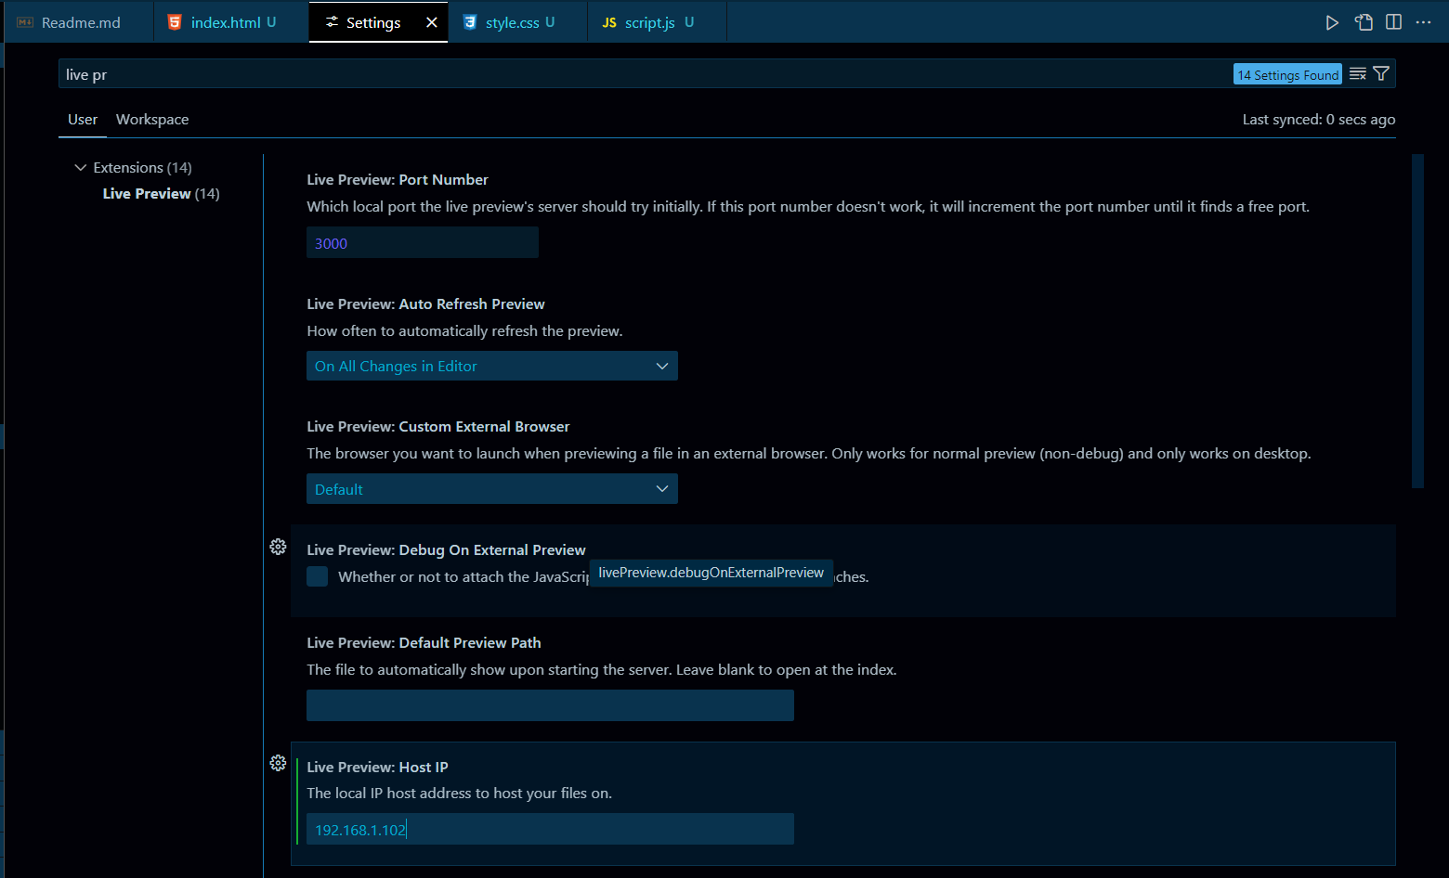

How to Preview Website in your phone
Go to VS Code settings and type Live Preview and paste you IP Address in Live Preview : Host IP and Restart VS Code

Slide 10
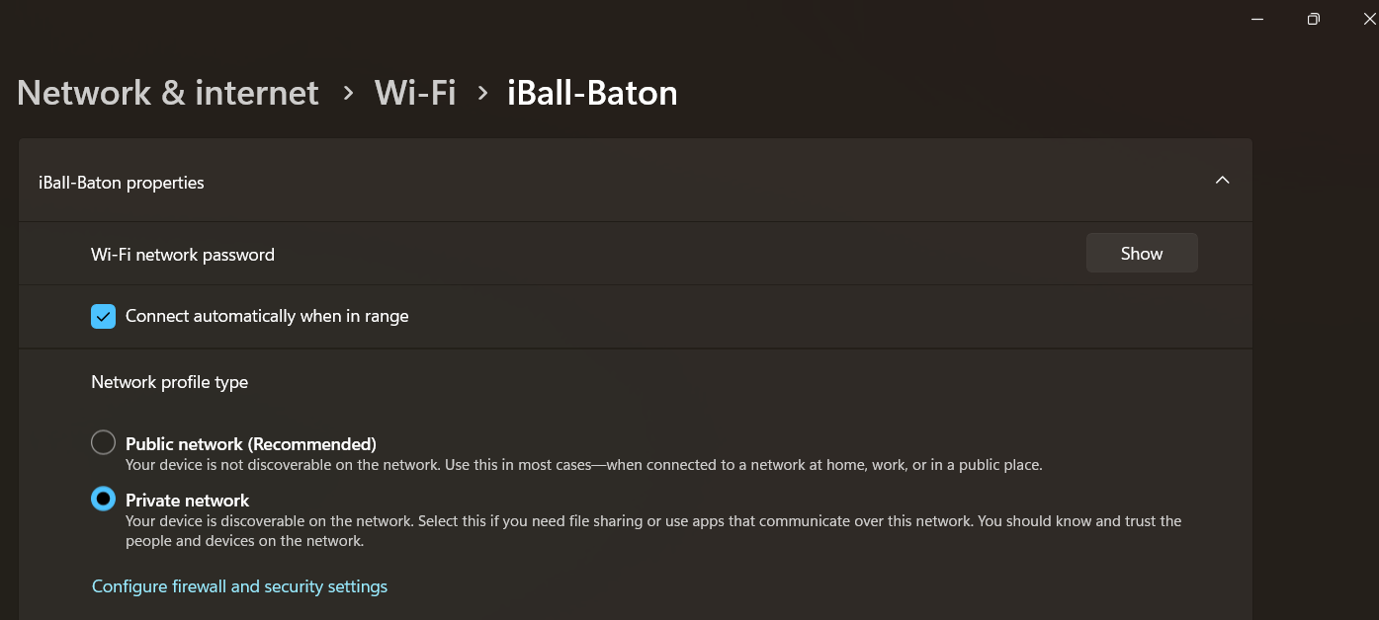
How to Preview Website in your phone
Make Sure your network is set to private

Slide 11
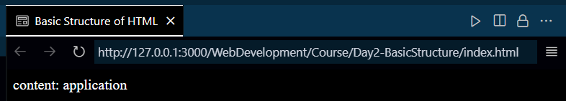

How to Preview Website in your phone
Now Paste this in your phone and make sure that Phone and PC are connected to the same Wi-Fi

Slide 12
Heading, Paragraph and Links
HTML

