Slide 1
Introduction
HTML

Slide 2
HTML
HTML -> Hyper Text Markup Language
HTML is a language of the web, it is used to create websites
We use HTML tags to define the looks of a website
With understanding of these tags we can learn how to create beautiful websites

Slide 3
Why use CSS & JavaScript
HTML is used for designing the layout of a page, a backbone of the website
CSS is used to add Styling to the layout
JavaScript is used to program logic for the text page layout, e.g. what happens when user hovers over a box, when to hide or show elements

Slide 4
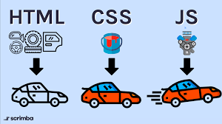
An Analogy for HTML, CSS, JS
HTML = Car Body
CSS = Car Paint, Decoration
JavaScript = Car Engine

Slide 5
Basic Structure
HTML

Slide 6
Basic Structure of HTML
<!DOCTYPE html>
<html lang="en">
<head>
<meta charset="UTF-8">
<meta name="viewport" content="width=device-width, initial-scale=1.0">
<title>Basic Structure of HTML</title>
<link rel="stylesheet" href="style.css">
</head>
<body>
content: application
<script src="script.js"></script>
</body>
</html>

Slide 7
Basic Structure of HTML
<html> & </html> are Opening and Closing tabs respectively, so are <body> & </body>, <head> & </head>
Everything inside <html> & </html> is the content of HTML
Everything inside <body> & </body> is the content of Body
Everything inside <head> & </head> is the content of Head
<!DOCTYPE html> is just for the Type of Document and is not necessary at all
<title> & </title> is the Title of Head that is used by Search Engines
<meta> & </meta> has all the keywords for a website to describe the content of a website

Slide 8
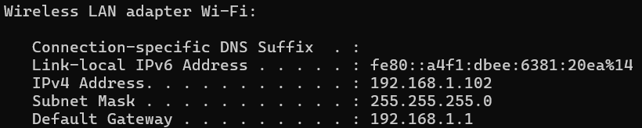
How to Preview Website in your phone
First go to cmd, type ipconfig and get your IP Address

Slide 9
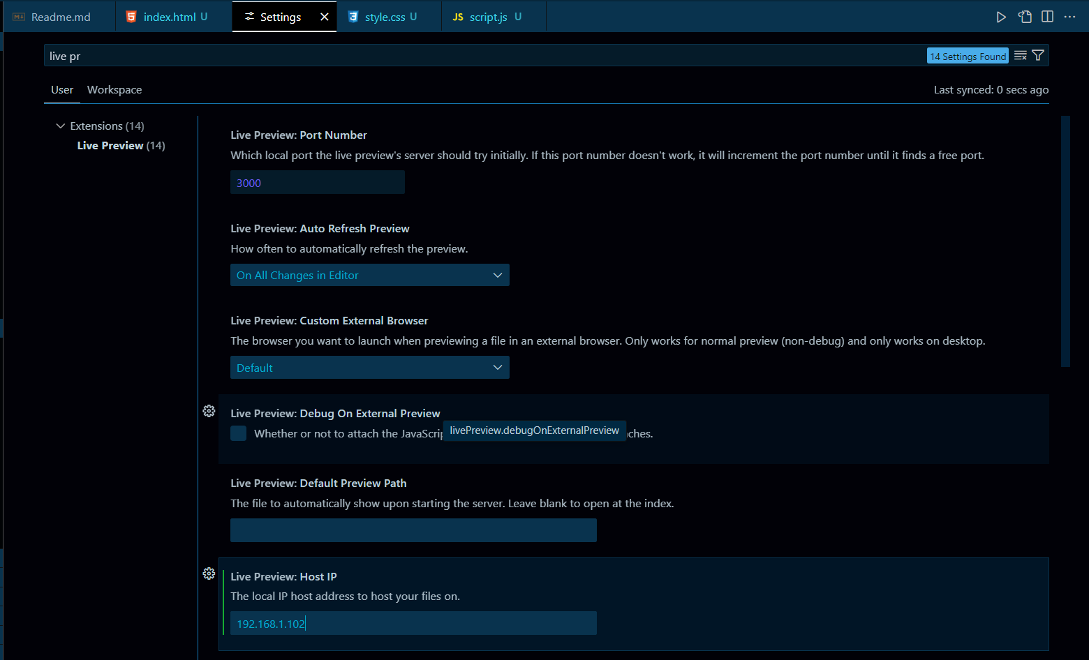

How to Preview Website in your phone
Go to VS Code settings and type Live Preview and paste you IP Address in Live Preview : Host IP and Restart VS Code

Slide 10
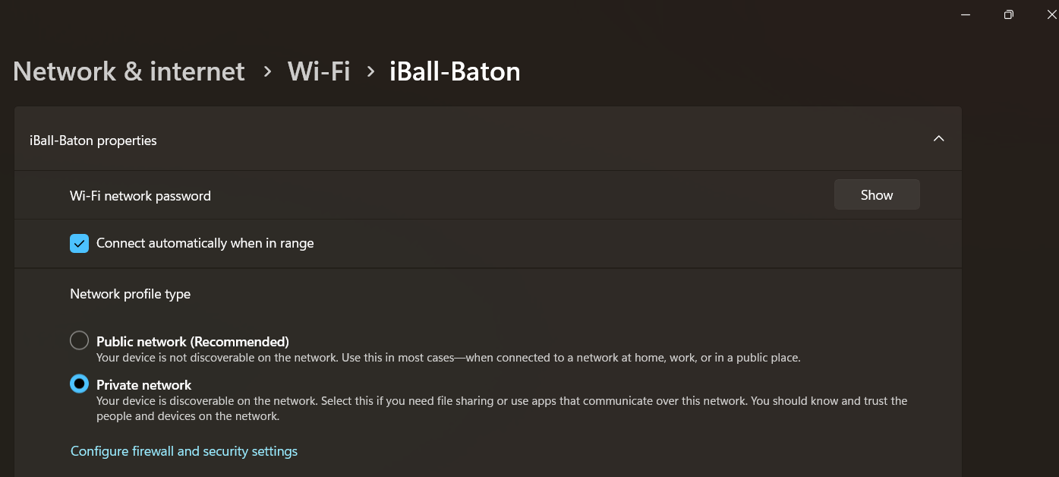
How to Preview Website in your phone
Make Sure your network is set to private

Slide 11
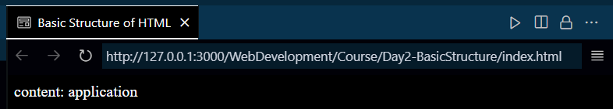

How to Preview Website in your phone
Now Paste this in your phone and make sure that Phone and PC are connected to the same Wi-Fi

Slide 12
Heading, Paragraph and Links
HTML

Slide 13
Headings
We have 6 header tags in html that are used to showcase hierarchy in the layout
h1 is the biggest header and h6 is the smallest header

Slide 14
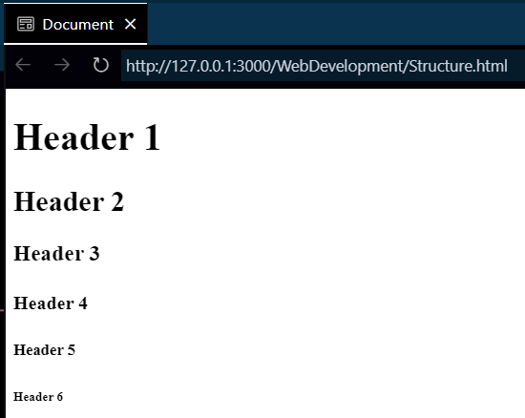
Headings
<!DOCTYPE html>
<html lang="en">
<head>
<title>Document</title>
</head>
<body>
<h1>Header 1</h1>
<h2>Header 2</h2>
<h3>Header 3</h3>
<h4>Header 4</h4>
<h5>Header 5</h5>
<h6>Header 6</h6>
</body>
</html>

Slide 15
Paragraphs
Paragraph tags are used to create a paragraph
Paragraphs tags are written inside <p></p>
Useful VS Code Tip : to write a placeholder/sample paragraph we can use lorem followed by the amounts of word we want the paragraph to contain, i.e. lorem25 for 25 word long paragraph

Slide 16
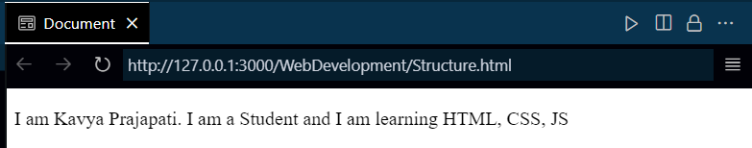
Paragraphs
<!DOCTYPE html>
<html lang="en">
<head>
<meta charset="UTF-8" />
<meta name="viewport" content="width=device-width, initial-scale=1.0" />
<title>Document</title>
</head>
<body>
<p>I am Kavya Prajapati. I am a Student and I am learning HTML, CSS, JS</p>
</body>
</html>

Slide 17
Links
a tag is used with href value to give the url of the page to be linked and target value to be able to open the page in a new page
The tag’s syntax :
<a target="_blank" href=""></a>

Slide 18
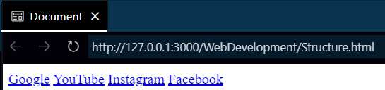
Links
<!DOCTYPE html>
<html lang="en">
<head>
<title>Document</title>
</head>
<body>
<a href="www.google.com">Google</a>
<a href="www.youtube.com">YouTube</a>
<a href="www.instagram.com">Instagram</a>
<a target="_blank" href="www.facebook.com">Facebook</a>
</body>
</html>

Slide 19
Images, Lists and Tables
HTML

Slide 20
Images
img tags are used for displaying images and we can give a direct url as value for directly showing the picture
src value is the source of picture and alt value is used when HTML cannot find the image and It will display the alt text instead

Slide 21
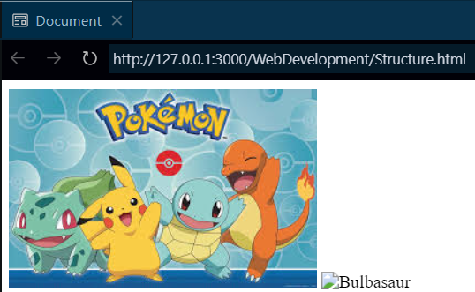
Images
<!DOCTYPE html>
<html lang="en">
<head>
<title>Document</title>
</head>
<body>
<img src="1.jpg" alt="Pokemon Photo">
<img src="2.jpg" alt="Bulbasaur">
</body>
</html>

Slide 22
Lists
There are 3 types of list in HTMl
Ordered List
Unordered List
Definition List

Slide 23
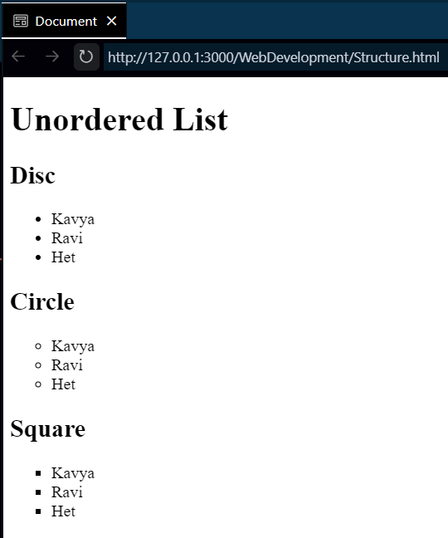
Unordered Lists
<h1>Unordered List</h1>
<h2>Disc</h2>
<ul>
<li>Kavya</li>
<li>Ravi</li>
<li>Het</li>
</ul>
<h2>Circle</h2>
<ul type="Circle">
<li>Kavya</li>
<li>Ravi</li>
<li>Het</li>
</ul>
<h2>Square</h2>
<ul type="Square">
<li>Kavya</li>
<li>Ravi</li>
<li>Het</li>
</ul>

Slide 24
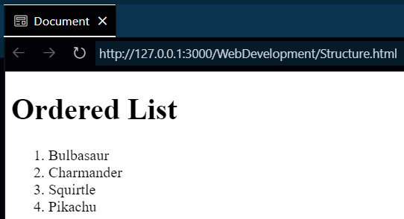
Ordered Lists
<h1>Ordered List</h1>
<ol>
<li>Bulbasaur</li>
<li>Charmander</li>
<li>Squirtle</li>
<li>Pikachu</li>
</ol>

Slide 25
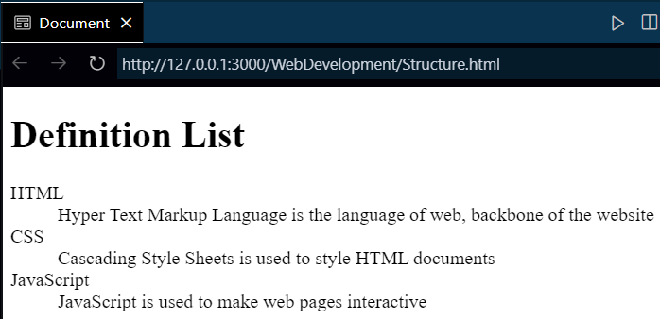
Definition Lists
<h1>Definition List</h1>
<dl>
<dt>HTML</dt>
<dd>
Hyper Text Markup Language is the language of web, backbone of the
website
</dd>
<dt>CSS</dt>
<dd>Cascading Style Sheets is used to style HTML documents</dd>
<dt>JavaScript</dt>
<dd>JavaScript is used to make web pages interactive</dd>
</dl>

Slide 26
Tables
Tables are used to organize data into rows and columns to make it easier to read and understand.
Table element: The <table> tag is the container for the entire table.
Table row element: The <tr> tag creates rows, which represent horizontal lines in the table.
Table header cell: The <th> tag creates header cells, which label columns or provide additional information about the data in the column.
Table data cell: The <td> tag creates data cells, which contain the actual data.

Slide 27
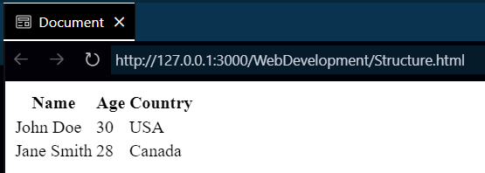
Tables
<table>
<tr>
<th>Name</th>
<th>Age</th>
<th>Country</th>
</tr>
<tr>
<td>John Doe</td>
<td>30</td>
<td>USA</td>
</tr>
<tr>
<td>Jane Smith</td>
<td>28</td>
<td>Canada</td>
</tr>
</table>

Slide 28
SEO and Core Web Vitals
HTML

Slide 29
SEO
SEO stands for Search Engine Optimization
SEO is used by every websites and by using this SEO, search engines like Google gives top priority to a website
If there are two similar websites then the one who loads faster will get the higher priority

Slide 30
Core Web Vitals
When two websites have similar contents then Core web vitals is used for getting higher priority by Search Engine
CLS (Cummulative Layout Shift) : We should have as less as possible shifts in our layout for better user experience
LCP (Largest Contentful Paint) : Time taken to load the largest element, 2.5 seconds is ideal
FID (First Input Delay) : time taken to process an input on website, less than 100 milliseconds is ideal
All of these 3 can be measured by using inspect element in Browser

Slide 31
Meta Keywords and Description
In the meta tag, content value is used to show the content of your page to SEO so that it can provide good content to the user when the user search on Search Engine
Meta keywords are deprecated now because many websites used to abuse it so now keywords are generated by SEO by parsing your webpage

