Slide 1


Major Project · Mid-Semester Review
Title:
TraceMap: A Web Privacy & Security Intelligence Platform for Detecting Third-Party Tracker Collusion Networks
Presented by:
Kavya Jain (CSF B3)
Krati Dhenkawat (DS B1)
Nityavardhan Singh Hartala (CSF B1)
Kartik Arora (CSF B1)
Guided by:
Sumitra Ma'am
Notes:
Mid-semester review of TraceMap. In one line: we built a working tool that opens a website like a phone user, finds every company it talks to, proves where personal data leaks, and we ran it on 50 Indian websites.

Slide 2
Content
1. | Abstract
2. | Literature Review
3. | Problem Statement
4. | Objectives & Status
5. | Methodology
6. | System Architecture (Implemented)
7. | Work Completed
8. | Web Application
9. | Testing & Validation
10. | Pilot Study Results
11. | Changes Since the Synopsis
12. | Remaining Work & Timeline
13. | References
Notes:
Idea-stage slides from the synopsis (introduction, SWOT, PERT roadmap) are removed; new slides show what is built, how we tested it, and pilot results.

Slide 3
1. Abstract
Every website quietly loads hidden third parties that can track you and read what you type into forms.
TraceMap opens a site like a phone user, records every company it contacts, and names who they are.
It types a fake email and phone number into forms, never submits, and proves which companies received them.
It finds companies that pass the same user ID between them, confirmed by comparing two separate visitors.
Every finding links to the exact network request that proves it.
Status: the first half is built and tested (crawler, detection, leak test, ID-sharing graph, web app, 44 automated tests).
A 50-site pilot on Indian government, banking, health, shopping and education sites is complete (49 scanned).
Notes:
Same idea as the synopsis, now with status. The two bold lines are what changed since the synopsis: it is built, tested, and has run on real Indian sites.

Slide 4
2. Literature Review
Prior work we build on, and the gap TraceMap fills:
Study | What it showed | How TraceMap builds on it
OpenWPM (Englehardt & Narayanan, ACM CCS 2016) | Standard tool for measuring tracking on a million sites; rules for spotting user-ID cookies. | We reuse its two-visitor ID rules inside our own phone-browser crawler (OpenWPM is Firefox-only).
Cookie Synchronization (Papadopoulos et al., WWW 2019) | Trackers swap your ID to merge their profiles of you. | We confirm ID sharing per site with two separate visitors and draw it as an ID-sharing map.
Leaky Forms (Senol et al., USENIX Security 2022) | Sites leak your email before you click submit (EU and US top sites). | We reimplement its canary method with +91 phone formats and apply it to Indian sectors.
Blacklight; Indian studies (The Markup 2020; ICWSM 2021; WebSci 2022) | Single-page privacy inspector; tracking on Indian news sites; cookies on .gov.in sites. | No study combines verified leaks, ID sharing and script risk across Indian sectors: our gap.
Notes:
Be upfront: each technique has prior art. Our contribution is combining them on Indian sectors with proof per finding.

Slide 5
3. Problem Statement
You cannot see which companies collect your data on a website, or where it goes.
Existing tools do not answer three questions together:
  Which companies pass your identity between them?
  Does your personal data leave before you press Submit, and to whom?
  How exposed is the site to tracking and to script attacks?
Indian websites are barely measured, and DPDP Act duties for websites apply from about May 2027.
We need one tool that proves each finding, and a study of Indian sites taken before enforcement.
Notes:
The DPDP Rules were notified on 13 Nov 2025; core duties apply from about May 2027, so a measurement now is a baseline.

Slide 6
4. Objectives & Status
Objective (from synopsis) | Status | Evidence today
Find and label hidden trackers and risky scripts | Done | 4 tracker datasets, 4 filter lists, India vendor list; fingerprinting, session-recording and form-reading flags
Reveal how trackers share your identity (graph) | Partly done | Per-site ID-sharing map with two-visitor confirmation; all-site communities in second half
Trace data leaks with canary values | Done on test site | 5 of 5 planted leaks found, 0 false; real-site tests after ethics approval
One clear risk score with reasons | Reasons done; score planned | Plain-English findings with proof; score shown only after validation
Study real Indian websites | Pilot done | 49 of 50 sites scanned; ~1,500-site study next
Show everything in a simple, interactive picture | Done | Web app: live scan, case file, leak replay, ID-sharing map, pilot page
Notes:
Walk the status column. Be clear the score is deliberately not shown yet.

Slide 7
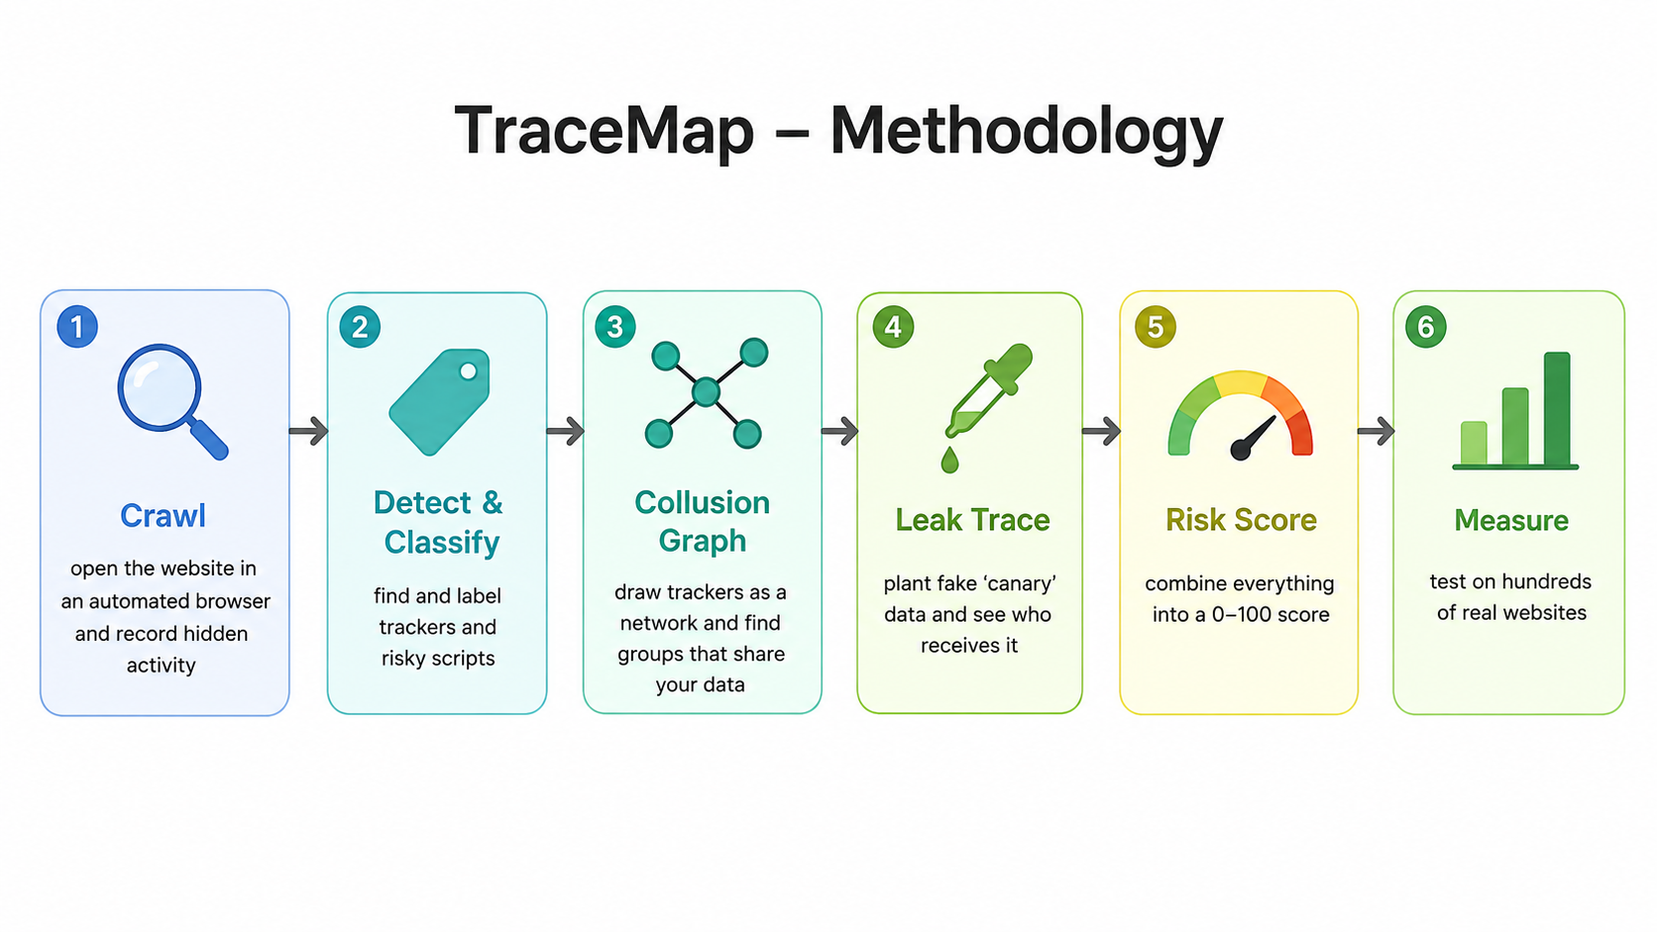
5. Methodology
Notes:
Same six stages as the synopsis: crawl, detect, ID graph (collusion), leak trace, risk score, measure. Stages 1-4 and 6 (pilot) are built; the score is second half.

Slide 8
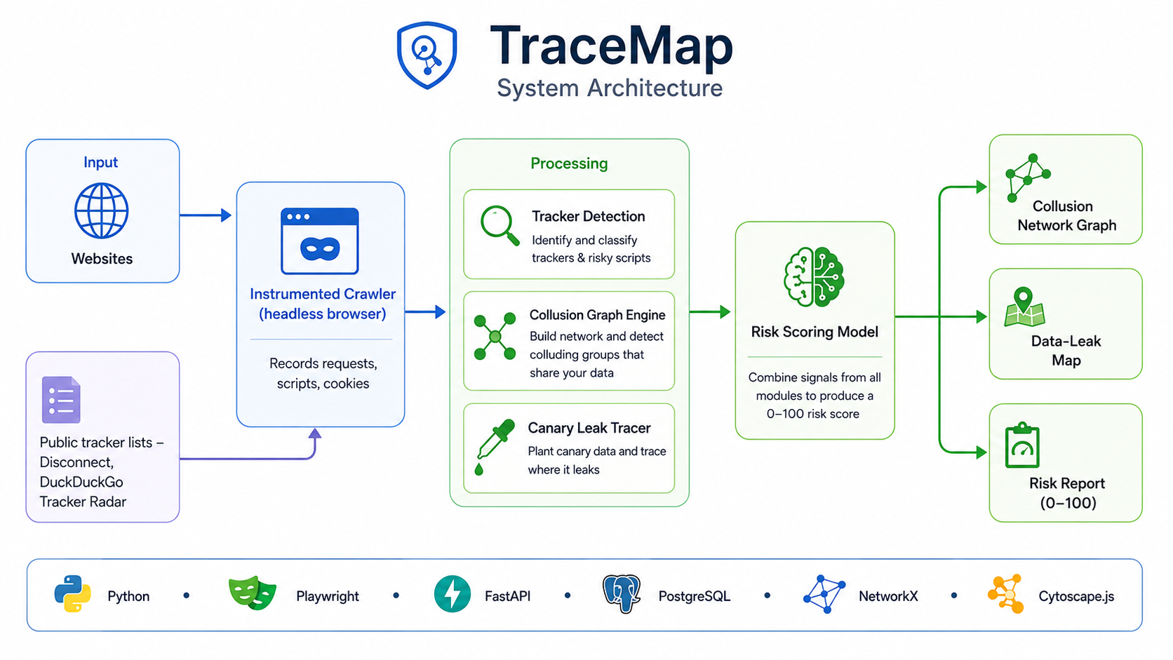
6. System Architecture (Implemented)
Input
Website address from the web app or the command line
Batch list for the pilot
Crawler
Playwright + installed Chrome
Chrome DevTools Protocol: every request, its script, POST bodies
Phone emulation
Visitors A, B, A2 + leak visitor
Cookie banners (autoconsent)
~80 browser-API hooks
Bot-wall detection, time limits
Detect
Owner, type, tracker; risky behaviour
Storage
JSON records, script files, SQLite index
Leak test
Canary email/phone, ~48,000 disguises
API
FastAPI, live progress (SSE), proof lookup
Public data (used by Detect)
DuckDuckGo, Ghostery, Disconnect, third-party-web
EasyPrivacy, EasyList, IndianList, AdGuard
Our India vendor list
ID graph
Two-visitor ID rule, confidence
Web app
React: case file, leak replay, ID map, pilot page
Findings
Plain-English reasons + proof
Stack: Python 3.11 · Playwright · Chrome DevTools Protocol · NetworkX · FastAPI · React + TypeScript · Cytoscape.js · SQLite
Changed from synopsis: SQLite + JSON instead of PostgreSQL for now; the risk-score model moves to the second half; own Chrome crawler instead of OpenWPM.
Notes:
Left to right: input, the crawler records everything, four analysis modules run on the stored record, results go to storage, the API and the web app. Analysis runs on saved crawls without a browser, so four people work in parallel.

Slide 9
7. Work Completed
Module | What is implemented | Owner
Crawler | Phone emulation; visitors A, B and revisit; landing + inner pages; every request with the script that sent it; POST bodies; cookies with who set them; cookie-banner modes; bot-wall detection; time limits | Kavya
Detection | Owners and types from 4 datasets; 4 filter lists incl. IndianList; India vendor list (23); fingerprinting, session-recording, form-reading flags | Nityavardhan
Leak test | Fake email + team phone; fields in pages and iframes; submission blocked in code; ~48,000 hashed/encoded variants; proof for every leak | Kartik
ID-sharing graph | Two-visitor ID rule (Englehardt & Narayanan 2016); per-site graph; confidence per link; same-company grouping | Krati
Web app and API | Live scan progress; case file with verdict; proof view; leak replay; ID-sharing map; companies; pilot page | Kartik, Kavya
Measurement | Resumable batch runner with per-site time limit; 50-site pilot; sector report | Krati, all
Notes:
Each row is a module with an owner. Everything listed runs today and is covered by automated tests.

Slide 10
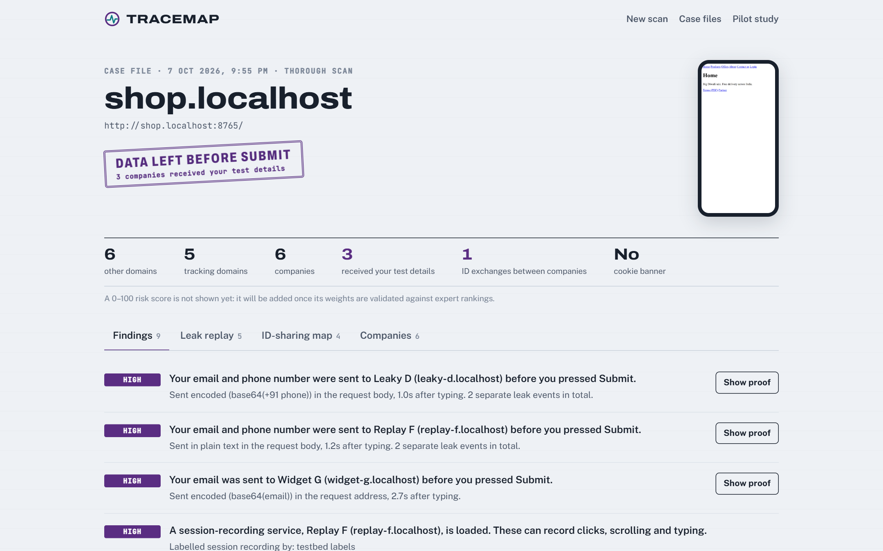
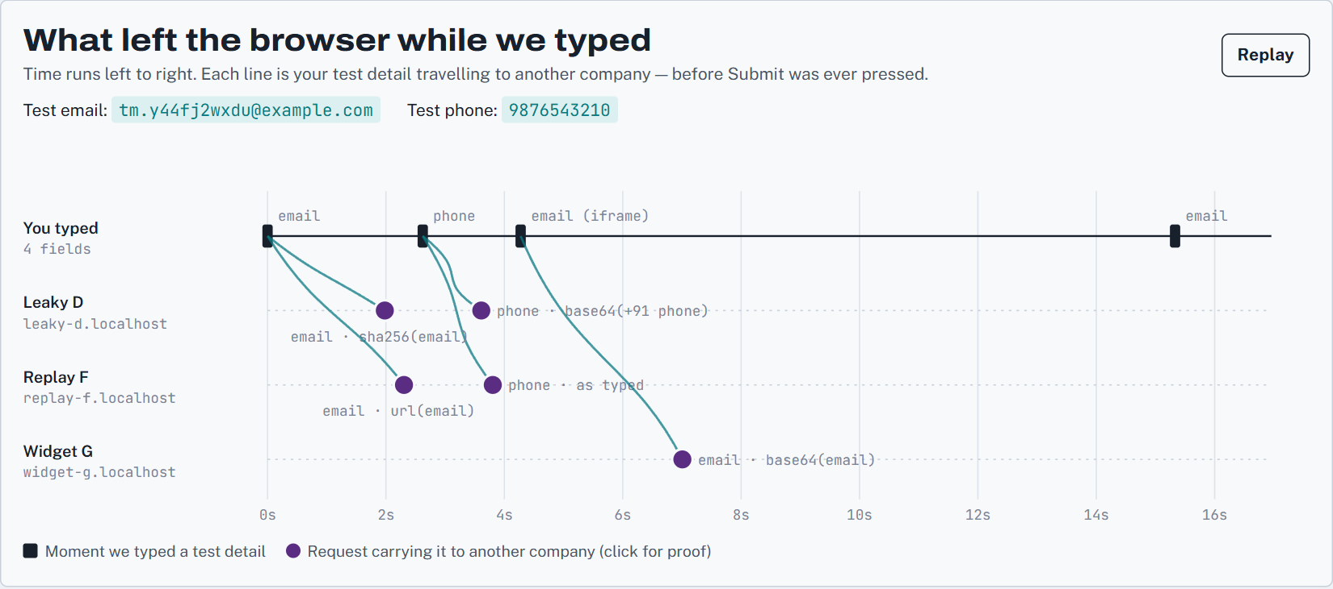
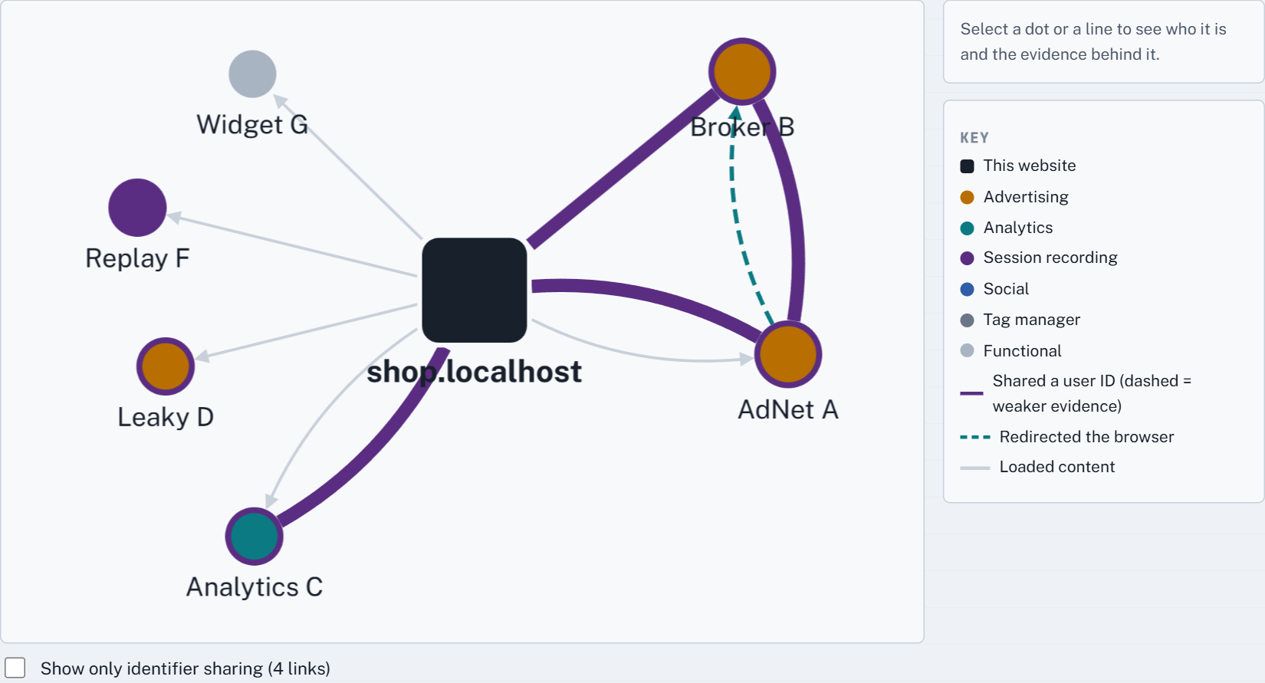
8. Web Application
Leak replay: typed fields (top) and the companies that received them
ID-sharing map: AdNet A passes the user ID to Broker B
Case file: verdict stamp, summary numbers, findings with Show proof
Every finding links to proof: the exact request, the script that sent it, and the leaked value highlighted.
Live demo: scan our test shop, then open stored Indian sites from Case files.
Notes:
Switch to the live demo here: python -m testbed and python -m tracemap serve --allow-local. Screenshots are from our test website.

Slide 11
9. Testing & Validation
A test website where we planted the answers (fake Indian shop with six fake companies):
Planted on the test site | Planted | Found
Third-party companies | 6 | 6
Form leaks (email, phone; hashed, base64, URL-encoded) | 5 | 5
Wrong leak recipients | 0 | 0
Cookie-sync pair (ID passed by redirect) | 1 | 1
Fingerprinting script (canvas + audio) | 1 | 1
Bot-check page | 1 | 1
Negative control: 0 hits
Same traffic searched for an email we never typed
44 automated tests pass
Unit, API and full end-to-end tests
Checked on real sites
AJIO bot wall confirmed by hand; clean site gives zero findings
Not yet measured: accuracy on real sites (second half: hand-labelled samples and comparison with Blacklight).
Notes:
The first question will be: how do you know it is right? Answer: planted ground truth, automated comparison, and a negative control proving we do not invent leaks.

Slide 12
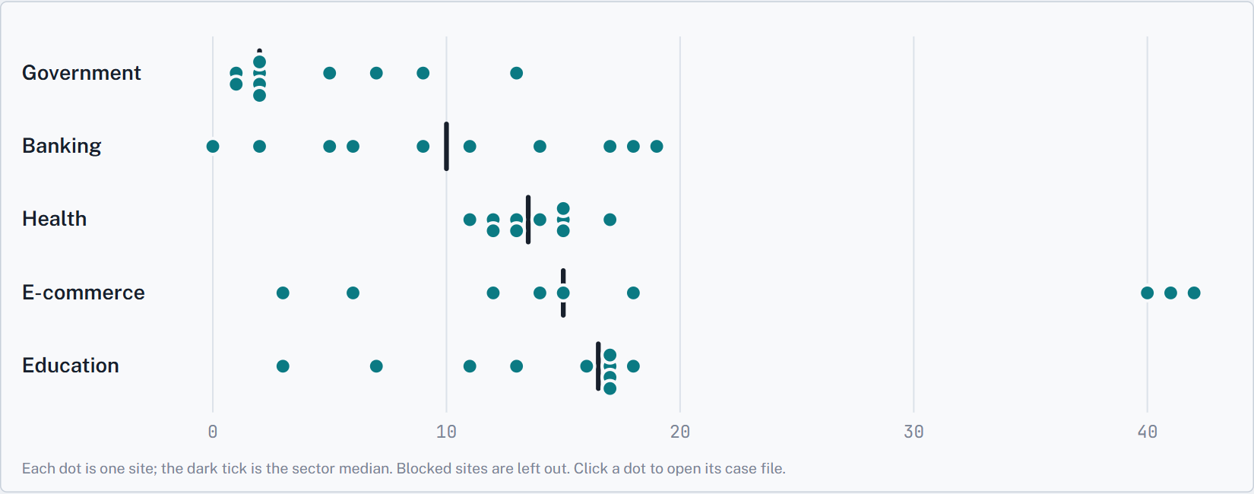
10. Pilot Study Results
50 Indian sites, 10 per sector · passive phone-browser scan, no cookie choice made, no form typing · 49 completed
48 / 49
sites loaded trackers before any cookie choice
13
median tracking domains per landing page
8 / 49
load a session-recording tool (incl. Axis Bank, Fortis, Narayana)
Tracking domains per site; each dot is a site, the tick is the sector median
19 / 49
use Indian martech (CleverTap on 10 sites)
By sector (median): government 2 · banking 10 · health 13.5 · e-commerce 15 · education 16.5
Only 8 of 49 showed a cookie banner; 8.7% of third parties are on no global list.
SBI has moved to sbi.bank.in (RBI .bank.in migration); AJIO blocked our browser.
Convenience sample to test the pipeline, not the study; session recording = capability, not observed recording.
Notes:
Real numbers from the pilot on 7 Oct 2026. Government sites are lightest, health, shopping and education heaviest. Caveat: convenience sample, passive scan.

Slide 13
11. Changes Since the Synopsis
Synopsis said | Now | Why
“Collusion network” | “Identifier-flow network”: ID-sharing evidence with a confidence | Shared IDs are evidence, not proof of intent
Louvain on each site | Per-site map now; Leiden + random-network tests on all sites together | One site’s graph is too small for reliable communities
Risk score from an ML model | Reasons now; score only after validation against expert rankings | No ground-truth labels for a “risky site”
First study of the Indian web | First sector study combining leaks, ID sharing and script risk | Indian news and .gov.in studies already exist
Desktop crawl; PostgreSQL | Phone browser; SQLite + JSON for now | ~65% of Indian traffic is mobile; simpler setup
Build on OpenWPM | Own Chrome crawler reusing DuckDuckGo open-source parts | OpenWPM is Firefox-only, no Windows support
Notes:
These changes came from an internal review before building. They make the project more defensible: we claim only what we can prove.

Slide 14
12. Remaining Work & Timeline
When | Work | Owner
Now | Submit ethics protocol; register canary email domain; two-person check of the India vendor list | All
Weeks 8–9 | Label ~300 ID links by hand; calibrated link confidence; communities tested against random networks | Krati
Weeks 8–10 | Security checks: outdated JavaScript libraries (retire.js, OSV), integrity checks, CSP, abandoned script domains | Nityavardhan
Weeks 9–11 | Full study: ~1,500 sites from CrUX India, 5 sectors; real-site form tests; comparison with Blacklight | Kavya, all
Weeks 10–12 | Validated risk score with uncertainty range; sector statistics | Krati, Kartik
Weeks 11–13 | Evidence download, sector dashboard, paper, dataset release, disclosures to sites and CERT-In | Kartik, all
Notes:
Replaces the synopsis PERT chart with the concrete second-half plan and owners.

Slide 15
13. References
Acar, G. et al. (2014). The Web Never Forgets: Persistent Tracking Mechanisms in the Wild. ACM CCS.
Englehardt, S. & Narayanan, A. (2016). Online Tracking: A 1-Million-Site Measurement and Analysis. ACM CCS. (OpenWPM)
Englehardt, S., Han, J. & Narayanan, A. (2018). I Never Signed Up for This! Privacy Implications of Email Tracking. PETS.
Papadopoulos, P. et al. (2019). Cookie Synchronization: Everything You Always Wanted to Know But Were Afraid to Ask. WWW.
Bashir, M. A. & Wilson, C. (2018). Diffusion of User Tracking Data in the Online Advertising Ecosystem. PETS.
Senol, A. et al. (2022). Leaky Forms: A Study of Email and Password Exfiltration Before Form Submission. USENIX Security.
Iqbal, U., Englehardt, S. & Shafiq, Z. (2021). Fingerprinting the Fingerprinters. IEEE S&P.
Dimova, Y. et al. (2021). The CNAME of the Game: Large-scale Analysis of DNS-based Tracking Evasion. PETS.
Traag, V., Waltman, L. & van Eck, N. (2019). From Louvain to Leiden: Guaranteeing Well-Connected Communities. Scientific Reports.
Demir, N. et al. (2022). Reproducibility and Replicability of Web Measurement Studies. WWW.
Agarwal, P. et al. (2021). Under the Spotlight: Web Tracking in Indian Partisan News Websites. ICWSM.
Götze, M. et al. (2022). Measuring Web Cookies in Governmental Websites. ACM WebSci.
The Markup (2020). Blacklight: A Real-Time Website Privacy Inspector. themarkup.org.
DuckDuckGo. Tracker Radar and autoconsent (open source). github.com/duckduckgo.
MeitY, Govt. of India (2023, 2025). Digital Personal Data Protection Act and DPDP Rules.
Notes:
Added the papers behind the methods we reimplemented and the Indian prior work.

Slide 16
Thank You

