Slide 1
REINFORCEMENT
LEARNING
ASSIGNMENT 1 | MARKOV DECISION PROCESSES
4×4 Frozen Lake Gridworld
Submitted by: Kavya Namburi • BT23CSE004
Parts 1–5 • Code-backed numerical results • Convergence analysis
RL Assignment 1 • Kavya Namburi • BT23CSE004 1

Slide 2
Assignment roadmap
All five parts from the assignment are covered
• Part 1 — Define the MDP and justify finite, episodic, fully observed.
• Part 2 — Evaluate the uniform random policy, verify two manual iterations, plot convergence, calculate Qπ(s,a).
• Part 3 — Run policy iteration and value iteration; compare policies and contraction behavior.
• Part 4 — Solve policy evaluation by linear algebra and compare against iterative evaluation.
• Part 5 — Test γ = 0.5 and 0.999, change the living reward to zero, and discuss model-free learning.
RL Assignment 1 • Kavya Namburi • BT23CSE004 2

Slide 3
Part 1 — Grid and state numbering
The same grid is used in all experiments
S (0) H (1) F (2) F (3)
F (4) F (5) F (6) H (7)
H (8) F (9) F (10) F (11)
F (12) F (13) H (14) G (15)
• Start state: 0
• Holes: {1, 7, 8, 14}
• Goal: 15
• Terminal states: {1, 7, 8, 14, 15}
RL Assignment 1 • Kavya Namburi • BT23CSE004 3

Slide 4
Part 1 — MDP tuple
Model definition
Component | Definition
S | {0, 1, …, 15}
A | {Left, Down, Right, Up}
P(s′|s,a) | 0.25 intended movement; 0.75 stay
R(s,a,s′) | −0.01 ordinary step/stay; −1 hole; +1 goal
γ | 0.9
Terminal convention | Holes and goal end the episode; future value is zero
RL Assignment 1 • Kavya Namburi • BT23CSE004 4

Slide 5
Part 1 — Transition assumption
The handout leaves the remaining 0.75 unspecified
• Explicit assumption: P(intended movement) = 0.25 and P(stay) = 0.75.
• If the intended movement would leave the grid, the agent stays in its current cell with probability 1.
• Rewards are assigned to the resulting state: hole = −1, goal = +1, ordinary transition/stay = −0.01.
• This assumption is stated openly because it is not fully specified by the assignment text.
P(s′|s,a) is the environment transition model; π(a|s) is the action-selection policy. They are different probabilities.
RL Assignment 1 • Kavya Namburi • BT23CSE004 5

Slide 6
Part 1 — MDP properties
Finite, episodic, and fully observed
Property | Answer | Justification
Finite | Yes | 16 states and 4 actions.
Episodic | Yes | Entering a hole or goal ends the episode.
Fully observed | Yes | The agent directly knows its current grid cell.
RL Assignment 1 • Kavya Namburi • BT23CSE004 6

Slide 7
Part 2 — Uniform random policy
The policy selects each action with probability 0.25
π(a|s) = 0.25 for every action a in every non-terminal state
Bellman expectation equation:
Vπ(s) = Σa π(a|s) Σs′ P(s′|s,a) [R(s,a,s′) + γVπ(s′)]
• Initialize V₀(s) = 0.
• Update all non-terminal states synchronously using the previous value vector.
• Stop when Δ = maxₛ |Vnew(s) − V(s)| < 10⁻⁸.
RL Assignment 1 • Kavya Namburi • BT23CSE004 7

Slide 8
Part 2 — Manual iterations for state 2
State 2 is adjacent to hole 1
Q₀(2, Left) = 0.25(−1) + 0.75(−0.01) = −0.2575
Q₀(2, Down) = Q₀(2, Right) = Q₀(2, Up) = −0.01
V₁(2) = ¼[−0.2575 − 0.01 − 0.01 − 0.01] = −0.071875
Second sweep:
Q₁(2,Left) = 0.25(−1) + 0.75[−0.01 + 0.9(−0.071875)] = −0.306015625
Q₁(2,Down) = Q₁(2,Right) = Q₁(2,Up) = −0.0746875
V₂(2) = ¼[−0.306015625 − 3(0.0746875)] = −0.13251953125
RL Assignment 1 • Kavya Namburi • BT23CSE004 8

Slide 9
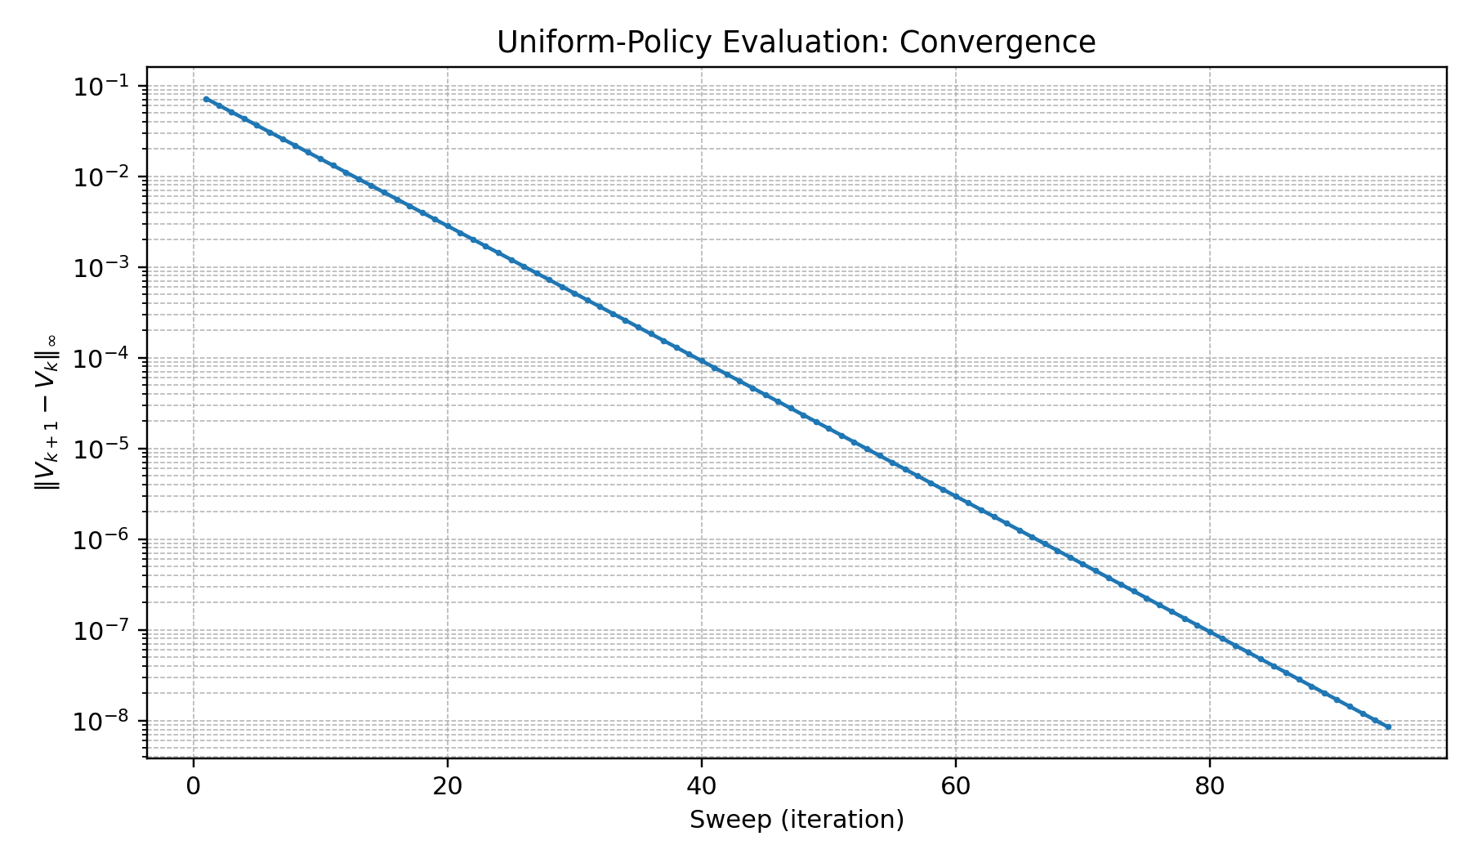
Part 2 — Convergence plot
Maximum absolute change per sweep; logarithmic y-axis
Converged after 94 sweeps: final Δ = 8.540e-09 < 10⁻⁸
RL Assignment 1 • Kavya Namburi • BT23CSE004 9

Slide 10
Part 2 — Converged Vπ
Uniform random policy, γ = 0.9, θ = 10⁻⁸
-0.4597 0.0000 -0.4573 -0.4593
-0.4590 -0.4556 -0.4477 0.0000
0.0000 -0.4477 -0.3961 -0.1155
-0.4593 -0.4573 0.0000 0.0000
• Synchronous policy evaluation: 94 sweeps.
• Most values are negative because ordinary steps are penalized and holes incur −1.
• State 11 is relatively favorable because it is near the goal.
RL Assignment 1 • Kavya Namburi • BT23CSE004 10

Slide 11
Part 2 — Qπ(s,a), states 0–7
Columns: Left, Down, Right, Up
State | Cell | Left | Down | Right | Up
0 | F | -0.4238 | -0.4236 | -0.5678 | -0.4238
1 | H | 0.0000 | 0.0000 | 0.0000 | 0.0000
2 | F | -0.5662 | -0.4194 | -0.4220 | -0.4215
3 | F | -0.4229 | -0.5675 | -0.4234 | -0.4234
4 | F | -0.4231 | -0.5673 | -0.4223 | -0.4233
5 | F | -0.4208 | -0.4182 | -0.4182 | -0.5650
6 | F | -0.4147 | -0.4013 | -0.5597 | -0.4151
7 | H | 0.0000 | 0.0000 | 0.0000 | 0.0000
RL Assignment 1 • Kavya Namburi • BT23CSE004 11

Slide 12
Part 2 — Qπ(s,a), states 8–15
Columns: Left, Down, Right, Up
State | Cell | Left | Down | Right | Up
8 | H | 0.0000 | 0.0000 | 0.0000 | 0.0000
9 | F | -0.5597 | -0.4151 | -0.4013 | -0.4147
10 | F | -0.3781 | -0.5249 | -0.3034 | -0.3781
11 | F | -0.1771 | 0.1646 | -0.1139 | -0.3354
12 | F | -0.4234 | -0.4234 | -0.4229 | -0.5675
13 | F | -0.4220 | -0.4215 | -0.5662 | -0.4194
14 | H | 0.0000 | 0.0000 | 0.0000 | 0.0000
15 | G | 0.0000 | 0.0000 | 0.0000 | 0.0000
For terminal states, Q is displayed as zero by convention because no further action is taken.
RL Assignment 1 • Kavya Namburi • BT23CSE004 12

Slide 13
Part 3 — Policy iteration
Alternate evaluation and greedy improvement
• Start from the uniform random policy.
• Evaluate the current policy using the Bellman expectation equation.
• Improve the policy using πnew(s) = argmaxₐ Qπ(s,a).
• Repeat until the greedy improvement no longer changes the policy.
Evaluation | Sweeps | Result
Initial uniform policy | 94 | Greedy improvement produces deterministic policy
Improved policy | 72 | Policy remains unchanged
RL Assignment 1 • Kavya Namburi • BT23CSE004 13

Slide 14
Part 3 — Stable optimal policy
L = Left, D = Down, R = Right, U = Up
D H D L
R D D H
H R R D
R U H G
• Policy iteration stabilizes after two improvement checks.
• The second evaluation takes 72 sweeps at θ = 10⁻⁸.
• Terminal-state actions are irrelevant.
RL Assignment 1 • Kavya Namburi • BT23CSE004 14

Slide 15
Part 3 — Value iteration
Bellman optimality update
Vₖ₊₁(s) = maxₐ Σs′ P(s′|s,a)[R(s,a,s′) + γVₖ(s′)]
Converged in 72 sweeps at θ = 10⁻⁸.
Optimal value function V*:
0.0346 0.0000 0.1808 0.0944
0.0944 0.1808 0.3056 0.0000
0.0000 0.3056 0.4858 0.7462
0.0944 0.1808 0.0000 0.0000
Greedy policy extraction: π*(s) = argmaxₐ Q*(s,a).
RL Assignment 1 • Kavya Namburi • BT23CSE004 15

Slide 16
Part 3 — Contraction and comparison
Why repeated Bellman updates converge
||TV − TU||∞ ≤ γ ||V − U||∞
• For bounded rewards and 0 ≤ γ < 1, both Tπ and T are contractions.
• Policy iteration explicitly evaluates a policy, then improves it; it often needs few improvement steps.
• Value iteration combines optimal action selection with each value update and may need many sweeps.
• Contraction guarantees convergence, but does not universally guarantee lower total runtime for policy iteration.
RL Assignment 1 • Kavya Namburi • BT23CSE004 16

Slide 17
Part 4 — Exact linear-system solution
Independent check of iterative policy evaluation
Vπ = Rπ + γPπVπ
(I − γPπ)Vπ = Rπ
Vπ = (I − γPπ)⁻¹Rπ
• Pπ(s,s′) = Σₐ π(a|s)P(s′|s,a).
• Rπ(s) is the expected immediate reward under π.
• In code, use np.linalg.solve(A, b) rather than explicitly forming an inverse.
Maximum absolute difference: 4.544e-08
RL Assignment 1 • Kavya Namburi • BT23CSE004 17

Slide 18
Part 4 — Why not solve huge matrices?
Scalability
• A dense n×n transition matrix requires O(n²) memory.
• A general dense linear-system solve typically requires O(n³) computation.
• Large state spaces make a direct exact solve impractical.
• Iterative updates, model-free sampling, sparse structure, and function approximation can scale better.
RL Assignment 1 • Kavya Namburi • BT23CSE004 18

Slide 19
Part 5 — Discount-factor experiments
Value iteration tolerance: 10⁻⁸
γ | Sweeps | V*(0) | Policy vs γ=0.9
0.5 | 24 | -0.019869 | Same
0.9 | 72 | 0.034569 | Same
0.999 | 105 | 0.750150 | Same
• γ = 0: only immediate reward matters; the agent is myopic.
• As γ increases, future rewards receive more weight.
• The contraction bound becomes weaker as γ approaches 1, so convergence can slow.
• At γ = 1, the usual discounted-MDP contraction guarantee does not apply.
RL Assignment 1 • Kavya Namburi • BT23CSE004 19

Slide 20
Part 5 — Effect of the living reward
What changes when the ordinary-step reward changes?
Living reward | Sweeps | V*(start state 0)
−0.01 | 72 | 0.034569
0 | 73 | 0.122335
When the living reward is −0.01
When the living reward is 0
• Each ordinary move or stay costs 0.01 reward, so unnecessary delay lowers the return.
• The agent is encouraged to reach the goal efficiently while avoiding holes.
• The start-state optimal value is 0.034569 under this model.
• Ordinary moves and stays carry no penalty; only the goal (+1) and holes (−1) provide non-zero rewards.
• The start-state value rises to 0.122335 because ordinary steps no longer reduce return.
• The optimal policy happens to stay the same in this grid; this is not guaranteed for every MDP.
Interpretation: removing the step cost makes taking extra time less costly, but the best action still depends on transition probabilities and terminal rewards.
RL Assignment 1 • Kavya Namburi • BT23CSE004 20

Slide 21
Part 5 — When P and R are unknown
Model-free reinforcement learning learns from experience rather than a known model
What does “unknown model” mean?
Main model-free methods
• The agent does not know the transition probabilities P(s′|s,a) or reward function R(s,a,s′) in advance.
• It interacts with the environment and records experience tuples (s, a, r, s′).
• It updates value estimates directly from observed rewards and next states instead of calculating exact expectations from a complete model.
• TD(0) — updates a state-value estimate V(s) toward r + γV(s′); commonly used to evaluate a policy.
• Q-learning — updates Q(s,a) toward r + γ maxₐ′ Q(s′,a′); off-policy control that learns toward the greedy optimal action.
• SARSA — updates Q(s,a) toward r + γQ(s′,a′); on-policy control using the next action actually selected.
How the agent explores
• ε-greedy: choose a random action with probability ε; otherwise choose the action with the highest current Q-value.
• Exploration discovers alternatives; exploitation uses what the agent has learned. ε is often reduced gradually as learning progresses.
Q-learning: Q(s,a) ← Q(s,a) + α[r + γ maxₐ′ Q(s′,a′) − Q(s,a)]
RL Assignment 1 • Kavya Namburi • BT23CSE004 21

Slide 22
Conclusion and reproducibility
All assignment questions are addressed
• Part 1: MDP defined; transition-model assumption disclosed.
• Part 2: uniform-policy evaluation, manual checks, convergence plot, and all Qπ entries.
• Part 3: policy iteration and value iteration yield the same greedy policy.
• Part 4: exact linear-system solution verifies iterative evaluation.
• Part 5: discount factor, living reward, and model-free learning discussed.
• Use the accompanying rl_assignment1.py to reproduce the numerical results and plot.
Fixed settings: γ = 0.9, θ = 10⁻⁸, synchronous updates, intended=0.25, stay=0.75.
RL Assignment 1 • Kavya Namburi • BT23CSE004 22

