Slide 1

CVR COLLEGE OF ENGINEERING DEPARTMENT OF COMPUTER SCIENCE AND ENGINEERING
Real-Time / Field based Research Project Review
On
CHIT FUND MANAGEMENT SYSTEM
TEAM MEMBERS:
S. Akshitha – 22B81A05K9
N. Kavya Reddy – 22B81A05L9
R. Sharanya – 22B81A05P2
PROJECT GUIDE:
Name of the Guide: C. Ramesh Sir
CSE Department

Slide 2

Contents
Abstract
Motivation
Literature review
Limitations of the existing Applications/ Models
Proposed problem statement
Software requirement/Technology stack
Hardware requirements
Innovation in the project
Plan of action to complete the project
Sample Outputs
References

Slide 3
Abstract
This project aims to develop a web-based chit fund management system to address the challenges faced by small businesses. Traditional manual methods, characterized by extensive paperwork and time-consuming tasks, hinder efficiency and transparency in managing chit funds.
The proposed system seeks to automate key processes, such as generating receipts and updating payments, while providing real-time updates and a user-friendly interface. By leveraging modern web technologies, the project aims to streamline operations, enhance user experience, and empower small business owners with the tools they need to thrive in the digital age.
Through this initiative, we aspire to make a tangible difference in the lives of those who rely on chit funds for their financial well-being.

Slide 4

Motivation
This project is driven by the practical need to support small businesses.
Witnessing the challenges they faces with manual methods, such as extensive paperwork and time-consuming calculations, inspired this initiative.
Manual processes pose significant obstacles, including errors and lack of transparency, which leave admin and his clients unsure about their investments.
Challenges with Manual Methods:
Extensive paperwork
Time-consuming calculations
High risk of errors
Lack of transparency

Slide 5

Literature review
The literature review aims to explore existing research, studies, and solutions related to chit fund management systems. It provides a foundation for understanding the current landscape and identifying areas for improvement.
Numerous academic studies have explored the role of chit funds in financial inclusion and their impact on economic stability.
Several commercial solutions offer chit fund management software, but many have limitations in terms of scalability, user experience, and security.
Recent advancements in technology, such as cloud computing and mobile applications, present new opportunities for enhancing chit fund management systems.

Slide 6
Limitations of the existing Applications/ Models
High Cost
Outdated Technologies
Lack of Real-Time Updates
Limited Accessibility
User Experience Issues
Scalability Issues
Over Complexity

Slide 7
Proposed problem statement
To develop a comprehensive, user-friendly, and secure chit fund management system that automates the management of users, schemes, members, and payment statuses, while integrating with a mail server for notifications.
Key Challenges:
Manual management of chit funds is inefficient and prone to errors.
Lack of transparency and real-time updates can lead to mistrust among members.
Existing solutions do not adequately address scalability and security concerns.
Provide an easy-to-use platform accessible via mobile devices to include a wider range of participants, particularly in rural and semi-urban areas.

Slide 8

Software Requirements
Technologies Used:
Front-End: HTML, CSS, JavaScript for creating a responsive user interface.
Back-End: Python- Flask for server-side logic and handling API requests.
Database: SQLite for storing user data, scheme details, and payment records.
Tools and Libraries:
Flask-Mail: For sending automated email reminders to members.
SQLAlchemy: ORM for database interactions.
Jinja2: For rendering dynamic HTML templates

Slide 9
Hardware requirements
Server Requirements:
Minimum: 1 CPU, 2 GB RAM, 20 GB SSD
Standard web server for hosting Flask application
Recommended: 2 CPUs, 4 GB RAM, 40 GB SSD
User Devices:
Minimum: Any modern device such as laptop with internet access
Recommended: Devices with the latest web browsers for optimal performance

Slide 10
Innovation in the project
Unique Features:
Automated email reminders for payment deadlines.
Real-time updates on member contributions and scheme status.
Detailed statistics and analytics for administrators.
Technological Advances:
Use of Flask and SQLAlchemy for efficient back-end development.
Responsive front-end design for an optimal user experience on various devices.
User Experience:
Intuitive user interface for easy navigation and interaction.
Accessibility features to ensure inclusivity for all users.

Slide 11

Plan of action to complete the project
Set up Flask application and configure database
Implement user authentication and registration
Develop functionalities for scheme and member management
Implement payment tracking and status updates
Integrate email reminder functionality using Flask-Mail
Test the application and deploy on a web server

Slide 12
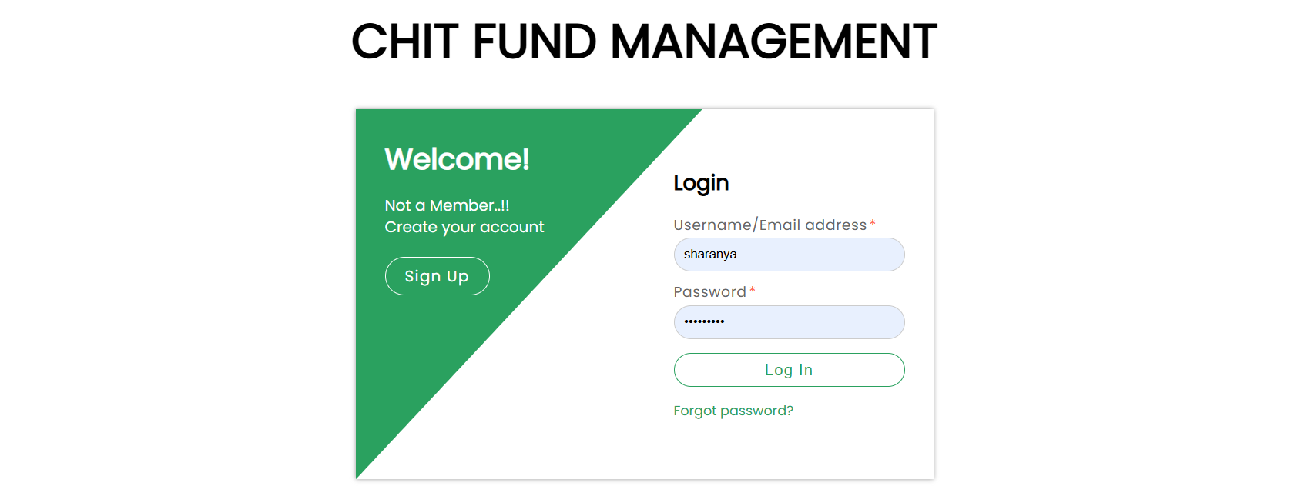
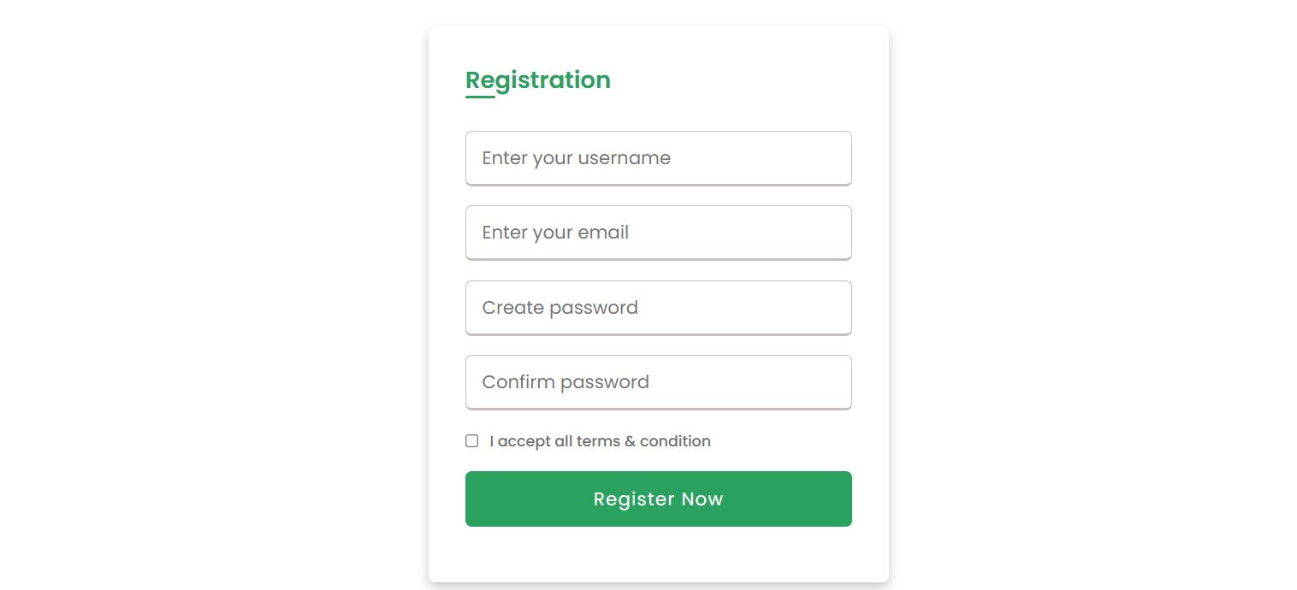
Demo:
Login/Signup page for application :
Registration for new admins :

Slide 13
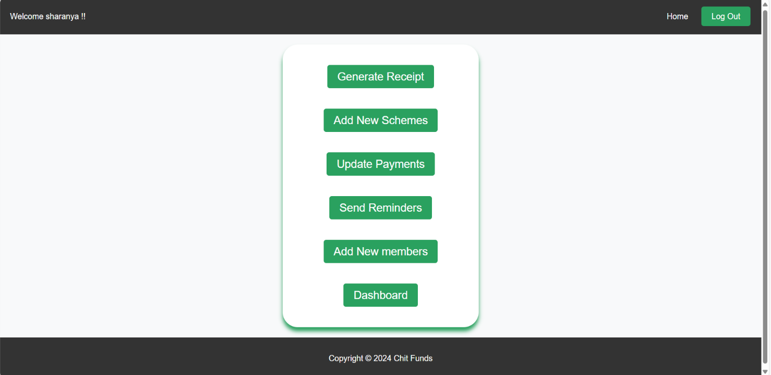
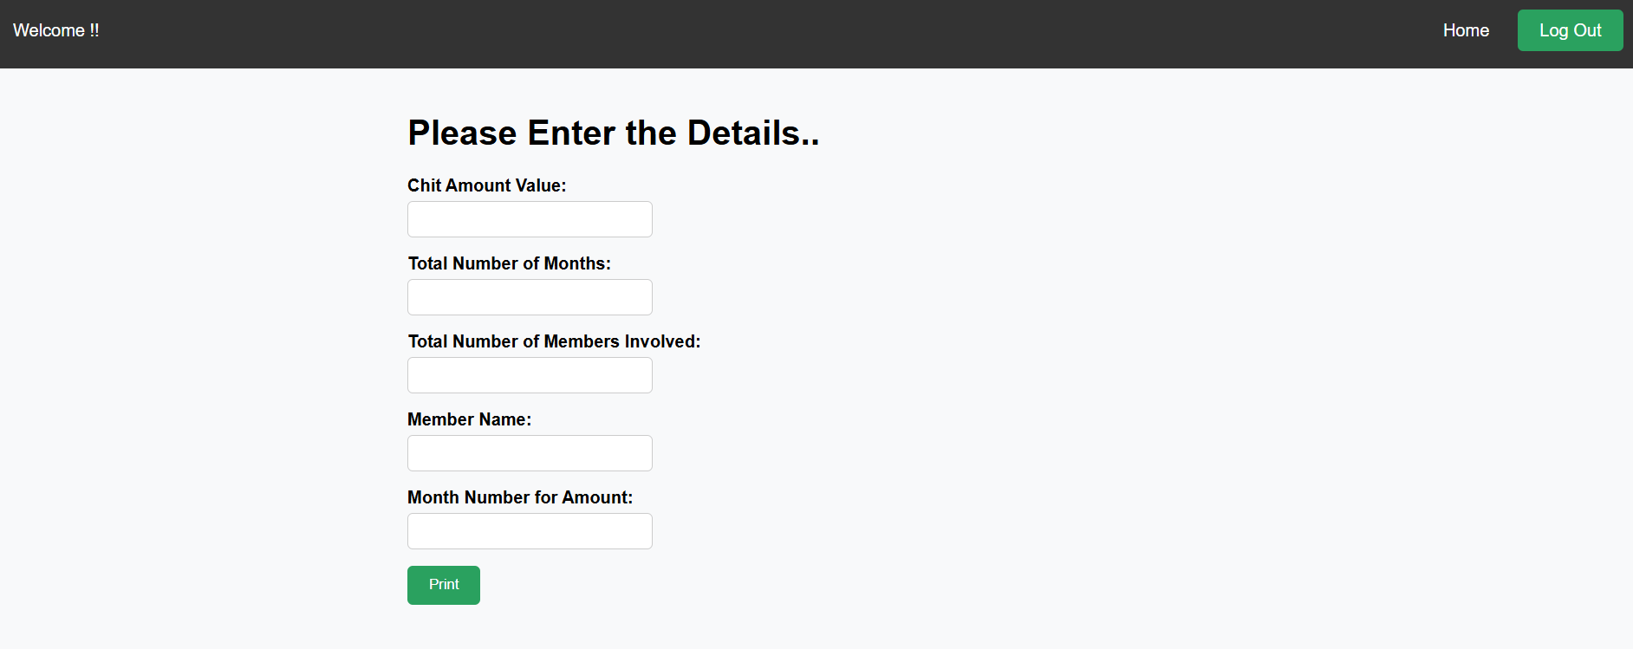
Home page after logging in
To generate a receipt for member who lifts the amount

Slide 14
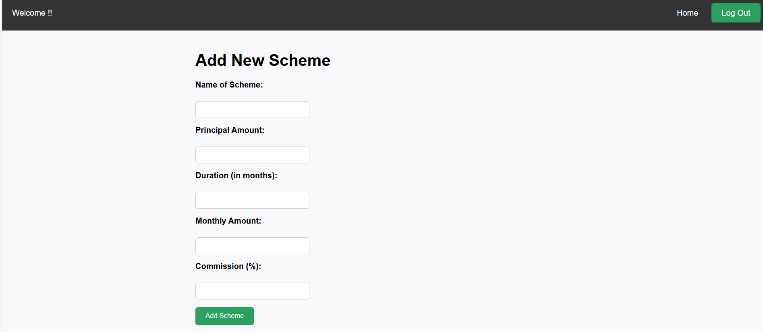
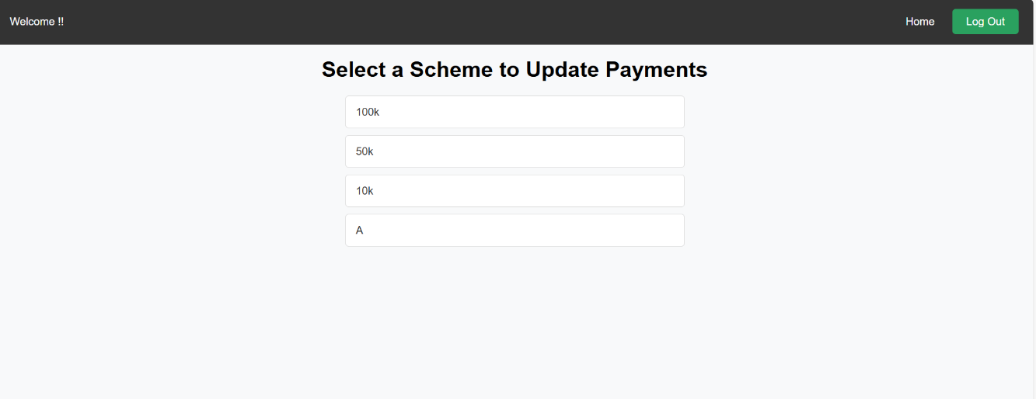
Adding new Schemes
Choose Scheme to update

Slide 15
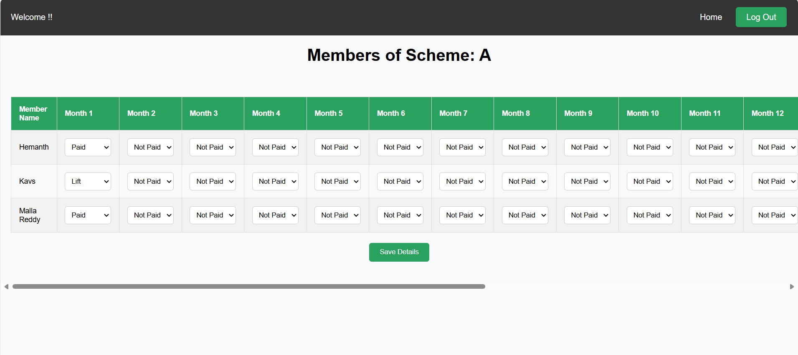
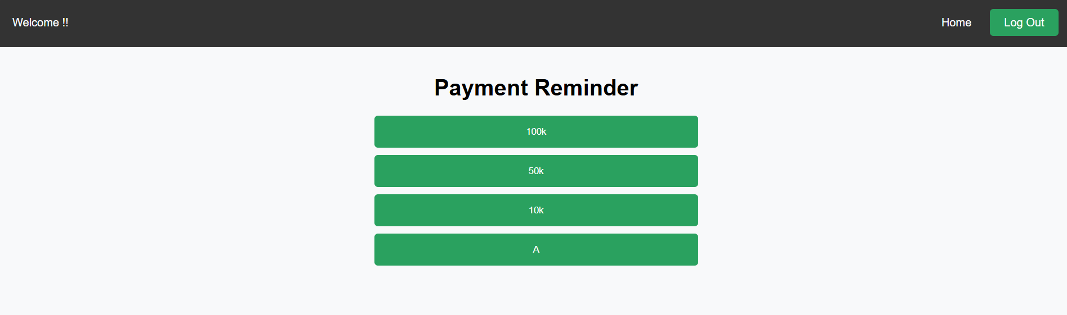
Updating Payment Status
Sending reminders based on schemes

Slide 16
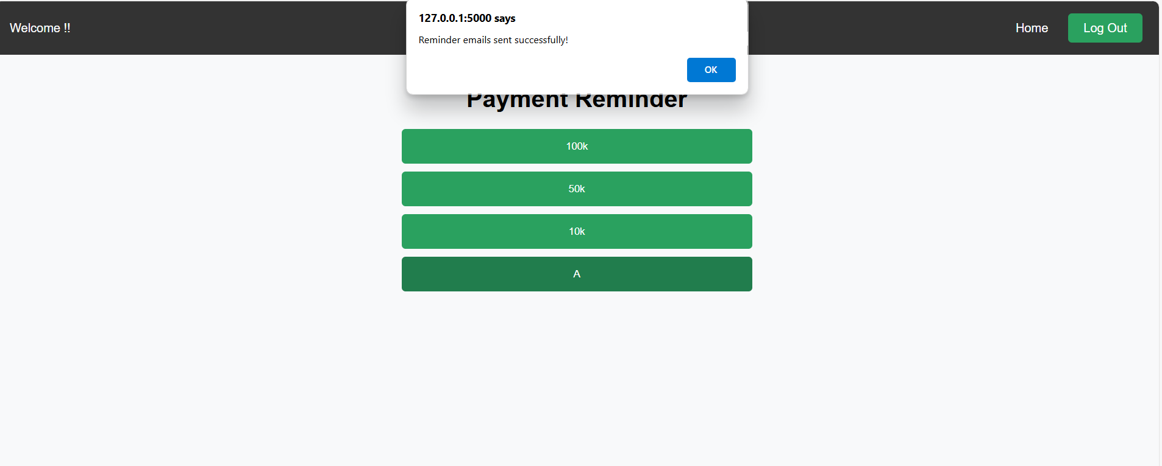
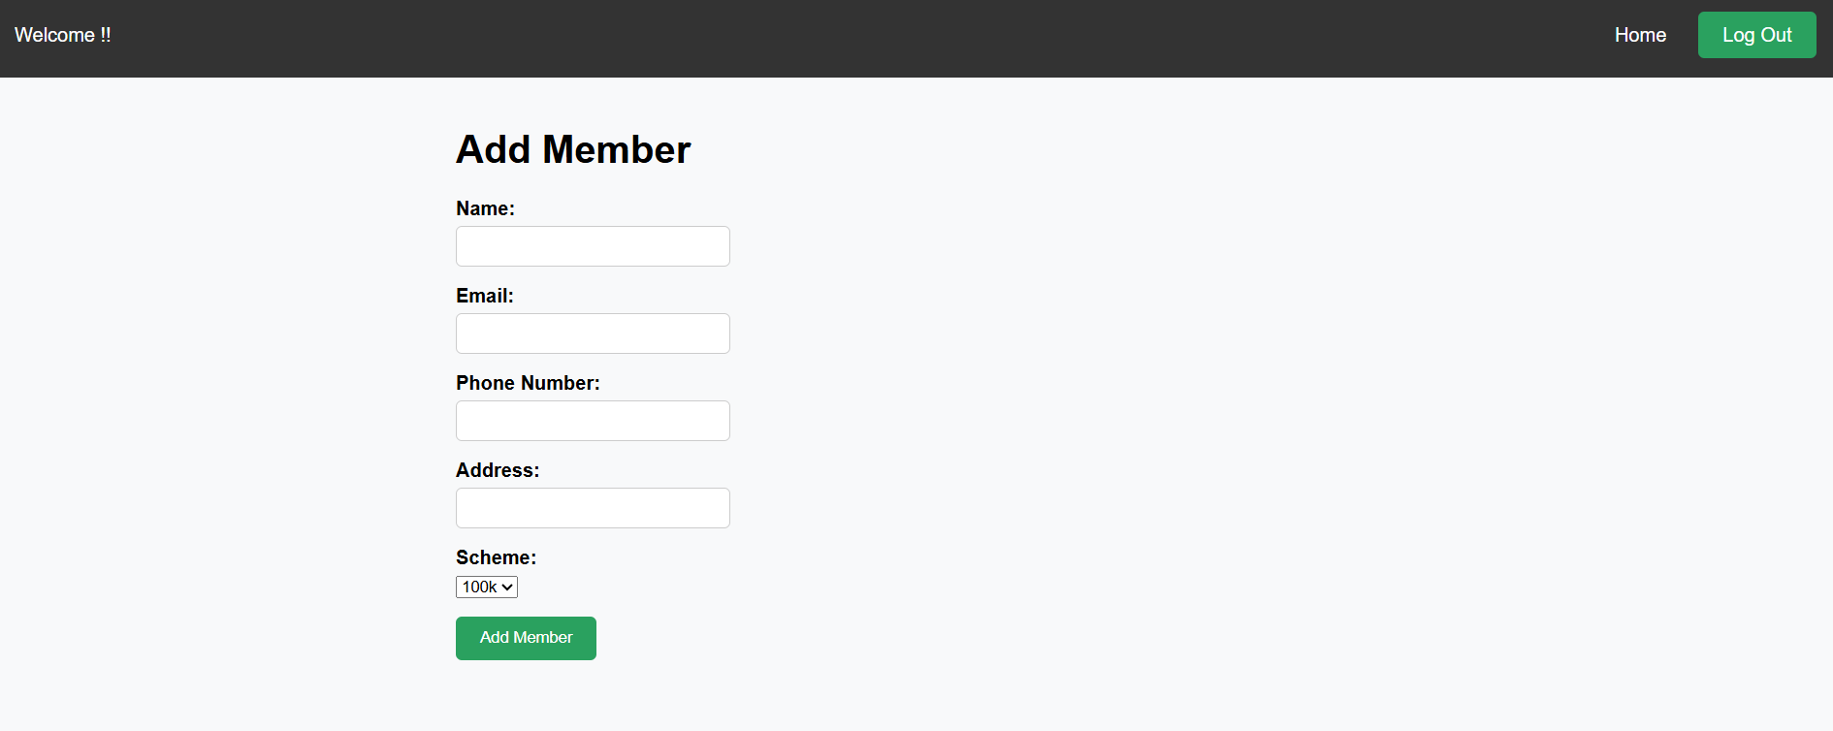
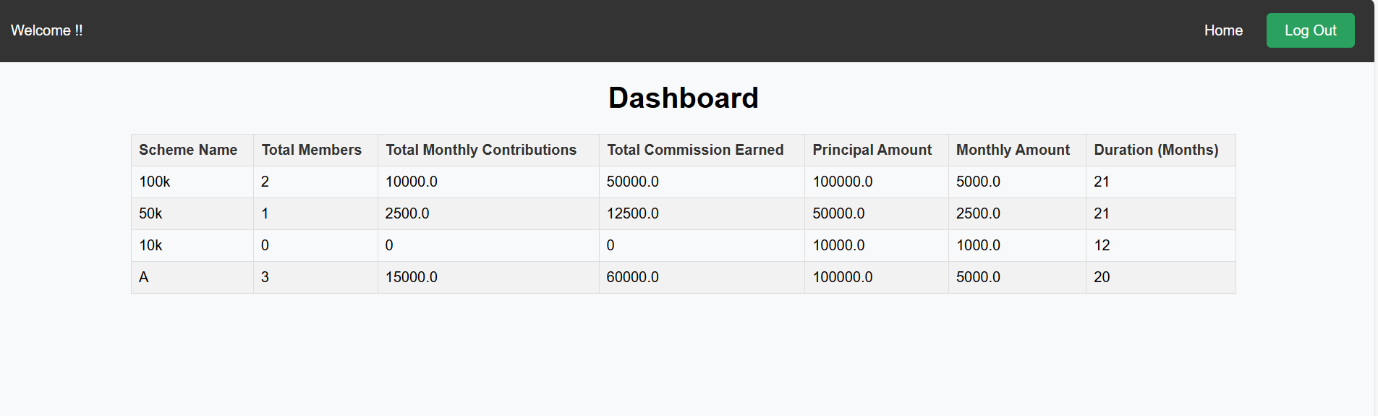
When reminder sent successfully
Adding new Members to suitable scheme
Dashboard Showing details

Slide 17
References
Chit Fund Department Government of NCT of Delhi
https://chitfund.delhi.gov.in/chitfund/what-chit-fund-business
Shriram chits
https://www.shriramchits.in/
5paisa.com
https://www.5paisa.com/blog/chit-fund#:~:text=Chit%20funds%20are%20a%20kind,money%20collected%20during%20each%20interval

Slide 18

THANK YOU

