Slide 1
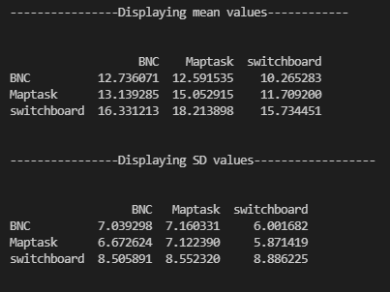
Output when tokenizer used is "word-level-tokenizer-wiki2.json"

Slide 2
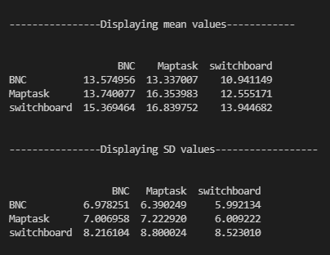
Output when tokenizer trained as per dataset

Slide 3
Mean and SD of combined corpus when tokenizer trained as per word level tokenization
Mean of ppl scores of Combined corpus: 20.480716303189595
Standard deviation of Combined corpus: 13.428275185534478

Slide 4
Mean and SD of combined corpus when tokenizer trained as per subword level tokenization
Mean of ppl scores of Combined corpus: 16.538656202952065
Standard deviation of Combined corpus: 9.41659597199234

