Slide 1
Problem
Credit risk modeling is central to financial stability.
- Traditional models: limited accuracy, interpretable.
- AI models: higher accuracy, but opaque and risk fairness issues.
- Challenge: How to predict defaults while ensuring fairness and explainability.

Slide 2
Data & Methods
Dataset: Home Credit Default Risk (Kaggle).
- 300K+ applicants, demographic + financial history.
- Models: Logistic Regression (baseline), LightGBM (advanced).
- Metrics: AUC, Accuracy, Precision, Recall.
- Explainability: SHAP (global + local).
- Fairness: Gender and Age group analysis (Selection Rate, TPR, FPR).

Slide 3
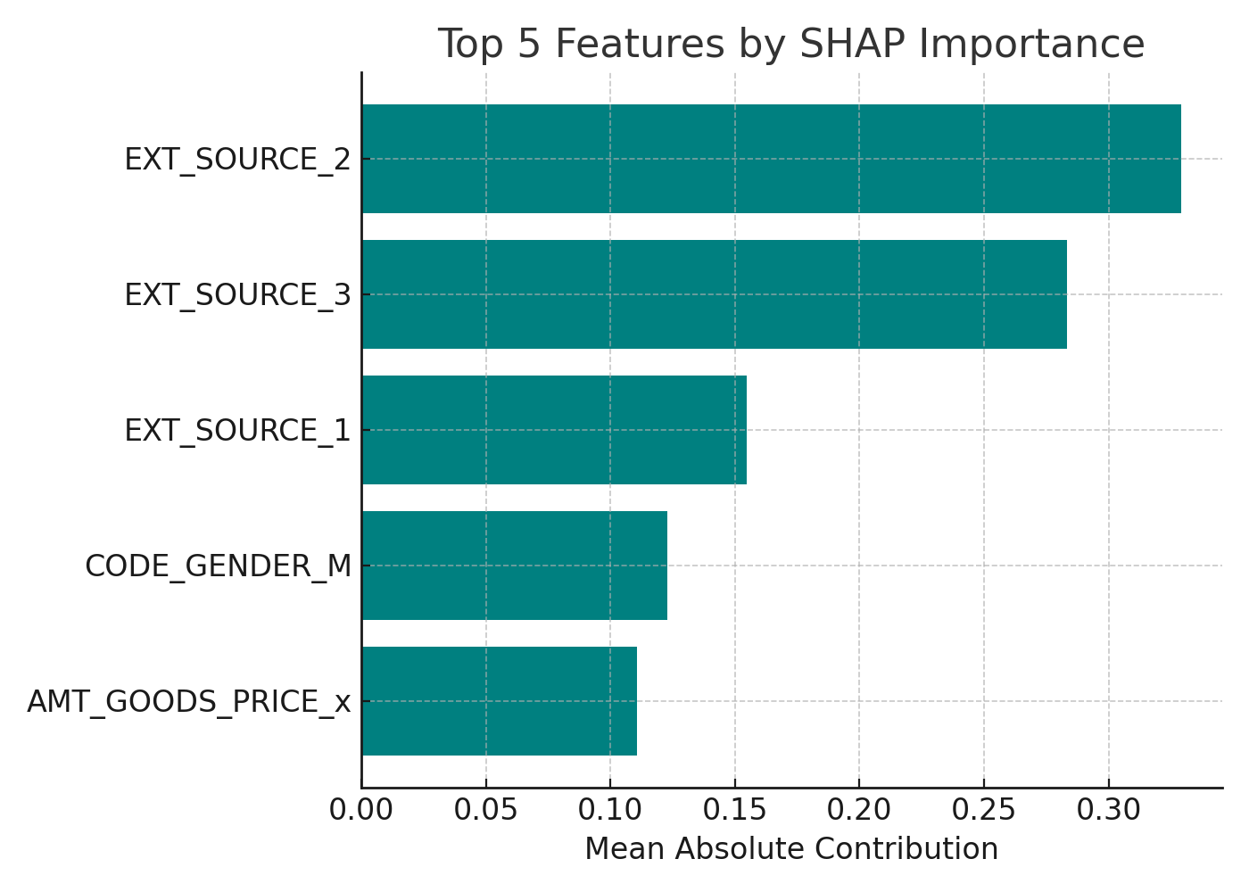
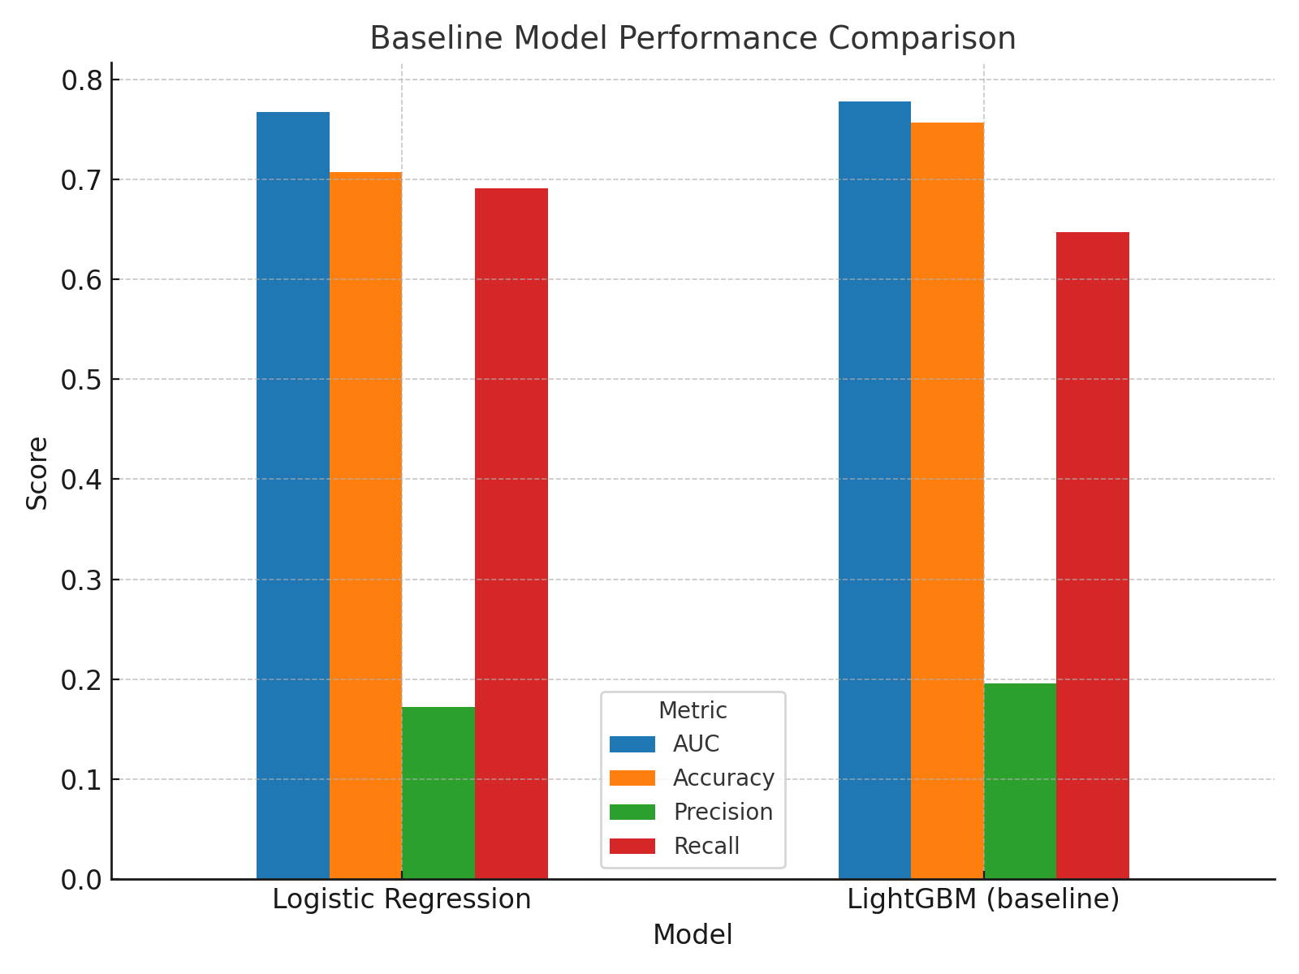
Key Findings
- LightGBM outperformed Logistic Regression (AUC 0.778 vs. 0.767).
- Both models had low precision (<20%), many false alarms.
- Top predictors: External credit scores, loan size.
- Gender: Males flagged as risky more often (↑TPR, ↑FPR).
- Age: Younger applicants scrutinized more, older applicants under-detected.

Slide 4
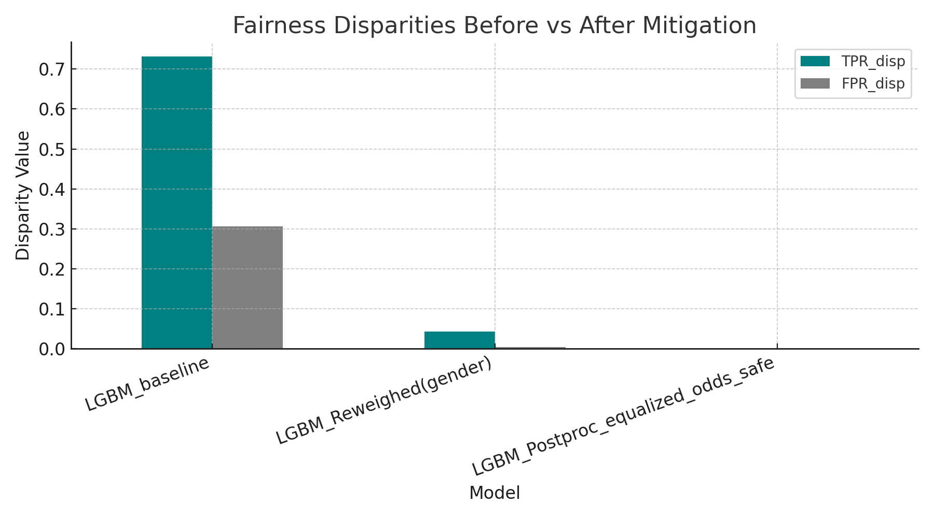
Mitigation Results
- Tested threshold adjustments and re-weighting.
- Trade-off: improved fairness metrics for some groups, but small drop in accuracy.
- Example: balanced TPR across genders with slight precision loss.
- Demonstrates feasibility of fairness-aware modeling.

Slide 5
Governance Implications
- Accuracy alone insufficient for credit AI assessment.
- Regulators should mandate:
• Fairness audits with clear metrics.
• Standardized explainability (SHAP).
• Transparency in thresholds and decisions.
- Align with EU AI Act (credit scoring = high-risk AI).

Slide 6
Next Steps
- Extend fairness analysis to intersectional groups (e.g., gender × age).
- Explore fairness-aware algorithms (e.g., adversarial debiasing).
- Build dashboard for regulator-facing explainability.
- Publish findings as PhD research portfolio component.

