Slide 1
Exploratory Data Analysis
Lending Club Default Analysis
Post Assignment Presentation
Based on the uploaded EDA notebook
Lending Club EDA • Post Assignment • 1

Slide 2
1. Project Overview
• The analysis is divided into four parts: data understanding, data cleaning, data analysis and recommendations.
• The main objective is to identify variables that are associated with loan default.
• Loan status is treated as the target variable.
• The analysis compares default rates across applicant characteristics and loan characteristics.

Slide 3
2. Dataset Overview
39,717
111
55
Loan records
Original columns
Columns after >90% missing-value removal
• Important variables include loan amount, term, interest rate, grade, sub-grade, annual income and loan purpose.
• The original dataset contains numeric and categorical variables.
• The project uses loan_status as the main target for default analysis.

Slide 4
3. Data Cleaning & Pre-processing
• Columns with more than 90% missing values were removed, reducing the dataset from 111 to 55 columns.
• The description field was dropped because it was not used for the analysis.
• mths_since_last_delinq was dropped because it is generated after loan approval and is not available as an approval-time predictor.
• Behaviour-related variables were excluded from predictor analysis.
• Interest rate was converted from text such as '10.65%' into a numeric value.
• Employment length was converted from text into numeric years.

Slide 5
4. Target Variable: Loan Status
32,145
5,399
1,098
Fully Paid
Charged Off
Current — removed
• Current loans were removed because they were neither fully paid nor defaulted.
• Fully Paid was coded as 0 (non-default) and Charged Off as 1 (default).
• After removing Current loans, the dataset contains 37,544 observations for the default-rate analysis.
• Overall default rate = 14.58%.

Slide 6
5. Overall Default Rate
14.58%
Overall default rate
• The analysis finds that around 15% of the analyzed loans were charged off.
• This provides the baseline against which the default rates of different borrower and loan categories can be compared.
• The remaining analysis focuses on identifying variables where default rates differ meaningfully from this baseline.

Slide 7
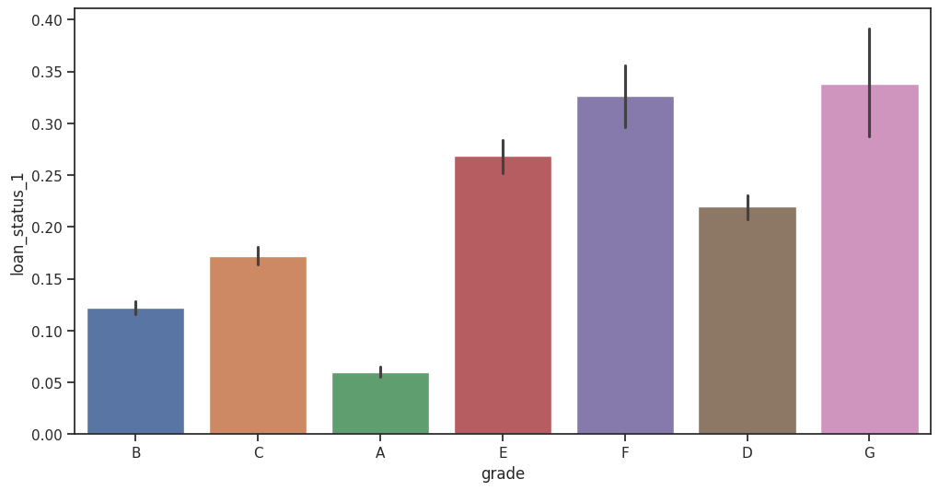
6. Loan Grade is a Strong Risk Indicator
• Default rate increases as loan grade moves from A toward G.
• Higher grades represent riskier loans in the Lending Club grading system.
• This makes grade one of the clearest variables associated with default in the EDA.

Slide 8
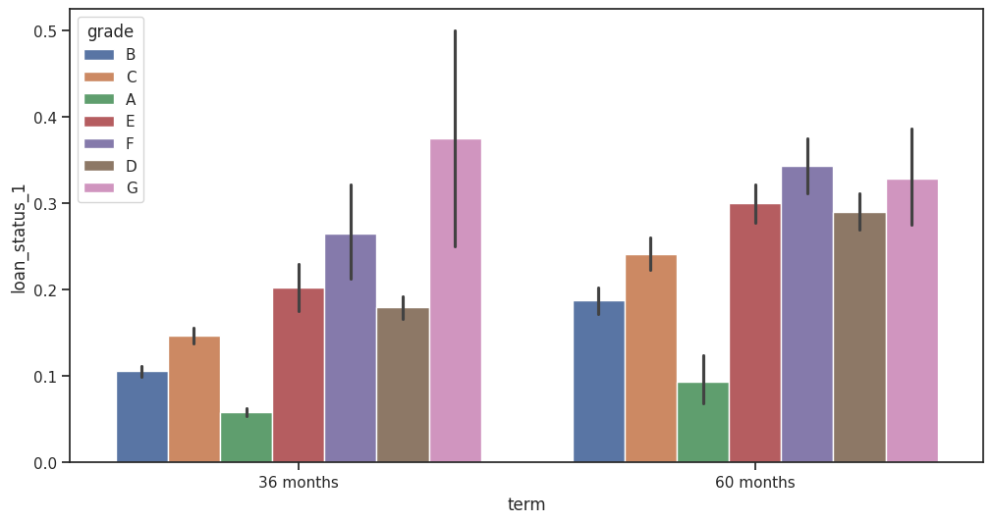
7. Loan Term and Default
• The notebook notes that 60-month loans have a higher default rate than 36-month loans.
• Longer repayment periods can therefore be treated as a risk signal in the analysis.
• Loan term should be considered together with other variables rather than used alone.

Slide 9
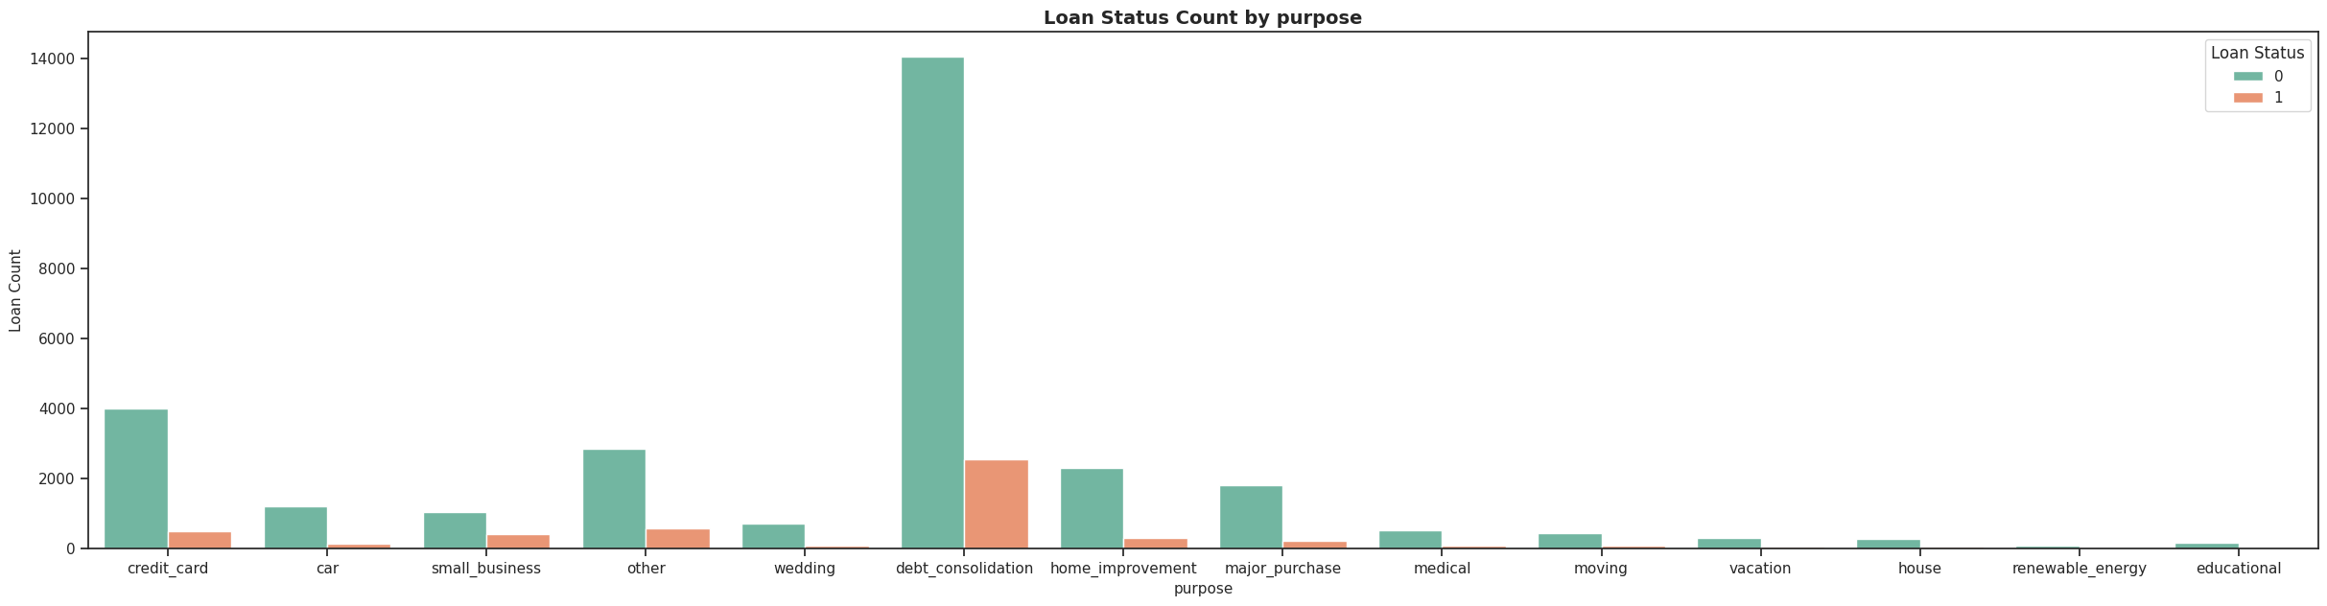
8. Purpose of Loan
• Small-business loans show the highest default rate in the notebook's analysis.
• Renewable-energy and education loans are also highlighted as relatively higher-default categories.
• Loan purpose is important because it can be related to borrower profile, interest rate, income and risk.

Slide 10
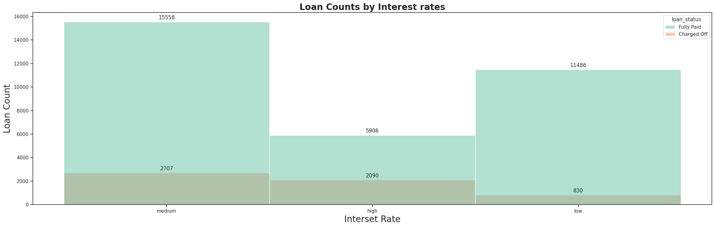
9. Interest Rate and Default
• Higher interest-rate categories show higher default rates.
• Interest rate therefore acts as an important risk-related variable.
• The result is consistent with the notebook's interpretation that higher-risk loans tend to carry higher rates.

Slide 11
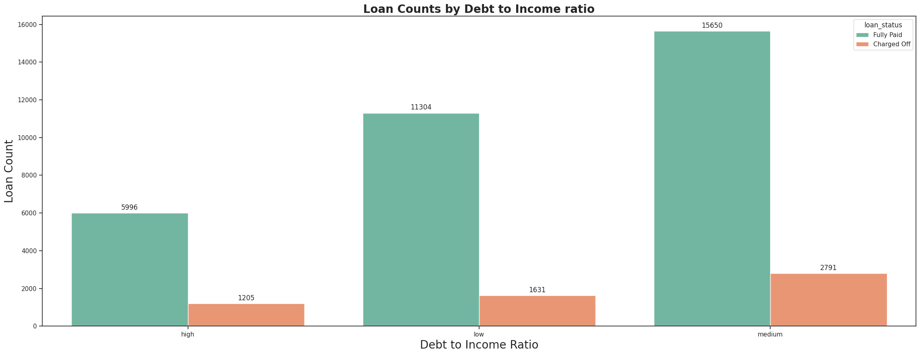
10. Debt-to-Income Ratio (DTI)
• Higher DTI categories have higher default rates.
• A higher DTI suggests that a larger share of income is already committed to debt obligations.
• DTI can therefore help identify borrowers with greater repayment pressure.

Slide 12
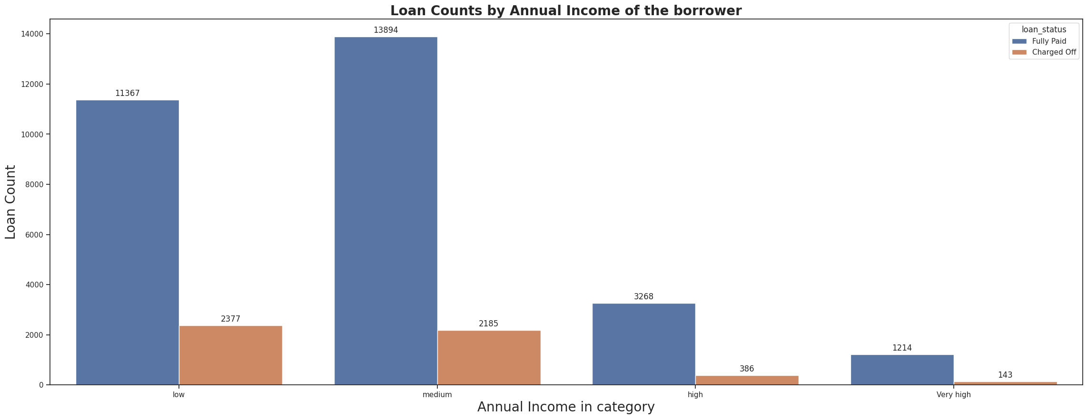
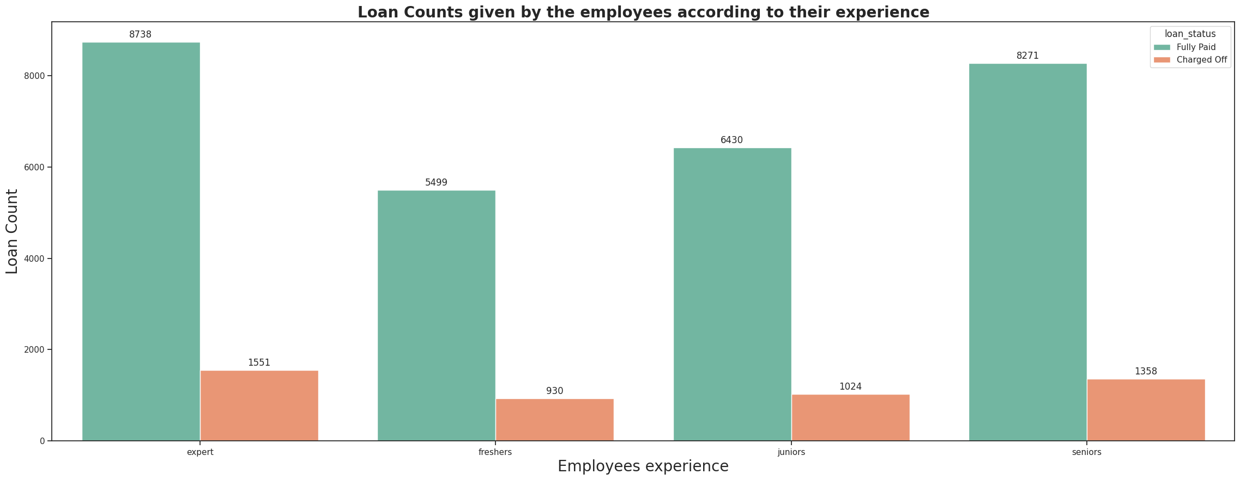
11. Income and Employment Length
• Lower annual-income categories have higher default rates.
• The notebook reports approximately a 6 percentage-point difference between the highest- and lowest-income groups.
• Employment length is not identified as a strong predictor of default.

Slide 13
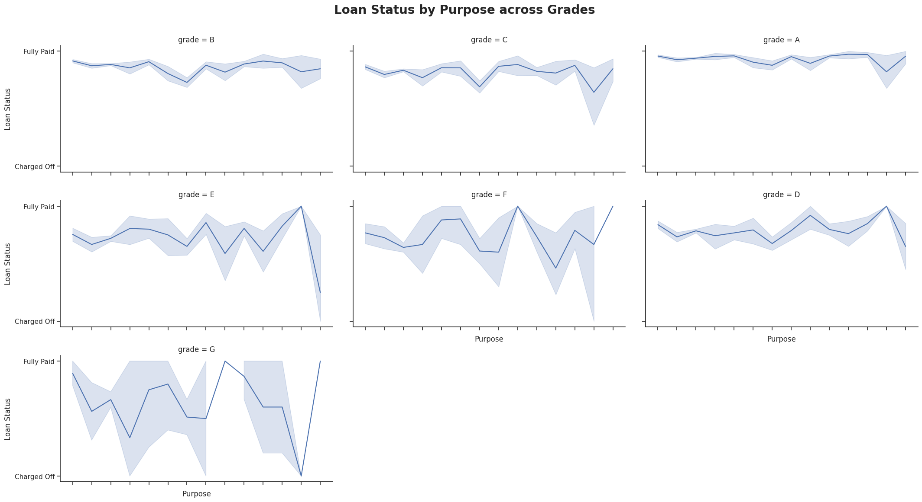
12. Segmented Analysis: Purpose × Grade
• Segmenting by loan purpose gives a more detailed view of risk.
• The notebook notes that debt-consolidation loans generally show high default rates across categories.
• This suggests that default risk should be evaluated using combinations of variables.

Slide 14
13. Key EDA Findings
• Loan grade shows a clear increase in default rate from A toward G.
• 60-month loans default more than 36-month loans.
• Small-business loans have the highest default rate among the highlighted purposes.
• Higher interest rates are associated with higher default rates.
• Higher DTI is associated with higher default risk.
• Lower annual income is associated with higher default rates.
• Home ownership and employment length are comparatively weaker discriminators.
• The overall default rate is 14.58%.

Slide 15
Conclusion
The EDA shows that Lending Club default risk is strongly associated with several loan and applicant characteristics. Grade, interest rate, DTI, income, loan purpose and term provide useful signals for understanding default patterns.
The analysis can be extended into predictive modelling after selecting appropriate application-time variables.
Lending Club EDA • Post Assignment • 16

Slide 16
Thank You

